Slide 1
DECS Auto Grader server
Ratnesh Patel - 23M0784
Kumaran Karthikeyan - 23M0803

Slide 2
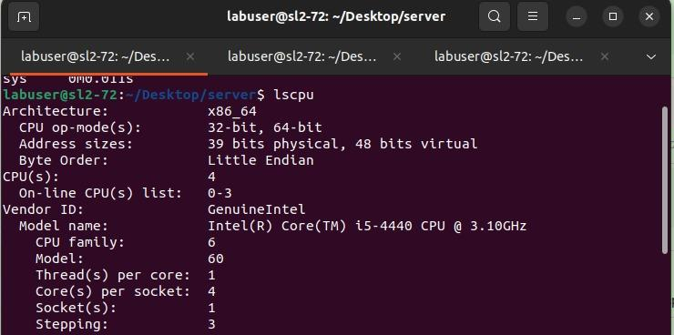
Experiment’s configuration

Slide 3
Metrics checked
Throughput = Number of requests in one second
Response time = Time taken for a request to be serviced
Goodput = Successful requests in one second

Slide 4
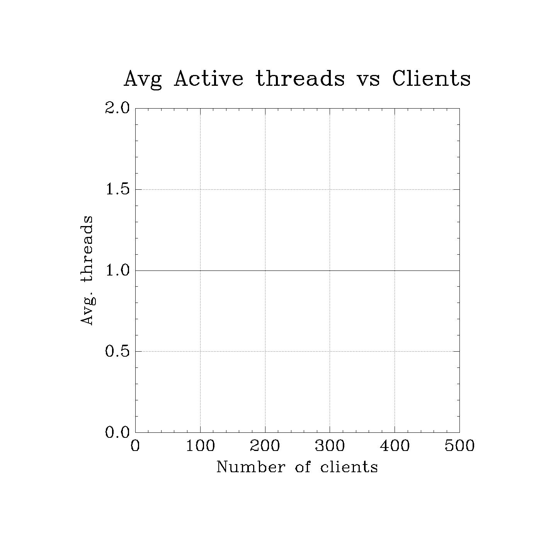
Performance metrics : version - 1

Slide 5
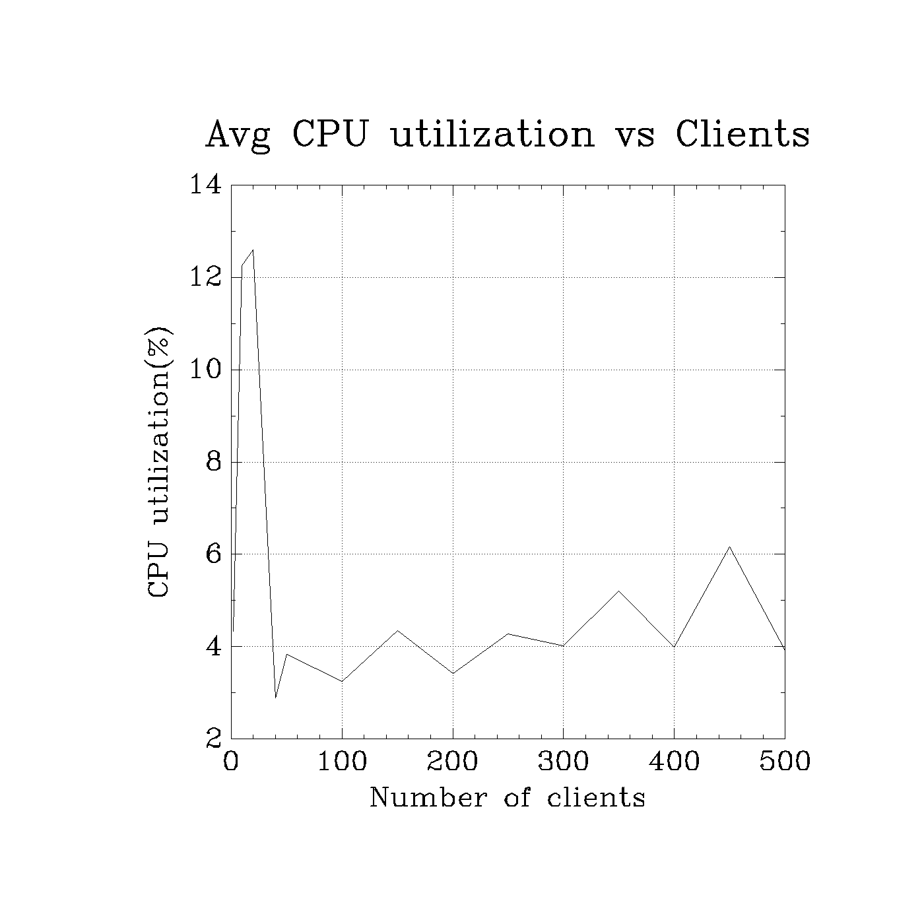
Performance metrics : version - 1

Slide 6
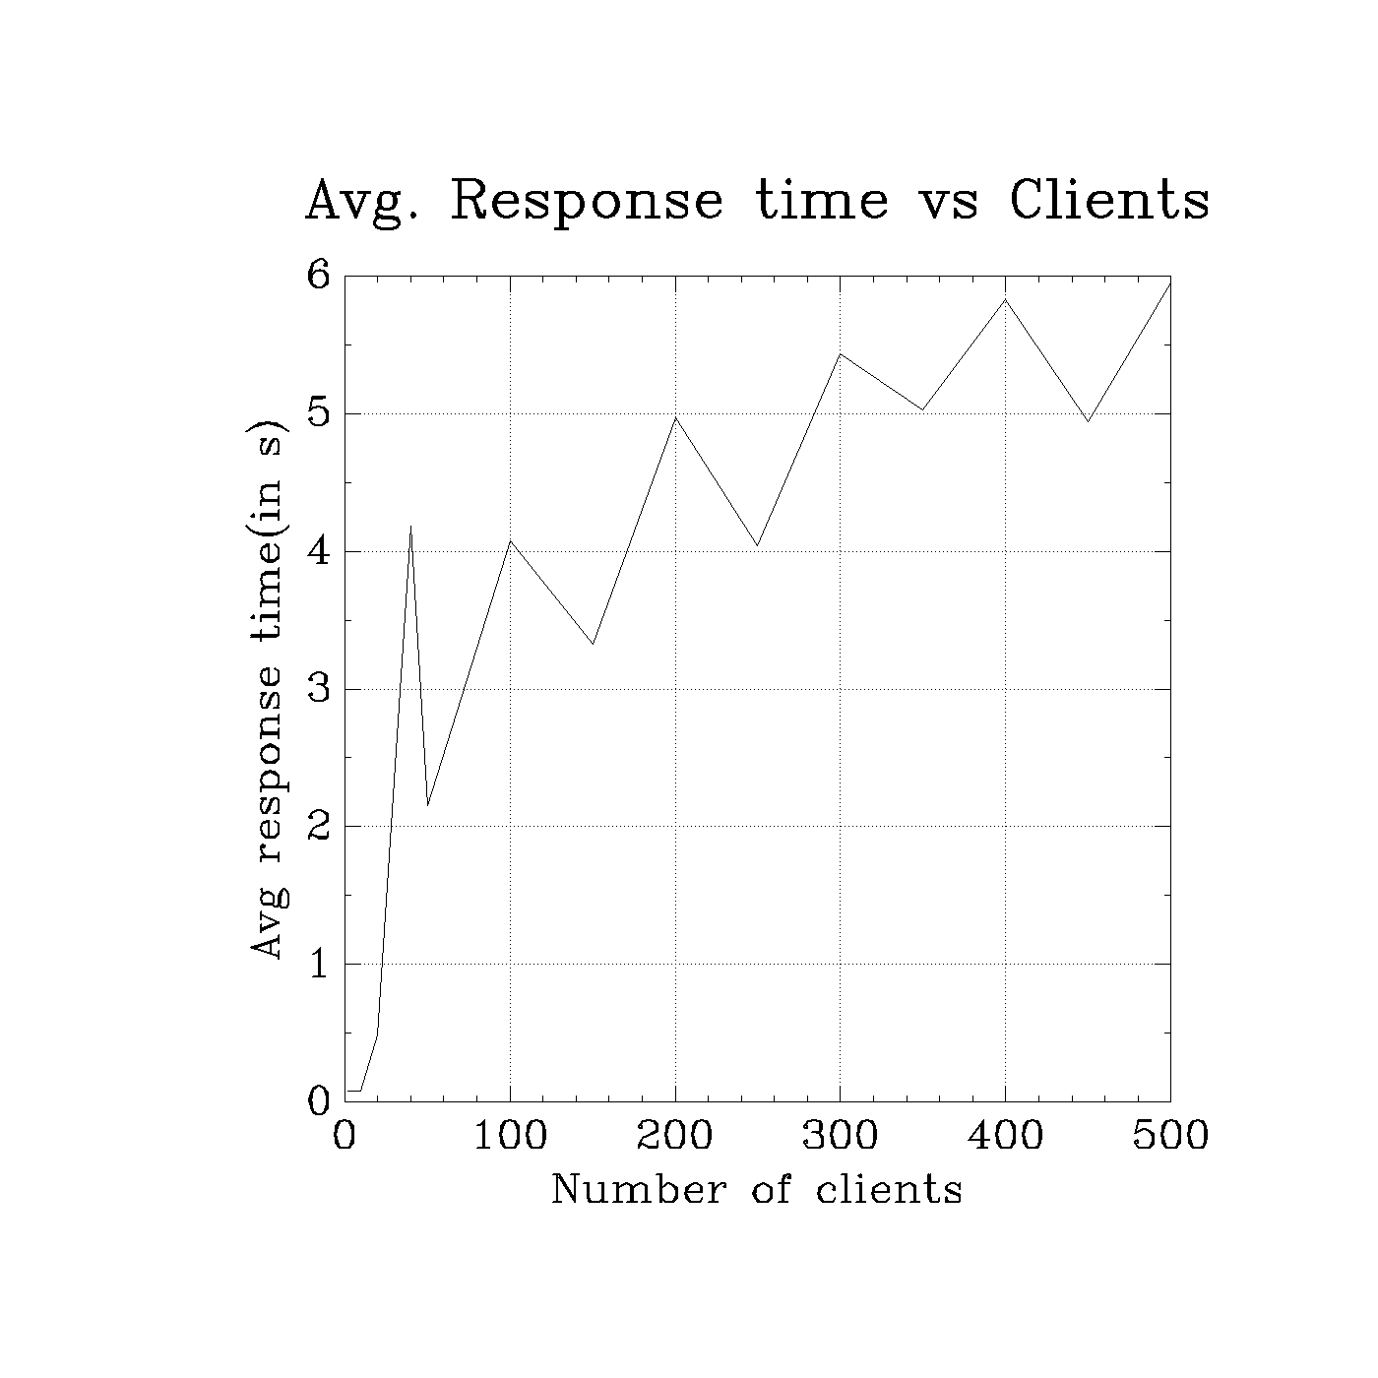
Performance metrics : version - 1

Slide 7
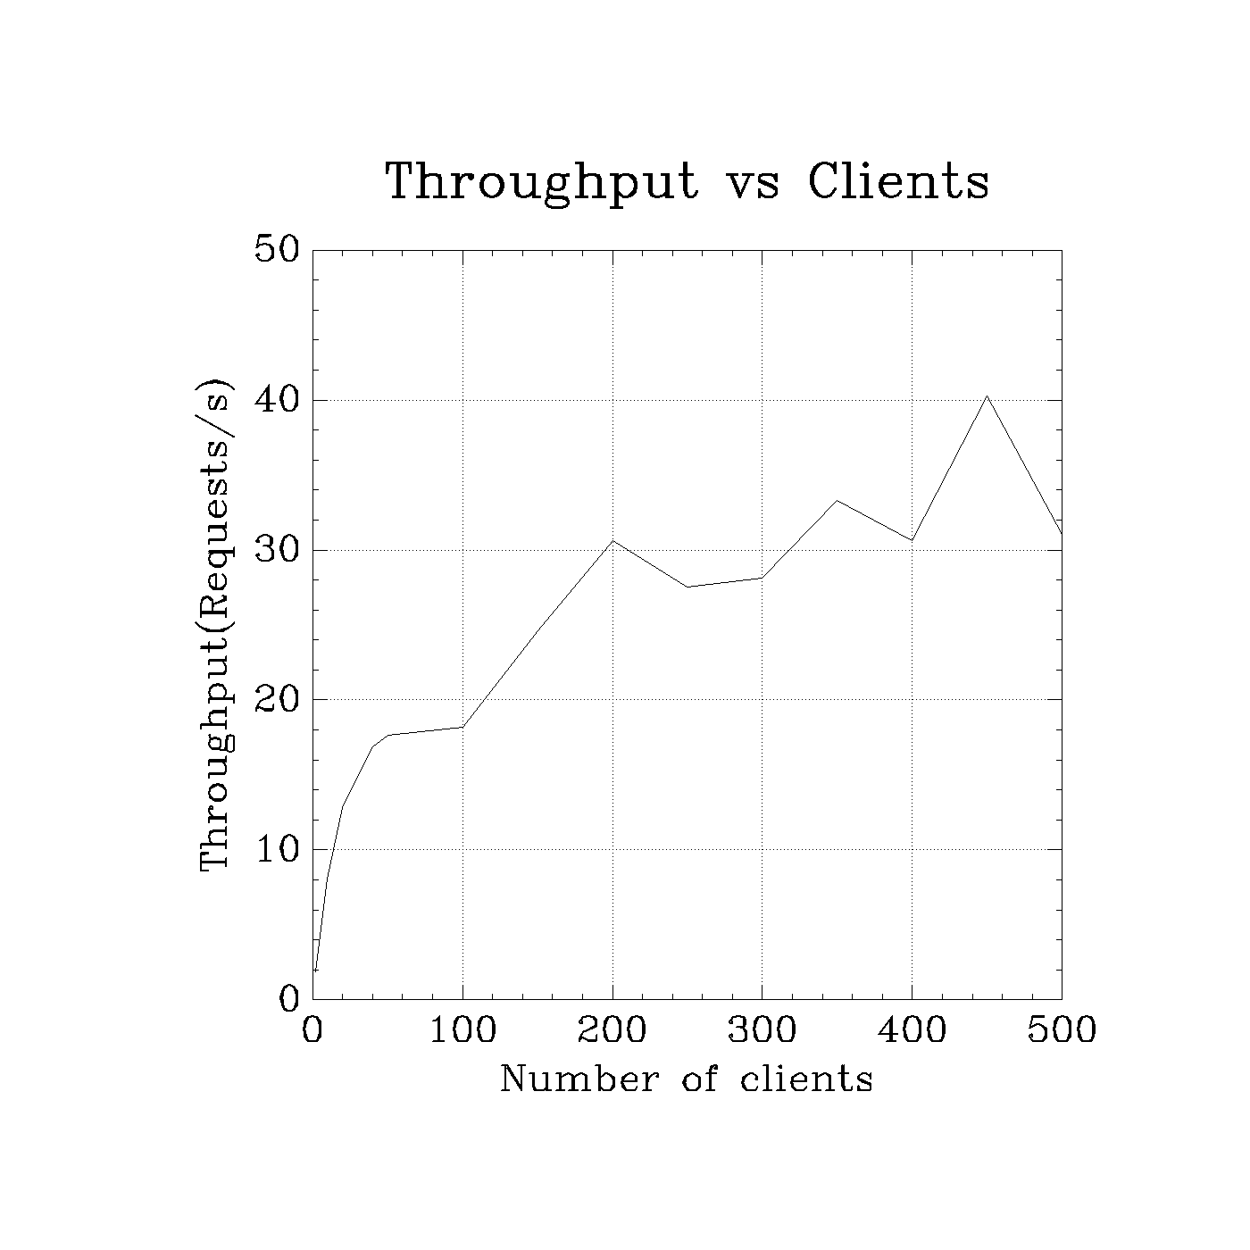
Performance metrics : version - 1

Slide 8
Observation
Average active threads is 1 since it is a single threaded server
We are not using the CPU to the maximum capability since it is a single threaded server
Throughput increases and tries to get constant because CPU reaches saturation stage, and it won’t be able to serve

Slide 9
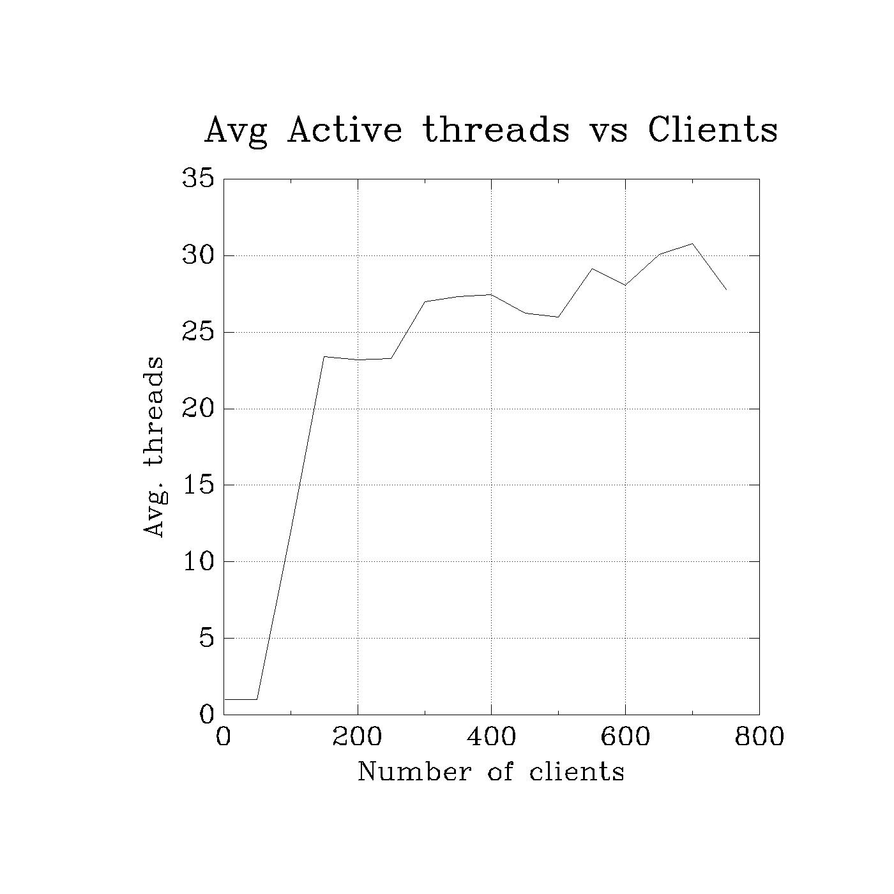
Performance metrics : version - 2

Slide 10
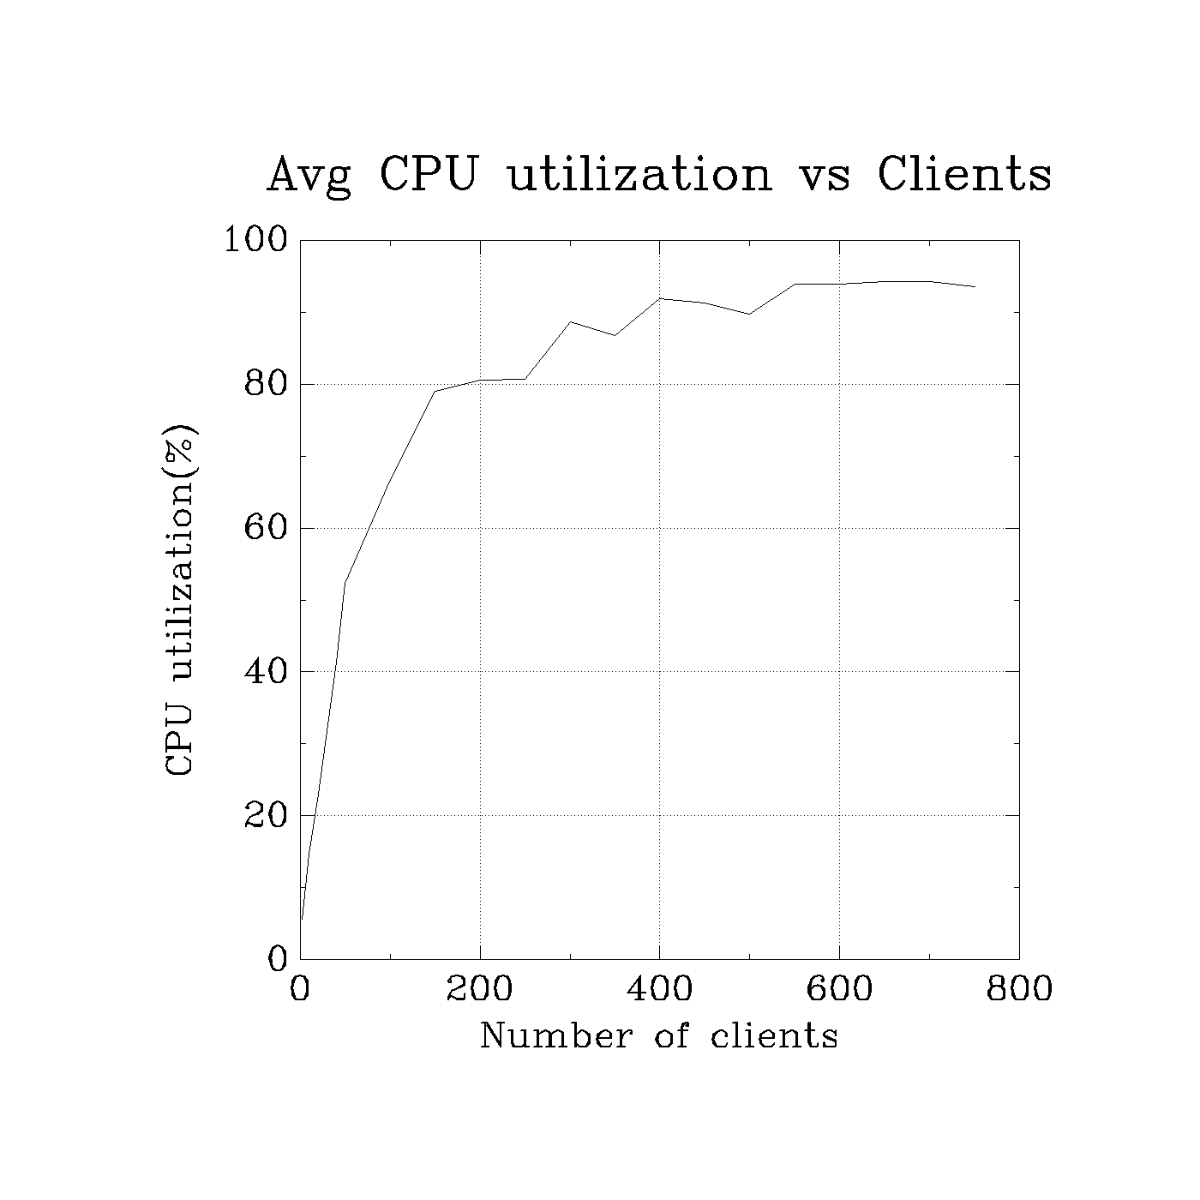
Performance metrics : version - 2

Slide 11
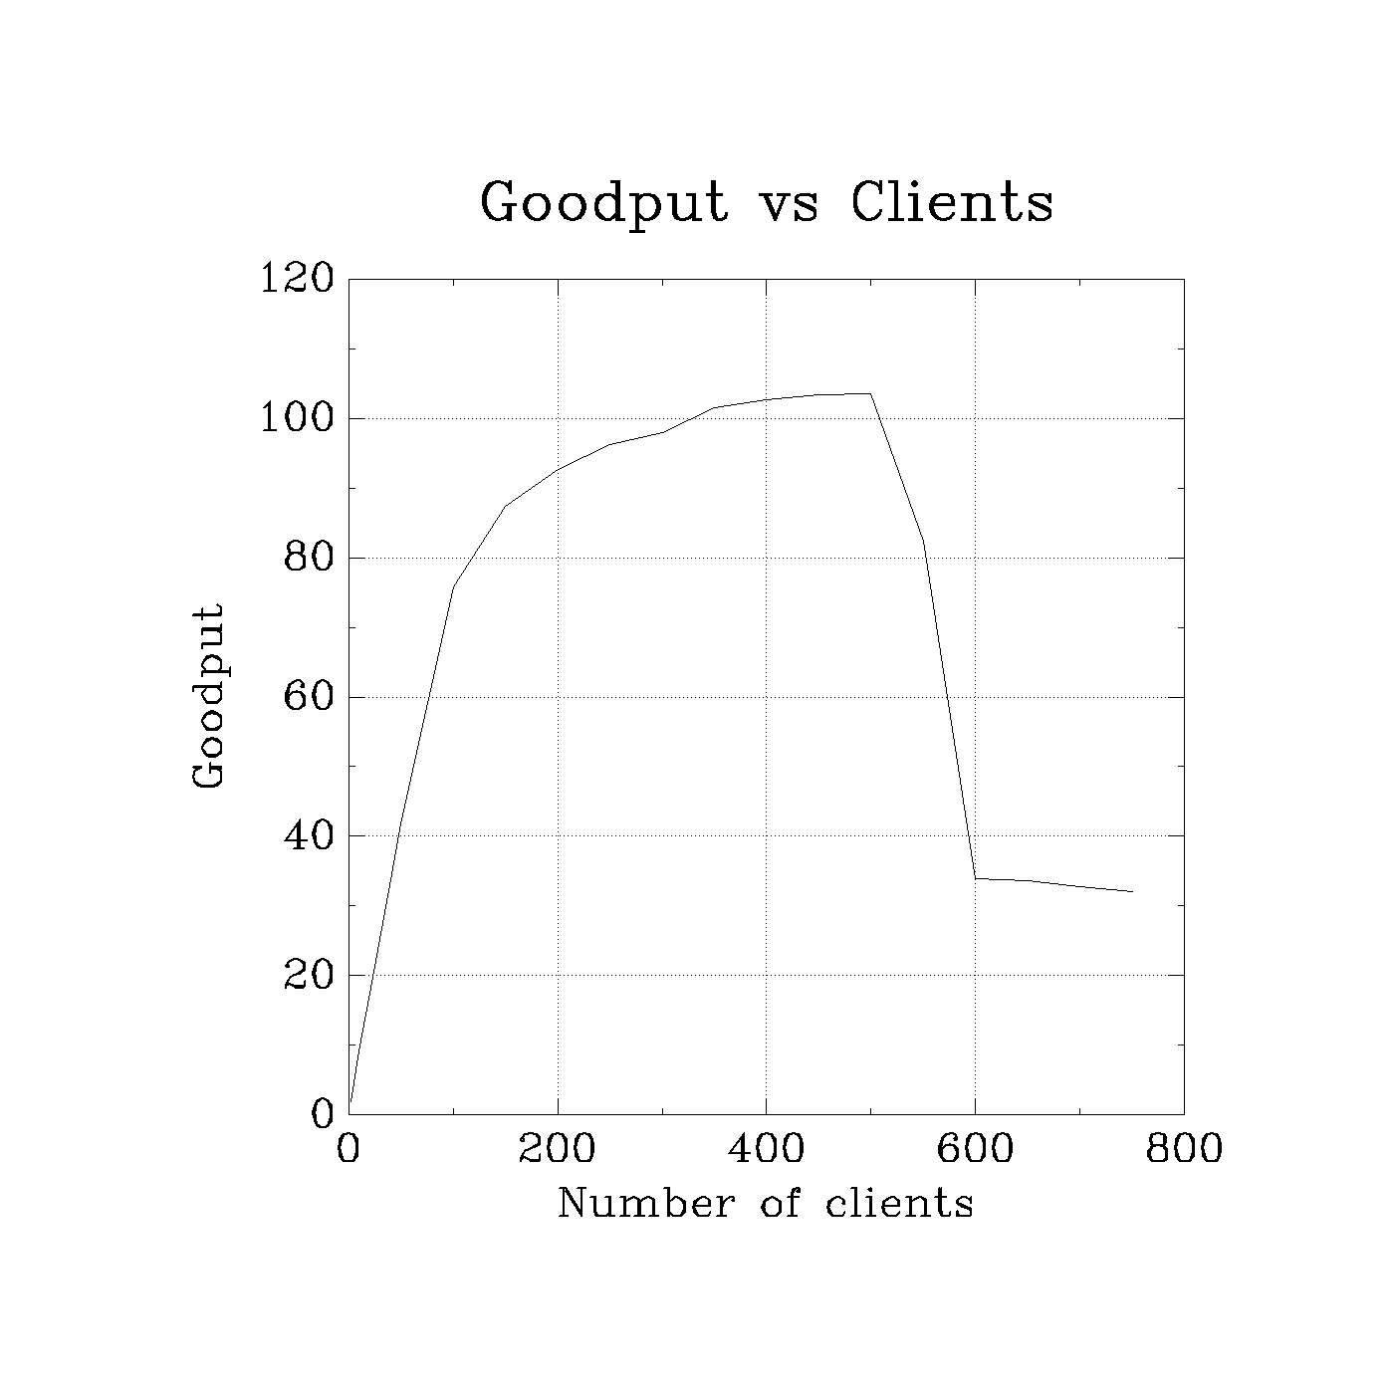
Performance metrics : version - 2

Slide 12
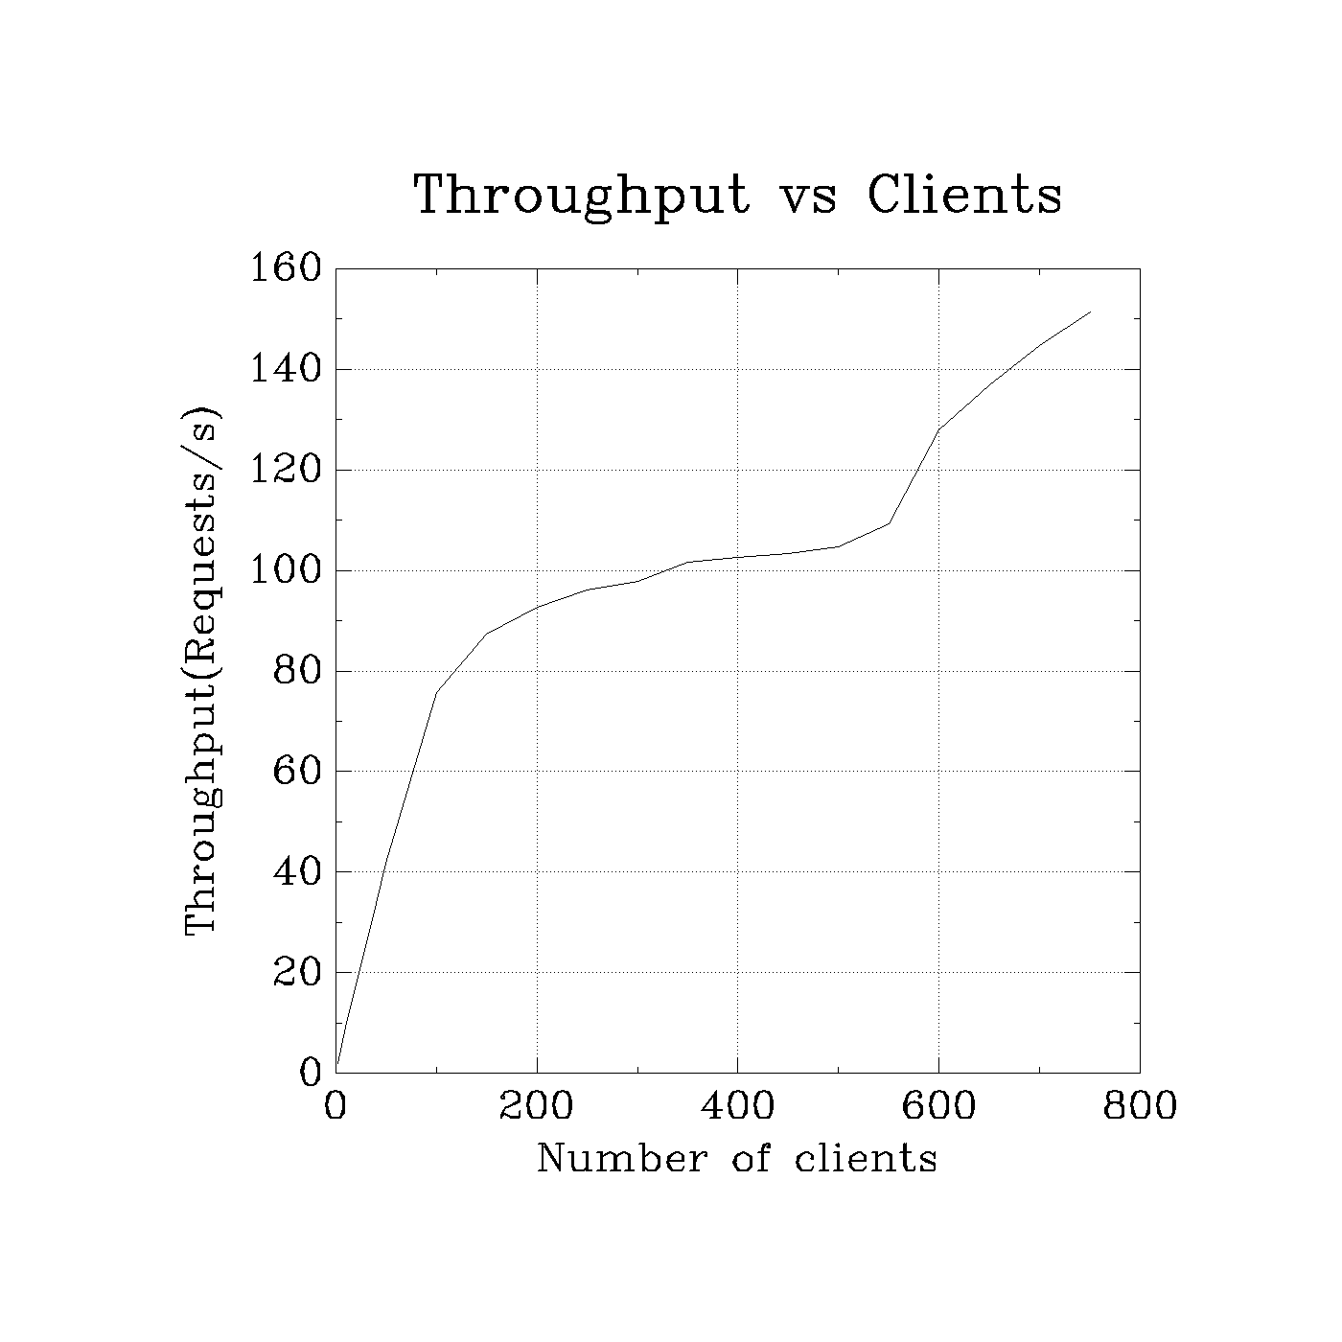
Performance metrics : version - 2

Slide 13
Observation
Timeout occurs and goodput decreases since after saturation since the requests gets failed.
Timeout occurs and throughput increases since we are just getting the error immediately and the response is sent back to the client immediately

Slide 14
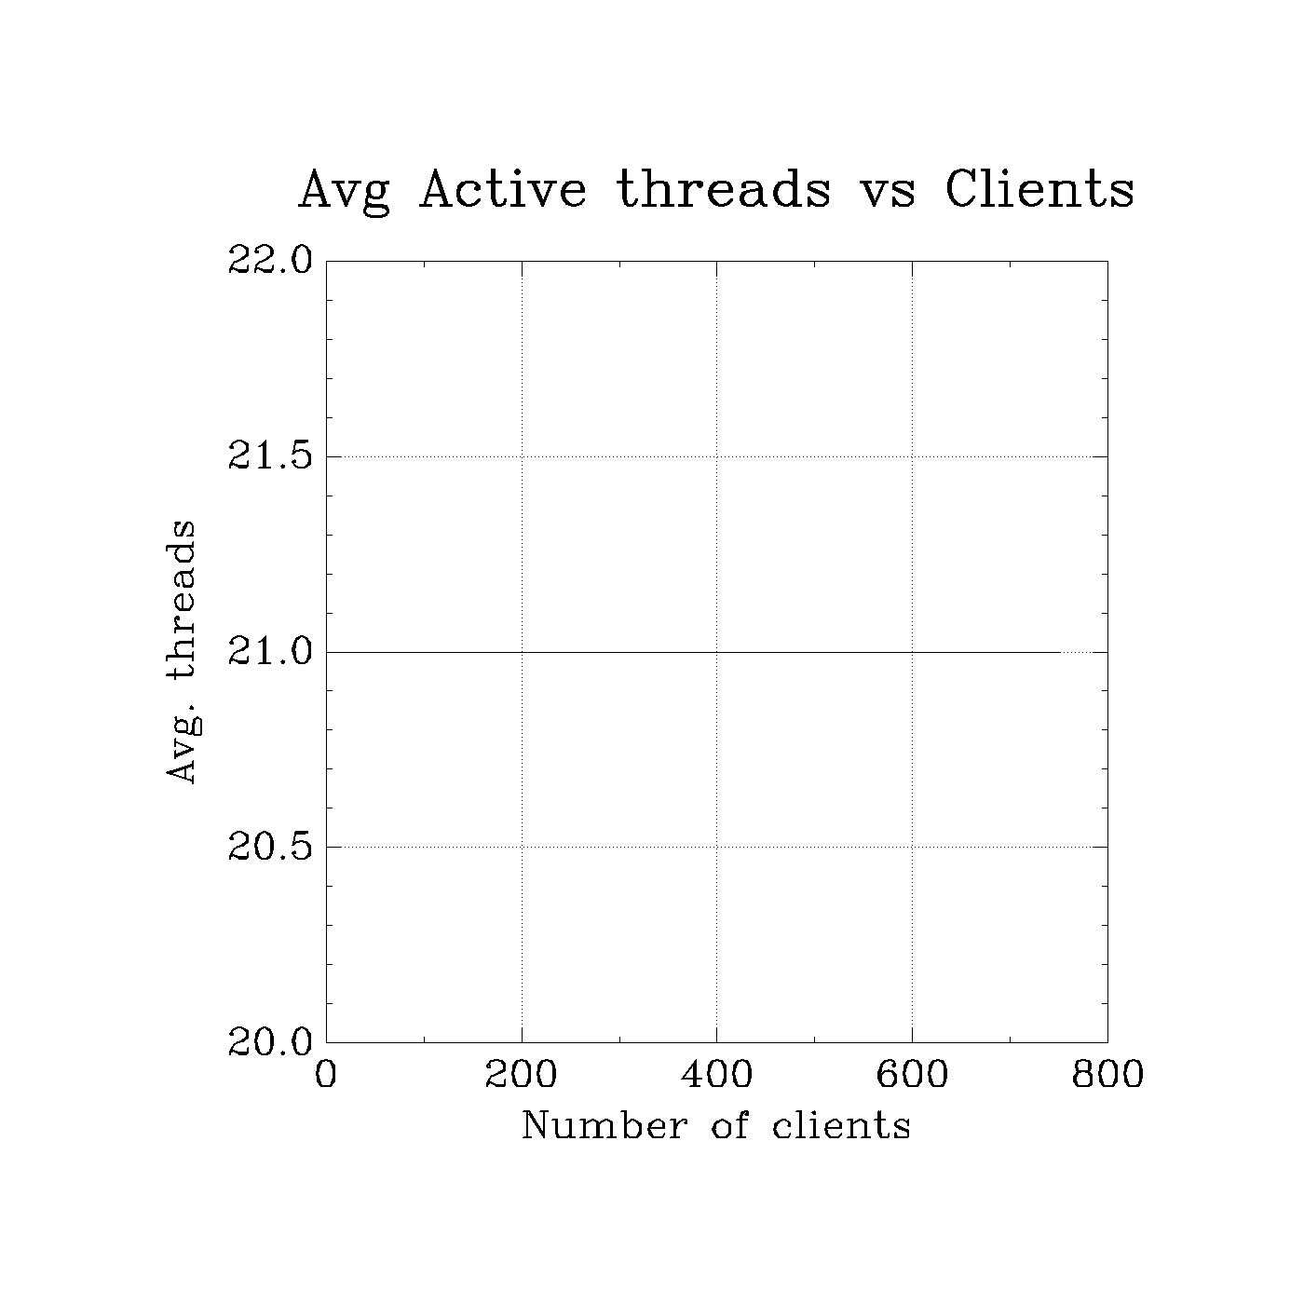
Performance metrics : version - 3

Slide 15

Performance metrics : version - 3

Slide 16

Performance metrics : version - 3

Slide 17

Performance metrics : version - 3

Slide 18
Observation
Timeout occurs and goodput decreases since after saturation since the requests gets failed.
Timeout occurs and throughput increases since we are just getting the error immediately and the response is sent back to the client immediately

Slide 19
Design of asynchronous server - Version 4
Client :
When we want to send file or when we want to check the status, we send 0 or 1 respectively, to let the server know beforehand what type of request it’s going to get.
Server:
When the server sends 0, client should be ready to receive the position.
When the server sends 1, file is not found. Client will print the message.
When the server sends 2, the request is processed and the client should be ready to receive the results.
When the server sends 3, the file is being processed. Client will send the message.

