Slide 1
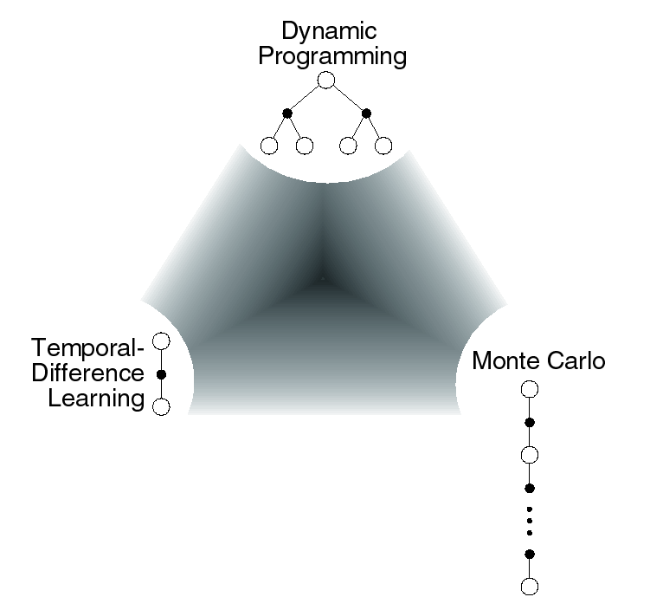
Chapter 7: Eligibility Traces

Slide 2
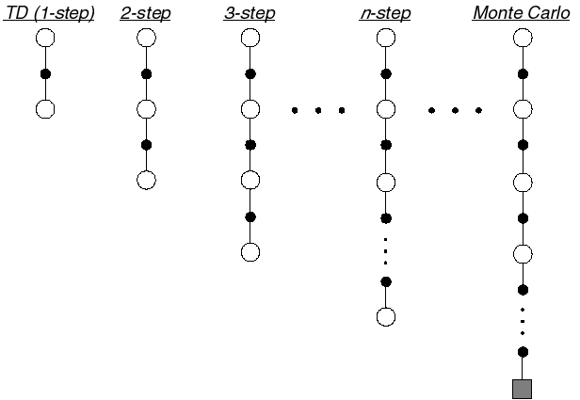
N-step TD Prediction
Idea: Look farther into the future when you do TD backup (1, 2, 3, …, n steps)

Slide 3



Mathematics of N-step TD Prediction
Monte Carlo:
TD:
  Use V to estimate remaining return
n-step TD:
  2 step return:
  n-step return:

Slide 4
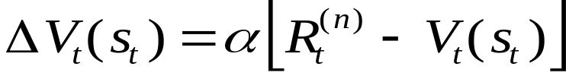
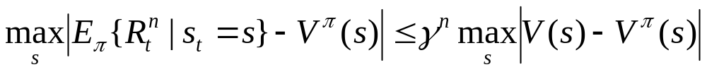
Learning with N-step Backups
Backup (on-line or off-line):
Error reduction property of n-step returns
Using this, you can show that n-step methods converge
n step return
Maximum error using n-step return
Maximum error using V

Slide 5

Random Walk Examples
How does 2-step TD work here?
How about 3-step TD?

Slide 6
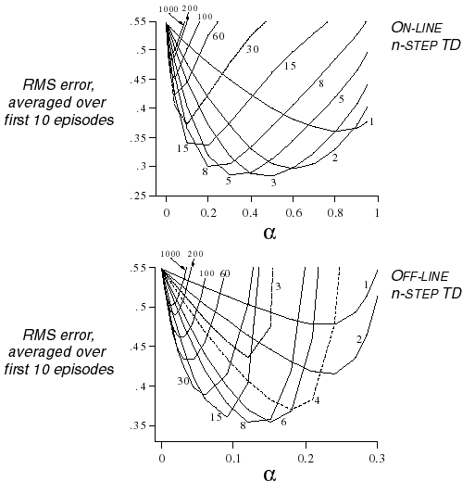
A Larger Example
Task: 19 state random walk
Do you think there is an optimal n (for everything)?

Slide 7
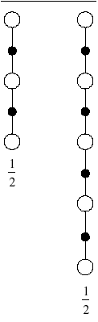
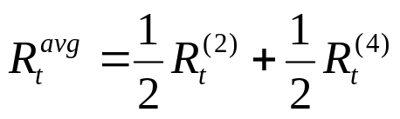
Averaging N-step Returns
n-step methods were introduced to help with TD(λ) understanding
Idea: backup an average of several returns
  e.g. backup half of 2-step and half of 4-step
Called a complex backup
  Draw each component
  Label with the weights for that component
One backup

Slide 8
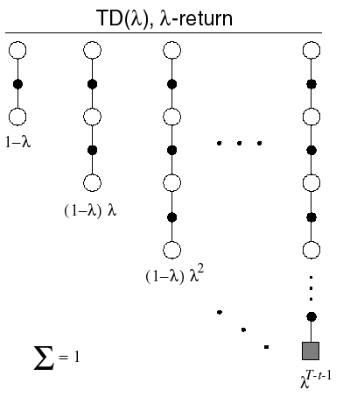
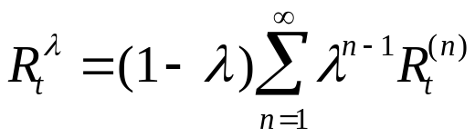
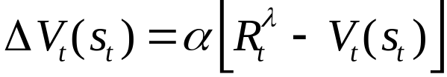
Forward View of TD(λ)
TD(λ) is a method for averaging all n-step backups
  weight by λ^{n-1} (time since visitation)
  λ-return:
Backup using λ-return:

Slide 9
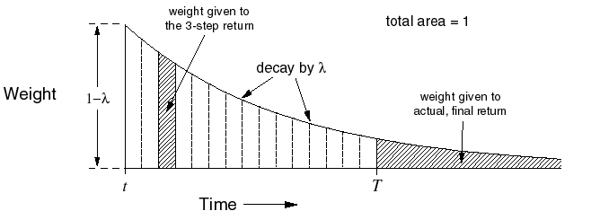
λ-return Weighting Function

Slide 10
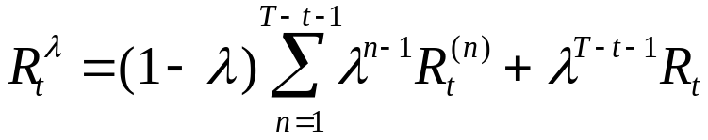
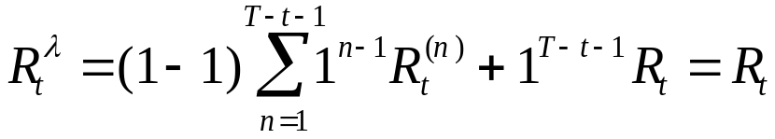
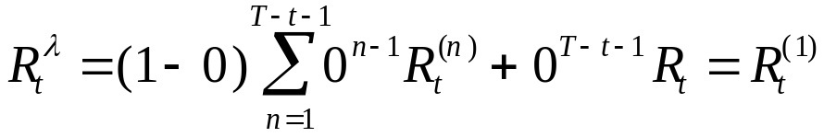
Relation to TD(0) and MC
λ-return can be rewritten as:
If λ = 1, you get MC:
If λ = 0, you get TD(0)
Until termination
After termination

Slide 11
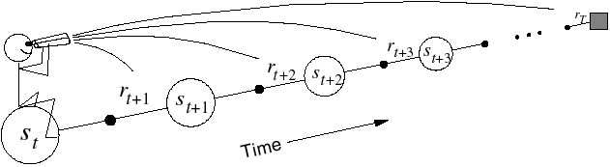
Forward View of TD(λ) II
Look forward from each state to determine update from future states and rewards:

Slide 12
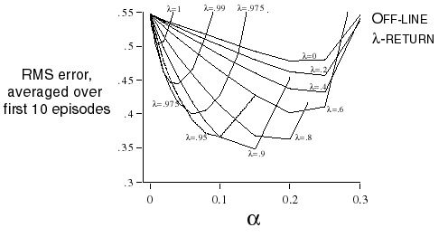
λ-return on the Random Walk
Same 19 state random walk as before
Why do you think intermediate values of λ are best?

Slide 13
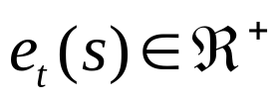
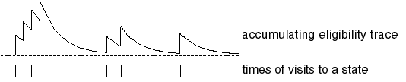
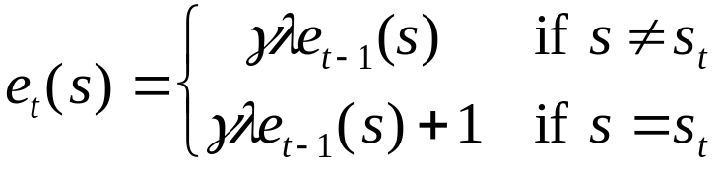
Backward View of TD(λ)
The forward view was for theory
The backward view is for mechanism
New variable called eligibility trace
  On each step, decay all traces by γλ and increment the trace for the current state by 1
  Accumulating trace

Slide 14
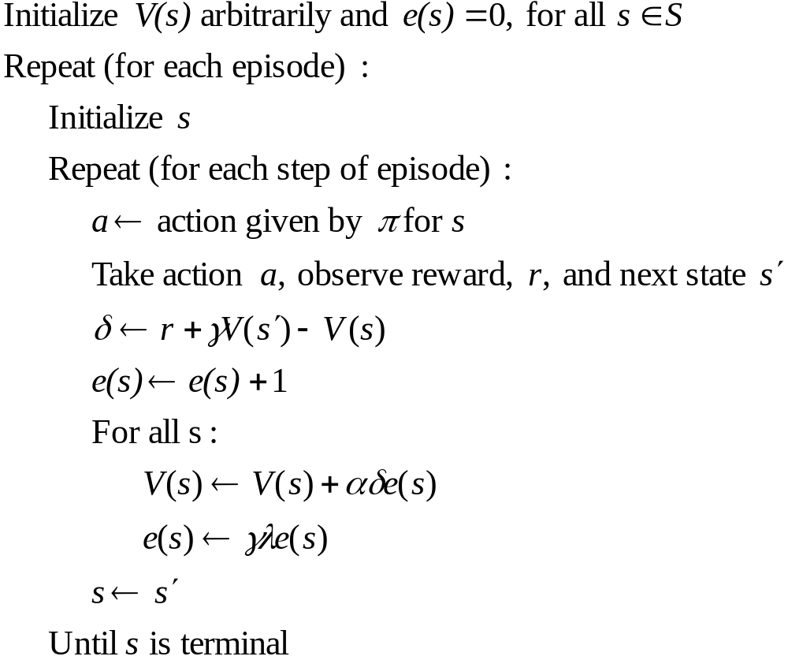
On-line Tabular TD(λ)

Slide 15
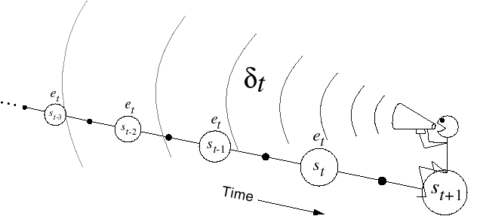

Backward View
Shout δ_{t} backwards over time
The strength of your voice decreases with temporal distance by γλ

Slide 16

Relation of Backwards View to MC & TD(0)
Using update rule:
As before, if you set λ to 0, you get to TD(0)
If you set λ to 1, you get MC but in a better way
  Can apply TD(1) to continuing tasks
  Works incrementally and on-line (instead of waiting to the end of the episode)

Slide 17
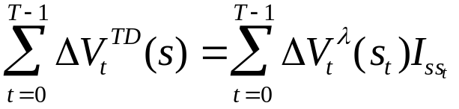
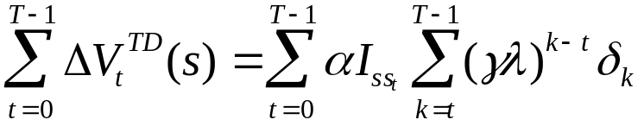
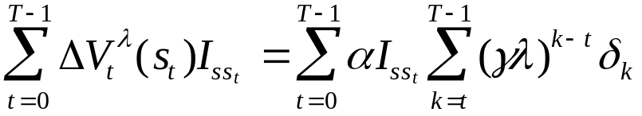
Forward View = Backward View
The forward (theoretical) view of TD(λ) is equivalent to the backward (mechanistic) view for off-line updating
The book shows:
On-line updating with small α is similar
Backward updates
Forward updates
algebra shown in book

Slide 18
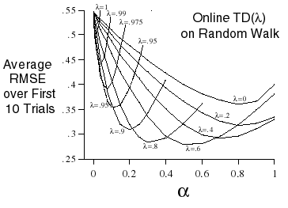
On-line versus Off-line on Random Walk
Same 19 state random walk
On-line performs better over a broader range of parameters

Slide 19
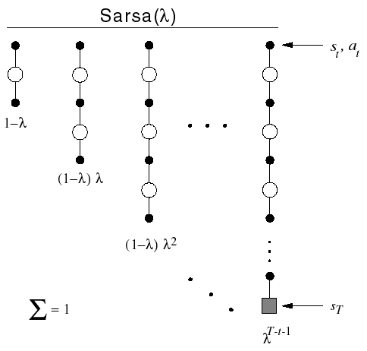
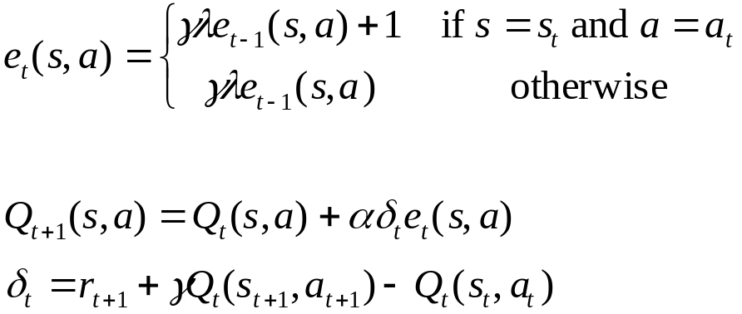
Control: Sarsa(λ)
Save eligibility for state-action pairs instead of just states

Slide 20
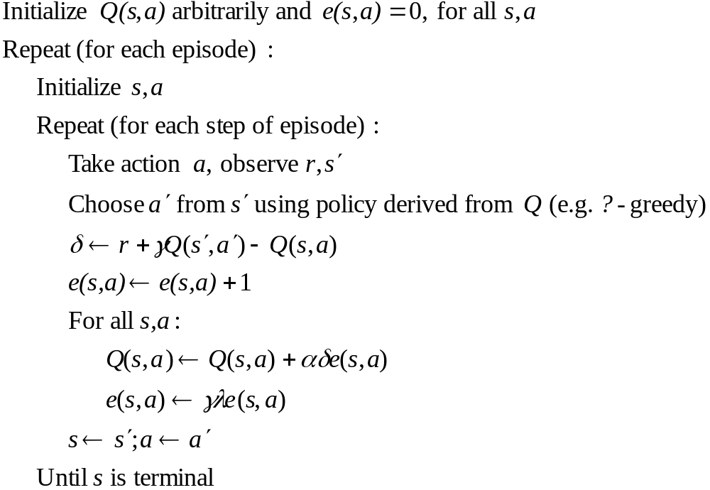
Sarsa(λ) Algorithm

Slide 21
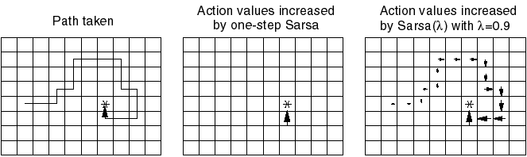
Sarsa(λ) Gridworld Example
With one trial, the agent has much more information about how to get to the goal
  not necessarily the best way
Can considerably accelerate learning

Slide 22

Sarsa(λ) Reluctant Walk Example
N states and two types of action right and wrong
When a wrong action, no reward and state not changed
Right action moves towards the goal
Reward +1 received when the terminal state reached
Consider Sarsa(lambda) with eligibility traces

Slide 23
Sarsa(λ) Reluctant Walk Example
% Example 7.7
% reluctant walk - choosing right action moves you towards the goal
% states are numbered from 1 to number_states
clear all;
close all;
lambda=0.9;
alpha=0.05;
gamma=0.95;
% rewards
number_states=15;
number_actions=2;
number_runs=50;
r=zeros(2,number_states);
% first row are the right actions
r(1,number_states)=1;
% change alpha
jjj=0;
alpha_range=0.05:0.05:0.4;
for alpha=alpha_range
jjj=jjj+1;
all_episodes=[];
for kk=1:number_runs
S_prime(1,:)=(1:number_states);
S_prime(2,:)=(1:number_states);
% generate a right action sequence
right_action=(rand(1,number_states)>0.5)+1;
% next state for the right action
for i=1:number_states
S_prime(right_action(i),i)=i+1;
end
% eligibility traces
e=zeros(number_actions,number_states+1);
Qsa=rand(number_actions,number_states);
Qsa(:,number_states+1)=0;
num_episodes=10;
t=1;
% repeat for each episode
for episode=1:num_episodes
epsi=1/t;
% initialize state
s=1;

Slide 24
Sarsa(λ) Reluctant Walk Example
% chose action a from s using epsilon greedy policy
chose_policy=rand>epsi;
if chose_policy
[val,a]=max(Qsa(:,s));
else
a=ceil(rand*(1-eps)*number_actions);
end;
% repeat for each step of episode
episode_size(episode)=0;
path=[];
random=[];
while s~=number_states+1
epsi=1/t;
% take action a, observe r, s_pr
s_pr=S_prime(a,s);
% chose action a_pr from s_pr using epsilon greedy policy
chose_policy_pr=rand>epsi;
[val,a_star]=max(Qsa(:,s_pr));
if chose_policy_pr
random=[random 0];
a_pr=a_star;
else
a_pr=ceil(rand*(1-eps)*number_actions);
random=[random 1];
end;
% reward
if s_pr==number_states+1
r=1;
else
r=0;
end;
delta=r+gamma*Qsa(a_pr,s_pr)-Qsa(a,s);
% eligibility traces
e(a,s)=e(a,s)+1;
% Sarasa lambda algorithm
Qsa=Qsa+alpha*delta*e;
e=gamma*lambda*e;
s=s_pr;
a=a_pr;
episode_size(episode)=episode_size(episode)+1;
path=[path s];
t=t+1;
end; %while s
end;

Slide 25
Sarsa(λ) Reluctant Walk Example
all_episodes=[all_episodes; episode_size];
end; % kk
last_episode=cumsum(mean(all_episodes));
all_episode_size(jjj)=last_episode(num_episodes);
end; % alpha
episode_size=mean(all_episodes);
plot([0 cumsum(episode_size)],(0:num_episodes));
xlabel('Time step');
ylabel('Episode index');
title('Eligibility traces-SARSA random walk 15 states learning rate with eps=1/t, lambda=0.9');
figure(2)
plot(alpha_range, (all_episode_size));
xlabel('Alpha');
ylabel('Number of steps for 10 episodes');
title('Eligibility traces-SARSA random walk 15 states learning rate with eps=1/t, lambda=0.9');
figure(3)
plot( episode_size(1:num_episodes))
xlabel('Episode index');
ylabel('Episode length in steps');
title('Eligibility traces-SARSA random walk 15 states learning rate with eps=1/t, lambda=0.9');

Slide 26
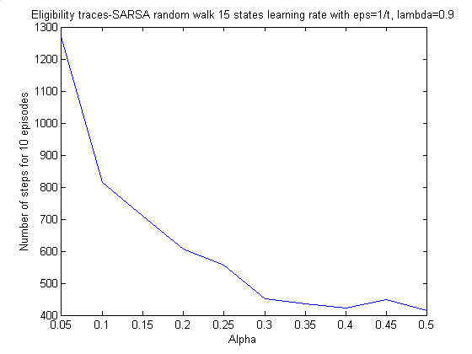
Sarsa(λ) Reluctant Walk Example
Eligibility traces with alpha> 0.5 is unstable

Slide 27
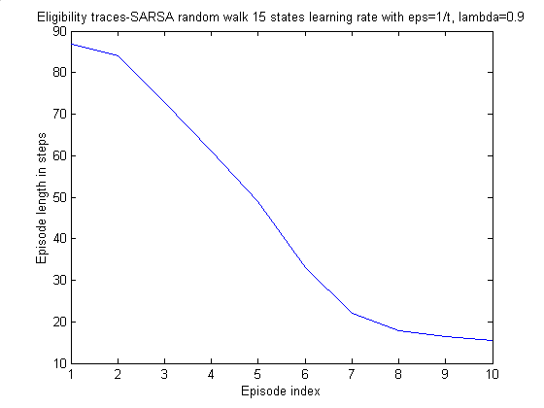
Sarsa(λ) Reluctant Walk Example
Learning rate in eligibility traces, alpha=0.4

Slide 28
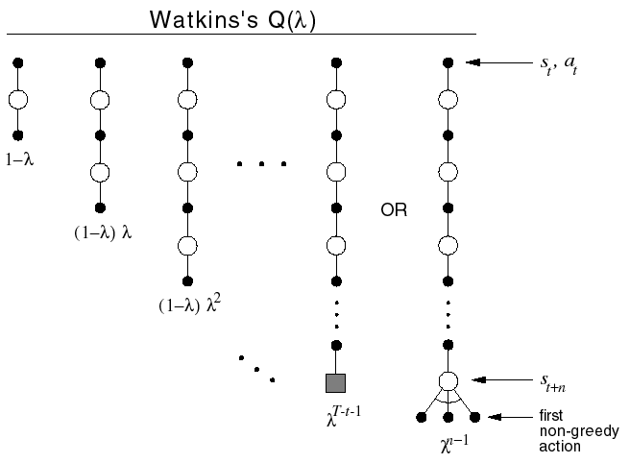
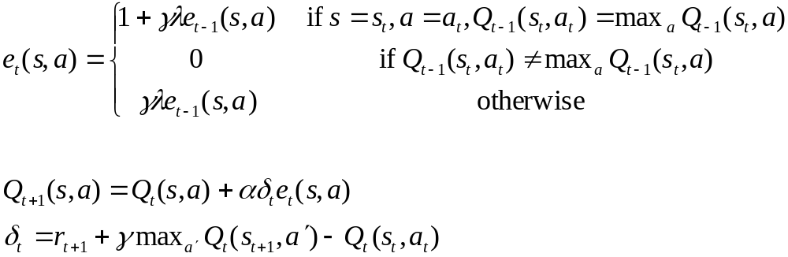
Three Approaches to Q(λ)
How can we extend this to Q-learning?
If you mark every state action pair as eligible, you backup over non-greedy policy
  Watkins: Zero out eligibility trace after a non-greedy action. Do max when backing up at first non-greedy choice.

Slide 29
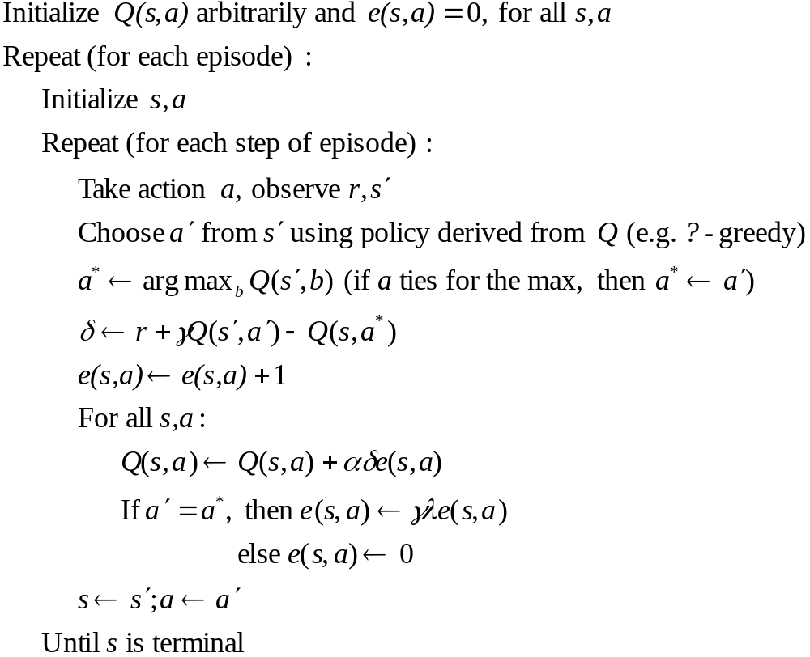
Watkins’s Q(λ)

Slide 30
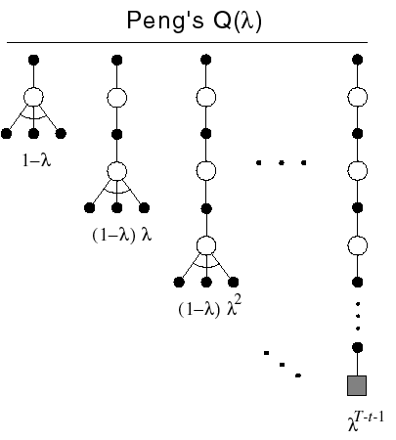
Peng’s Q(λ)
Disadvantage to Watkins’s method:
  Early in learning, the eligibility trace will be “cut” (zeroed out) frequently resulting in little advantage to traces
Peng:
  Backup max action except at end
  Never cut traces
Disadvantage:
  Complicated to implement

Slide 31
Naïve Q(λ)
Idea: is it really a problem to backup exploratory actions?
  Never zero traces
  Always backup max at current action (unlike Peng or Watkins’s)
Is this truly naïve?
Works well is preliminary empirical studies
What is the backup diagram?

Slide 32
Comparison Task
Compared Watkins’s, Peng’s, and Naïve (called McGovern’s here) Q(λ) on several tasks.
  See McGovern and Sutton (1997). Towards a Better Q(λ) for other tasks and results (stochastic tasks, continuing tasks, etc)
Deterministic gridworld with obstacles
  10x10 gridworld
  25 randomly generated obstacles
  30 runs
  α = 0.05, γ = 0.9, λ = 0.9, ε = 0.05, accumulating traces
From McGovern and Sutton (1997). Towards a better Q(λ)

Slide 33
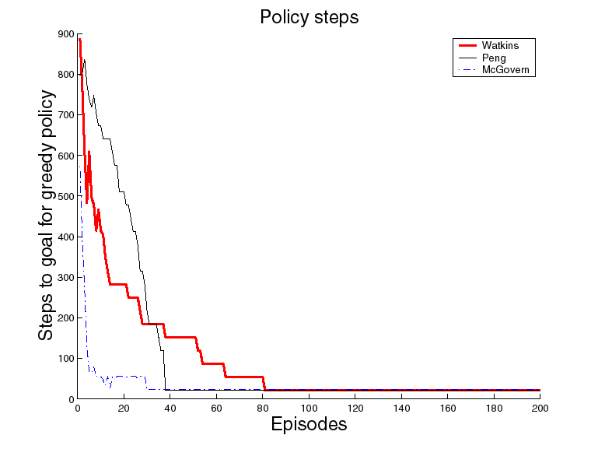
Comparison Results
From McGovern and Sutton (1997). Towards a better Q(λ)

Slide 34
Convergence of the Q(λ)’s
None of the methods are proven to converge.
  Much extra credit if you can prove any of them.
Watkins’s is thought to converge to Q*
Peng’s is thought to converge to a mixture of Q^{π} and Q*
Naïve - Q*?

Slide 35
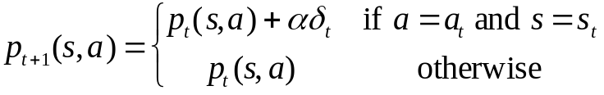

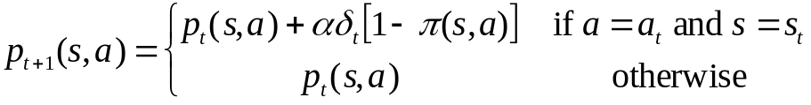
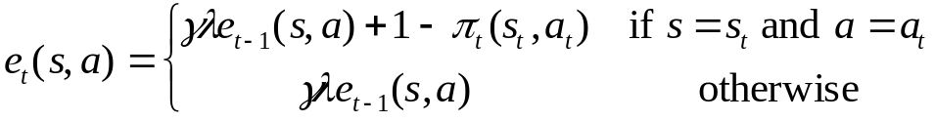
Eligibility Traces for Actor-Critic Methods
Critic: On-policy learning of V^{π}. Use TD(λ) as described before.
Actor: Needs eligibility traces for each state-action pair.
We change the update equation:
Can change the other actor-critic update:
to
to
where

Slide 36
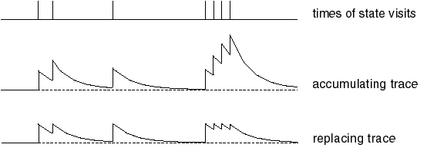
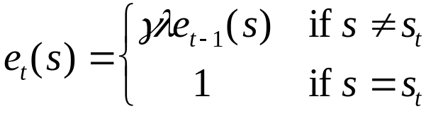
Replacing Traces
Using accumulating traces, frequently visited states can have eligibilities greater than 1
  This can be a problem for convergence
Replacing traces: Instead of adding 1 when you visit a state, set that trace to 1

Slide 37
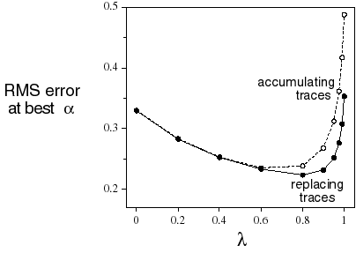
Replacing Traces Example
Same 19 state random walk task as before
Replacing traces perform better than accumulating traces over more values of λ

Slide 38
Why Replacing Traces?
Replacing traces can significantly speed learning
They can make the system perform well for a broader set of parameters
Accumulating traces can do poorly on certain types of tasks
Why is this task particularly onerous for accumulating traces?

Slide 39
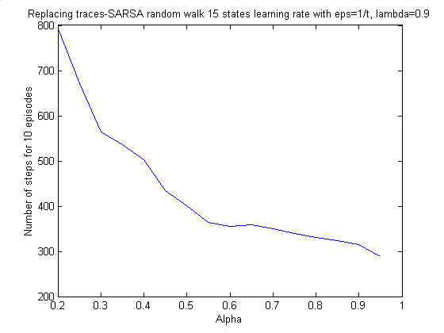
Sarsa(λ) Reluctant Walk Example
Replacing traces
delta=r+gamma*Qsa(a_pr,s_pr)-Qsa(a,s);
% replacing traces
% e(:,s)=0;
e(a,s)=1;
% Sarasa lambda algorithm
Qsa=Qsa+alpha*delta*e;
e=gamma*lambda*e;

Slide 40
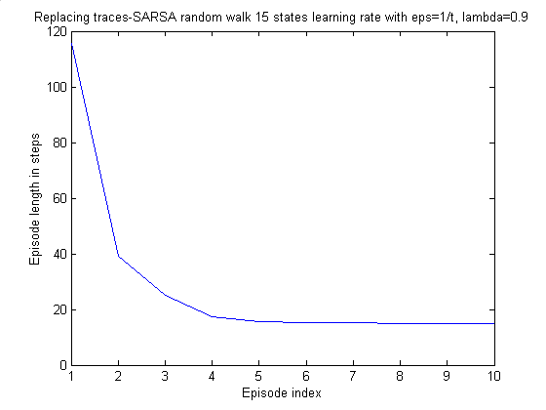
Sarsa(λ) Reluctant Walk Example
Replacing traces

Slide 41
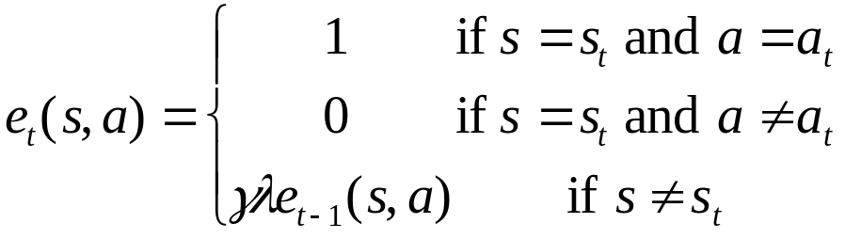
More Replacing Traces
Off-line replacing trace TD(1) is identical to first-visit MC
Extension to action-values:
  When you revisit a state, what should you do with the traces for the other actions?
  Singh and Sutton say to set them to zero:

Slide 42
Implementation Issues
Could require much more computation
  But most eligibility traces are VERY close to zero
If you implement it in Matlab, backup is only one line of code and is very fast (Matlab is optimized for matrices)

Slide 43
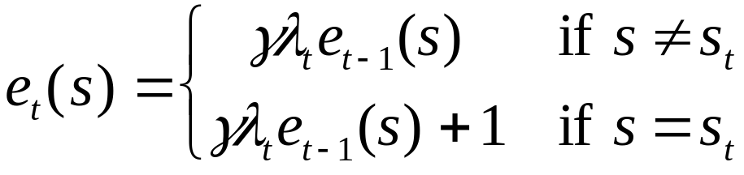
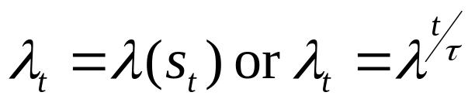
Variable λ
Can generalize to variable λ
Here λ is a function of time
  Could define

Slide 44
Conclusions
Provides efficient, incremental way to combine MC and TD
  Includes advantages of MC (can deal with lack of Markov property)
  Includes advantages of TD (using TD error, bootstrapping)
Can significantly speed learning
Does have a cost in computation

Slide 45
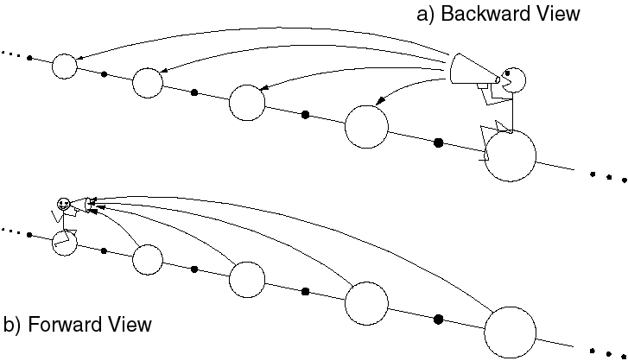
Something Here is Not Like the Other

