Slide 1
Pitch — Aufgabenblatt 3
Stephanus Park, 09.06.26 — Aufgabenblatt 3

Slide 2
Agenda
What I did to solve the tasks
Goals and Scope
Mapping / Planning
Obstacle Detection
Active Map Update
Replanning
Conclusion

Slide 3
Goals and Scope

Slide 4
Scope
What goals did the task sheet demand
Block A
Block B
Arena mapping
Path planning
LiDAR obstacle integration
Active map updating
Collision-avoiding navigation

Slide 5
Block A: Mapping / Planning

Slide 6
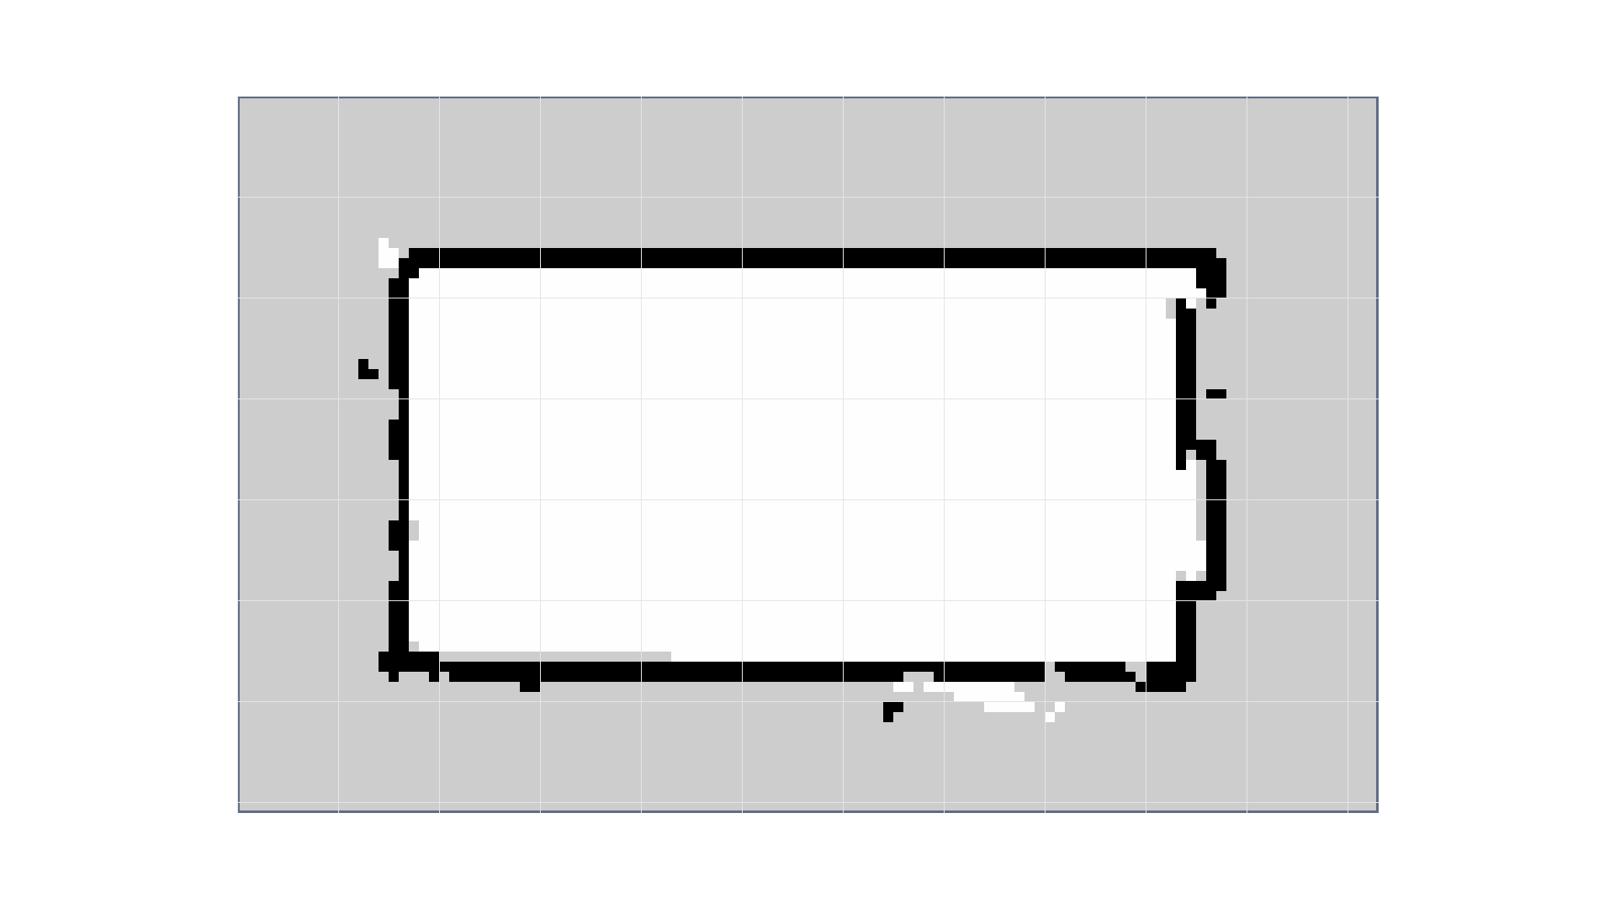
Initial problem
A map is not yet a planning map
maps/aufgabe03/arena_1p898x3p9_auto.yaml
Notes:
This is the stationary map created from SLAM.
At this stage it is only a saved ROS occupancy map file, not yet something my own planner can directly use.
The important implementation step was to treat the SLAM map as fixed input:
I read arena_1p898x3p9_auto.yaml,
keep the saved map unchanged, and
build the planning representation from it.

Slide 7
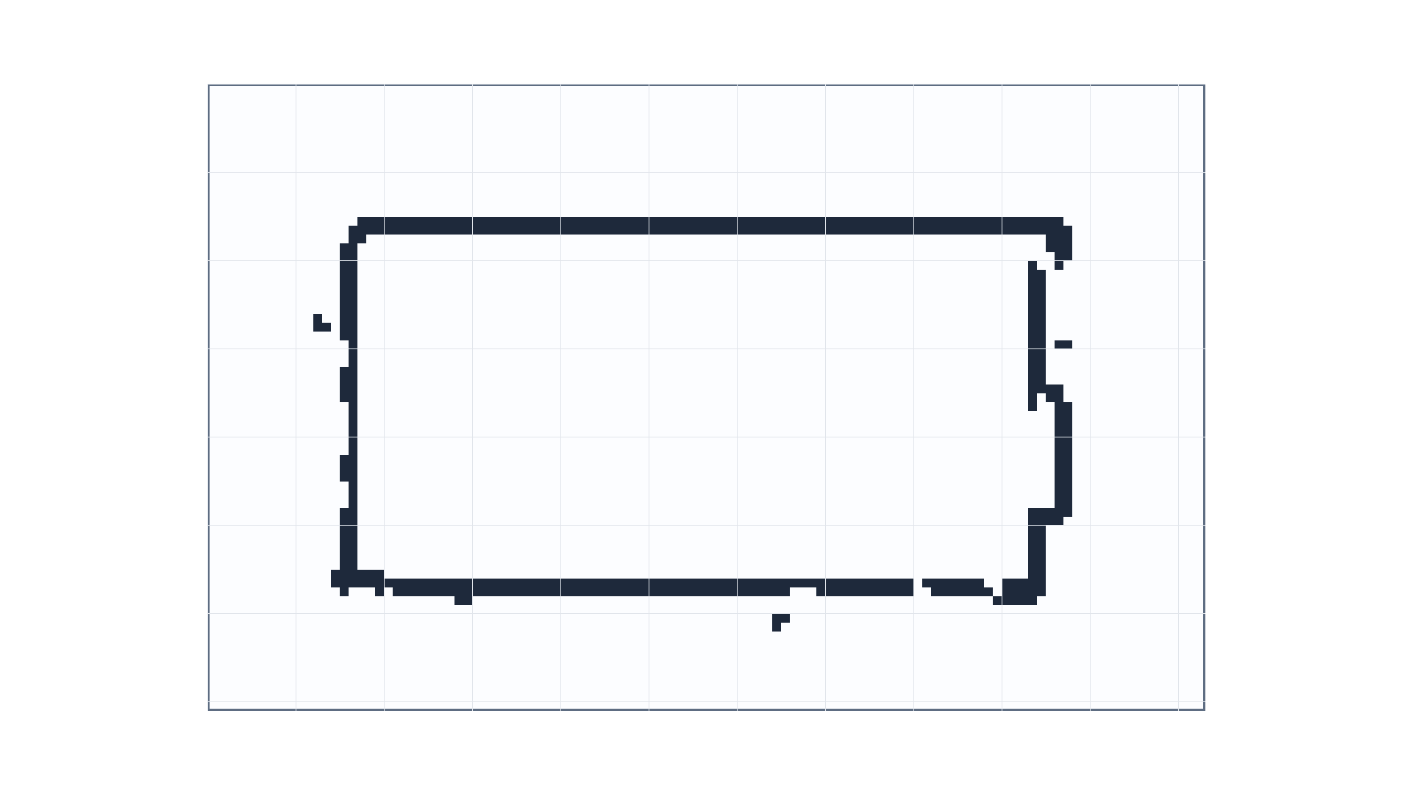
Occupancy mask
Map is converted into a trinary occupancy grid
PGM/YAML → grid cells
Cell types:
Free
Occupied
Unknown
Notes:
The planner cannot reason over the raw map image directly.
I convert the PGM/YAML map into a trinary occupancy grid with free, occupied, and unknown cells.
This step was important because A* needs a clear traversability decision for each cell.
Unknown and occupied cells are treated as blocked, while only free cells can become part of the path.

Slide 8
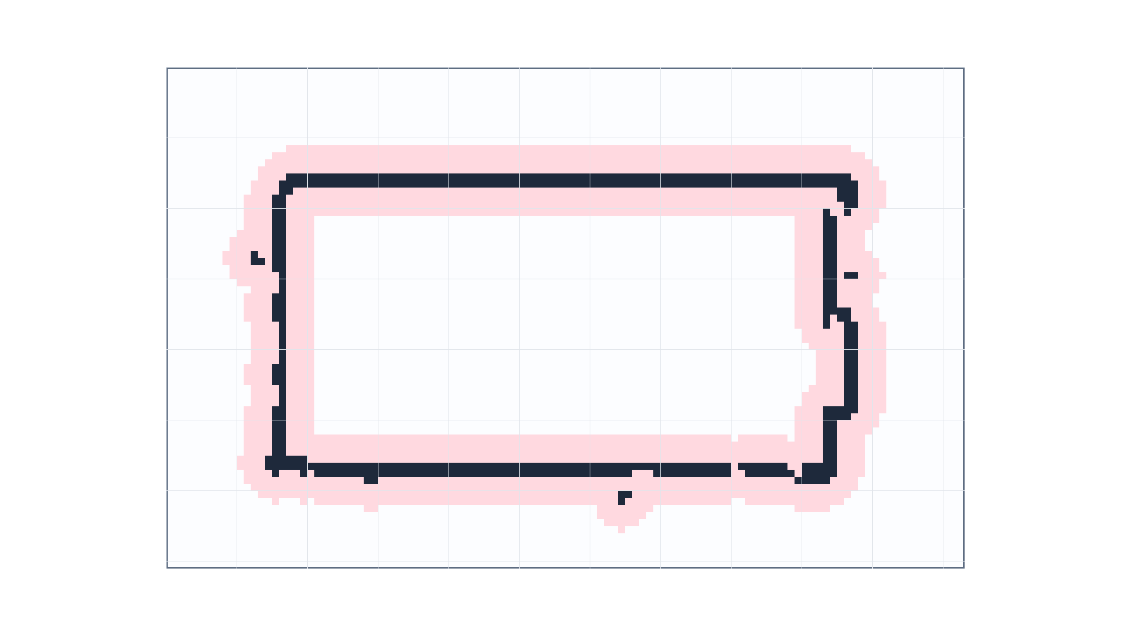
Inflated blocked mask
Obstacles and walls are inflated by the robot clearance radius
$$\text{Resolution}=0.05\frac{m}{\text{cell}}$$
Notes:
A cell that is free for a point robot is not necessarily safe for the TurtleBot.
I therefore inflate walls and blocked cells by the robot clearance radius before planning.
This changed the actual search space: some cells that looked free in the SLAM map became unsafe for navigation.
The A* planner runs on this inflated mask, not on the raw map.

Slide 9
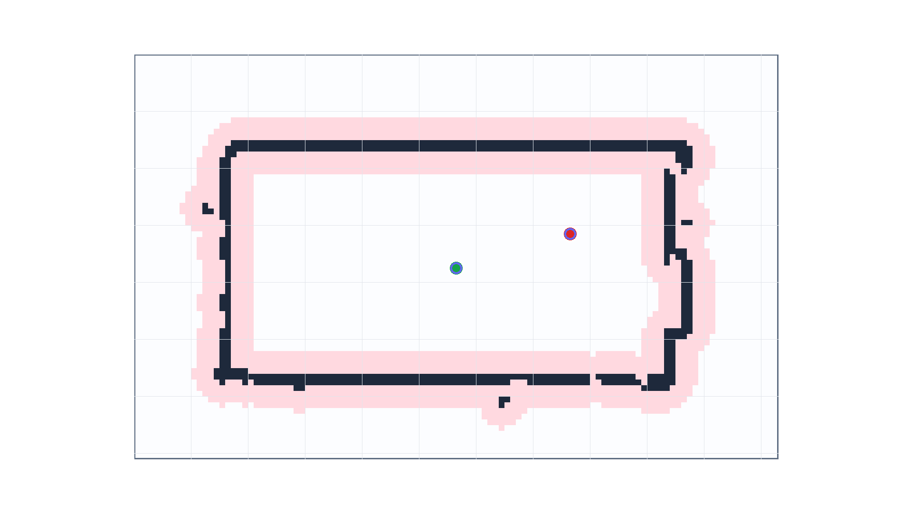
Offline planner preprocessing
Start and goal are snapped to traversable cells before A* starts
Req. pose → grid cell
Reject
Wall
Inflated cells
Unknown cells
Use nearest safe free cell as A* input
Notes:
Before A* can expand anything, the continuous start and goal poses have to be converted into grid cells.
If a pose lands inside an occupied, unknown, or inflated cell, I snap it to the nearest traversable cell.
These snapped cells become the actual input for the offline A* search on the next slide.

Slide 10
Offline A* search expansion
Initial route is planned on the saved SLAM grid before execution
8-neighbor motion
Euclidean heuristic
Inflated obstacle mask
Notes:
For the initial route, I used an offline A* planner on the saved occupancy map.
This gave me full control over the occupancy conversion, wall inflation, start/goal snapping, and waypoint simplification.
Later, the same planning idea is reused for replanning on the temporary run-local obstacle map.

Slide 11
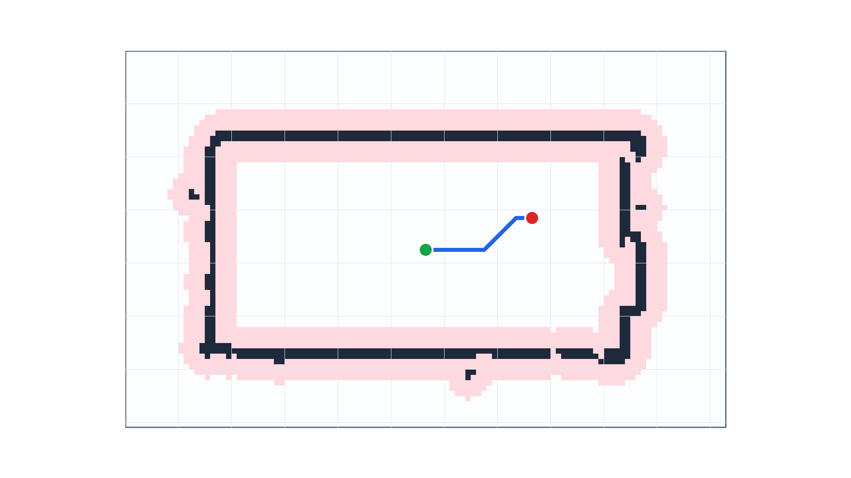
Final dense path
Backtrack from goal to start through the A* parent links
Goal reached:
Follow parent cells backward
Reverse order
Dense grid path
Notes:
After A* reaches the goal cell, the planner does not directly output waypoints.
It first reconstructs the dense path by following the parent link of each expanded cell back to the start.
I then reverse that sequence to get the final grid path from start to goal.
This dense path is still too detailed for robot execution, so the next step is to simplify it into a smaller set of waypoints.

Slide 12
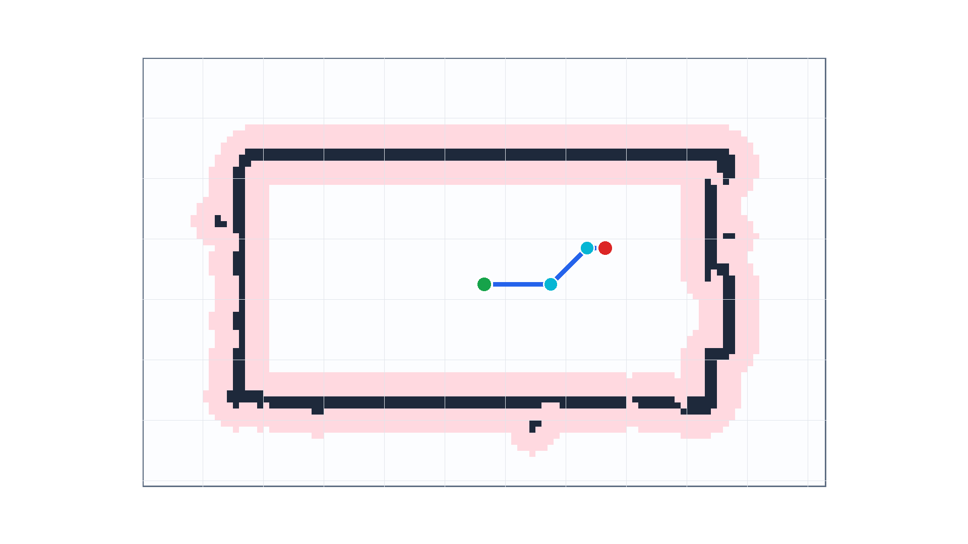
Simplified waypoints
Grid path is simplified into executable waypoints
Dense path: 21 cells
Simplified waypoints: 4
Path length: ~1.124 m
linear_speed_mps = 0.03
Notes:
I had to simplify the path into waypoints while keeping the route collision-free.
The planned path only became usable after tuning the follower.
Faster controller settings caused failures/timeouts; slower motion was reliable enough to complete the route.

Slide 13
Block B: Obstacle detection

Slide 14
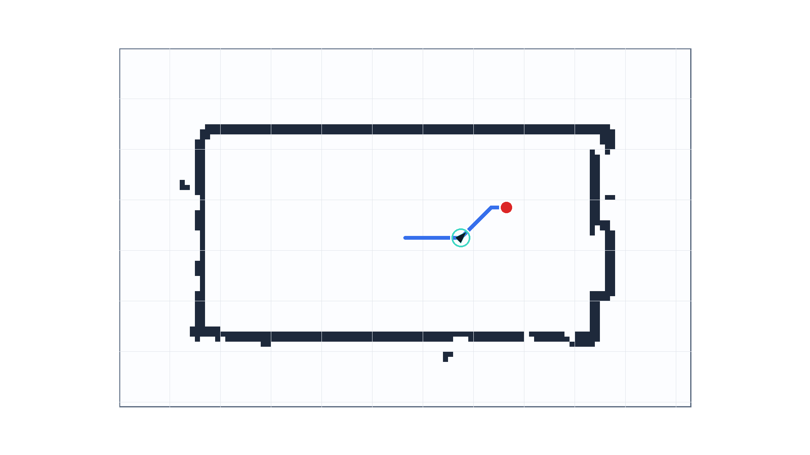
Custom waypoint follower
A* waypoints are converted into /cmd_vel commands
waypoints.csv:
Curr. target waypoint
Dist. + heading error
Bound lin./ang. vel.
/cmd_vel
Notes:
The A* planner only gives me waypoints, not robot motion.
I implemented a custom waypoint follower that selects the next waypoint, computes the distance and heading error to it, and publishes bounded linear and angular velocity commands to /cmd_vel.
While this control loop is running, the robot also receives raw LiDAR scans.
That is the input for the obstacle detection step on the next slide.

Slide 15
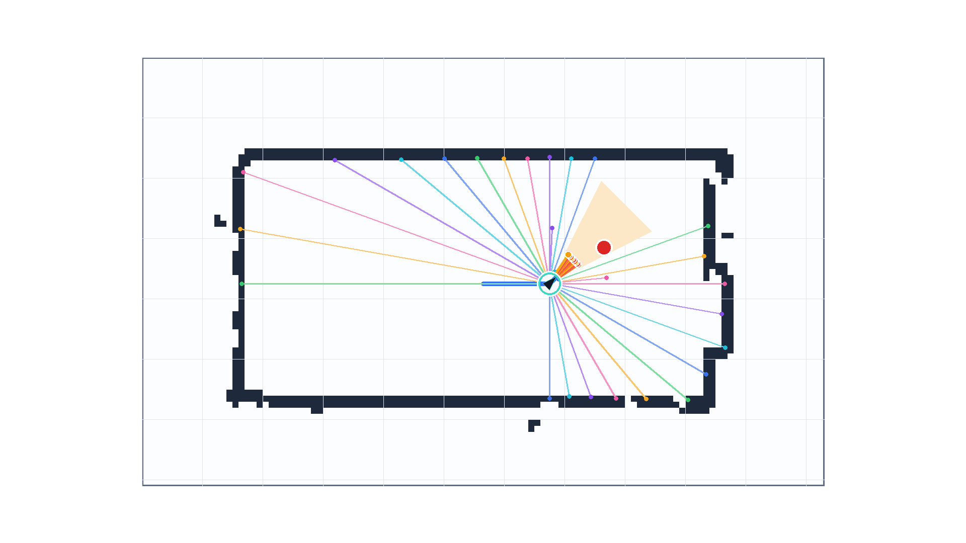
Raw LiDAR scan points
Robot receives raw /scan returns during motion
/scan → base frame
$$θ_{i}=∠_{min}+i⋅∠_{\text{inc}}$$
$$x≈r_{i}⋅cos(θ_{i})$$
$$y≈r_{i}⋅sin(θ_{i})$$
Notes:
Raw LiDAR contains wall hits, out-of-bounds points, and temporary objects.
The hard part was deciding which scan points should become temporary obstacle cells.

Slide 16
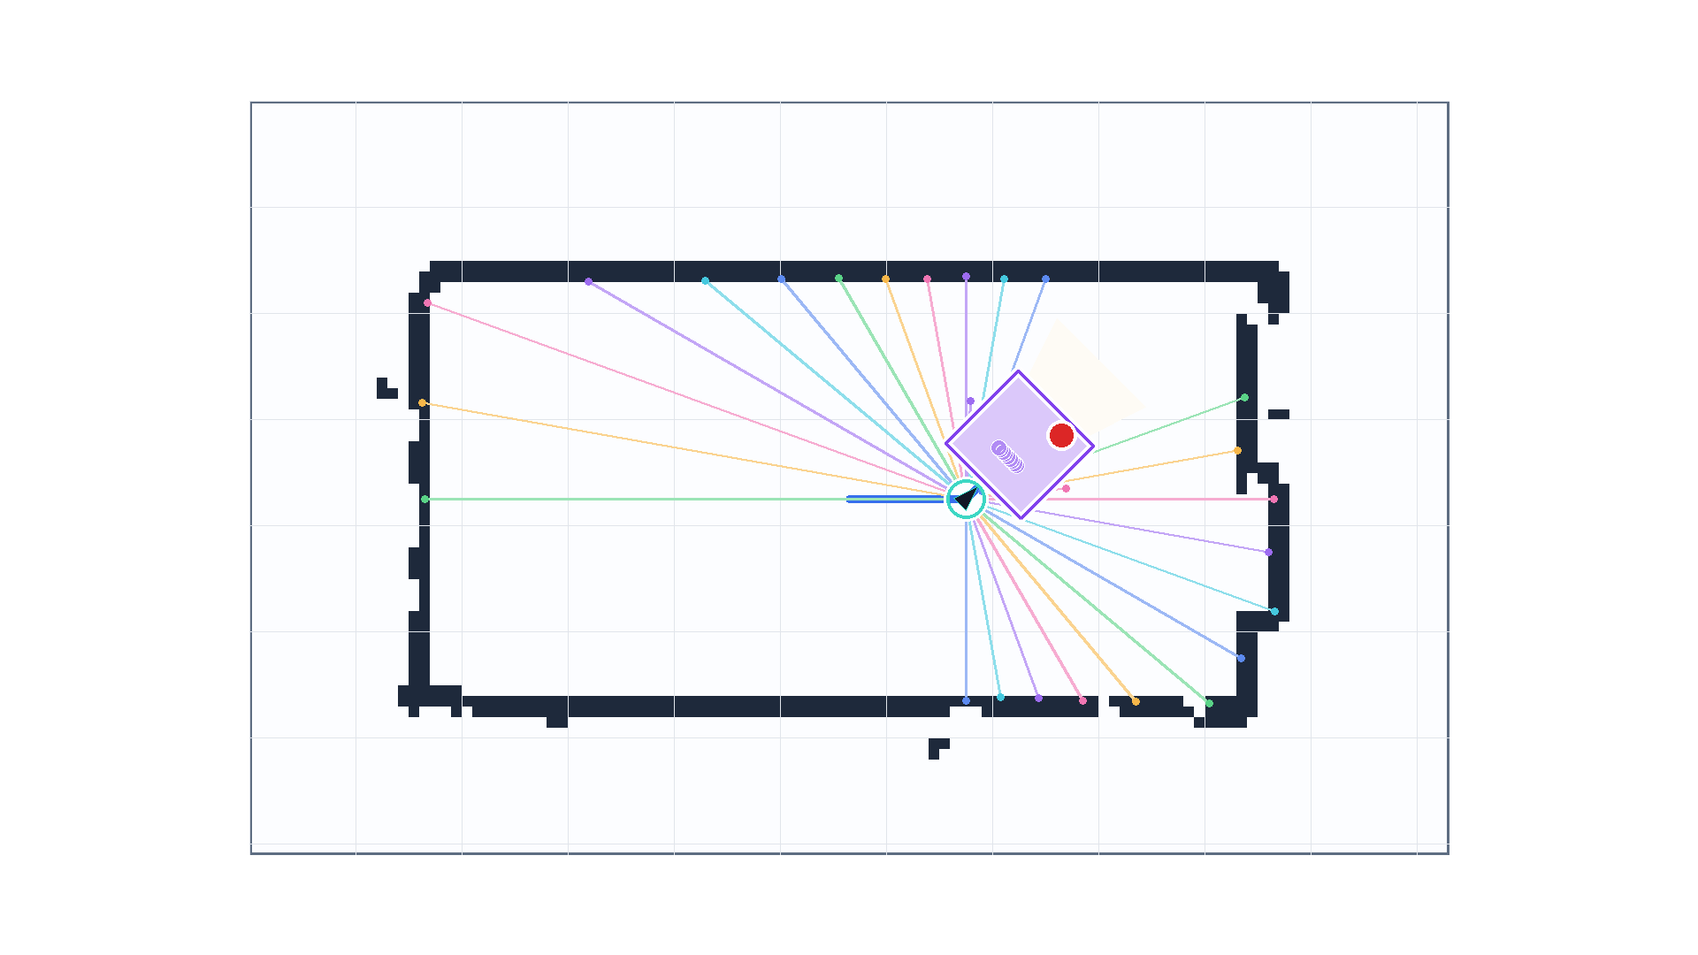
Filter points through forward ROI
Only relevant points in front of the robot are considered
Keep point if:
$$0<x<\text{forw. dist.}$$
$$|y|<\text{half_width}$$
$$|∠|<∠_{\text{window}}$$
Notes:
On the previous slide, every LiDAR return was converted from polar scan data into a point in the robot base frame.
But not every point should trigger replanning.
A wall beside the robot or a point behind it is not an immediate obstacle for the planned motion.
Therefore, I introduced a forward ROI: only points in front of the robot and inside a lateral corridor are passed to the obstacle update step.

Slide 17
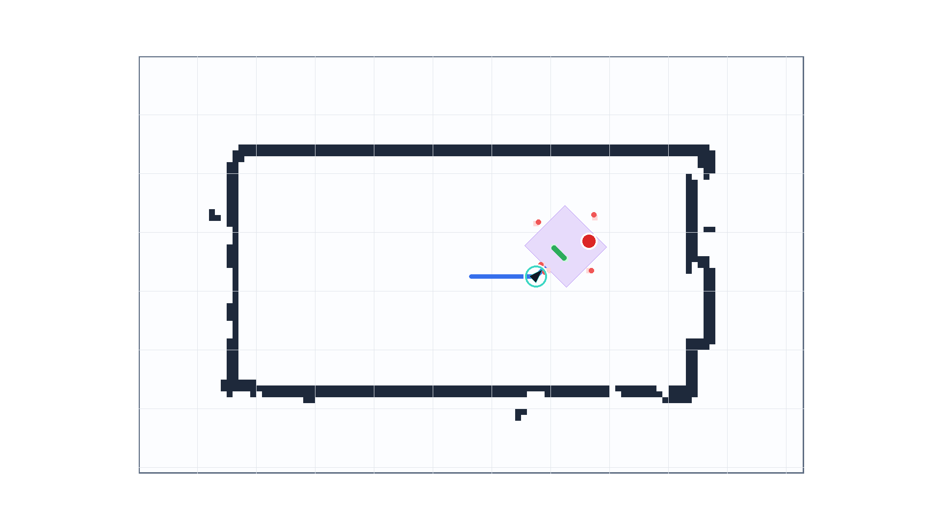
Accept only new free-space obstacles
ROI points are checked against the saved occupancy map
Base point → map cell
Accept if:
Cell is inside map
Cell is free in saved map
Reject if:
Cell is static wall / unknown / outside map
Notes:
The ROI only tells me that a scan point is relevant for the robot’s forward motion.
It does not yet tell me whether this point is a new temporary obstacle.
Therefore, I transform each candidate into a map cell and compare it against the saved occupancy map.
If the cell is free, I accept it as a temporary obstacle.
If it is already a wall, unknown, or outside the map, I reject it so the LiDAR endpoints do not modify the arena walls.

Slide 18
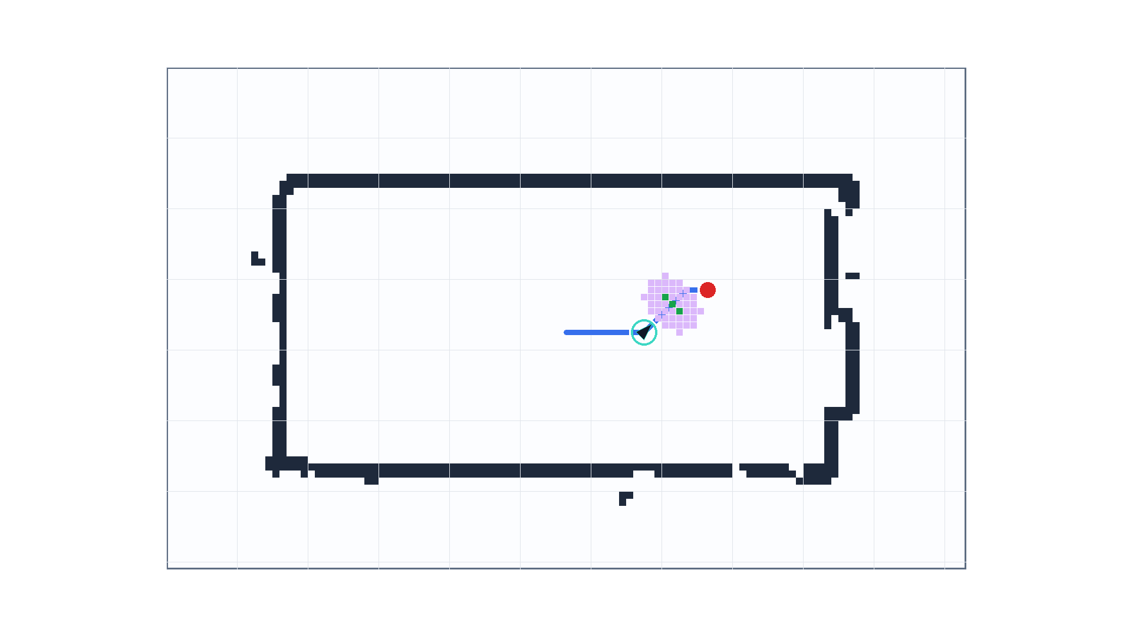
Temporary local obstacle overlay
Accepted cells are added only to the run-local planning map
$$M_{p}=M_{s}+O_{\text{temp.}}$$
$M_{p}$ = planning map
$M_{s}$ = saved map
$O_{\text{temp}}$ = temporary overlay
$M_{s}$ : unchanged
$O_{\text{temp.}}$ : obstacle cells
Inflation: clearance $r$
Notes:
After the accepted/rejected decision, I do not modify the original SLAM map.
That was an important design decision, because the obstacle is temporary.
Instead, I create a run-local overlay: the saved map stays unchanged, and only the accepted LiDAR obstacle cells are added to the temporary planning map.
This is the map used for collision checking and replanning.

Slide 19
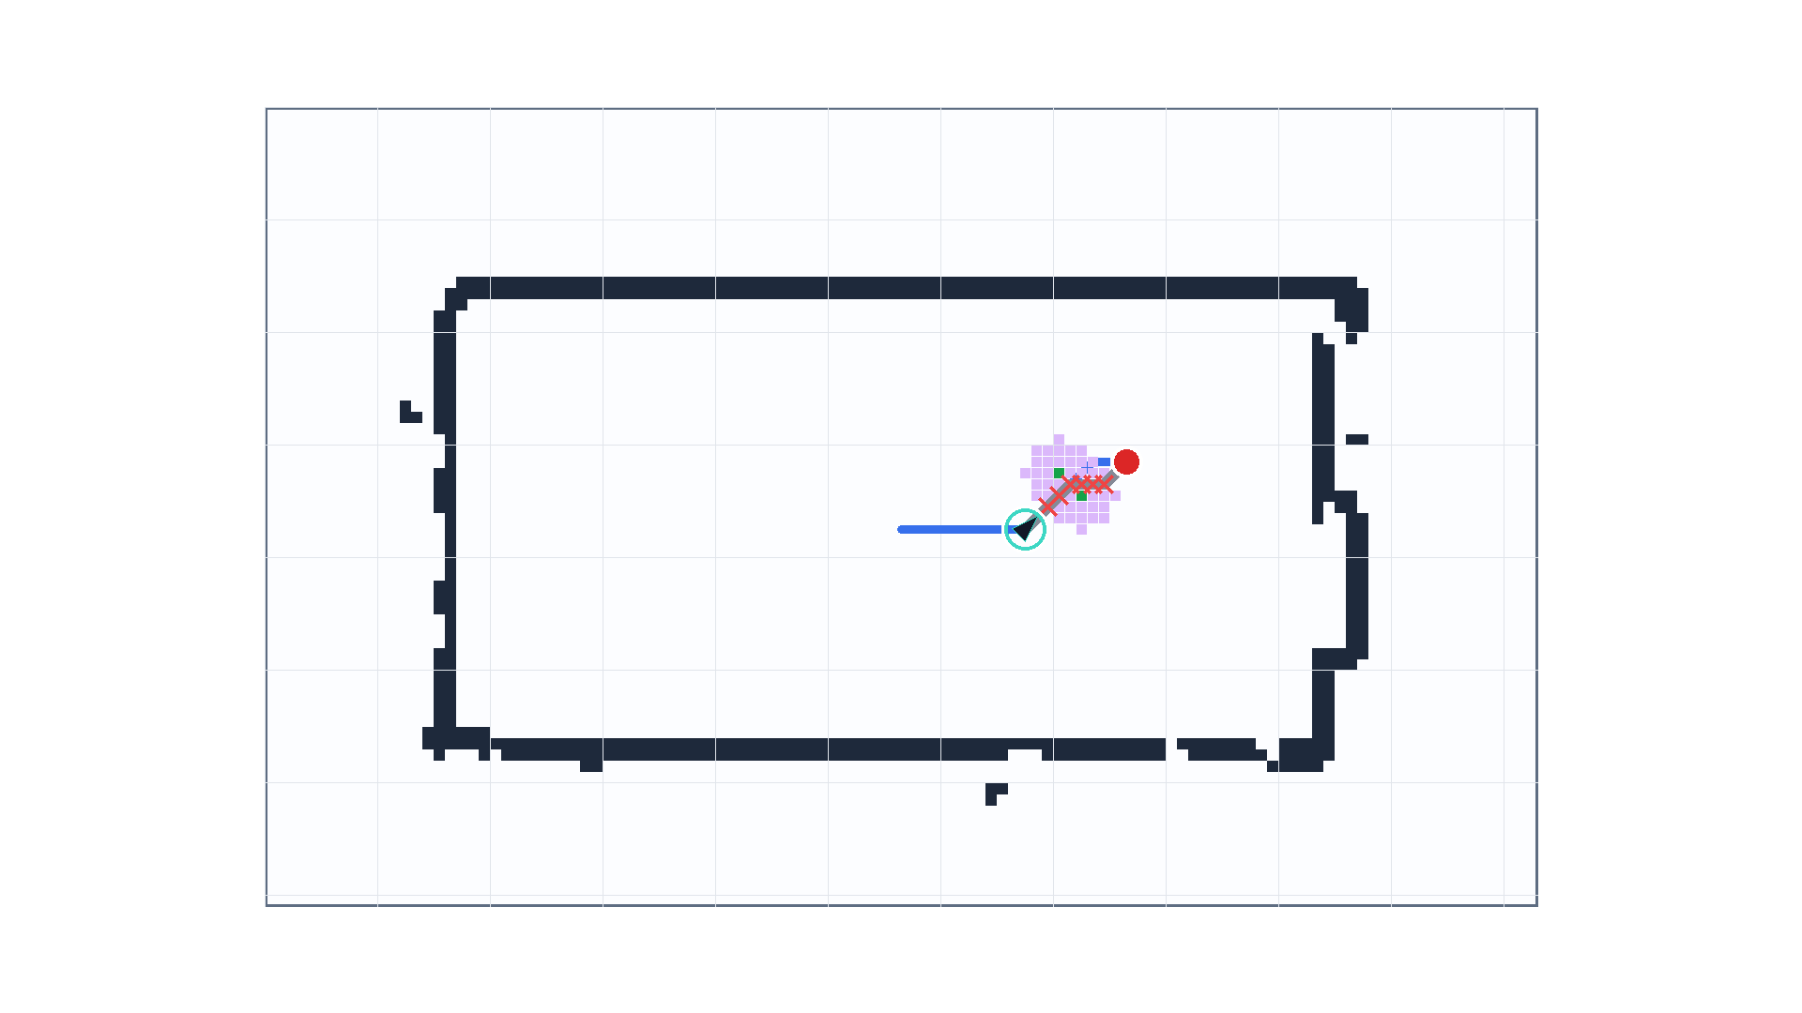
Old path blocked
The previous route is invalid once obstacle clearance is added
$P_{\text{old}}∩O_{\text{infl.}}≠∅$:
Stop following
Trigger replanning
$P_{\text{old}}$ : old path
$O_{\text{infl.}}$ : inflated overlay
Notes:
After adding the temporary overlay, I inflate the obstacle by the robot clearance radius.
Then I check whether the path the robot is currently following intersects this inflated obstacle region.
If the intersection is non-empty, the old path is no longer safe.
That is the condition where the follower stops and triggers replanning.

Slide 20
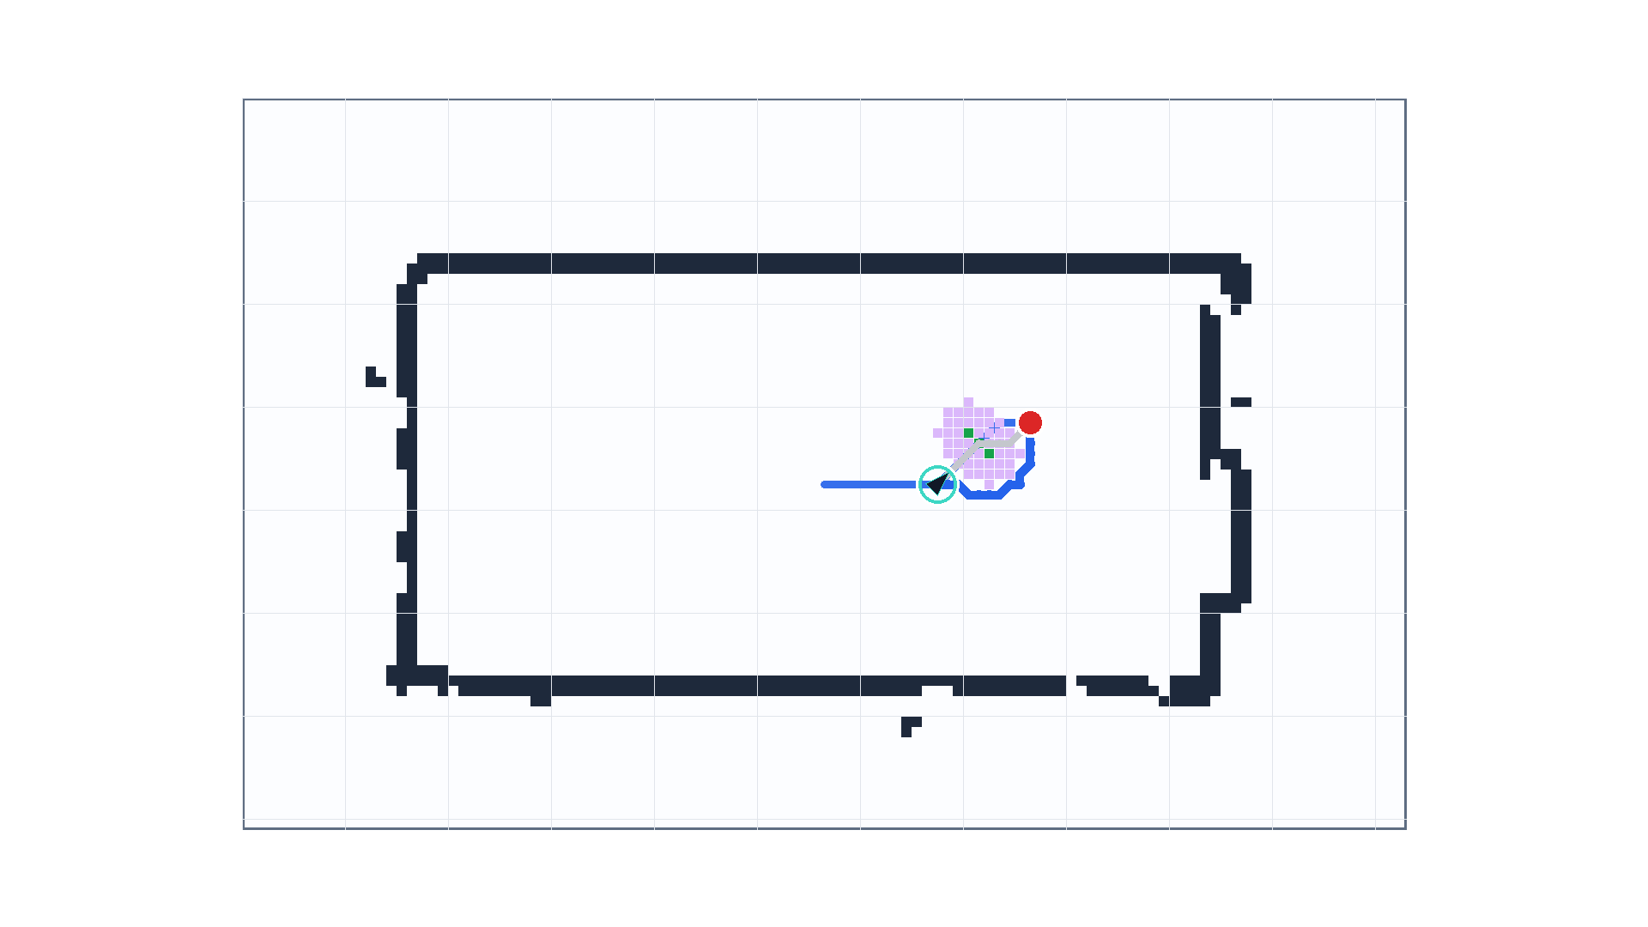
Replanned path
A* is rerun on the temporary planning map
Start = current pose
Goal = original goal
$$A^{*}(M_{s}+O_{\text{temp}})$$
New path
New waypoints
Resume follower
Notes:
Once the old path is blocked, I do not restart the whole task from the original start.
I take the robot’s current pose as the new start, keep the original goal, and rerun A* on the temporary planning map.
The resulting path is converted into new waypoints, and the follower resumes with this updated route.”

Slide 21
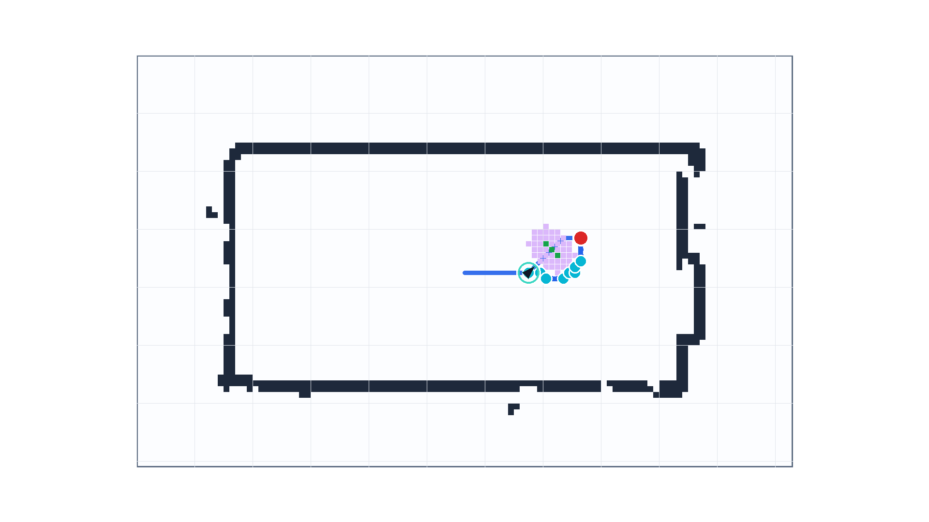
Validation: temporary obstacle avoided
Final route avoids the inflated obstacle overlay
$$P_{\text{old}}∩O_{\text{infl.}}≠∅$$
$$P_{\text{new}}∩O_{\text{infl.}}=∅$$
$P_{\text{old}}$ : old path
$P_{\text{new}}$ : new path
blocked old path cells: 6
inflated obstacle cells: 47
new waypoints: 9
Notes:
This final frame validates the pipeline.
The old route intersects the inflated temporary obstacle, so it is unsafe.
After replanning, the new route no longer intersects the inflated overlay.
That means the robot can continue toward the same goal while avoiding the temporary obstacle, without changing the saved SLAM map.

Slide 22
Conclusion

Slide 23
Conclusion
What I learned from this task sheet

Slide 24
Thank you!

