Slide 1
PITCH SPINE
The assignment became a measurement problem before it became a modeling problem.
5-10 minute pitch: the concrete problems, the decisions I made, and why those decisions were defensible.
Problem
Decision
Consequence
The task asks for real final pose, but the robot does not give a clean absolute endpoint alone.
Build an external camera tracker and gate each run against a repeatable start.
A simple probabilistic model works for primitives; the composed route exposes the limits.
Sources: docs/tasks/Aufgabe_02.pdf; scripts/; vision_tracker/; results/
1

Slide 2
PROBLEM 1: MEASURING POSE
I could not treat odometry as the answer.
The task needed final position in the physical experiment, so I needed an external reference frame.
Decision
Key code path
Use an overhead camera, three green markers, and a homography to write the latest absolute tracker pose.
vision_tracker/main.py -> tracker.py -> calibration.py -> pose_estimator.py
camera frame
HSV green marker detection
pixel -> world homography
Why
It made simulation endpoints, real endpoints, and repeated-run statistics comparable in meters.
classify 3 markers
estimate x, y, yaw
latest tracker pose CSV
/Users/stephpark/Documents/stephsWorld/mii-amr/vision_tracker/main.py; pose_estimator.write_latest_pose()
2

Slide 3
PROBLEM 2: REPEATABLE STARTS
The start pose became a control variable.
Without a gate, small manual placement differences would look like motion-model error.
0.04 m
4 deg
1 s
3
position tolerance before a real run can start
yaw tolerance before a real run can start
stable tracker pose required
markers required for a valid camera pose
accepted starts logged with measured dx/dy/yaw error
stale / invalid / missing marker poses block the run
Decision
Make the run script wait for camera-confirmed pose instead of trusting manual placement.
vision_tracker/config.py; vision_tracker/start_pose_gate.py; results/real_start_pose_checks.csv
3

Slide 4
PROBLEM 3: COUPLING COMMANDS
The same /cmd_vel command hid different stop logic.
That mattered because the assignment asked for real motion coupled to perfect simulation commands.
Simulation run
Real robot run
input
RUN_DISTANCE and RUN_SPEED
input
same command vocabulary: speed, duration, angle
stop
drive until odometry reaches target distance
stop
time / primitive execution on hardware
validate
start pose, forward distance, lateral drift, yaw drift
measure
external tracker start and final pose plus odometry
Decision
Log both odometry and camera tracker fields, then compare endpoint displacement instead of assuming either source is perfect.
scripts/scripted_drive.py; scripts/real_scripted_drive.py; scripts/run_real_experiment.sh
4

Slide 5
DECISION 4: MODEL SCOPE
I chose a deliberately small empirical model.
The task asked for a rough endpoint prediction. Tradeoff: no full trajectory, map uncertainty, or full x/y/yaw covariance.
30
0.302 m
-0.002 m
+0.32 deg
valid F30 forward runs
mean local forward displacement
mean lateral displacement
mean yaw drift after F30
-85.0 deg
+84.6 deg
10k
CW90 measured mean yaw change
CCW90 measured mean yaw change
Monte Carlo samples for path endpoint
results/probabilistic_motion_primitives_model_summary.csv; scripts/build_motion_primitives_model.py
5

Slide 6
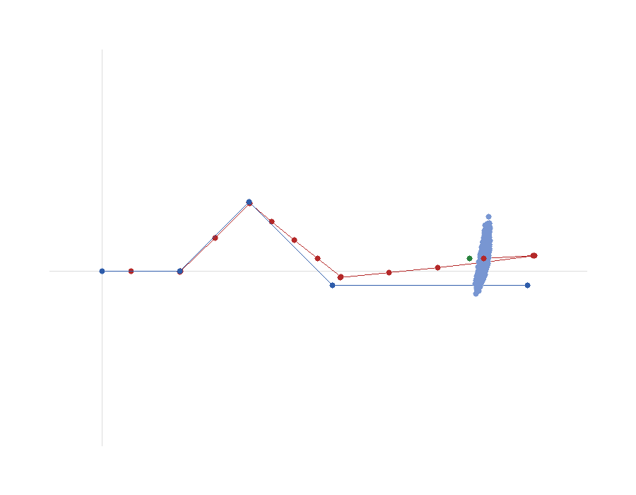
PROBLEM 5: COMPOSED ROUTE
The final route exposed the model limit.
0.149 m
False
validation residual magnitude
inside the 95% endpoint ellipse
-10.7
0.498 m
yaw residual in validation run 004, deg
95% ellipse major-axis length
Decision after seeing this
Use it as uncertainty evidence. The route failure motivates closed-loop localization.
results/supervisor_route_prediction_summary.csv; results/supervisor_route_validation_runs.csv
6

Slide 7
CLOSE
What I would defend in the pitch
1. Measurement first
The external camera tracker was not extra polish; it was required to answer the task with physical final positions.
2. Repeatability before statistics
The start-pose gate made repeated runs comparable by rejecting stale, invalid, or badly placed starts.
3. The model failed in the useful way
A rough endpoint model is enough to show uncertainty, but the supervisor route demonstrates why mobile robots need localization feedback such as SLAM.
Closing line: the work made the need for SLAM visible instead of just stating it.
7

