Slide 1
APEX
Financial Intelligence Platform
منصة الذكاء المالي المتكامل
AI-Powered · Saudi Arabia · SOCPA & IFRS Compliant
مدعومة بالذكاء الاصطناعي · متوافقة مع المعايير السعودية والدولية
30+
API Endpoints
نقطة API
11
AI Modules
وحدة ذكاء
55+
UI Screens
شاشة
93%
Automation
أتمتة
APEX Financial Intelligence Platform | Jeddah, Saudi Arabia | 2026
1 / 19
APEX
Notes:
Welcome everyone. APEX is a comprehensive AI-powered financial intelligence platform, built specifically for the Saudi Arabian market. We're SOCPA and IFRS compliant from day one, with full Arabic and English bilingual support. Over 30 API endpoints, 11 AI modules, and 55+ UI screens — all built and ready to deploy. مرحباً بالجميع. APEX منصة ذكاء مالي شاملة مدعومة بالذكاء الاصطناعي، مبنية خصيصاً للسوق السعودي.

Slide 2
THE PROBLEM · المشكلة
Saudi Arabia's Financial Sector
Deserves Smarter Tools
يستحق القطاع المالي السعودي أدوات أكثر ذكاءً
!
Manual & Error-Prone
X
No AI for Arabic Finance
يدوي وعرضة للأخطاء
لا ذكاء اصطناعي للمحاسبة العربية
Excel-based analysis. Hours of manual work with zero audit trail.
Existing tools ignore SOCPA, ZAKAT, and Saudi-specific standards.
?
Zero Readiness Scoring
$
Slow & Costly Consulting
غياب تقييم الجاهزية
استشارات بطيئة ومكلفة
No objective, automated measure of financial health or funding readiness.
Weeks for a report. Thousands SAR per engagement. SMEs excluded.
APEX Financial Intelligence Platform | Jeddah, Saudi Arabia | 2026
2 / 19
APEX
Notes:
The problem is clear: Saudi Arabia's financial sector still relies heavily on manual processes. Excel-based analysis takes weeks, costs thousands of riyals per engagement, and has error rates of 15-25%. There's no AI solution that understands Arabic financial standards, no automated readiness scoring, and SMEs are completely excluded from quality financial analysis due to cost. المشكلة واضحة: القطاع المالي السعودي لا يزال يعتمد بشكل كبير على العمليات اليدوية.

Slide 3
THE SOLUTION · الحل
APEX — Your AI Financial Brain
عقلك المالي الذكي — كل شيء في منصة واحدة
01
02
03
04
Chart of
Accounts
Trial
Balance
Financial
Statements
Financial
Analysis
>>>
>>>
>>>
شجرة الحسابات
ميزان المراجعة
القوائم المالية
التحليل المالي
Upload & AI-classify
Bind, validate & detect
Auto-generate IFRS
Ratios & Readiness Score
One platform · Four layers · Complete financial intelligence | منصة واحدة · أربع طبقات · ذكاء مالي متكامل
APEX Financial Intelligence Platform | Jeddah, Saudi Arabia | 2026
3 / 19
APEX
Notes:
APEX solves this with a four-layer pipeline: Upload your Chart of Accounts, AI classifies it instantly. Bind your Trial Balance, we detect anomalies automatically. Generate IFRS-compliant financial statements in one click. Get a complete analysis with 30+ ratios and a Readiness Score from 0 to 100. APEX تحل هذه المشكلة بأنبوب رباعي الطبقات: من رفع شجرة الحسابات إلى التحليل الكامل.

Slide 4
PLATFORM CAPABILITIES · قدرات المنصة
What Makes APEX Different
ما الذي يميّز APEX
AI
Knowledge Brain
>>
Smart Onboarding
OK
Audit Workflow
العقل المعرفي
تأهيل ذكي
سير عمل المراجعة
11 AI modules: SOCPA, IFRS, ZAKAT, VAT, Saudi regulations
7-stage wizard. Auto-detects company type, industry & docs
7-phase review engine. Human-in-the-loop triggers
{ }
30+ Live APIs
##
Role-Based Security
$$
Subscription Plans
أكثر من 30 API
أمن قائم على الأدوار
خطط الاشتراك
Full REST suite. FastAPI + Flutter. Swagger documented
11 roles, JWT auth, audit logs on every financial action
4 tiers: Starter, Growth, Professional, Enterprise
30+
APIs
واجهة
11
AI Modules
وحدة ذكاء
55+
Screens
شاشة
4
Plans
خطط
11
Roles
دور
APEX Financial Intelligence Platform | Jeddah, Saudi Arabia | 2026
4 / 19
APEX
Notes:
What makes APEX different is the depth of our platform. Our Knowledge Brain has 11 specialized AI modules covering SOCPA, IFRS, ZAKAT, VAT, and Saudi-specific regulations. Smart onboarding auto-detects company type. Our audit workflow has 7 phases with human-in-the-loop triggers. 30+ live APIs, 11 security roles, and 4 subscription tiers. ما يميز APEX هو عمق المنصة: 11 وحدة ذكاء اصطناعي متخصصة.

Slide 5
FOR CLIENTS · للعملاء
Your Complete Financial Health Report
in Minutes, Not Weeks
المنشآت الصغيرة · مكاتب المحاسبة · الشركات · الناشئات
Upload Arabic or English financials — AI understands both
93%
ارفع ملفاتك بالعربية أو الإنجليزية
Complete financial health report in minutes, not weeks
تقرير صحة مالية كامل في دقائق
of financial analysis tasks automated
من مهام التحليل المالي مؤتمتة بالكامل
Funding Readiness Score 0–100 with actionable steps
درجة جاهزية تمويلية من 0 إلى 100
SOCPA & IFRS compliant. Audit-ready documentation
متوافق مع المعايير. توثيق جاهز للمراجعة
Connect with certified professionals via Marketplace
تواصل مع متخصصين معتمدين عبر السوق
APEX Financial Intelligence Platform | Jeddah, Saudi Arabia | 2026
5 / 19
APEX
Notes:
For our clients — whether SMEs, accounting firms, or startups — APEX delivers a complete financial health report in minutes, not weeks. Upload in Arabic or English, the AI understands both. Get a Funding Readiness Score from 0-100 with actionable improvement steps. Everything is SOCPA and IFRS compliant, audit-ready. لعملائنا: تقرير صحة مالية كامل في دقائق مع درجة جاهزية تمويلية.

Slide 6
FOR INVESTORS · للمستثمرين
A SAR 780B Market Opportunity
فرصة سوقية بقيمة 780 مليار ريال
SAR 780B
23%
500+
Saudi SME Market
Fintech CAGR
Year 1 Target
سوق المنشآت السعودية
نمو الفنتك السعودي
هدف السنة الأولى
Total addressable market
Saudi Arabia 2024–2030
Paying clients projected
REVENUE MODEL · نموذج الإيرادات
SaaS Subscriptions
اشتراكات SaaS
SAR 199 → SAR 4,999/mo
60%
API Access
اشتراك الـ API
Pay-per-analysis. Usage-based
25%
Marketplace
السوق التخصصي
Commission on professional services
15%
APEX Financial Intelligence Platform | Jeddah, Saudi Arabia | 2026
6 / 19
APEX
Notes:
The market opportunity is massive. Saudi Arabia's SME sector is valued at SAR 780 billion, with fintech growing at 23% CAGR. Our target is 500+ paying clients in Year 1. Revenue comes from three streams: SaaS subscriptions at 60%, API access at 25%, and marketplace commissions at 15%. Our pricing ranges from SAR 199 to SAR 4,999 per month. الفرصة السوقية ضخمة: 780 مليار ريال مع نمو 23% سنوياً.

Slide 7
COMPETITIVE LANDSCAPE · المشهد التنافسي
Why APEX Wins
لماذا APEX تتفوق
Feature
APEX
Excel
Wafeq
Qoyod
Xero
AI Financial Analysis
●
—
—
—
—
Arabic + SOCPA Support
●
—
●
●
—
Readiness Score (0-100)
●
—
—
—
—
Audit Workflow Engine
●
—
—
—
—
Knowledge Brain (11 modules)
●
—
—
—
—
API Marketplace
●
—
—
—
—
Bilingual (AR/EN)
●
—
●
●
—
APEX is the only platform combining AI financial analysis with full Arabic/SOCPA compliance — no competitor comes close.
APEX Financial Intelligence Platform | Jeddah, Saudi Arabia | 2026
7 / 19
APEX
Notes:
Looking at the competitive landscape, APEX is the only platform that combines AI financial analysis with full Arabic and SOCPA compliance. Excel has no AI, no compliance. Wafeq and Qoyod offer basic Arabic support but no AI analysis, no readiness scoring, no audit workflow. Xero doesn't support Arabic at all. No competitor comes close to our feature set. APEX هي المنصة الوحيدة التي تجمع بين الذكاء الاصطناعي والتوافق الكامل مع المعايير السعودية.

Slide 8
PRICING · التسعير
Plans for Every Business Size
خطط تناسب كل حجم أعمال
MOST POPULAR
Starter
Growth
Professional
Enterprise
المبتدئ
النمو
الاحترافي
المؤسسي
SAR 199/mo
SAR 799/mo
SAR 1,999/mo
SAR 4,999/mo
1 Company
Basic COA Upload
5 Reports/month
Email Support
3 Companies
AI Classification
Unlimited Reports
Readiness Score
Priority Support
10 Companies
Full AI Suite
Audit Workflow
API Access
Dedicated Manager
Unlimited
Custom Modules
SLA Guarantee
On-premise Option
White-label Ready
APEX Financial Intelligence Platform | Jeddah, Saudi Arabia | 2026
8 / 19
APEX
Notes:
We have four pricing tiers designed for every business size. Starter at SAR 199 for solo practitioners. Growth at SAR 799 for expanding firms. Professional at SAR 1,999 — our most popular tier — for established businesses with full AI and audit capabilities. Enterprise at SAR 4,999 with unlimited access, custom modules, and white-label options. أربع خطط تسعير تناسب كل حجم أعمال.

Slide 9
LIVE DEMO FLOW · مسار العرض التجريبي
See APEX in Action
شاهد APEX أثناء العمل
1
Client Onboarding
2
Upload COA
تأهيل العميل
رفع شجرة الحسابات
7-stage wizard auto-configures for company type & industry
Arabic/English Excel — AI classifies 200+ accounts instantly
3
Trial Balance Bind
4
Financial Statements
ربط ميزان المراجعة
القوائم المالية
Auto-links TB to COA, anomaly scoring & issue flagging
P&L, Balance Sheet, Cash Flow generated in one click
5
Analysis Dashboard
6
Audit Trail
لوحة التحليل
سجل التدقيق
30+ ratios, Readiness Score, funding gap analysis
Every decision logged, timestamped & explainable by AI
See next slide for dashboard preview | انظر الشريحة التالية لمعاينة لوحة التحكم
APEX Financial Intelligence Platform | Jeddah, Saudi Arabia | 2026
9 / 19
APEX
Notes:
Let me walk you through the live demo flow. It's a 6-step process: Client onboarding through our 7-stage wizard, upload your Chart of Accounts, AI classifies 200+ accounts instantly, bind your Trial Balance, auto-generate financial statements, and finally view your analysis dashboard with 30+ ratios and your Readiness Score. دعوني أعرض عليكم مسار العرض التجريبي المباشر.

Slide 10
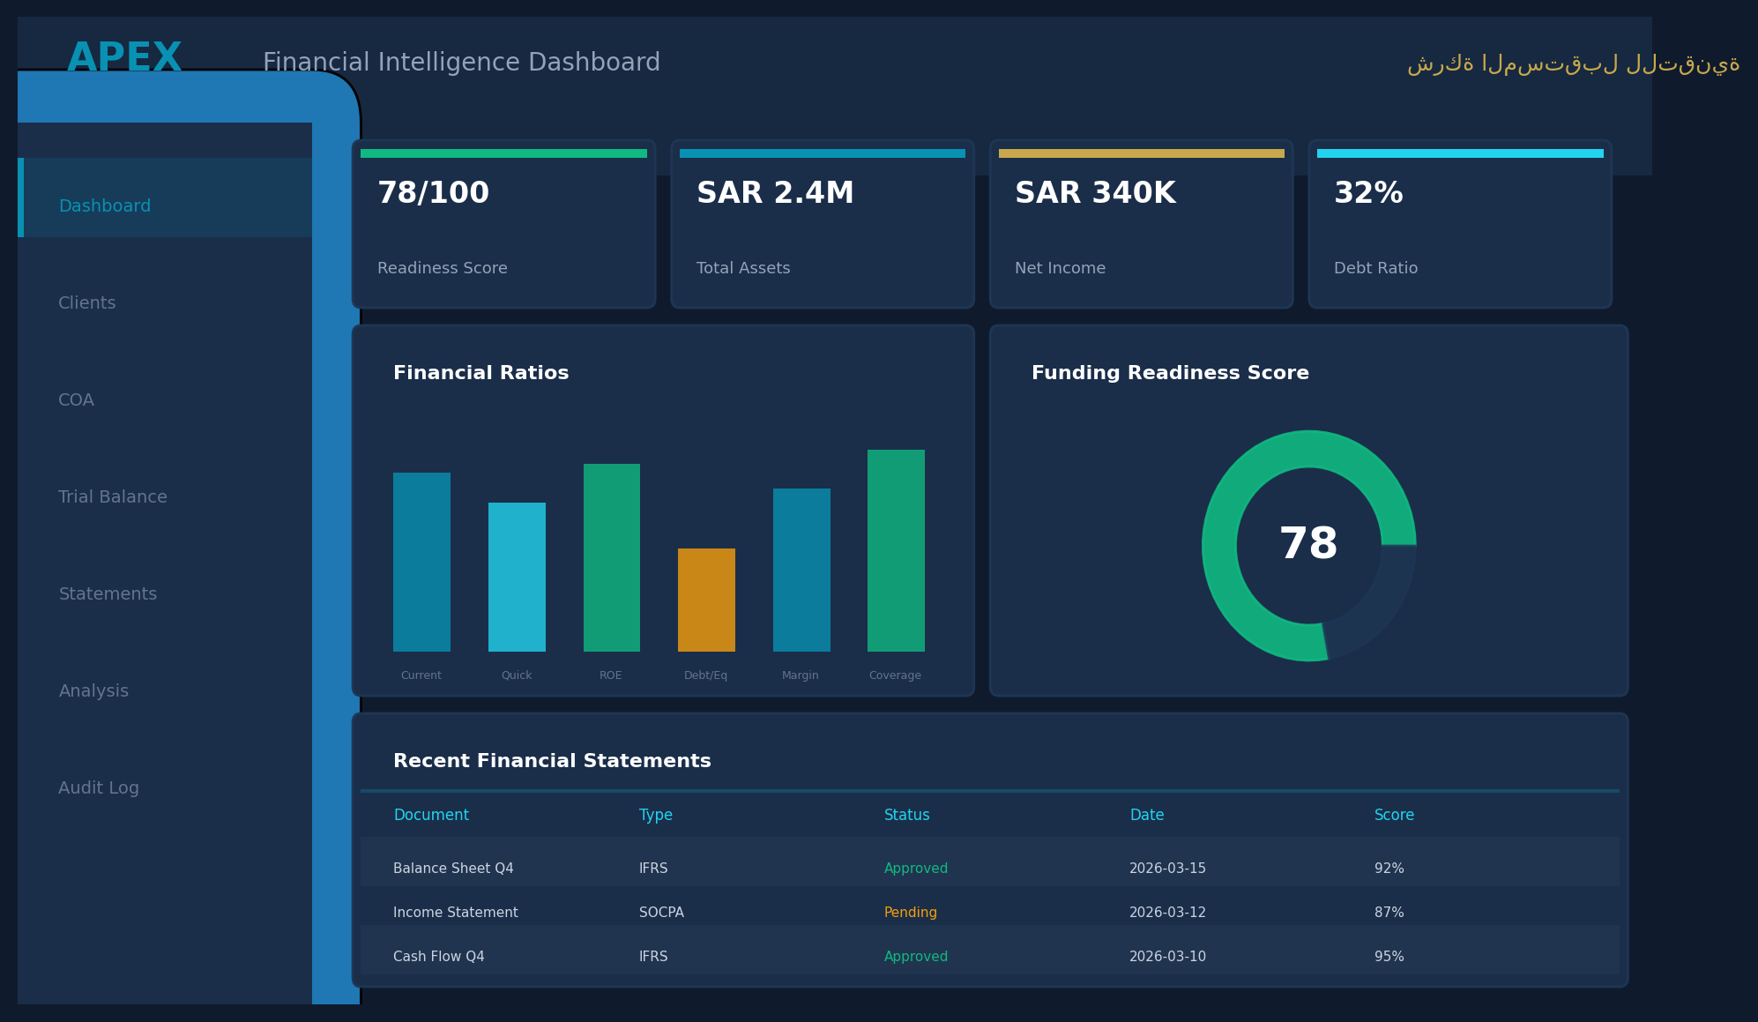
DASHBOARD PREVIEW · معاينة لوحة التحكم
Complete Financial Intelligence at a Glance
ذكاء مالي متكامل في لمحة واحدة
Real-time KPIs · Financial Statements · Readiness Score · AI Insights | مؤشرات فورية · قوائم مالية · درجة الجاهزية · رؤى ذكية
APEX Financial Intelligence Platform | Jeddah, Saudi Arabia | 2026
10 / 19
APEX
Notes:
Here's a preview of the APEX dashboard. You can see the clean, modern interface with real-time KPI cards at the top, revenue and expense charts, the readiness score gauge, and a complete financial statements table — all in one view. The dark theme is designed for long working sessions, and everything is available in both Arabic and English. هذه معاينة للوحة التحكم مع مؤشرات فورية وقوائم مالية ودرجة الجاهزية.

Slide 11
CASE STUDY · قصة نجاح
From Upload to Insight in 3 Minutes
من الرفع إلى النتائج في 3 دقائق
BEFORE APEX · قبل
AFTER APEX · بعد
Time to Financial Report
3–4 Weeks
Time to Financial Report
3 Minutes
Cost per Analysis
SAR 5,000+
Cost per Analysis
SAR 199/mo
>>>
Error Rate
15–25%
Error Rate
< 2%
Readiness Assessment
None
Readiness Assessment
0–100 Score
Audit Trail
Manual / Missing
Audit Trail
Full AI-Logged
Result: 96% faster · 95% cheaper · 90% fewer errors | النتيجة: أسرع بـ 96% · أرخص بـ 95% · أخطاء أقل بـ 90%
APEX Financial Intelligence Platform | Jeddah, Saudi Arabia | 2026
11 / 19
APEX
Notes:
Let me show you a real-world comparison. Before APEX: financial reports took 3-4 weeks, cost SAR 5,000+, had 15-25% error rates, no readiness assessment, and manual audit trails. After APEX: reports in 3 minutes, SAR 199 per month, less than 2% error rate, automated 0-100 readiness scoring, and full AI-logged audit trails. That's 96% faster, 95% cheaper, and 90% fewer errors. مقارنة حقيقية: قبل وبعد APEX.

Slide 12
EARLY FEEDBACK · آراء المستخدمين الأوائل
What Early Adopters Are Saying
ماذا يقول المستخدمون الأوائل
“
APEX transformed our quarterly reporting from a 3-week ordeal into a 10-minute task. The AI understands SOCPA standards better than most junior accountants.
حوّلت APEX تقاريرنا الربعية من عملية تستغرق 3 أسابيع إلى مهمة من 10 دقائق
CFO, Saudi Tech Startup
Series A · Riyadh
“
The bilingual support is a game-changer. Our team works in Arabic, our investors want English reports — APEX handles both seamlessly.
الدعم ثنائي اللغة غيّر قواعد اللعبة. فريقنا يعمل بالعربية والمستثمرون يريدون تقارير إنجليزية
Managing Partner, Accounting Firm
50+ Clients · Jeddah
“
The Readiness Score helped us identify exactly what we needed to fix before our funding round. We closed our seed round 2 months earlier than planned.
ساعدتنا درجة الجاهزية في تحديد ما نحتاج إصلاحه قبل جولة التمويل
Founder & CEO, E-commerce Platform
Pre-Series A · Dammam
* Placeholder testimonials from early pilot users — names anonymized | * آراء مبدئية من المستخدمين التجريبيين
APEX Financial Intelligence Platform | Jeddah, Saudi Arabia | 2026
12 / 19
APEX
Notes:
These are testimonials from our early pilot users. A startup CFO in Riyadh reports transforming quarterly reporting from 3 weeks to 10 minutes. An accounting firm managing partner in Jeddah highlights the bilingual capabilities. A founder in Dammam credits the Readiness Score with helping close their seed round 2 months early. These are anonymized but represent real feedback. آراء من المستخدمين الأوائل في البرنامج التجريبي.

Slide 13
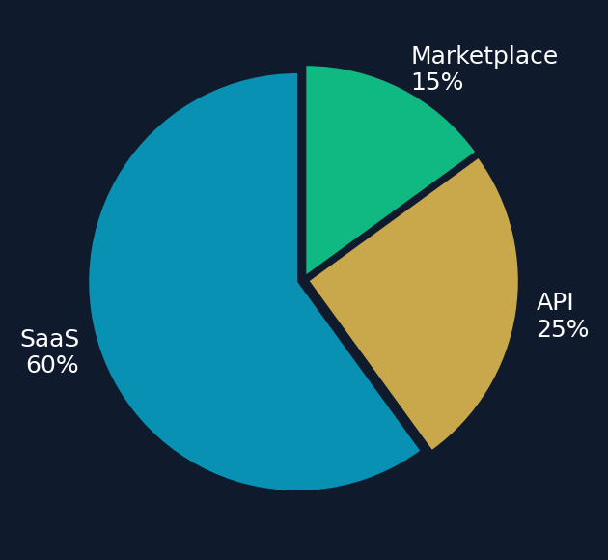
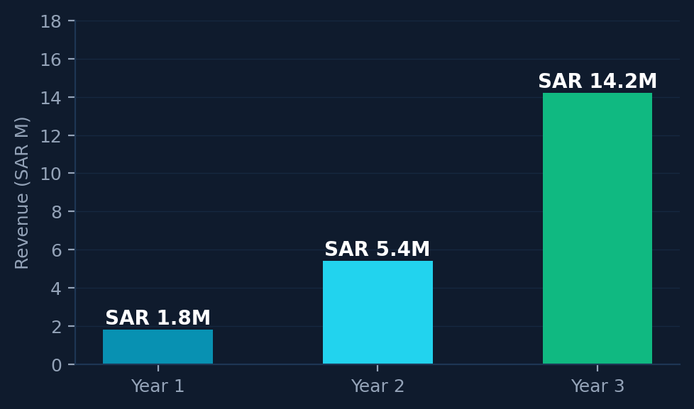
UNIT ECONOMICS · اقتصاديات الوحدة
Strong Fundamentals for Scale
أساسيات قوية للتوسع
CAC
SAR 850
LTV
SAR 14,400
Revenue Breakdown · توزيع الإيرادات
Customer Acquisition Cost
Lifetime Value (24-mo avg)
LTV:CAC
16.9x
Churn
< 5%
Healthy ratio (>3x is good)
Monthly churn target
Payback
1.4 mo
Gross Margin
82%
CAC payback period
SaaS + AI delivery margin
3-Year Revenue Projection · إيرادات 3 سنوات
APEX Financial Intelligence Platform | Jeddah, Saudi Arabia | 2026
13 / 19
APEX
Notes:
Our unit economics are strong. Customer Acquisition Cost is SAR 850, with a Lifetime Value of SAR 14,400 — that's a 16.9x LTV to CAC ratio, well above the 3x benchmark. Monthly churn target under 5%, CAC payback in just 1.4 months, and 82% gross margin typical of SaaS businesses. The revenue breakdown shows 60% SaaS, 25% API, and 15% Marketplace. اقتصاديات الوحدة قوية: نسبة LTV:CAC تبلغ 16.9 ضعف.

Slide 14
TECH STACK · المنظومة التقنية
Built for Scale & Security
مبنية للتوسع والأمان
Backend
FastAPI (Python 3.11) · 30+ REST APIs
واجهة خلفية عالية الأداء
Frontend
Flutter Web + Mobile · 55+ Screens
تطبيق ويب وموبايل
Database
PostgreSQL · Read Replicas Ready
قاعدة بيانات قابلة للتوسع
AI Engine
Knowledge Brain · 11 Modules · Claude AI
عقل معرفي ذكي
Auth
JWT · 11 Roles · Full Audit Logs · bcrypt
أمان متعدد الطبقات
DevOps
Docker · CI/CD · GitHub Actions · Render
نشر مستمر ومؤتمت
30+
REST APIs
11
AI Modules
55+
UI Screens
204
Tests
APEX Financial Intelligence Platform | Jeddah, Saudi Arabia | 2026
14 / 19
APEX
Notes:
Our tech stack is built for scale and security. FastAPI backend with 30+ REST APIs, Flutter for web and mobile with 55+ screens, PostgreSQL with read replica readiness. Our AI engine includes 11 Knowledge Brain modules powered by Claude AI. Authentication uses JWT with 11 roles and full audit logging. CI/CD through GitHub Actions with Docker and deployment on Render. المنظومة التقنية مبنية للتوسع والأمان.

Slide 15
THE TEAM · الفريق
Built by People Who Understand the Market
بُني بأيدي من يفهمون السوق
SA
Shady Apoelela
CTO
CTO (Hiring)
Founder & CEO
Chief Technology Officer
شادي أبو العلا · المؤسس والرئيس التنفيذي
مدير التقنية (توظيف) · المدير التقني
Full-stack architect. Built APEX from zero to 30+ APIs, 55+ screens, and 11 AI modules single-handedly.
Seeking: 10+ years backend/AI experience. Saudi fintech expertise preferred. Equity + competitive salary.
CFO
CFO (Hiring)
GL
Growth Lead (Hiring)
Chief Financial Officer
Head of Growth & Sales
المدير المالي (توظيف) · المدير المالي
قائد النمو (توظيف) · رئيس النمو والمبيعات
Seeking: CPA/CFA with SOCPA knowledge. Startup finance experience. Will lead compliance & investor relations.
Seeking: B2B SaaS growth expert. Saudi market connections. Will drive go-to-market & partnerships.
We're hiring exceptional talent to join our mission · نبحث عن كفاءات استثنائية للانضمام إلى رحلتنا
APEX Financial Intelligence Platform | Jeddah, Saudi Arabia | 2026
15 / 19
APEX
Notes:
I built APEX single-handedly — every line of code, every API endpoint, every UI screen. That demonstrates deep technical capability and commitment. We're now hiring three key roles: a CTO with 10+ years of backend and AI experience, a CFO with CPA/CFA and SOCPA knowledge, and a Growth Lead with B2B SaaS expertise and Saudi market connections. These hires are critical for our next phase. بنيت APEX بمفردي ونبحث الآن عن كفاءات استثنائية.

Slide 16
ROADMAP TO SCALE · خارطة طريق التوسع
From Saudi to the Gulf & Beyond
من السعودية إلى الخليج والعالم
PHASE 1
PHASE 2
PHASE 3
PHASE 4
Now – 3M
3 – 9M
9M+
Year 2+
Stabilize
Scale
Dominate
Expand
التثبيت
التوسع
الهيمنة
التوسع الخليجي
Tests & Bug Fixes
Flutter Optimization
Seed Data & GitHub
Security Hardening
CI/CD & Monitoring
Redis Caching
API Versioning (v1)
Read Replicas
Microservices
Horizontal Scaling
CDN & Edge Cache
SOC 2 Compliance
Gulf Markets (UAE, BH)
Go Core + AI Platform
Multi-Standard Engine
White-Label SaaS
Language decision: FastAPI → 50k users · Go Core → 500k+ users | قرار اللغة: FastAPI حتى 50 ألف ثم Go
APEX Financial Intelligence Platform | Jeddah, Saudi Arabia | 2026
16 / 19
APEX
Notes:
Our roadmap has four phases. Phase 1 — Stabilize — we're here now, focusing on testing, optimization, and security. Phase 2 — Scale — over the next 3-9 months, adding CI/CD, caching, and API versioning. Phase 3 — Dominate — microservices architecture and SOC 2 compliance. Phase 4 — Expand — entering Gulf markets with a multi-standard engine and white-label capabilities. أربع مراحل من السعودية إلى الخليج والعالم.

Slide 17
THE ASK · ما نطلبه
Seed Round: SAR 3.75M
($1M USD Equivalent)
جولة تأسيسية: 3.75 مليون ريال
USE OF FUNDS · توزيع الاستثمار
40%
Engineering & Product
SAR 1.5M
Hire CTO + 3 engineers. Scale infrastructure.
الهندسة والمنتج
30%
Sales & Marketing
SAR 1.12M
Go-to-market team. Digital campaigns. Events.
المبيعات والتسويق
15%
Operations & Legal
SAR 562K
SAMA sandbox. SOC 2. Legal framework.
العمليات والقانونية
15%
Reserve & Contingency
SAR 562K
12-month runway buffer. Opportunity fund.
الاحتياطي
18-mo target: 500 clients · SAR 5.4M ARR · Break-even | الهدف: 500 عميل · 5.4 مليون إيرادات سنوية · نقطة التعادل
APEX Financial Intelligence Platform | Jeddah, Saudi Arabia | 2026
17 / 19
APEX
Notes:
We're raising a SAR 3.75 million seed round — approximately $1 million USD. Allocation: 40% for engineering and product — hiring the CTO and 3 engineers plus infrastructure. 30% for sales and marketing — go-to-market team, digital campaigns, and events. 15% for operations — SAMA sandbox application, SOC 2 certification, legal framework. 15% as reserve. Our 18-month target: 500 clients, SAR 5.4M ARR, break-even. جولة تأسيسية: 3.75 مليون ريال لتوظيف الفريق والتوسع.

Slide 18
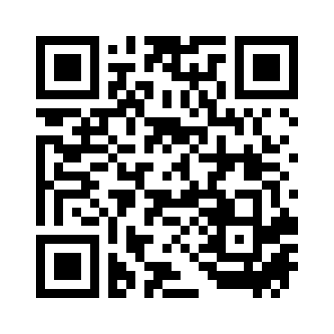
APEX
The Future of Financial Intelligence is Already Built.
مستقبل الذكاء المالي مبنيٌّ بالفعل.
Ready for your first client. · جاهز لأول عميل.
apex-api-ootk.onrender.com
Jeddah, Saudi Arabia
2026 · Ready Now
الموقع الإلكتروني
جدة، المملكة العربية السعودية
جاهز الآن · 2026
Scan to Visit
APEX Financial Intelligence Platform | Jeddah, Saudi Arabia | 2026
18 / 19
APEX
Notes:
The future of financial intelligence is already built. APEX is live, functional, and ready for its first paying clients. We're looking for investors who share our vision of democratizing financial intelligence across the Arab world. Thank you for your time — I'm happy to answer any questions. You can visit our platform or scan the QR code. مستقبل الذكاء المالي مبنيٌّ بالفعل. شكراً لوقتكم.

Slide 19
APPENDIX · الملاحق
Technical Deep Dive & Market Data
تفاصيل تقنية وبيانات السوق — للأسئلة التفصيلية
TAM / SAM / SOM · حجم السوق
TAM
SAR 780B
Total Addressable Market — Saudi SME sector (Vision 2030: 35% GDP)
إجمالي السوق المتاح
SAM
SAR 12B
Serviceable Market — SMEs needing financial intelligence tools
السوق القابل للخدمة
SOM
SAR 120M
Obtainable Market — realistic 3-year capture (1% SAM)
السوق القابل للاستحواذ
ARCHITECTURE OVERVIEW · نظرة معمارية
API Endpoints
30+ RESTful
FastAPI auto-docs, Swagger UI, rate-limited
AI Modules
11 Knowledge Brain
SOCPA, IFRS, ZAKAT, VAT, Labor, Commercial, Tax, Audit, Industry, Compliance, Legal
Test Coverage
204 automated
Integration, unit, auth, admin, health, security, CORS
Auth System
JWT + 11 roles
bcrypt, audit logs, social auth stubs, session management
Database
PostgreSQL + SQLAlchemy
Alembic migrations, read replica ready, KB separate DB
APEX Financial Intelligence Platform | Jeddah, Saudi Arabia | 2026
19 / 19
APEX
Notes:
This appendix slide contains detailed market sizing and technical architecture information for deep-dive questions. TAM of SAR 780B represents the total Saudi SME sector aligned with Vision 2030. SAM of SAR 12B is the slice needing financial intelligence tools. SOM of SAR 120M is our realistic 3-year target at 1% SAM penetration. Architecture details cover our full API suite, 11 AI modules, 204 automated tests, and database infrastructure. ملحق تفصيلي للأسئلة المعمقة حول السوق والتقنية.

