Slide 1




Created by:
Oneț Rareș-Nicolae
Anca Nicolae-Aurelian
Oatu Mihai
Andrei Denis Eric Mihai
Șoltuz Rareș-Florin
UnLockedBV
LifeKit

Slide 2

MOTIVATION
AWARENESS IN PROVIDING FIRST AID
  Only 10% of cardiac arrest victims outside of hospitals receive bystander CPR
  Approximately 1 in 4 people would not attempt CPR due to fear of infection
  2/10 people can provide basic first aid in Romania
  Romania is last place in Europe at knowledge about first aid

Slide 3
MOTIVATION
IMPORTANCE OF FIRST AID
  More than 3 million lives are saved worldwide each year due to effective pre-hospital emergency care
  First aid interventions can reduce the severity of injuries in about 60-70% of cases
  Providing CPR can triple the chances of saving the life of a person in cardiac arrest.

Slide 4

THE CURRENT METHOD
  Long lectures
  Hard to follow for children
  Not efficient
  The distribution

Slide 5

OUR SOLUTION
GAMIFIED APPROACH
ENCOURAGE PRACTICE

Slide 6





WHY IT WORKS?

Slide 7
BUSINESS MODEL
ADS
We will be running ads inside the application and sell ad space.
B2B licensing
By collaborating with the red cross, smurd and other companies we will also be sharing their services and helping them grow.

Slide 8


FUTURE PARTNERS

Slide 9

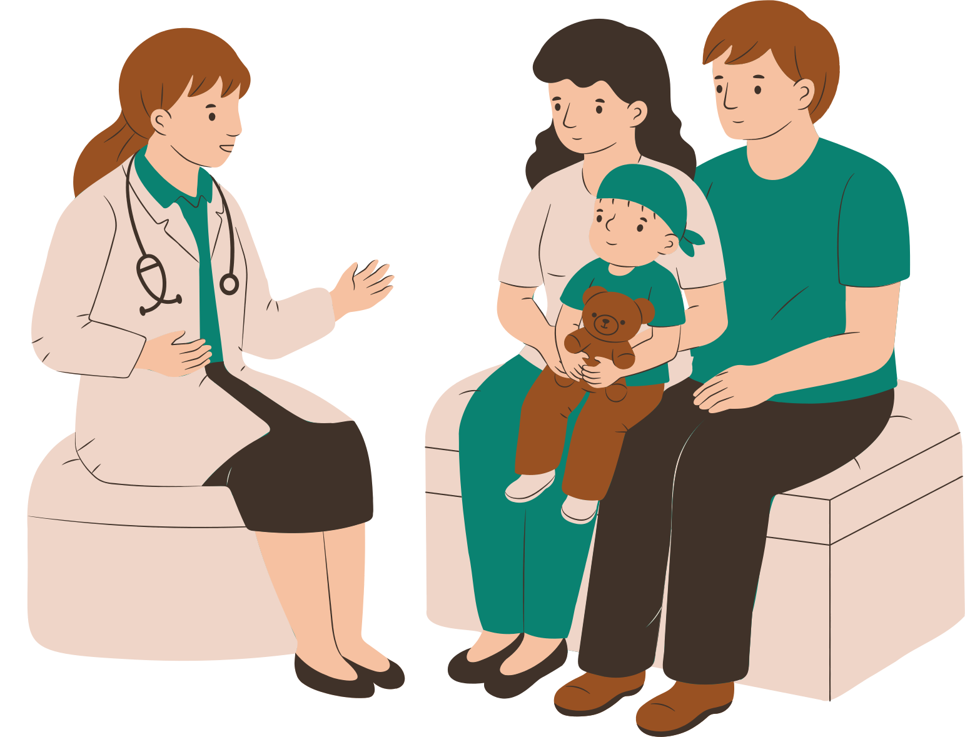
PROMO
B2B
We will have partnerships with schools and colleges and teach students about the importance and impact of first aid
Peer2Peer
People will inevitably talk about it, and the most convincing advertisement is a friend recommending the application.

Slide 10
THANK YOU FOR YOUR ATTENTION

