Slide 1
Introduction to Arduino Uno

Slide 2
Intended Learning Outcomes
At the end of the session, you should be able to:
Identify the parts of Arduino Uno.
Know the components of Arduino Uno.
Learn how to program to read inputs and to produce outputs in response to that input.
Create a simple program

Slide 3
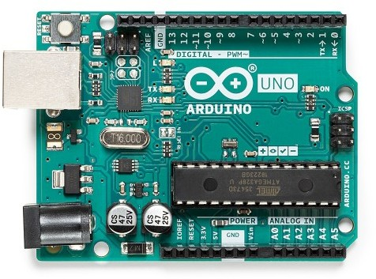
What is Arduino?
Arduino is an open-source electronics platform based on easy-to-use hardware and software.
Arduino boards are able to read inputs - light on a sensor, a finger on a button, or a Twitter message - and turn it into an output - activating a motor, turning on an LED, publishing something online.
You can tell your board what to do by sending a set of instructions to the microcontroller on the board.
To do so you use the Arduino programming language (based on Wiring), and the Arduino Software (IDE), based on Processing.

Slide 4
What is Arduino?
Arduino was born at the Ivrea Interaction Design Institute as an easy tool for fast prototyping, aimed at students without a background in electronics and programming.
As soon as it reached a wider community, the Arduino board started changing to adapt to new needs and challenges, differentiating its offer from simple 8-bit boards to products for IoT applications, wearable, 3D printing, and embedded environments.
All Arduino boards are completely open-source, empowering users to build them independently and eventually adapt them to their particular needs. The software, too, is open-source, and it is growing through the contributions of users worldwide.

Slide 5
Arduino Uno board provides the user with:
6 analog input pins
14 digital I/O pins of which 6 of them can also be used for PWM outputs
a power jack
a USB port
an ICSP header
a reset button
a small LED connected to digital pin 13
16MHz crystal oscillator

Slide 6
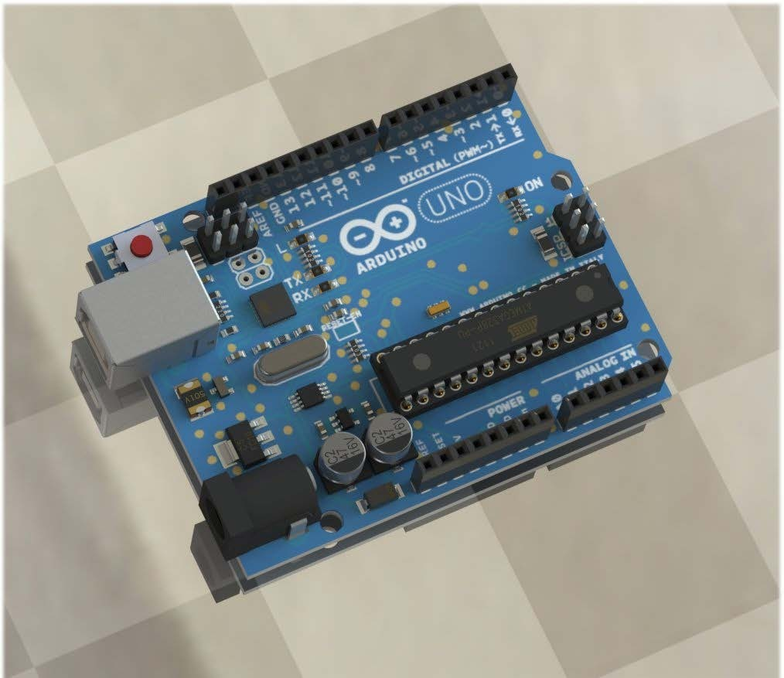
Built-in LED
Digital I/O pins
TX RX LED
Power LED indicator
Reset button
In-circuit serial programming header
USB Jack
USB to serial IC
Atmel ATmega 328
Resettable fuse
16 Mhz Crystal Oscillator
Analog pins
Power pins
3.3 volt low dropout regulator
DC Power Jack

Slide 7
Component Explanations
1. Digital I/O pins – input and output pins (0-13) of which 6 of them (3, 5, 6, 9, 10 and 11) also provide PWM (Pulse Width Modulation) output by using the analogWrite() function. Pins (0 (RX) and 1 (TX)) are also used to transmit and receive serial data.
2. Power LED indicator – LED that lights up when the board is connected to a power source.
3. ICSP Header – pins for “In-Circuit Serial Programming” which is another method of programming.
ATmega328 chip – 8-bit microcontroller that processes the sketch you programmed. This is the soul of the board. It helps the board receive information from users and transmit command signals to devices that are connected to the Arduino board.
Analog input pins – pins (A0-A5) that take-in analog values to be converted to be represented with a number range 0-1023 through an Analog to Digital Converter (ADC).

Slide 8
Component Explanations
6. Power Pins – pins that can be used to supply a circuit with values VIN (voltage from DC Jack), 3.3V and 5V.
DC Power Jack – where the power source (AC-to-DC adapter or battery) should be connected. It is limited to input values between 6-20V but recommended to be around 7-12V.
3.3 volt low dropout regulator - used to derive lower output voltages from a main supply or battery.
16 Mhz Crystal Oscillator (aa·suh·lei·tr) – clock that has a frequency of 16MHz
Resettable fuse - used to protect against overcurrent faults in electronic circuits.

Slide 9
Component Explanations
USB to serial IC - The USB serial converter chip is just a solution to allow PC software to allow application software like the Arduino IDE to talk to a device via a software comm port interface, but using the USB bus to send the data.
USB port/jack – allows the user to connect with a USB cable the board to a PC to upload sketches or provide a voltage supply to the board. This is also used for serial communication through the serial monitor from the Arduino software.
Reset Button – a button that is pressed whenever you need to restart the sketch programmed in the board.
TX RX LED - TX and RX - for Transmit and Receive
Built-in LED – in order to gain access or control of this pin, you have to change the configuration of pin 13 where it is connected to.

Slide 10
Microcontroller
Microcontroller is called a computer on a chip. It has its own memory, CPU, and RAM inbuilt on a single chip. It has pins that can perform digital and analog operations
Basically, a microprocessor is the brain of the computer while a microcontroller is a muscle with brain and it can perform many tasks on its own (standalone).
The microcontroller has a solid state memory which can be programmed as many times as you need to perform the function with the pins ,they are called General Purpose Input Output pins or GPIO pins
They are available with various architectures such as 8bit ,16bit,32bit, and 64 bit

Slide 11
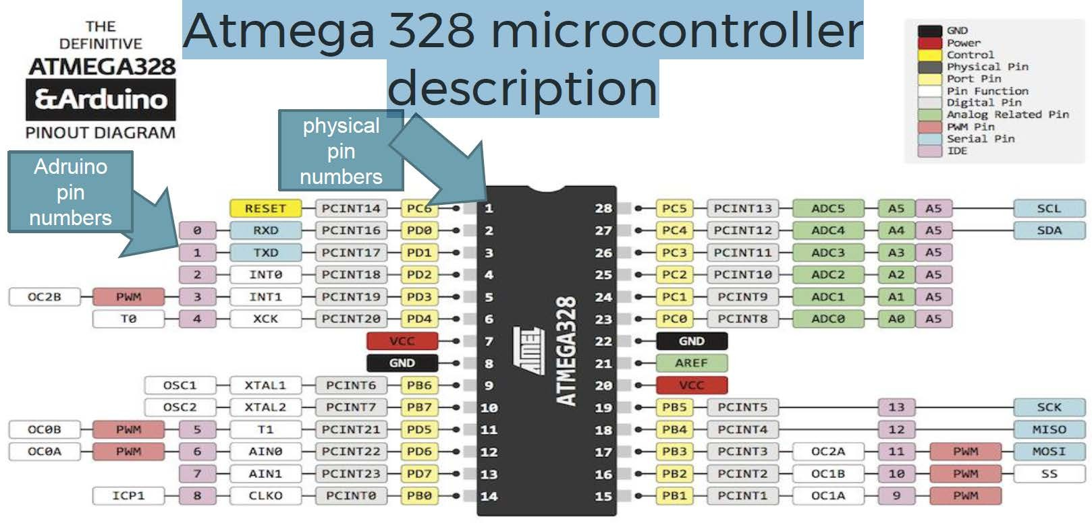

Slide 12
Arduino software for the beginners

Slide 13
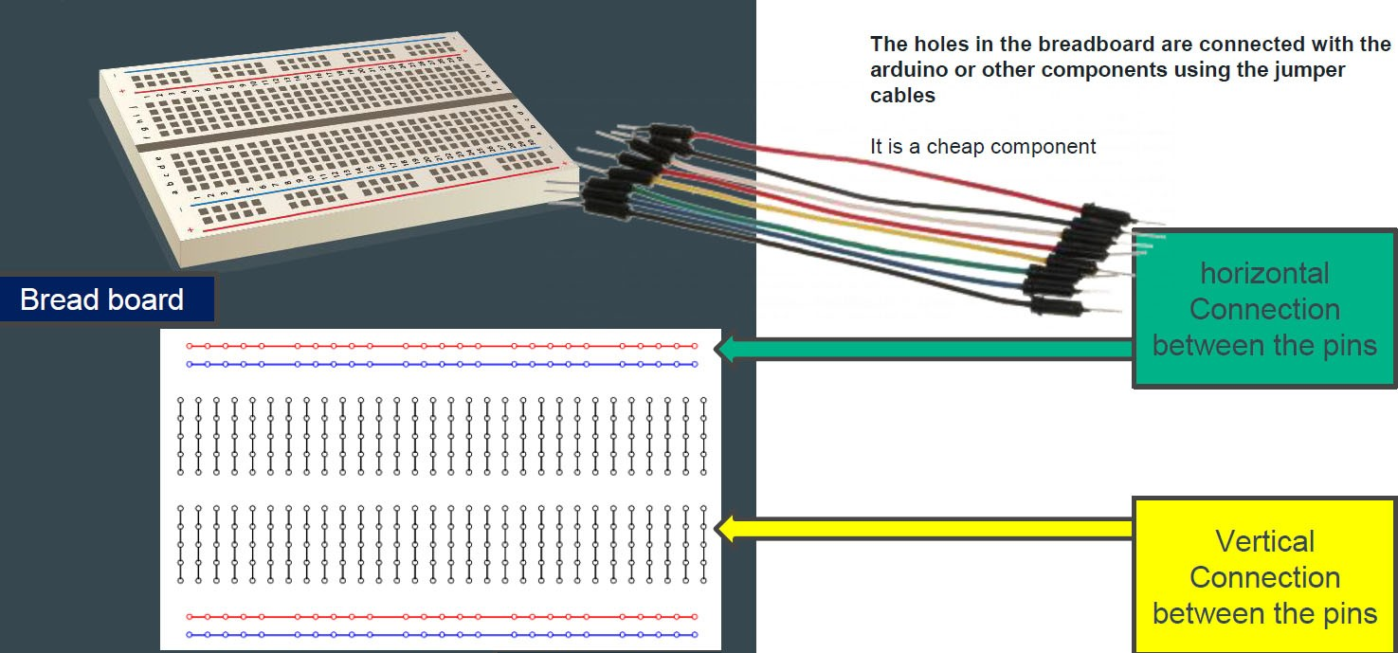
Arduino Uno and breadboard wiring
The breadboard is a type of prototyping tool that is used for temporary connections of electronic components.
It is the cheapest and most easy way to connect the components

Slide 14
Let's get started with programming
The program to run the Arduino board is written in Arduino programming language.
It has a simple syntax of mainly three steps
Declare the pin to use
Set it input or output
Select its use
And put it for continuous use in the void loop and for single-use in void setup
Check out: http://arduino.cc/en/Guide/HomePage (Links to an external site.)
Download & install the Arduino environment (IDE)
Connect the board to your computer via the USB cable
If needed, install the drivers
Launch the Arduino IDE
Select your board
Select your serial port
Open the blink example
Upload the program

Slide 15
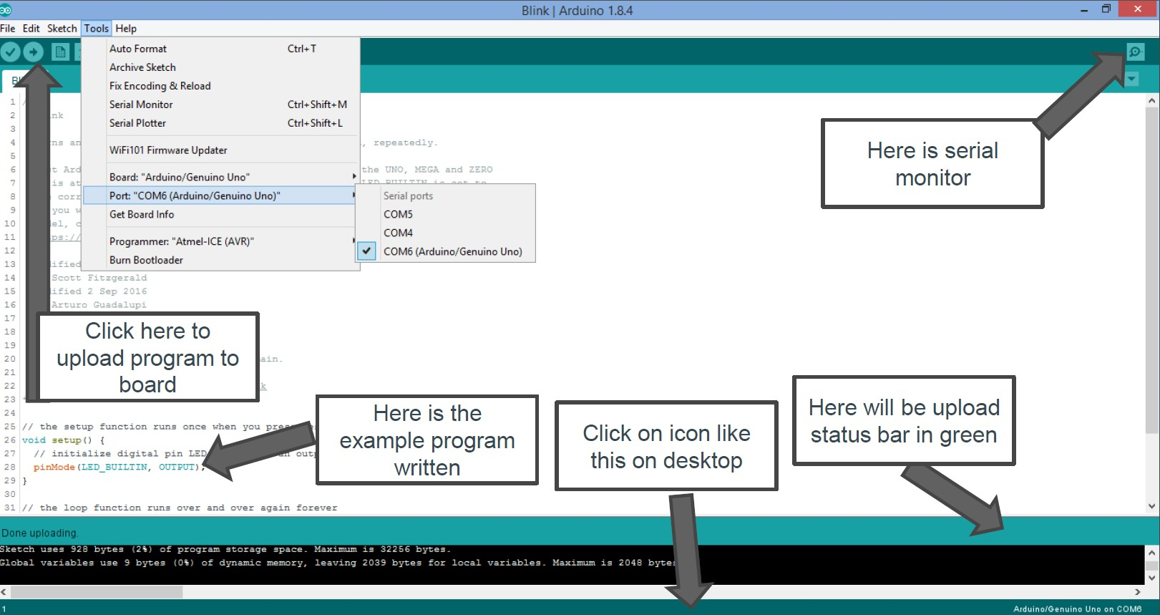
Arduino Environment

Slide 16
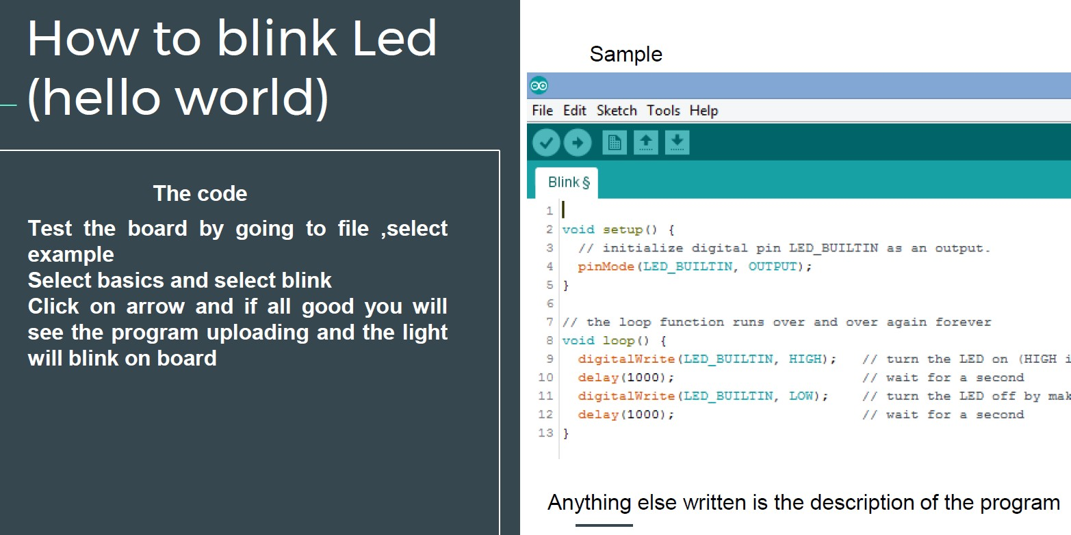

Slide 17
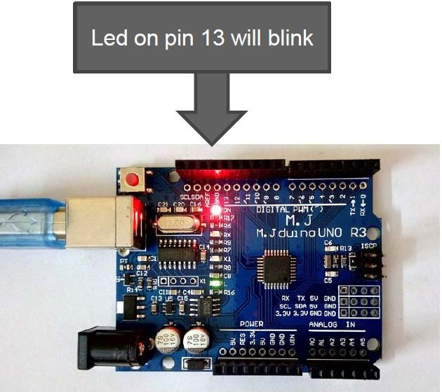
Output
Code meaning
The code is a three-step program
Define the pin in void setup
Set it output
In the void, loop set the pin to digital write = high and wait for 1 second
Digital write = low
Wait for 1 second
Run this in the loop

Slide 18
Programming

Slide 19
setup()
The setup() function is called when a sketch starts. Use it to initialize variables, pin modes, start using libraries, etc. The setup() function will only run once, after each powerup or reset of the Arduino board.
Example Code int buttonPin = 3;
void setup() { Serial.begin(9600); pinMode(buttonPin, INPUT);
}
void loop() {
// ...
}

Slide 20
loop()
After creating a setup() function, which initializes and sets the initial values, the loop() function does precisely what its name suggests, and loops consecutively, allowing your program to change and respond. Use it to actively control the Arduino board.
Example Code int buttonPin = 3;
// setup initializes serial and the button pin void setup() {
Serial.begin(9600); pinMode(buttonPin, INPUT);
}
// loop checks the button pin each time,
// and will send serial if it is pressed void loop() {
if (digitalRead(buttonPin) == HIGH) { Serial.write('H');
}
else { Serial.write('L');
}
delay(1000);
}

Slide 21
digitalWrite()
Write a HIGH or a LOW value to a digital pin.
If the pin has been configured as an OUTPUT with pinMode(), its voltage will be set to the corresponding value: 5V (or 3.3V on 3.3V boards) for HIGH, 0V (ground) for LOW.
Syntax digitalWrite(pin, value)

Slide 22
Example Code (digitalWrite())
The code makes the digital pin 13 an OUTPUT and toggles it by alternating between HIGH and LOW at one second pace.
void setup() { pinMode(13, OUTPUT);
}
// sets the digital pin 13 as output
void loop() {
digitalWrite(13, HIGH); // sets the digital pin 13 on delay(1000); // waits for a second digitalWrite(13, LOW); // sets the digital pin 13 off delay(1000); // waits for a second
}

Slide 23
digitalRead()
Reads the value from a specified digital pin, either HIGH or LOW.
Syntax digitalRead(pin)
Parameters
pin: the Arduino pin number you want to read
Returns HIGH or LOW

Slide 24
Example Code (digitalRead())
Sets pin 13 to the same value as pin 7, declared as an input.
int ledPin = 13; // LED connected to digital pin 13
int inPin = 7; // pushbutton connected to digital pin 7 int val = 0; // variable to store the read value
void setup() {
pinMode(ledPin, OUTPUT); // sets the digital pin 13 as output pinMode(inPin, INPUT); // sets the digital pin 7 as input
}
void loop() {
val = digitalRead(inPin); // read the input pin digitalWrite(ledPin, val); // sets the LED to the button's value
}

Slide 25
analogRead()
Reads the value from the specified analog pin. Arduino boards contain a multichannel, 10-bit analog to digital converter. This means that it will map input voltages between 0 and the operating voltage(5V or 3.3V) into integer values between 0 and 1023.
On an Arduino UNO, for example, this yields a resolution between readings of: 5 volts / 1024 units or, 0.0049 volts (4.9 mV) per unit.
Syntax analogRead(pin)
Parameters
pin: the name of the analog input pin to read from (A0 to A5 on most boards, A0 to A6 on MKR boards, A0 to A7 on the Mini and Nano, A0 to A15 on the Mega).
Returns
The analog reading on the pin. Although it is limited to the resolution of the analog to digital converter (0-1023 for 10 bits or 0-4095 for 12 bits). Data type: int.

Slide 26
analogWrite()
Writes an analog value (PWM wave) to a pin. Can be used to light a LED at varying brightnesses or drive a motor at various speeds. After a call to analogWrite(), the pin will generate a steady rectangular wave of the specified duty cycle until the next call to analogWrite() (or a call to digitalRead() or digitalWrite()) on the same pin.
Syntax analogWrite(pin, value)
Parameters
pin: the Arduino pin to write to. Allowed data types: int.
value: the duty cycle: between 0 (always off) and 255 (always on). Allowed data types: int.
Example Code
Sets the output to the LED proportional to the value read from the potentiometer.
int ledPin = 9; // LED connected to digital pin 9
int analogPin = 3; // potentiometer connected to analog pin 3 int val = 0; // variable to store the read value
void setup() {
pinMode(ledPin, OUTPUT); // sets the pin as output
}
void loop() {
val = analogRead(analogPin); // read the input pin
analogWrite(ledPin, val / 4); // analogRead values go from 0 to 1023, analogWrite values from 0 to 255
}

Slide 27
Variables
A variable is a place to store a piece of data. It has a name, a value, and a type. For example, this statement (called a declaration):
int pin = 13;
creates a variable whose name is pin, whose value is 13, and whose type is int. Later on in the program, you can refer to this variable by its name, at which point its value will be looked up and used. For example, in this statement:
pinMode(pin, OUTPUT);
it is the value of pin (13) that will be passed to the pinMode() function. In this case, you don't actually need to use a variable, this statement would work just as well:
pinMode(13, OUTPUT);

Slide 28
Variable Scope
It refers to the part of your program in which the variable can be used. This is determined by where you declare it. For example, if you want to be able to use a variable anywhere in your program, you can declare at the top of your code. This is called a global variable; here's an example:
int pin = 13; void setup()
{
pinMode(pin, OUTPUT);
}
void loop()
{
digitalWrite(pin, HIGH);
}
As you can see, pin is used in both the setup() and loop() functions. Both functions are referring to the same variable, so that changing it one will affect the value

Slide 29
Variable Scope
int pin = 13; void setup()
{
pin = 12;
pinMode(pin, OUTPUT);
}
void loop()
{
digitalWrite(pin, HIGH);
}
Here, the digitalWrite() function called from loop() will be passed a value of 12, since that's the value that was assigned to the variable in the setup() function.

Slide 30
Variable Scope
If you only need to use a variable in a single function, you can declare it there, in which case its scope will be limited to that function. For example:
void setup()
{
int pin = 13; pinMode(pin, OUTPUT); digitalWrite(pin, HIGH);
}
In this case, the variable pin can only be used inside the setup() function. If you try to do something like this:
void loop()
{
digitalWrite(pin, LOW); // wrong: pin is not in scope here.
}

