Slide 1
Experiment No. 4
Problem Definition: To display the temperature sensor output from ADC 0809 on the LCD

Slide 2
Objectives of the Experiment:
To demonstrate the interfacing of ADC 0809 and Temperature Sensor LM335 with 8051 Microcontroller.
To develop an 8051 ‘C’ code to display the ADC output on LCD

Slide 3
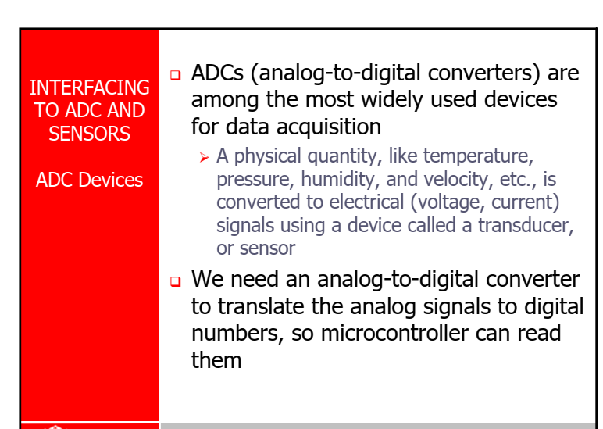
INTRODUCTION TO ADCs

Slide 4
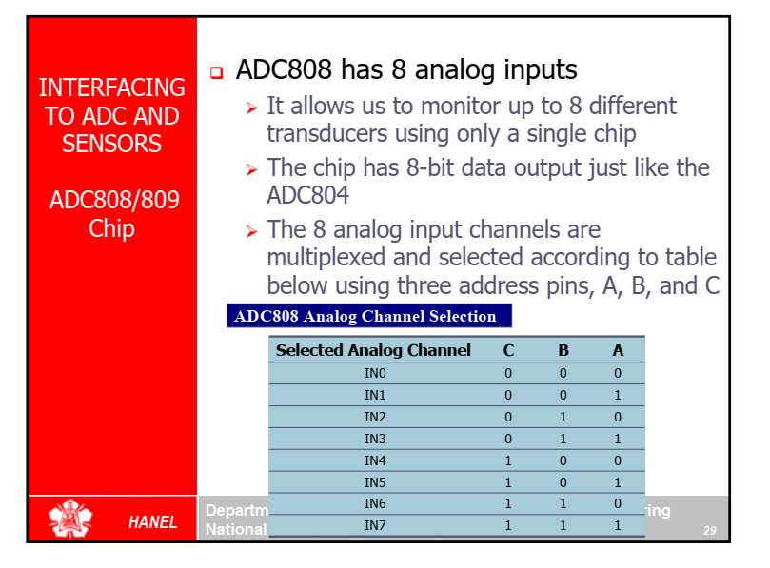
ADC 0808/09

Slide 5
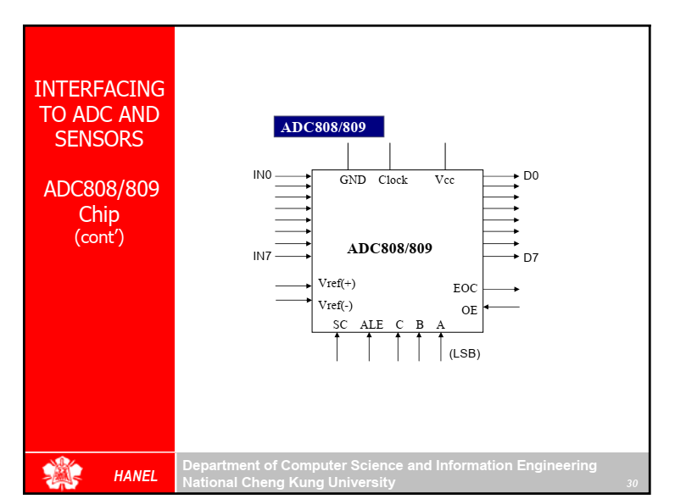
ADC 0808/09

Slide 6
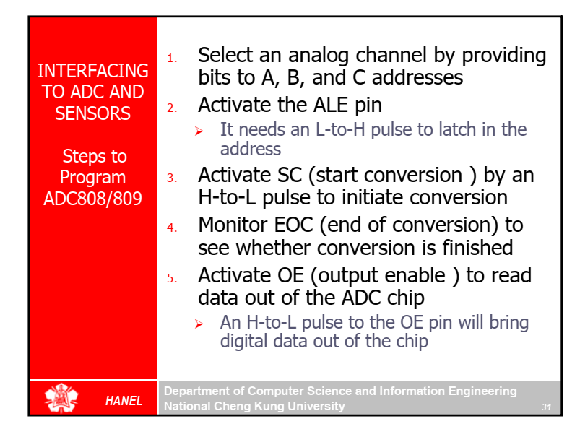
STEPS TO PROGRAM THE ADC 0808/09

Slide 7
Temperature Sensor –LM335
LM335 series are precision, easily-calibrated, integrated circuit temperature sensors.
Operating as a 2-terminal Zener, the LM335 has a breakdown voltage directly proportional to absolute temperature at 10 mV/°K. With less than 1 Ω dynamic impedance, the device operates over a current range of 400 µA to 5 mA with virtually no change in performance. When calibrated at 25°C, the LM335 has typically less than 1°C error over a 100°C temperature range. Unlike other sensors, the LM335 has a linear output.
Applications for the LM335 include almost any type of temperature sensing over a -40°C to +100°C temperature range. The low impedance and linear output make interfacing to readout or control circuitry are especially easy.

Slide 8
Temperature Sensor –LM335 Features
Directly calibrated to the Kelvin temperature scale
1°C initial accuracy available
Operates from 400 µA to 5 mA
Less than 1 Ω dynamic impedance
Easily calibrated
Wide operating temperature range
200°C over-range
Low cost

Slide 9
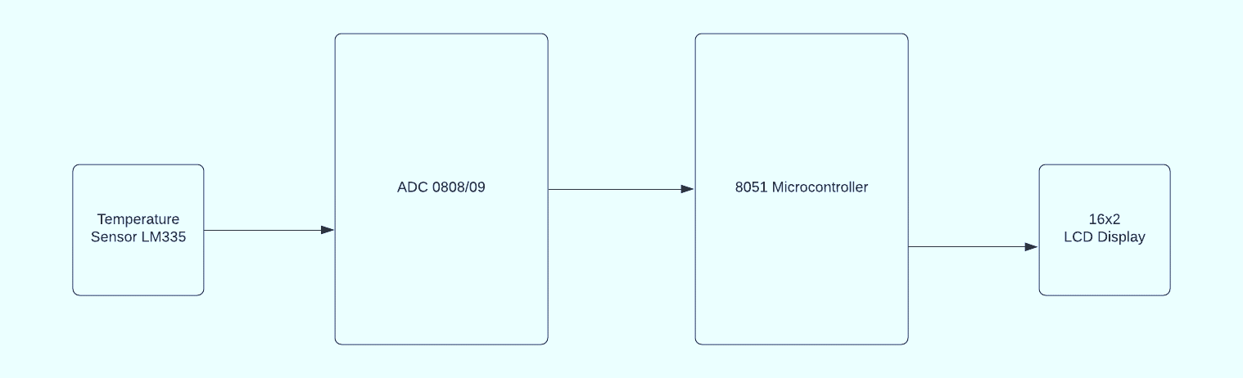
Interfacing block diagram

Slide 10
Connection Details
CN1- CN14
CN2- CN13
CN3- CN6

Slide 11
Course Learning Outcomes
At the end of the session, students should be able to
Interface ADC 0809 and Temperature sensor LM 335 with 8051 Microcontroller.
Develop an Embedded ‘C’ program to read temperature from the sensor LM 335, send it to ADC and display the converted data on LCD of 8051 Microcontroller

