Slide 1
Experiment No. 2
Problem Definition: To Illustrate the concept of DAC(0800) interface by generating different types of waveforms like Square/Rectangular, Triangular, Staircase and Sine wave.

Slide 2
Objectives of the Experiment:
To Interface DAC 0800 to 8051 Microcontroller.
To develop an 8051 ‘C’ code to generate different waveforms.
To use and generate time delays.

Slide 3
Theoretical Background of the Experiment
DAC 0800 is a 8-bit high speed current output digital to analog converter.
DAC 0800 is used to convert the digital data into analog signal.
Digital data from any port is given to DAC input.

Slide 4
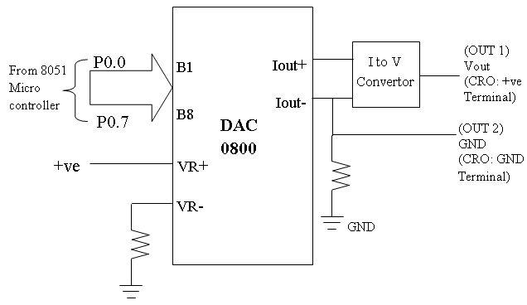
Interfacing Block Diagram

Slide 5
Algorithm to generate square wave
STEP 1: INCLUDE HEADER FILE “at89c51ed2.h”
STEP 2: FUNCTION DECALARATION OF DELAY ROUTINE.
STEP 3: BEGIN MAIN
STEP 4: SEND THE VALUE 0X00 ON PORT 0
STEP 5: CALL DELAY
STEP 6: SEND THE VALUE 0XFF ON PORT 0
STEP 7: CALL DELAY
STEP 8: REPEAT STEPS 4 TO 7 FOREVER
STEP 9: END MAIN
STEP 10: DELAY ROUTINE: DECLARE VARIABLES
STEP 11: INITIALIZE FOR LOOP TO INCLUDE CERTAIN DELAY
STEP 12: END DELAY ROUTINE.

Slide 6
Code For Square wave
#include “at89c5ed2.h”
void delay(void);
void main ()
{
while(1)
{
P0 = 0x00; // program outputs 0 and 0xff alternatively to port P0 with a delay delay();
P0 = 0xff;
delay();
}
}
void delay(void) // function to generate delay
{
int i;
for(i=0;i<=300;i++);
}
.

Slide 7
Algorithm to generate Staircase wave
STEP 1: INCLUDE HEADER FILE “at89c51ed2.h”
STEP 2: DECLARE VARIABLES
STEP 3: BEGIN MAIN
STEP 4: INITIALIZE FOR LOOP; for (i=0;i<255;i+50) FOR STEP SIZE OF 50
ON Y-AXIS
STEP 5: SEND THE VALUES 0 TO 255 ON PORT 0
STEP 6: INITIALIZE FOR LOOP TO INCLUDE CERTAIN DELAY
STEP 7: SEND i+30 ON PORT 0 TO INCLUDE INCREMENT OF 30 ON X-
AXIS.
STEP 8: END MAIN.

Slide 8
Code for Staircase wave
#include “at89c51ed2.h”
unsigned int i, j;
void main ()
{
while(1)
{
for(i=0;i<=255;i=i+50)
{
P0=i;
for(j=0;j<100;j++)
{
}
P0=i+30;
}
}
}

Slide 9
Algorithm to generate Triangular wave
STEP 1: INCLUDE HEADER FILE “at89c51ed2.h”
STEP 2: DECLARE THE VARIABLE COUNT
STEP 3: BEGIN MAIN
STEP 4: INITIALIZE FOR LOOP TO COUNT FROM 0 TO 255;
for (count=0; count! =0xff; count++)
STEP 5: SEND COUNT ON PORT 0
STEP 6: INITIALIZE FOR LOOP TO COUNT FROM 255 TO 0;
for (count=0xff; count! =0; count--)
STEP 7: SEND COUNT ON PORT 0
STEP 8: REPEAT STEPS 4 TO 7 FOREVER.
STEP 9: END MAIN

Slide 10
Code For Triangular wave
#include “at89c51ed2.h
unsigned char count;
void main ()
{
while(1)
{
for(count=0;count!=0xff;count++)
{ P0=count;
}
for(count=0xff; count>0;count--)
{
P0=count;
}
}
}

Slide 11
Algorithm to generate Sine wave
STEP 1: INCLUDE HEADER FILE “at89c51ed2.h”
STEP 2: DECLARE THE EXTERNAL RAM ARRAY VALUES. ɵ=7.2 DEGREES. 50
VALUES ARE DECLARED IN AN ARRAY.
STEP 3: DECLARE INDEX VARIABLE
STEP 4: BEGIN MAIN
STEP 5: INITIALIZE FOR LOOP for (count=0; count<49; count++)
STEP 6: SEND ARRAY VALUES ON PORT 0
STEP 7: REPEAT STEPS 5 TO 6 FOREVER
STEP 8: END MAIN

Slide 12
Code For Sine wave
#include “at89c51xd2.h>
xdata unsigned char sine_tab[49]=
{ 0x80,0x90,0xA1,0xB1,0xC0,0xCD,0xDA,0xE5,0xEE,0xF6,0xFB,0xFE,
0xFF,0xFE,0xFB,0xF6,0xEE,0xE5,0xDA,0xCD,0xC0,0xB1,0xA1,0x90,
0x80,0x70,0x5F,0x4F,0x40,0x33,0x26,0x1B,0x12,0x0A,0x05,0x02,
0x00,0x02,0x05,0x0A,0x12,0x1B,0x26,0x33,0x40,0x4F,0x5F,0x70,0x80};
unsigned int count; // index variable for loop count
void main ()
{
while(1)
{
for(count=0;count<49;count++)
{
P0 = sine_tab[count];
}
}
}

Slide 13
CONNECTION DETAILS
PORT 0 TO CN15.

Slide 14
Learning Outcomes of the Experiment
At the end of the session, students should be able to :
Write the 8051 ‘C’ program to generate various waveforms and understand how to create and use time delays .

