Slide 1
IMPLEMENTING IPC USING PIPES AND MESSAGE QUEUES
Prepared by
Dr. Sharada M. Kori
Associate Professor, Department of Computer Science & Engineering, KLS GIT, Belagavi

Slide 2
Inter-Process Communication (IPC)
Process: Program in execution.
A process can be of two types:
Independent process.
Co-operating process.
An independent process is not affected by the execution of other processes while a co-operating process can be affected by other executing processes.
Processes can communicate with each other through:
Shared Memory
Message passing

Slide 3
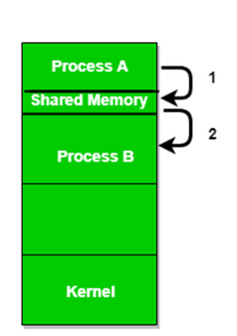
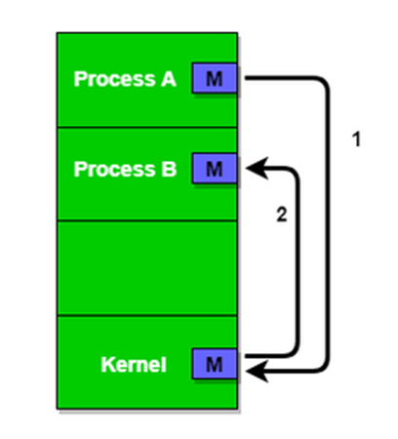
Shared Memory and Message Passing
Shared Memory
Message Passing

Slide 4
Example of IPC Systems
POSIX: Shared Memory
Mach: Message Passing
Windows XP: Message Passing

Slide 5
Methods in Inter-process Communication
Inter-process communication (IPC) is set of interfaces, which is usually programmed in order for the programs to communicate between series of processes.
This allows running programs concurrently in an Operating System.
These are the methods in IPC:
Pipes (Same Process) – This allows flow of data in one direction only. Analogous to simplex systems (Keyboard). Data from the output is usually buffered until input process receives it which must have a common origin.
Message Queuing – This allows messages to be passed between processes using either a single queue or several message queue. This is managed by system kernel these messages are coordinated using an API.
Sockets – This method is mostly used to communicate over a network between a client and a server. It allows for a standard connection which is computer and OS independent.

Slide 6
Prerequisites: Write system call
#include<unistd.h>
int main()
{
//syntax: ssize_t write(int fd, const void *buf, size_t count);
write(1,"Hello",5); // prints Hello on Monitor
}

Slide 7
Prerequisites: Read system call
#include<unistd.h>
int main()
{
//syntax: ssize_t read(int fd, const void *buf, size_t count);
char b[30]; // buffer size 30 characters
read(0,b,10); // reads 10 characters from the buffer b
write(1,b,10); // read content displayed on monitor
}

Slide 8
Prerequisites: Creating child process using fork
fork() creates a new process by duplicating the calling process.
The new process is referred to as the child process.
The calling process is referred to as parent process.
The child process and the parent process run in separate memory space.
At the time of fork() both memory spaces have the same content.
Memory writes, file mappings and un-mappings performed by one of the processes do not affect the other.
The child process is an exact duplicate of the parent process except for the following points:
The child has its own unique process ID.
This process ID does not match the ID of any existing process group or session.
fork(): q= fork(); return three possible values
< 0; error
=0; child process
>0; parent process

Slide 9
Inter-Process Communication using pipe() function
Syntax:
#include<unistd.h>
int pipe(int fd[2]);
Pipe: creates a unidirectional pipe(data channel) for the communication between two processes.
Pipe uses two file descriptors:
Writing end –fd[1]
Reading end- fd[0]

Slide 10
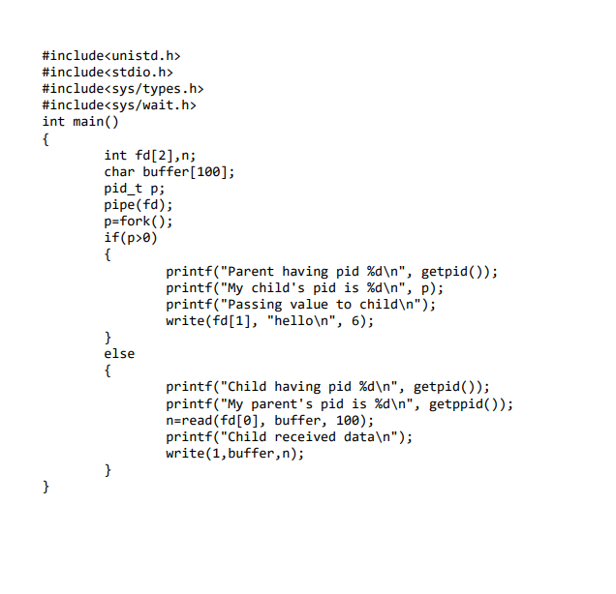
Program:

Slide 11
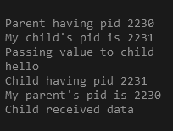
Output

Slide 12
IPC using message queue
This allows messages to be passed between processes using either a single queue or several message queue.
This is managed by system kernel. These messages are coordinated using an API.
Functions used:
msgget(): to create a message queue.
msgsnd(): to add message to message queue.
msgrcv(): to retrieve message from message queue.
msgctl(): to delete the message.

Slide 13
Steps
Program1: the sender
Create the message queue.
Add data to the message queue.
Program2: the receiver
Retrieve data from message queue.
Delete the message queue.

Slide 14
The msgsnd() and msgrcv() system calls are used, respectively, to send messages to, and receive messages from, a message queue. The calling process must have write permission on the message queue in order to send a message, and read permission to receive a message.
The msgp argument is a pointer to caller-defined structure of the following general form:
struct msgbuf
{
long mtype; /* message type, must be > 0 */
char mtext[1]; /* message data */
};
The mtext field is an array (or other structure) whose size is specified by msgsz, a nonnegative integer value. Messages of zero length (i.e., no mtext field) are permitted. The mtype field must have a strictly positive integer value. This value can be used by the receiving process for message selection.

Slide 15
Prerequisites: msgsnd()
int msgsnd(int msqid, const void *msgp, size_t msgsz, int msgflg);
The msgsnd() system call appends a copy of the message pointed to by msgp to the message queue whose identifier is specified by msqid.

Slide 16
Prerequisites: msgrcv()
ssize_t msgrcv(int msqid, void *msgp, size_t msgsz, long msgtyp,int msgflg);
The msgrcv() system call removes a message from the queue specified by msqid and places it in the buffer pointed to by msgp.

Slide 17
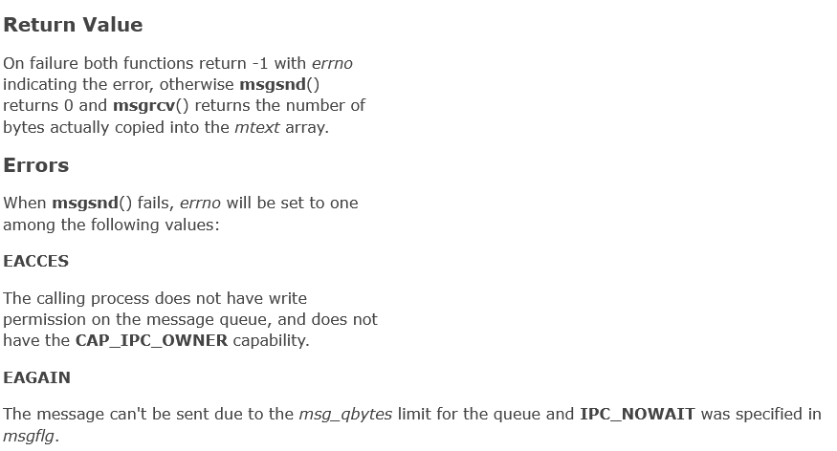

Slide 18
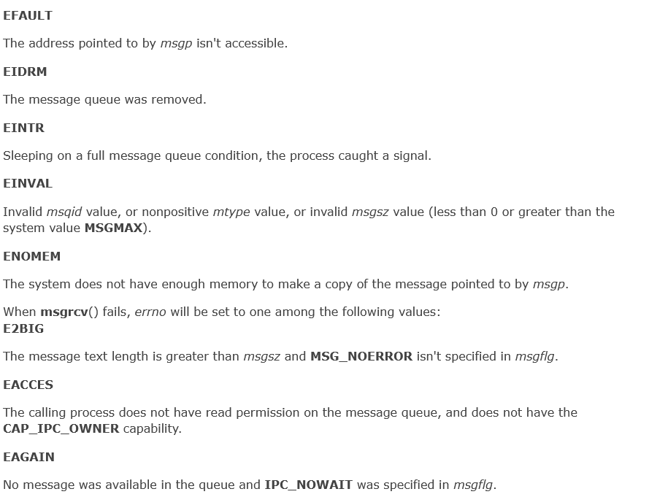

Slide 19
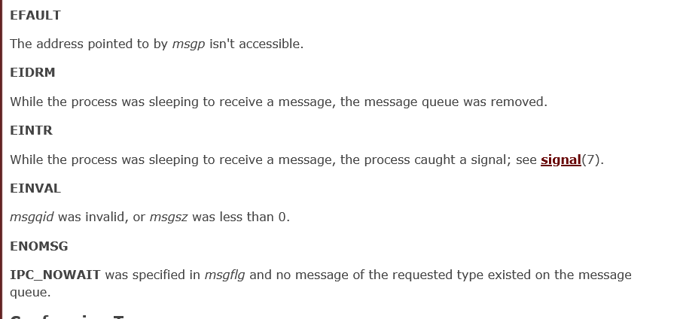

Slide 20
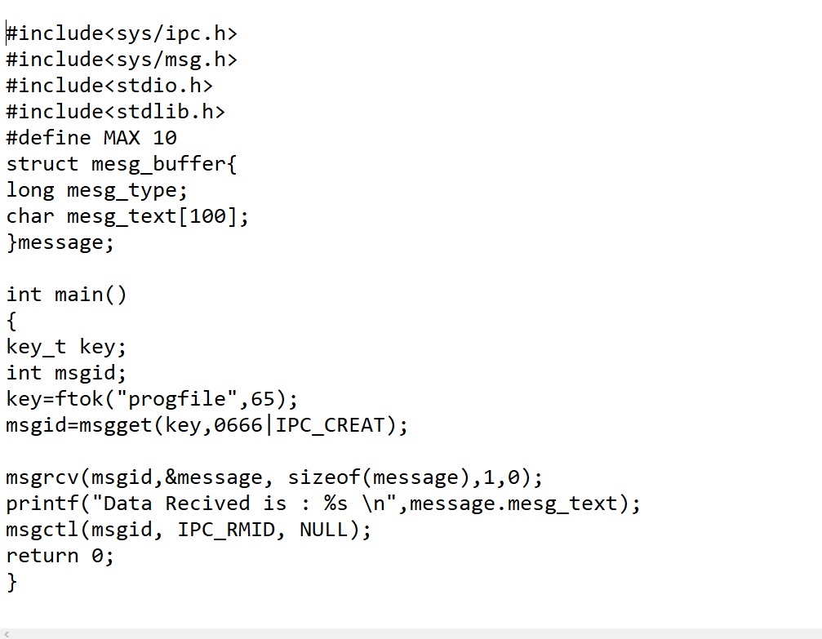
Sender

Slide 21
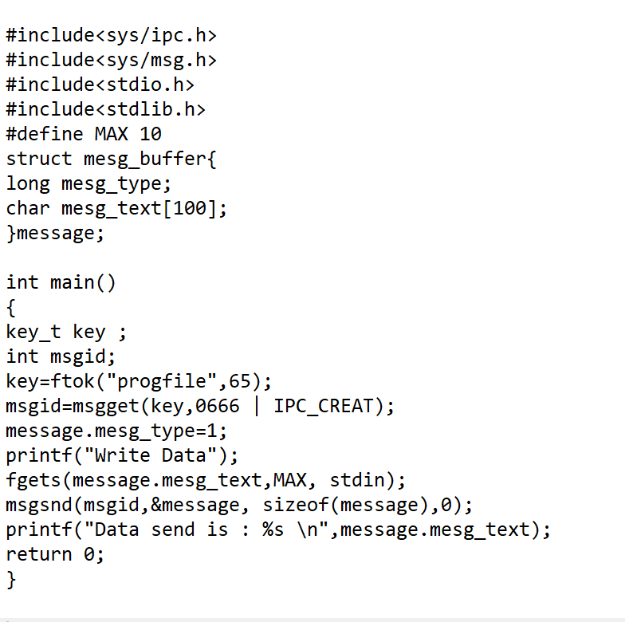
Receiver

Slide 22
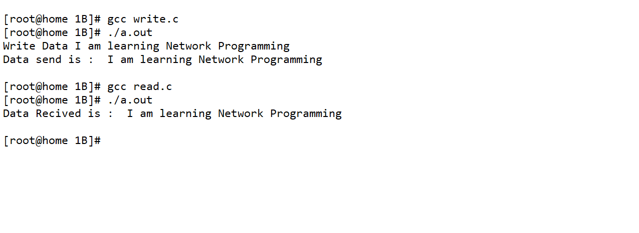
Output

Slide 23
Learning outcomes
At the end of the session students will be able to:
Understand the concept of IPC.
Implementing IPC using pipe and message queue.

Slide 24
References
W. Richard Stevens, Bill Fenner, Andrew M. Rodoff: “UNIX Network Programming”. Volume 1, Third Edition, Pearson 2004.
Barry Nance: “Network Programming in C”, PHI 2002 3.Bob Quinn, Dave Shute: “Windows Socket Network Programming”, Pearson 2003.
Richard Stevens: “UNIX Network Programming”. Volume 2, Second Edition.
James F Kurose and Keith W Ross, Computer Networking, A Top-Down Approach, Sixth edition, Pearson,2017

