Slide 1
Implementing client server communication using socket programming that uses connection oriented protocol at transport layer.
Prepared by
Dr. Sharada M. Kori
Associate Professor, Department of Computer Science & Engineering, KLS GIT, Belagavi

Slide 2
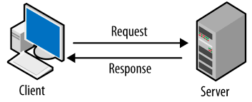
Client- Server Communication
Clients and servers exchange messages in a request response messaging pattern.
The client sends a request, and the server returns a response.
This exchange of messages is an example of inter-process communication.

Slide 3
Client server architecture examples
Mail servers: Email servers are used for sending and receiving emails. There are different software that allow email handling.
File servers: File servers act as a centralized location for files.
One of the daily life examples to understand this is the files that we store in Google Docs.
The cloud services for Microsoft Office and Google Docs can be accessed from your devices; the files that you save from your computer, can be accessed from your phone.
So, the centrally stored files can be accessed by multiple users.
Web servers: Web servers are high-performance computers that host different websites. The server site data is requested by the client through high-speed internet.

Slide 4
What is socket programming?
Socket programming is a way of connecting two nodes on a network to communicate with each other.
One socket(node) listens on a particular port at an IP, while other socket reaches out to the other to form a connection.
Server forms the listener socket while client reaches out to the server

Slide 5
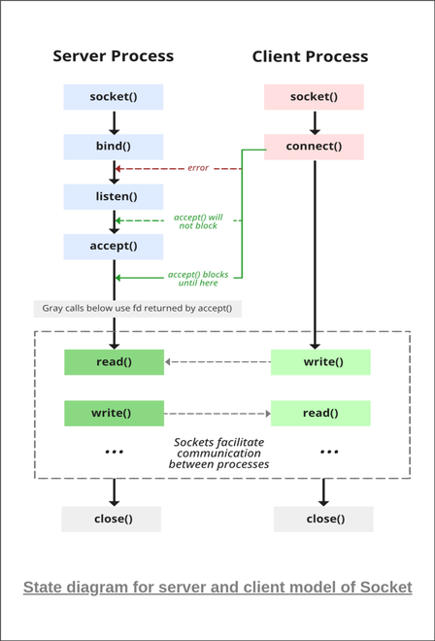

Slide 6
Stages for server
1. Socket creation:
int sockfd = socket(domain, type, protocol)
sockfd: socket descriptor, an integer (like a file-handle)
domain: integer, specifies communication domain.
We use AF_ LOCAL as defined in the POSIX standard for communication between processes on the same host.
For communicating between processes on different hosts connected by IPV4, we use AF_INET and AF_INET 6 for processes connected by IPV6.

Slide 7
Stages for server
Type: communication type
SOCK_STREAM: TCP(reliable, connection oriented)
SOCK_DGRAM: UDP(unreliable, connectionless)
protocol: Protocol value for Internet Protocol(IP), which is 0.
This is the same number which appears on protocol field in the IP header of a packet. (man protocols for more details)

Slide 8
Stages for server
2. Setsockopt: This helps in manipulating options for the socket referred by the file descriptor sockfd.
This is completely optional, but it helps in reuse of address and port.
Prevents error such as: <address already in use= int setsockopt(int sockfd, int level, int optname,const void *optval, socklen_t optlen);
3. Bind:
int bind(int sockfd, const struct sockaddr *addr, socklen_t addrlen);
After creation of the socket, bind function binds the socket to the address and port number specified in addr(custom data structure).
In the example code, we bind the server to the local host, hence we use INADDR_ANY to specify the IP address.

Slide 9
Stages for server
4. Listen:
int listen(int sockfd, int backlog);
It puts the server socket in a passive mode, where it waits for the client to approach the server to make a connection.
The backlog, defines the maximum length to which the queue of pending connections for sockfd may grow.
If a connection request arrives when the queue is full, the client may receive an error with an indication of ECONNREFUSED.

Slide 10
Stages for server
5. Accept:
int new_socket= accept(int sockfd, struct sockaddr *addr, socklen_t *addrlen);
It extracts the first connection request on the queue of pending connections for the listening
socket, sockfd, creates a new connected socket, and returns a new file descriptor referring to
that socket. At this point, connection is established between client and server, and they are
ready to transfer data.

Slide 11
Stages for Client
Socket connection: Exactly same as that of server’s socket creation.
Connect: The connect() system call connects the socket referred to by the file descriptor sockfd to the address specified by addr. Server’s address and port is specified in addr.
int connect(int sockfd, const struct sockaddr *addr, socklen_t addrlen);

Slide 12
TCP
If we are creating a connection between client and server using TCP then it has few functionality like, TCP is suited for applications that require high reliability, and transmission time is relatively less critical.
It is used by other protocols like HTTP, HTTPs, FTP, SMTP, Telnet. TCP rearranges data packets in the order specified.
There is absolute guarantee that the data transferred remains intact and arrives in the same order in which it was sent.
TCP does Flow Control and requires three packets to set up a socket connection, before any user data can be sent.
TCP handles reliability and congestion control.
It also does error checking and error recovery. Erroneous packets are retransmitted from the source to the destination.

Slide 13
Algorithm: Server
1.Start
2.Create a socket
3.If socket creation failed
Write Error Message
Goto 11
4.Assign IP and Port
5.Bind the created socket to IP
6.If socket bind fails
Write error message
Goto 11
7.Accept the data packet from client
8.If accept fails
Write Error
Goto 11

Slide 14
Algorithm: Server
9.While True:
Read the message from client and copy it in buffer Write buffer which contains the client contents Copy server message in the buffer and send that buffer to client
if msg contains exit
End the Chat.
Break
10.Close the Socket.
11.Stop

Slide 15
Algorithm: Client
1.Start
2.Create a socket
3.If socket creation failed
Write Error Message
Goto 9
4.Assign IP and Port
5.Connect the created client socket to server
6.If connection fails
write error message
goto 9

Slide 16
Algorithm: Client
7.While True:
Read message
Write message to socket
Read message from server through socket Write message to User
if message is exit
Exit
Break
8.Close the Socket
9.Stop

Slide 17
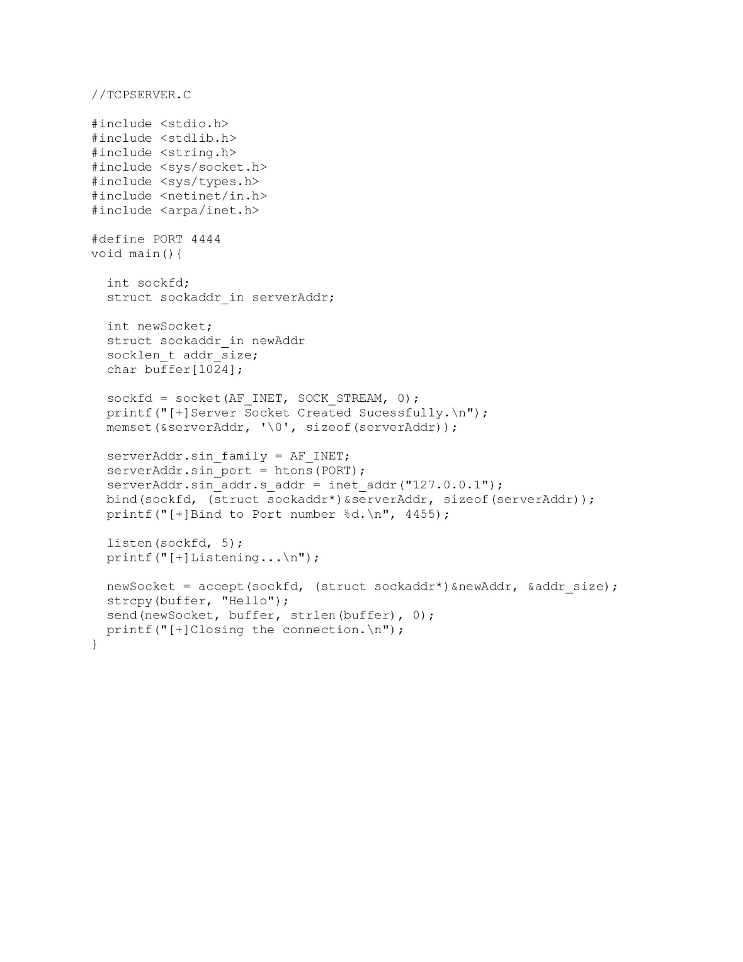

Slide 18
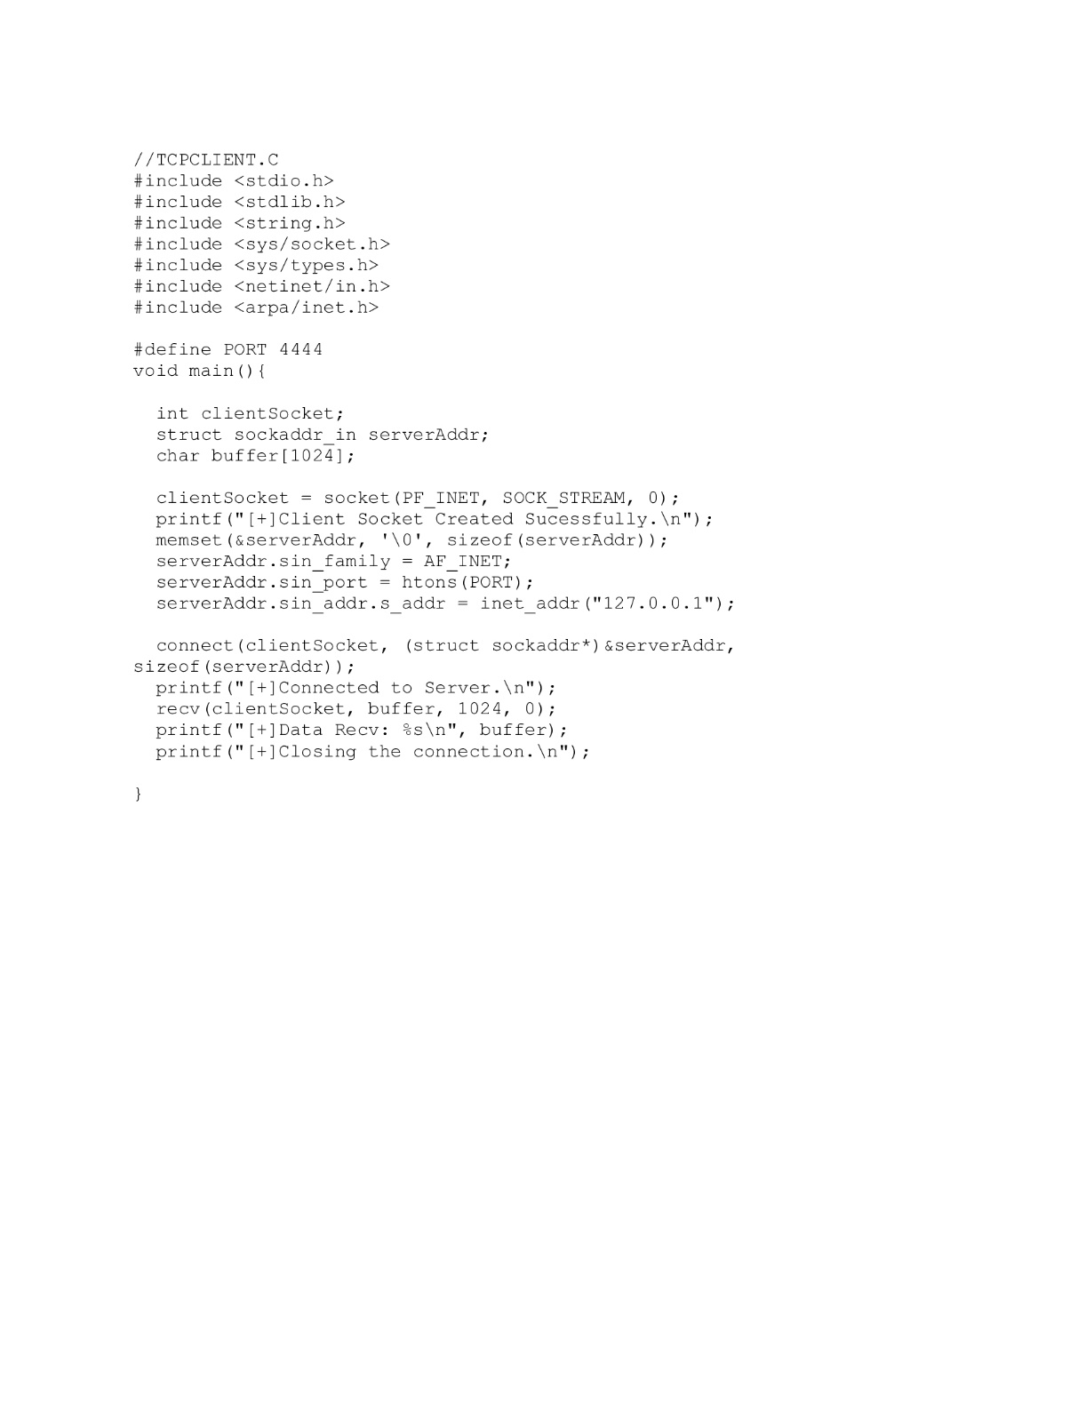

Slide 19
Learning outcomes
At the end of the session students will be able to:
Understand the concept of Client- Server Communication.
Understand the concept of Socket.

Slide 20
References
W. Richard Stevens, Bill Fenner, Andrew M. Rodoff: “UNIX Network Programming”. Volume 1, Third Edition, Pearson 2004.
Barry Nance: “Network Programming in C”, PHI 2002 3.Bob Quinn, Dave Shute: “Windows Socket Network Programming”, Pearson 2003.
Richard Stevens: “UNIX Network Programming”. Volume 2, Second Edition.
James F Kurose and Keith W Ross, Computer Networking, A Top-Down Approach, Sixth edition, Pearson,2017

