Slide 1
DISTANCE VECTOR ROUTING ALGORITHM
Prepared by
Dr. Sharada M. Kori
Associate Professor, Department of Computer Science & Engineering, KLS GIT, Belagavi

Slide 2
OBJECTIVE
To implement Distance Vector Routing algorithm to find suitable path for transmission

Slide 3
INTRODUCTION
An internet is a combination of networks connected by routers.
When a packet goes from source to destination, it will probably pass through many routers until it reaches the router attached to the destination network.
A router consults a routing table when a packet is ready to be forwarded.
The routing table specifies the optimum path for the packet.
The table can be either static or dynamic.

Slide 4
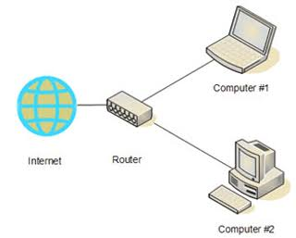
ROUTER CONNECTING DEVICES/ NETWORKS

Slide 5
STATIC VERSUS DYNAMIC ROUTING TABLE
Static Table
Dynamic Table
Does not change frequently.
Updated automatically where there is a change somewhere in the internet.

Slide 6
DYNAMIC ROUTING TABLE
An internet needs dynamic routing table in order to incorporate changes into the table whenever there is a change in internet.
They need to be updated when the route is down, or when a better route is created.

Slide 7
ROUTING PROTOCOLS
Routing Protocol is a combination of rules and procedures that lets routers in the internet inform one another of changes.
Have been created in response to the demand for dynamic routing tables.
It allows routers to share whatever they know about the internet or neighbourhood.

Slide 8
TYPES OF DYNAMIC ROUTING
ROUTING PROTOCOLS
UNICAST
MULTICAST

Slide 9
UNICAST ROUTING
In unicast communication, there is one source and one destination.
The router forwards the received packet through only of its ports (the one belonging to the optimum path) as defined in the routing table.
The router may discard the packet if it cannot find the destination address in its routing table.

Slide 10
METRIC
A router receives a packet from a network and passes it to another network.
A router is usually attached to several networks.
When it receives a packet, to which network should it pass the packet?
The decision is based on optimization.
A metric is a cost assigned for passing through a network.
The total metric of a particular route is equal to the sum of the metrics of the networks that comprise the route.
The metric assigned to each network depends on the type of protocol.
Ex: Routing Information Protocol treat all networks as equal. (one hop count)

Slide 11
INTERIOR AND EXTERIOR ROUTING
An autonomous system(AS) is a group of networks and routers under the authority of a single administration.
Routing inside an autonomous system is referred to as interior routing.
Routing between autonomous system is referred to as exterior routing.

Slide 12
DISTANCE VECTOR ROUTING
Three key points in understanding the working of Distance Vector Routing are as follows:
Sharing knowledge about the entire autonomous system:
Each router shares its knowledge about the entire autonomous system with its neighbours.
Sharing only with neighbours:
Each router sends its knowledge only to neighbours.
Sharing at regular intervals.
Each router sends its knowledge to its neighbours at fixed intervals for example, every 30ms.

Slide 13
DISTANCE VECTOR ROUTING
Adaptive/Dynamic Algorithm.
Route decisions will change dynamically in milliseconds.
Each Router maintains a table called “Vector”
Vector contains number of Hops & delays.
Table has the best known distance for each router.
Tables are updated by exchanging information with neighbours.

Slide 14
DISTANCE VECTOR ROUTING
Each router knows the best distance to reach another router.
Also known as Bellman Ford Algorithm.
Each router’s table has one entry for one router.
Each entry has two parts
Preferred outgoing line for each router.
Estimated distance to destination router.
Distance is basically considered by number of hops.

Slide 15
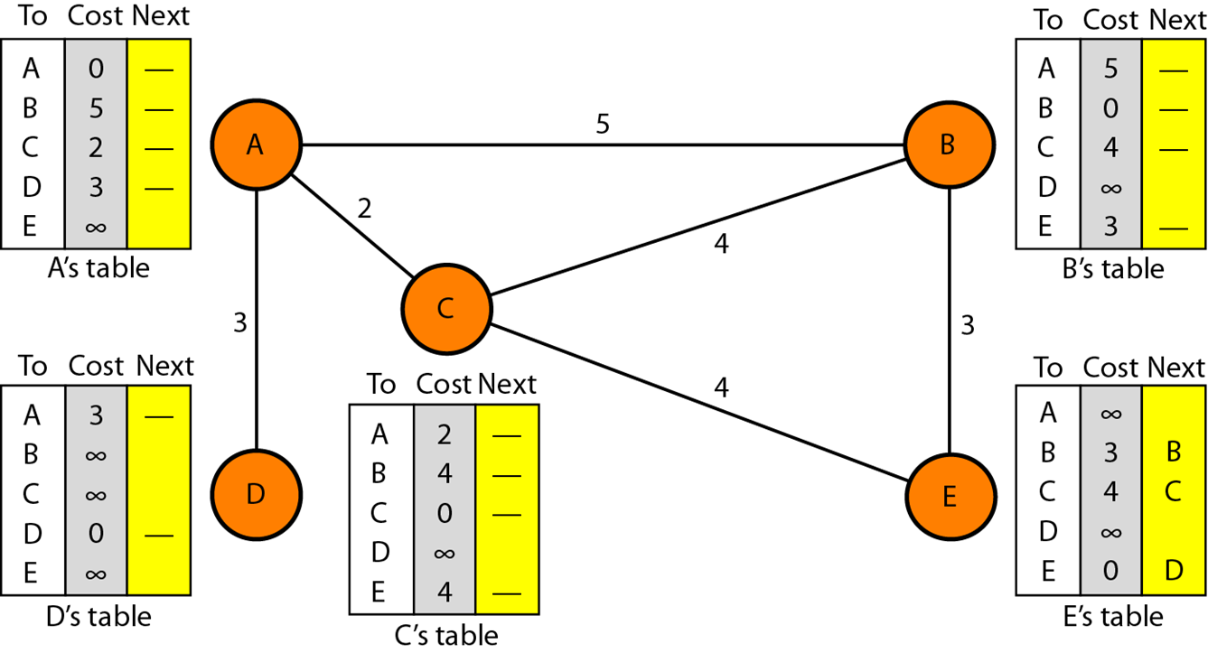
DISTANCE VECTOR ROUTING TABLE INITIALIZATION- EXAMPLE

Slide 16


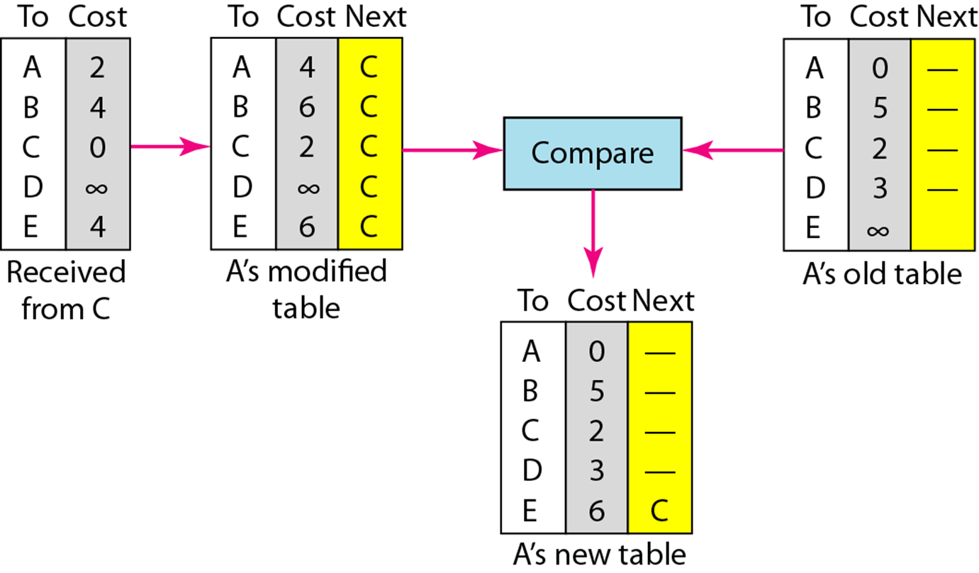
DISTANCE VECTOR ROUTING TABLE INITIALIZATION- EXAMPLE

Slide 17
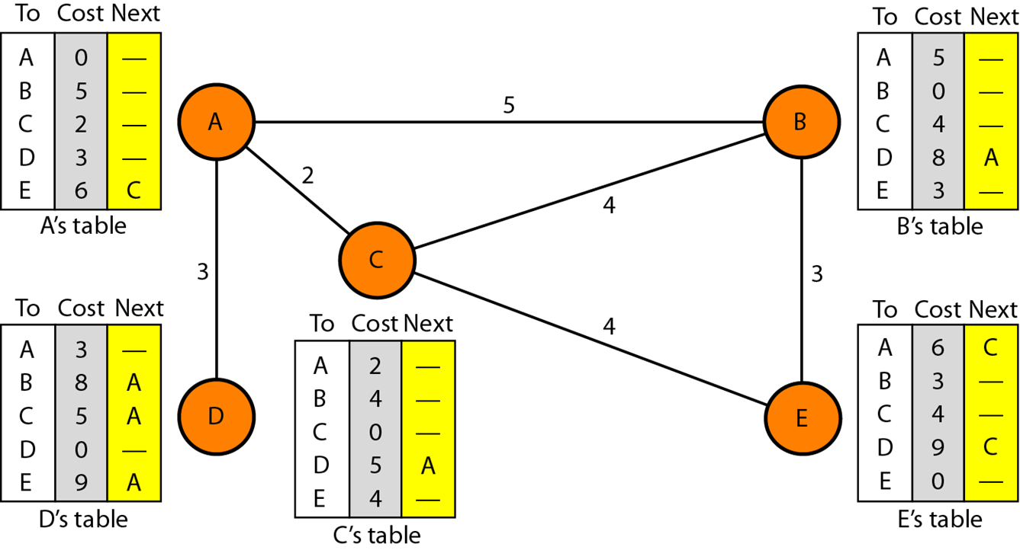
FINAL DISTANCE VECTOR ROUTING TABLE

Slide 18
ALGORITHM
1. Send my routing table to all my neighbours whenever my link table changes.
2. When I get a routing table from a neighbour on port P with link metric M:
add L to each of the neighbour's metrics.
for each entry (D, P', M') in the updated neighbour's table
i) if I do not have an entry for D, add (D, P, M') to my routing table
ii) if I have an entry for D with metric M", add (D, P, M') to my routing
table if M' < M“
3. If my routing table has changed, send all the new entries to all my neighbours.

Slide 19
SOURCE CODE

Slide 20
SOURCE CODE

Slide 21
SOURCE CODE

Slide 22
SOURCE CODE

Slide 23
SOURCE CODE

Slide 24
SOURCE CODE

Slide 25
EXPECTED OUTPUT

Slide 26
EXPECTED OUTPUT

Slide 27
EXPECTED OUTPUT

Slide 28
EXPECTED OUTPUT

Slide 29
EXPECTED OUTPUT

Slide 30
EXPECTED OUTPUT

Slide 31
EXPECTED OUTPUT

Slide 32
Learning outcome
At the end of the session students will be able to:
Understand the concept of Distance Vector Routing.
Implement ‘C’ program to find the shortest path between the two nodes.

Slide 33
REFERENCES
1. Behrouz Forouzon - Data Communications and Networking, McGraw Hill Edition
2. Anany Levitin -Introduction to the design & analysis of algorithms.
3. Thomas H. Cormen , Charles E. Leiserson , Ronald L. Rivest, Clifford Stein- Introduction to Algorithms.
4. Mark Allen Weiss -Data Structures and Algorithm Analysis in Java.

