Slide 1
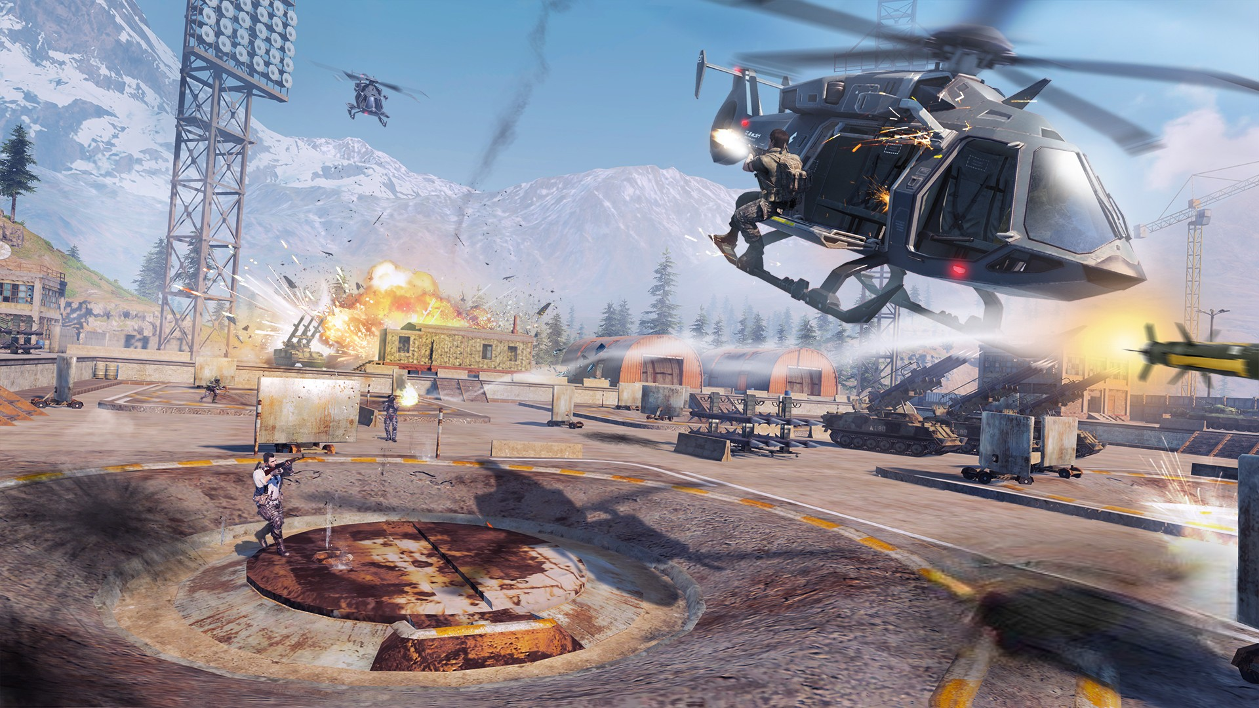
PLAY GAME

Slide 3
PLAY GAME
INSTRUCTIONS
ABOUT
EXIT

Slide 4
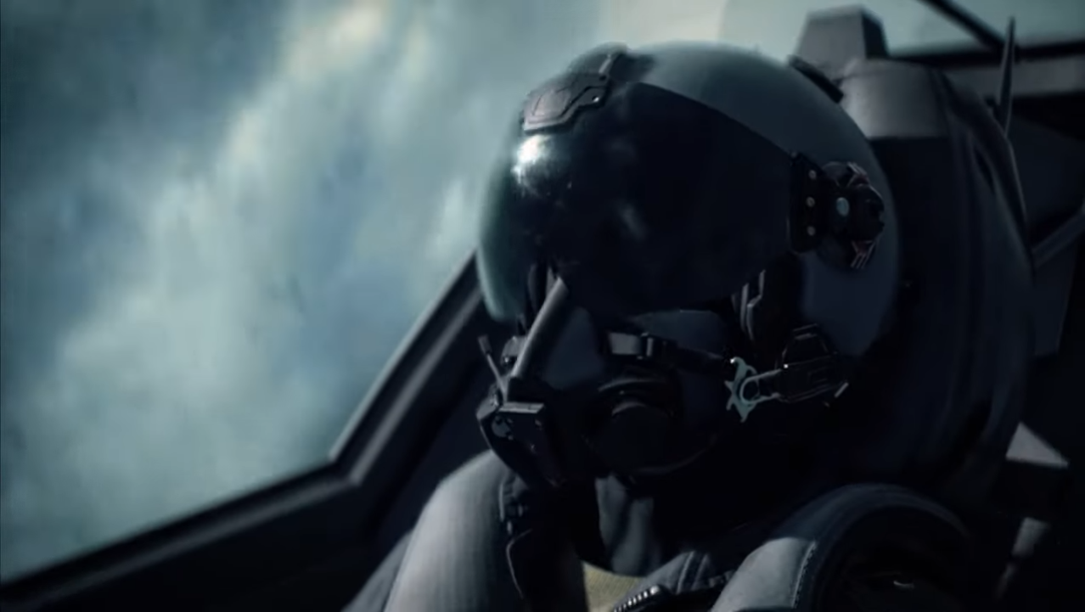
BUMBLE JET
PLAY GAME
INSTRUCTIONS
ABOUT
EXIT

Slide 5
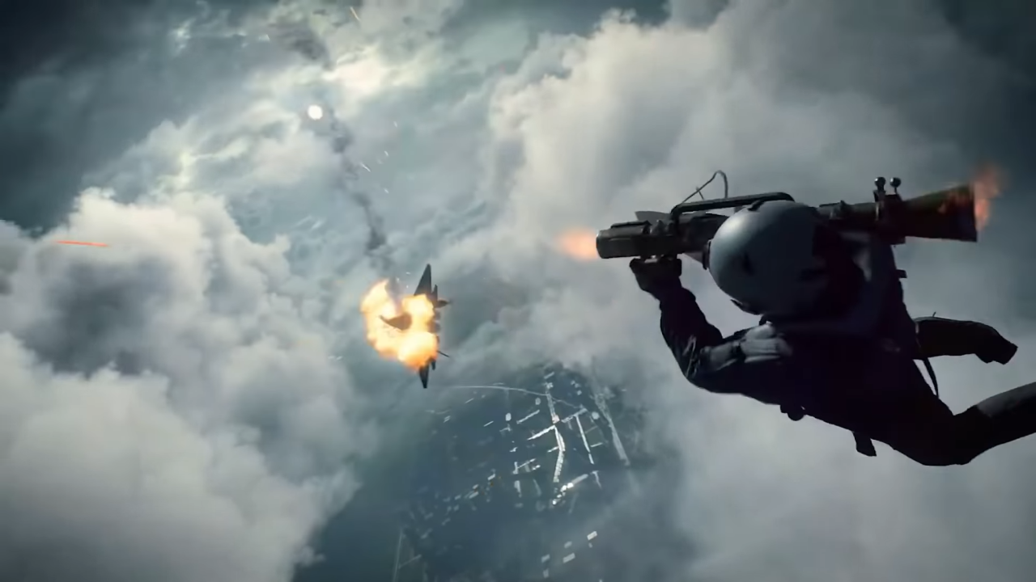

Slide 7
PLAY GAME
PLAY GAME

