Slide 1
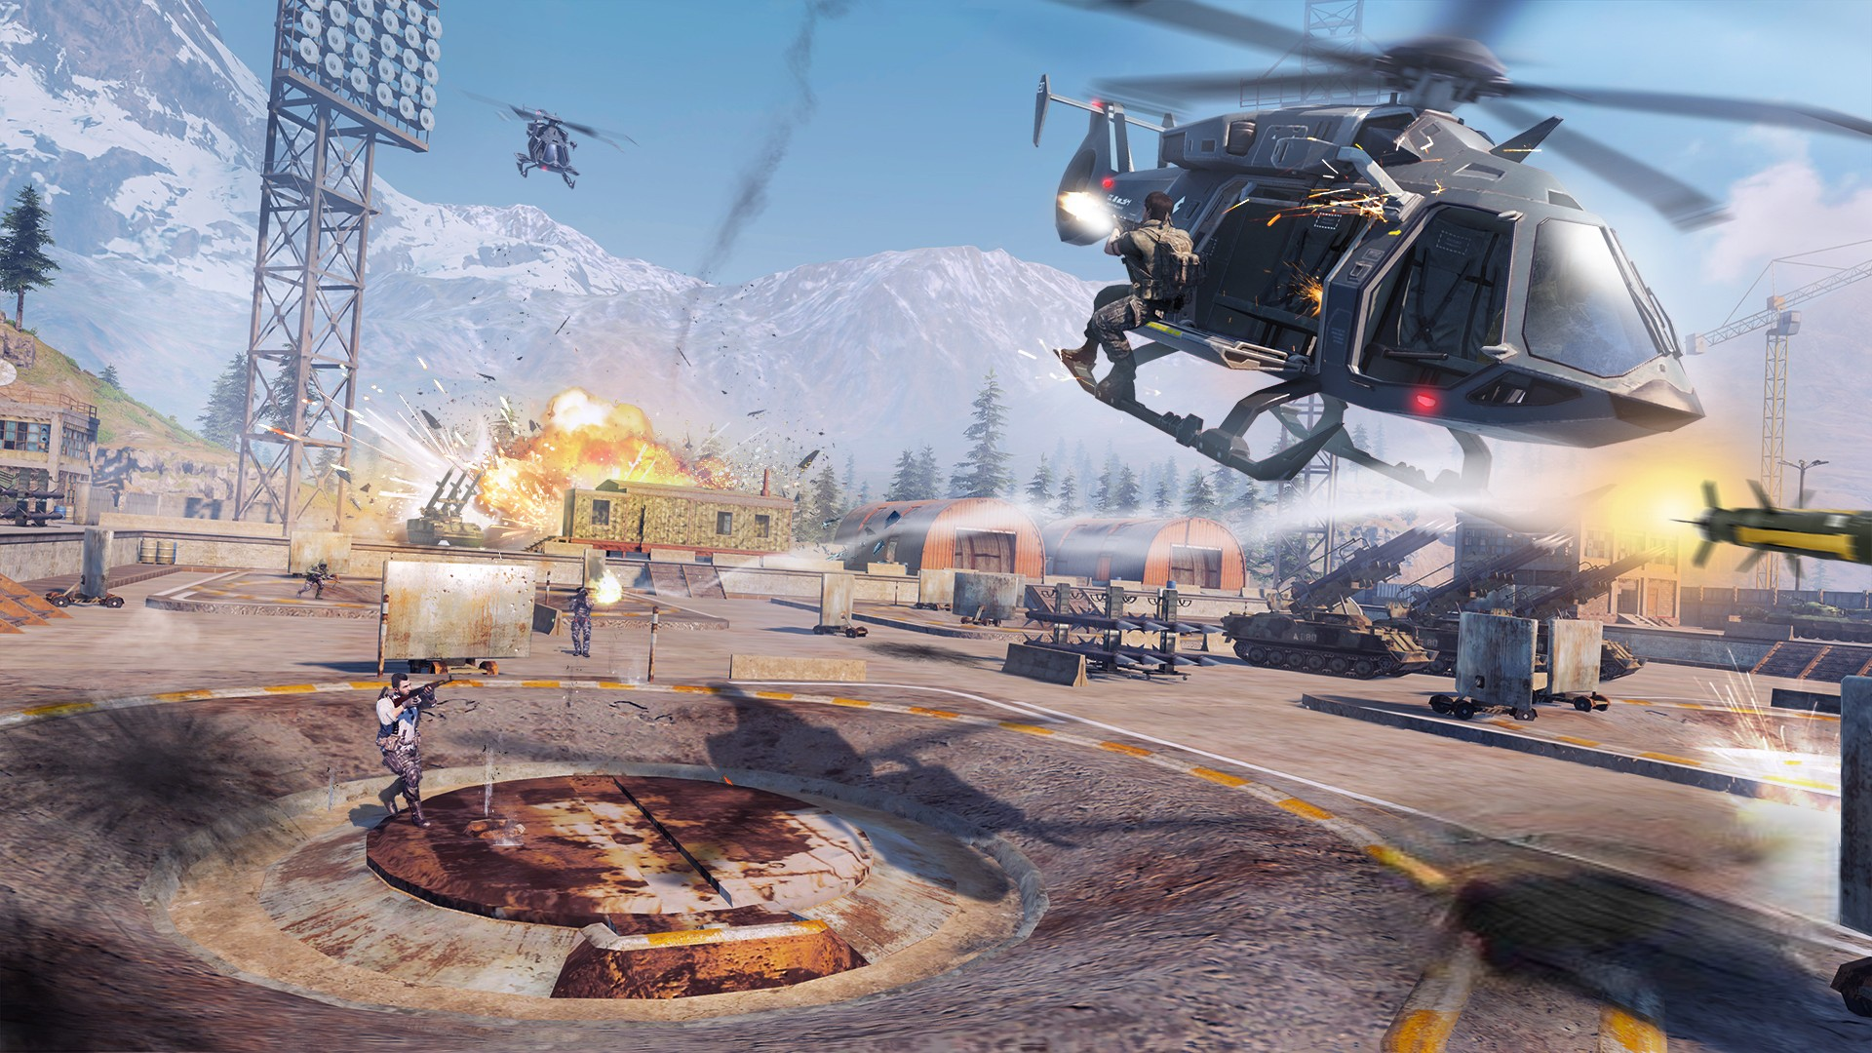
PLAY GAME

Slide 3
PLAY GAME
INSTRUCTIONS
ABOUT
EXIT

Slide 4
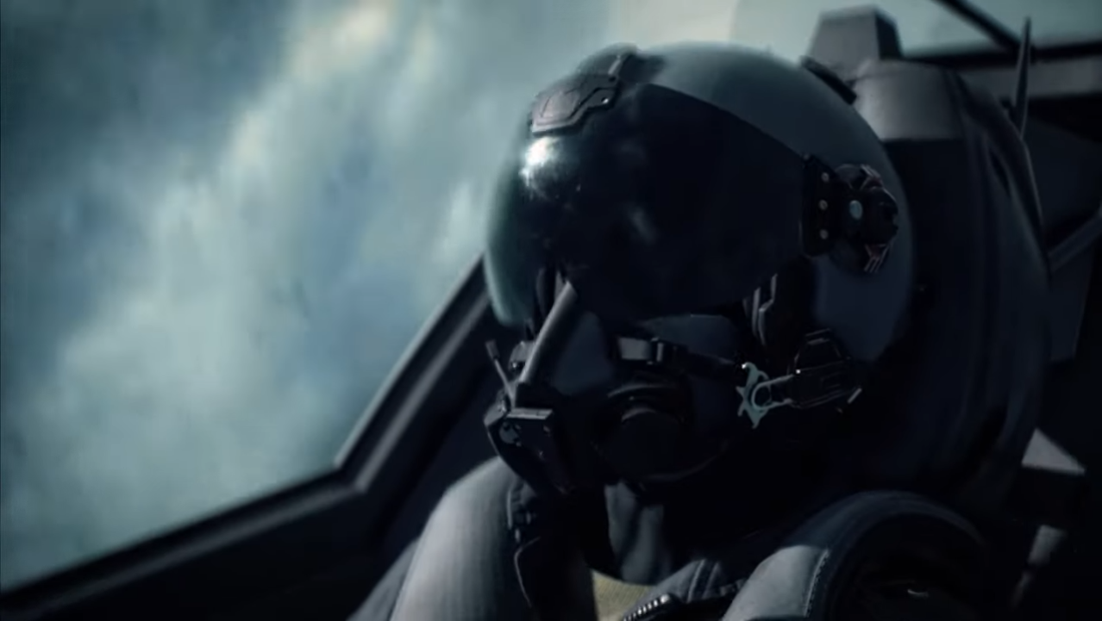
BUMBLE JET
PLAY GAME
INSTRUCTIONS
ABOUT
EXIT

Slide 5
BUMBLE JET
PLAY GAME
INSTRUCTIONS
ABOUT
EXIT

Slide 6
BUMBLE JET

Slide 7
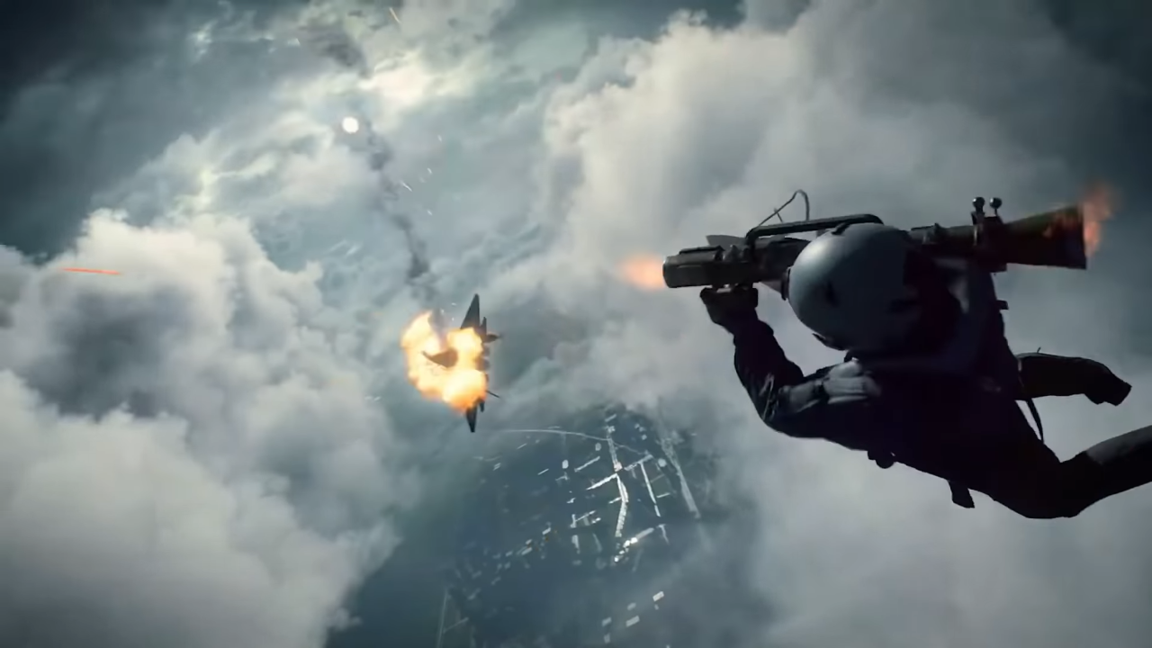

Slide 9
PLAY GAME
PLAY GAME

