Slide 1
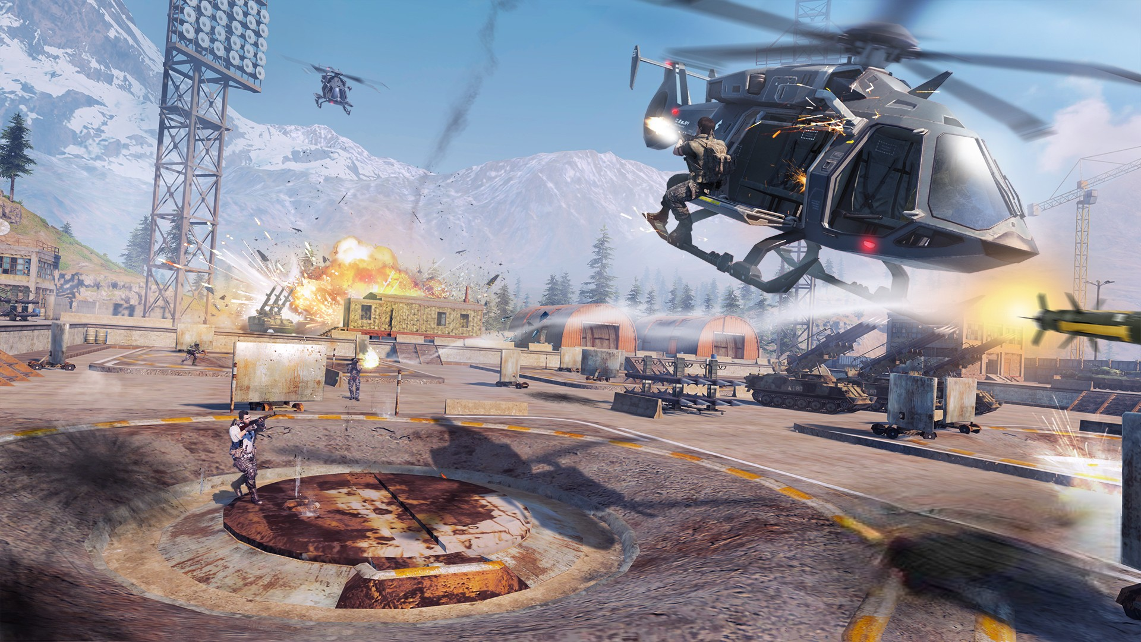
PLAY GAME

Slide 3
PLAY GAME
INSTRUCTIONS
ABOUT
EXIT

Slide 4
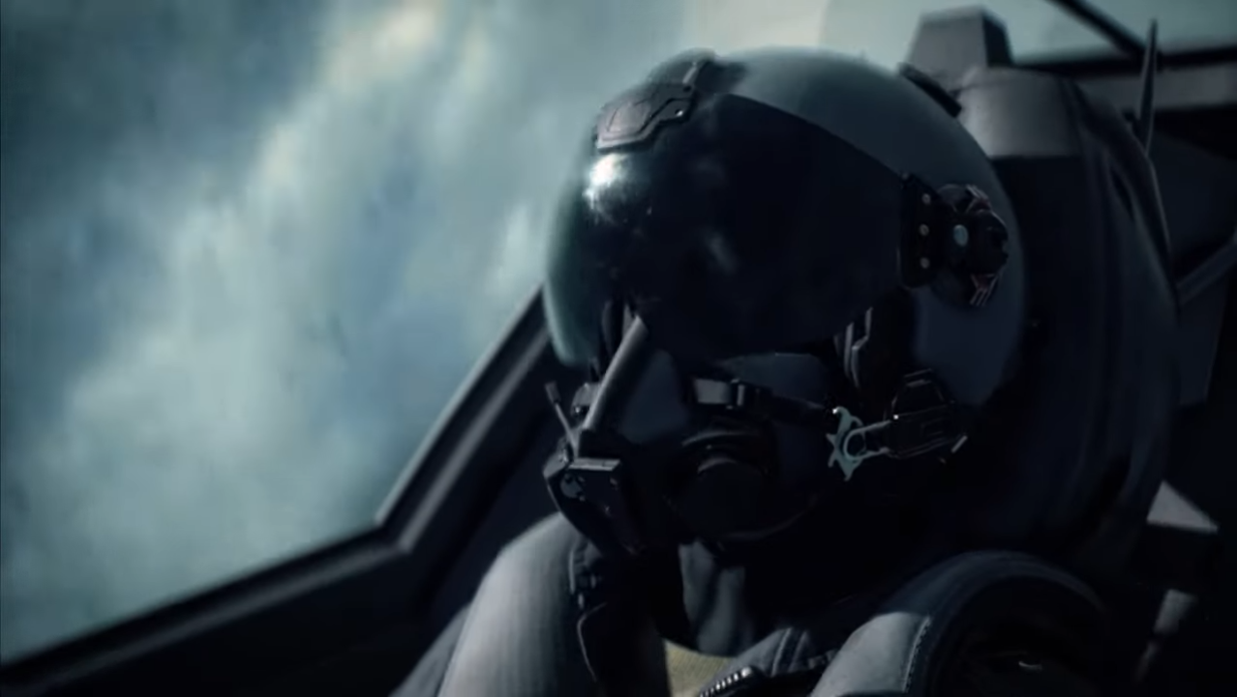
BUMBLE JET
PLAY GAME
INSTRUCTIONS
ABOUT
EXIT

Slide 5
BUMBLE JET
PLAY GAME
INSTRUCTIONS
ABOUT
EXIT

Slide 6
BUMBLE JET

Slide 7
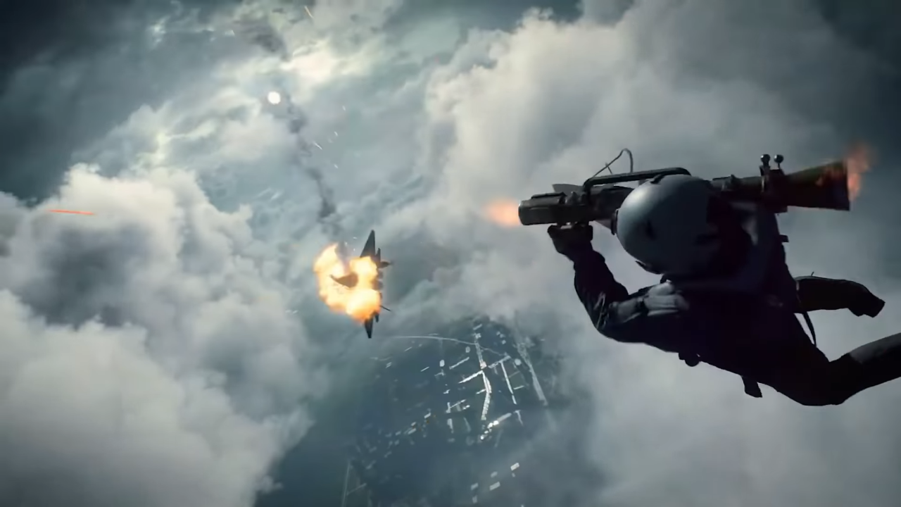
ABOUT
This game is made with C++ programming language. We used the iGraphics to build this game.
Creators: Shaeakh Ahmed Chowdhury Reg. No. 2020831022 Arif Rabbani
Reg. No. 2020831049
The iGraphics.h header file features a selection of drawing functions that are capable of producing fundamental graphical shapes within Visual C++. These functions are constructed in openGL, however, users of iGraphics are not required to possess any familiarity with openGL in order to utilize it. By making use of these drawing functions, a user can simply create any 2D shape on their screen. In addition to this, the library also presents effortless methods for animation, in addition to the handling of keyboard and mouse events.

Slide 9
PLAY GAME
PLAY GAME

