Slide 1









Shahjalal University Of Science and Technology, Sylhet
THESIS DEFENSE
Presented By
Towhidur Rahman Asif
&
M. M. Zahid Hasan

Slide 2





The Role of Structure in Reasoning:
A Comparative Evaluation of Structured Chain-of-Thought Prompting for Text-to-SQL with Modern Language Models
Towhidur Rahman Asif (2020831016)
&
M. M. Zahid Hasan (2020831035)
Supervisor:
Fazle Rabbi Rakib
Lecturer
Department of Software Engineering
Shahjalal University of Science and Technology, Sylhet, Bangladesh
Date: 25 November, 2025

Slide 3






Abstract
Large Language Models have improved Text-to-SQL tasks, but they still struggle with complex, multi-step reasoning. To address this, we propose Structured Chain-of-Thought (SCoT), which guides the model through a clear, structured process. We compare SCoT with several prompting methods and find that it performs the best across all settings. On Gemini 2.5 Pro and GPT-4o-mini, SCoT reaches 84.33% and 70.20% execution accuracy, clearly outperforming baselines. Our seven-stage pipeline produces no execution errors, showing that light structure and multiple candidate solutions can make Text-to-SQL far more reliable without extra training or annotation.

Slide 4




Overview
1
5
Introduction
Results
2
6
Research Questions
Comparison
3
7
Literature Review
Findings
4
8
Methodology
Conclusion

Slide 5





Introduction
Motivation & Background
SQL is hard for non-technical users.
NLIs allow users to query databases using natural language.
Text-to-SQL converts natural language questions into SQL.
Shift Toward Large Language Models
Traditional Text-to-SQL relies on supervised models requiring costly, large annotated datasets.
LLMs reduce this dependency—they can perform tasks through prompting, not task-specific training.
This makes development faster, cheaper, and more flexible.
Core Challenge: Complex Reasoning
Many Text-to-SQL queries require multi-step logical reasoning.
Chain-of-Thought (CoT) prompting helps break problems into steps, improving performance.
But CoT is unstructured, and for highly complex queries it may drift logically, leading to incorrect SQL.
In benchmarks like Spider, this limitation becomes evident.

Slide 6





Research Questions
1
2
3
RQ1:
RQ2:
RQ3:
Can Structured Chain-of-Thought prompting directly improve large language models’ accuracy and reasoning in generating SQL queries?
Does enforcing a structured reasoning format (SCoT) lead to higher exact match accuracy in Text-to-SQL generation compared to unstructured Chain-of-Thought (CoT)?
Howdoestheperformance of SCoT compare against other advanced prompting techniques, including Question Decomposition (QDecomp), across a variety of modern Large Language Models?

Slide 7
Literature Review
This chapter reviews prior work on Text-to-SQL, large language models, and prompting-based reasoning methods, and positions our proposed SCoT approach within this landscape.
1
2
Literary review 1
Literary review 2
Early semantic parsing on small, single-domain datasets (e.g., GEOQUERY).
Spider benchmark introduced cross-domain, multi-table, complex SQL queries.
LLMs with in-context learning enable few/zero-shot Text-to-SQL.
CoT helps reasoning but can propagate early SQL clause errors.
QDecomp and QDecomp+InterCOL use higher-level sub-questions with schema grounding.
They outperform standard prompting and CoT on Spider benchmarks.
Reasoning steps are still unstructured text → ambiguity remains.
This motivates our Structured Chain-of-Thought (SCoT) method.

Slide 8



Methodology
1
Datasets: Spider benchmark subsets (dev_600 for Gemini 1.5 Pro, dev_500 for GPT-4o-mini); human-readable schema format with PK/FK.
2
Baselines: Standard (direct SQL), CoT (step-by-step reasoning), QDecomp (question decomposition), QDecomp_InterCol (with PK/FK grounding).
3
SCoT Stages: Plan generation in JSON, validation (schema/PK-FK paths), pattern-aware candidates (4-7 diverse SQL), sanitization & auto-fixes.
4
SCoT Stages (cont.): GROUP BY/HAVING validators, template skeletons, canonicalization, execution-guided ranking with cardinality checks.
5
Protocol: SQLite execution environment; hyperparameters (τ=0.0-0.2, max tokens 1024); metrics: Execution Accuracy (EX) for semantic match.

Slide 9
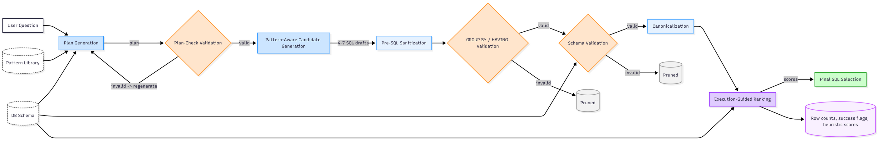
Figure :- SCoT pipeline flowchart (Question/Schema → Plan → Validation → Generation → Ranking → Final SQL).

Slide 10


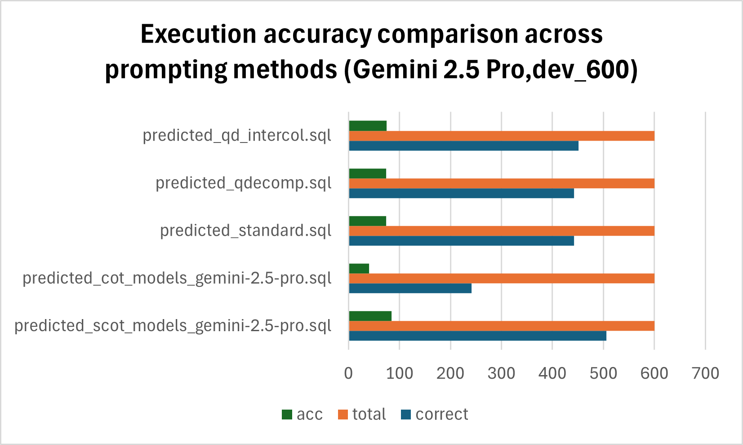




Results
Gemini 2.5 Pro Execution Accuracy
SCoT achieves 84.33% EX, the highest among all methods.
~9% higher than the strongest baseline (75.17%).
Standard and QDecomp perform similarly (73.67% EX).
Chain-of-Thought is the weakest (40.17% EX), confirming its instability on complex queries.

Slide 11
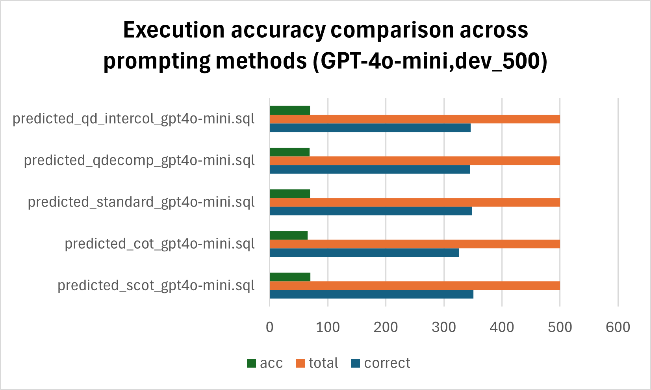
Results
GPT-4o-mini Execution Accuracy
SCoT again ranks first with 70.20% EX.
Other methods cluster closely:
Standard: 69.60%,
QDecomp_InterCol: 69.20%,
QDecomp: 69.00%
Chain-of-Thought is still lowest (65.20% EX).

Slide 12
Results
Cross-Model Insights
SCoT is the top performer on both models, with consistent gains.
The improvement gap is large on Gemini (~9 points) but small on GPT-4o-mini (~1 point).
Chain-of-Thought remains the least accurate, supporting evidence that long, clause-level reasoning introduces errors.
On GPT-4o-mini, Standard and QDecomp variants cluster tightly, showing that the lighter model reduces method differences.

Slide 13



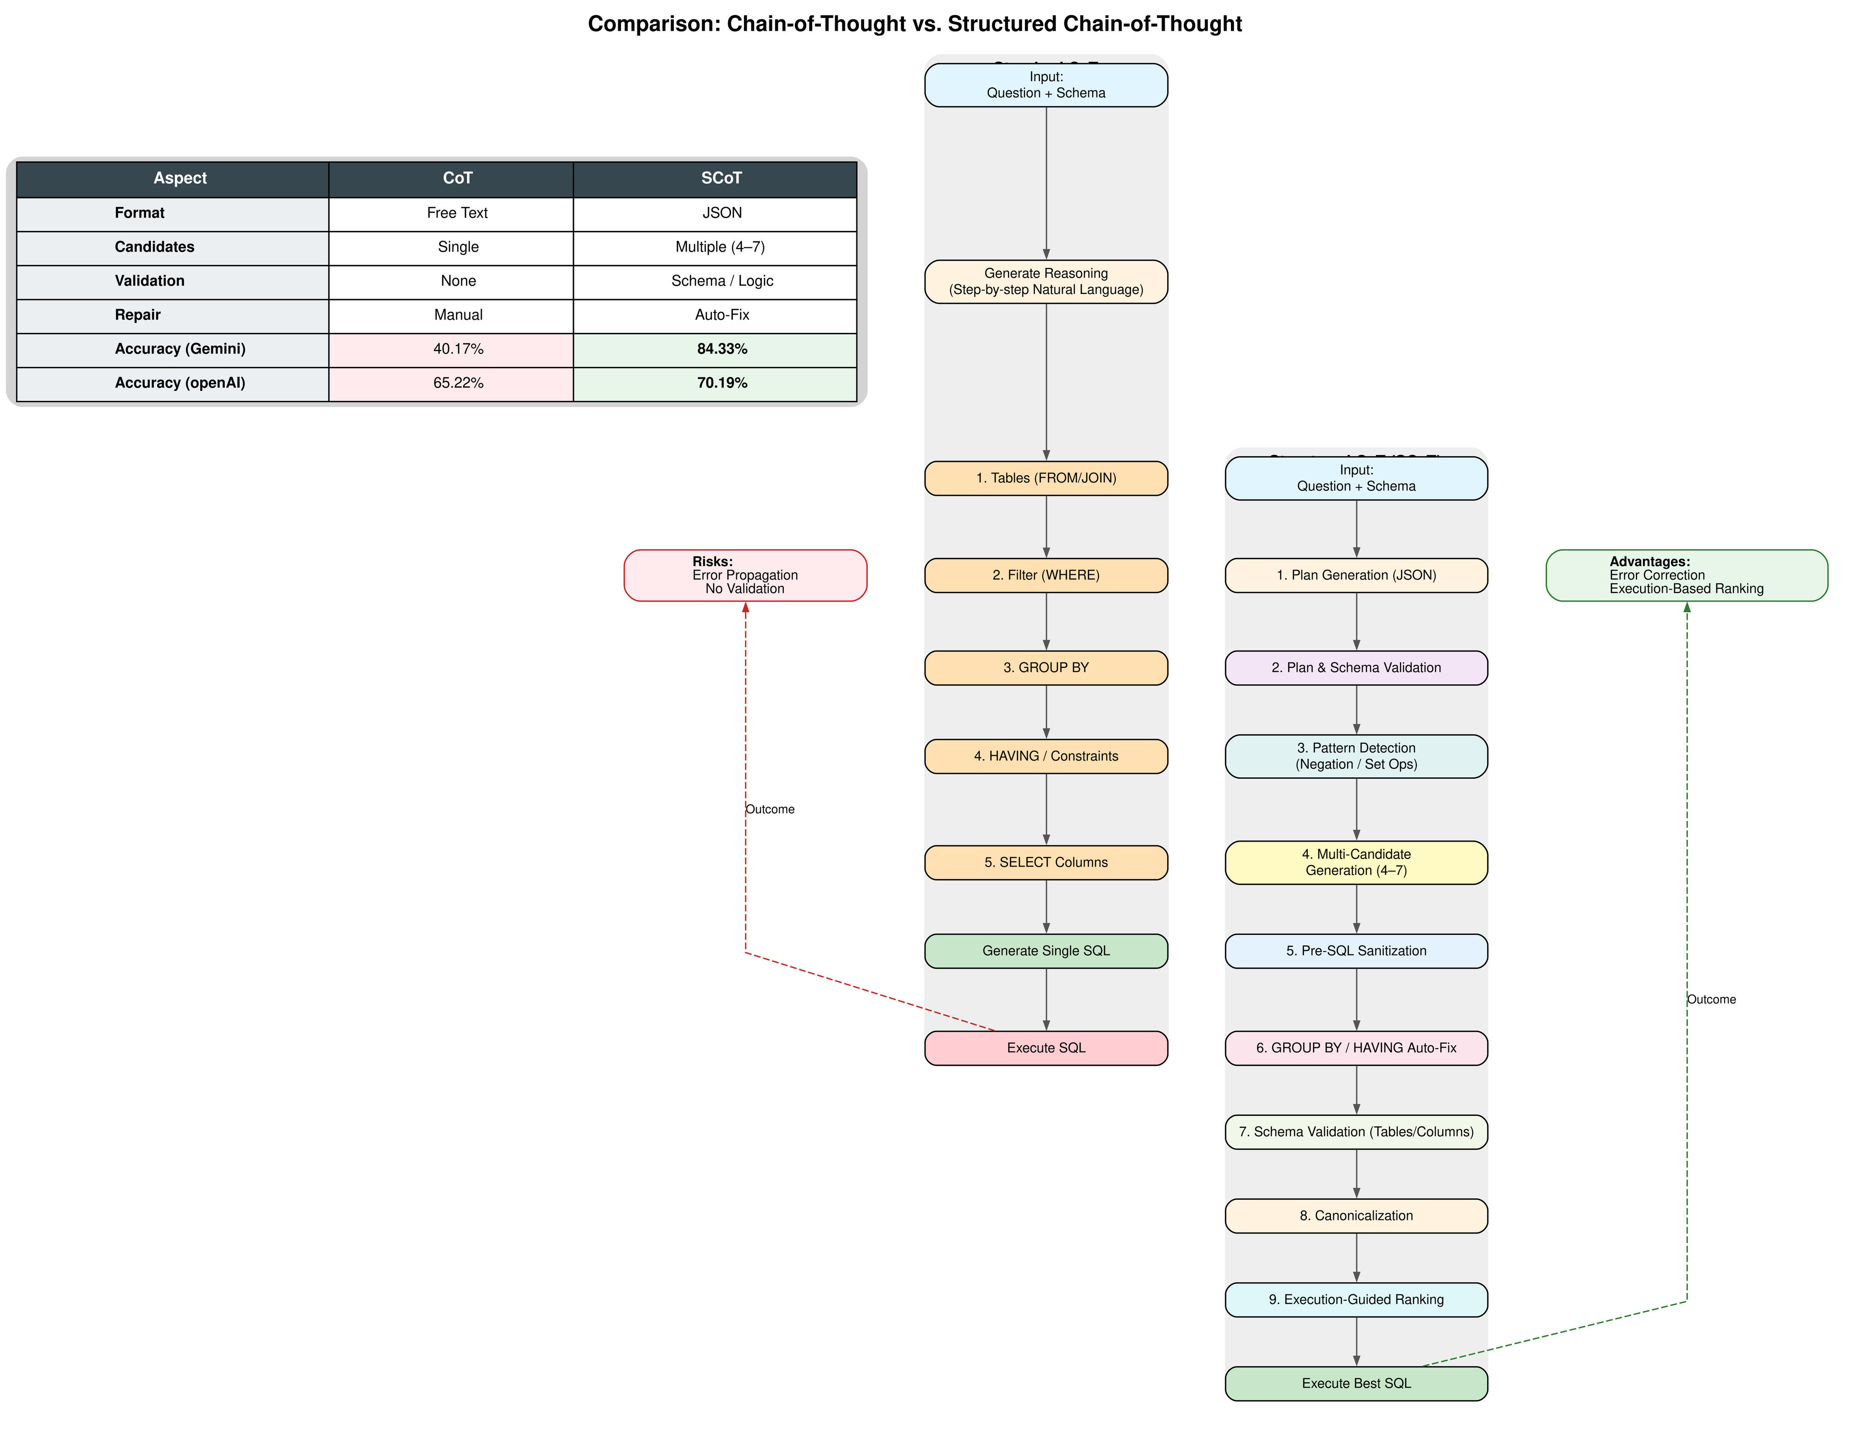


Comparision of SCoT vs CoT
1) SCoT uses a structured JSON format, whereas CoT relies on free-text reasoning.
2) Multiple candidate reasoning paths (4–7) allow SCoT to explore diverse logical routes; CoT generates only a single chain.
3) Built-in schema and logic validation in SCoT prevents invalid reasoning early; CoT has no validation.
4) SCoT includes automatic repair, reducing execution errors; CoT requires manual correction.
5) Accuracy gains are significant — SCoT nearly doubles accuracy on Gemini (84.33% vs 40.17%) and improves results on GPT-4o-mini.

Slide 14


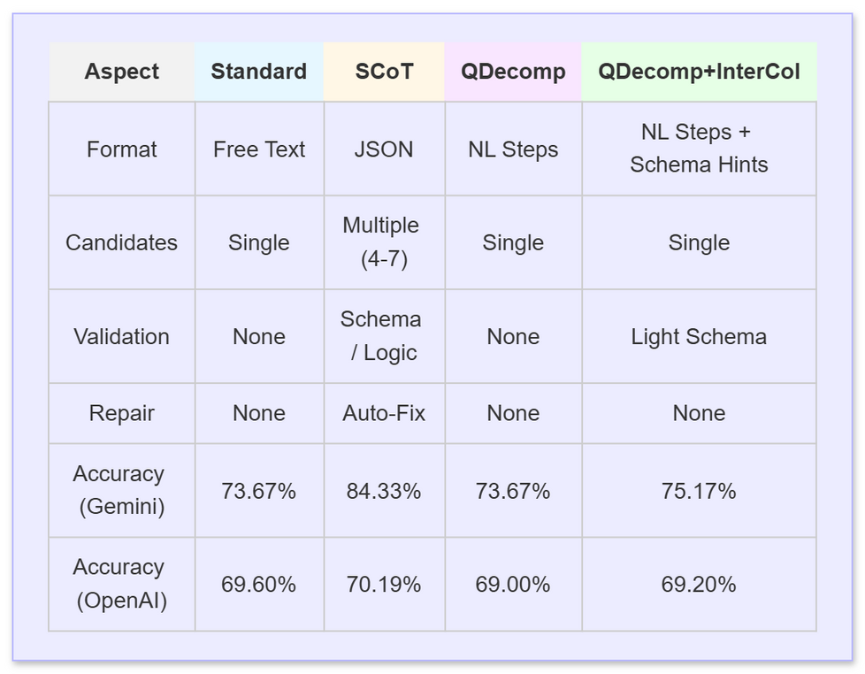



Findings
Structured reasoning made a much larger difference than expected.
Traditional CoT and QDecomp variants often failed due to missing schema grounding and lack of validation.
SCoT outperformed all baselines because it uses:
These features reduced error propagation and improved accuracy across both models, with the largest gains seen on Gemini.
1) JSON-structured reasoning,
2) multiple candidate paths, and
3) schema/logic validation with auto- repair.

Slide 15
Conclusion
SCoT-based prompting consistently outperformed all other methods on both Gemini 2.5 Pro and GPT-4o-mini. Its structured reasoning, multiple candidate generation, and auto-fix mechanism helped avoid the clause-level errors that affected other approaches. Although Standard and QDecomp variants remained competitive, traditional Chain-of-Thought performed the weakest due to its overly detailed reasoning steps. Overall, our results show that adding structure to the reasoning process makes Text-to-SQL generation more accurate and reliable across different model sizes.

Slide 16





THANK YOU

