Slide 1
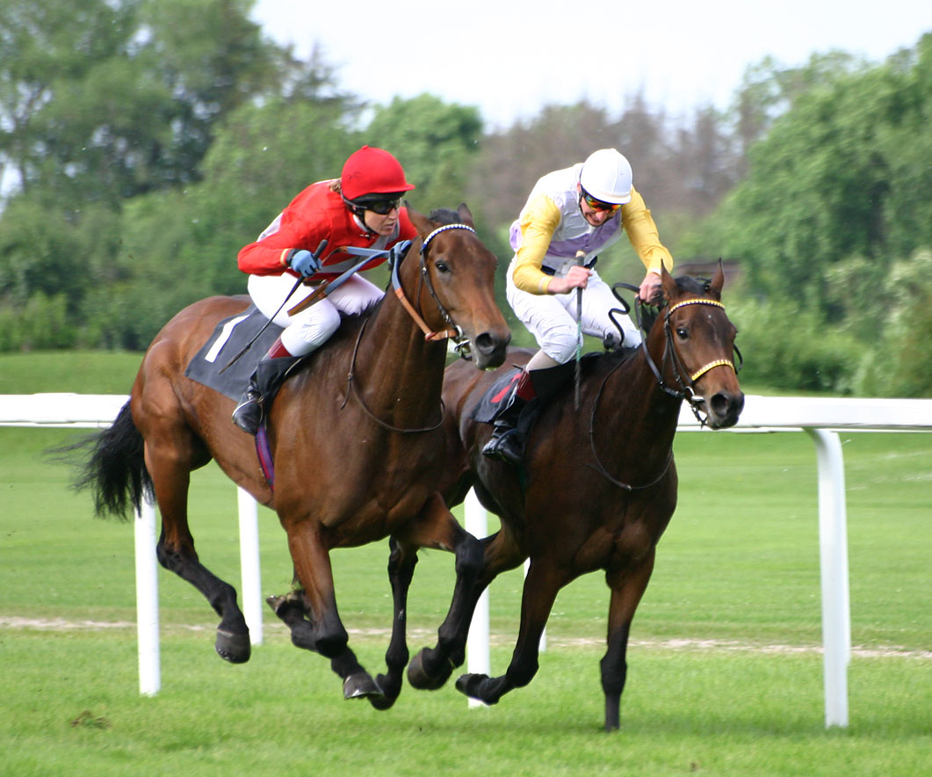
Horse Racing
By Shaefer Drew

Slide 2
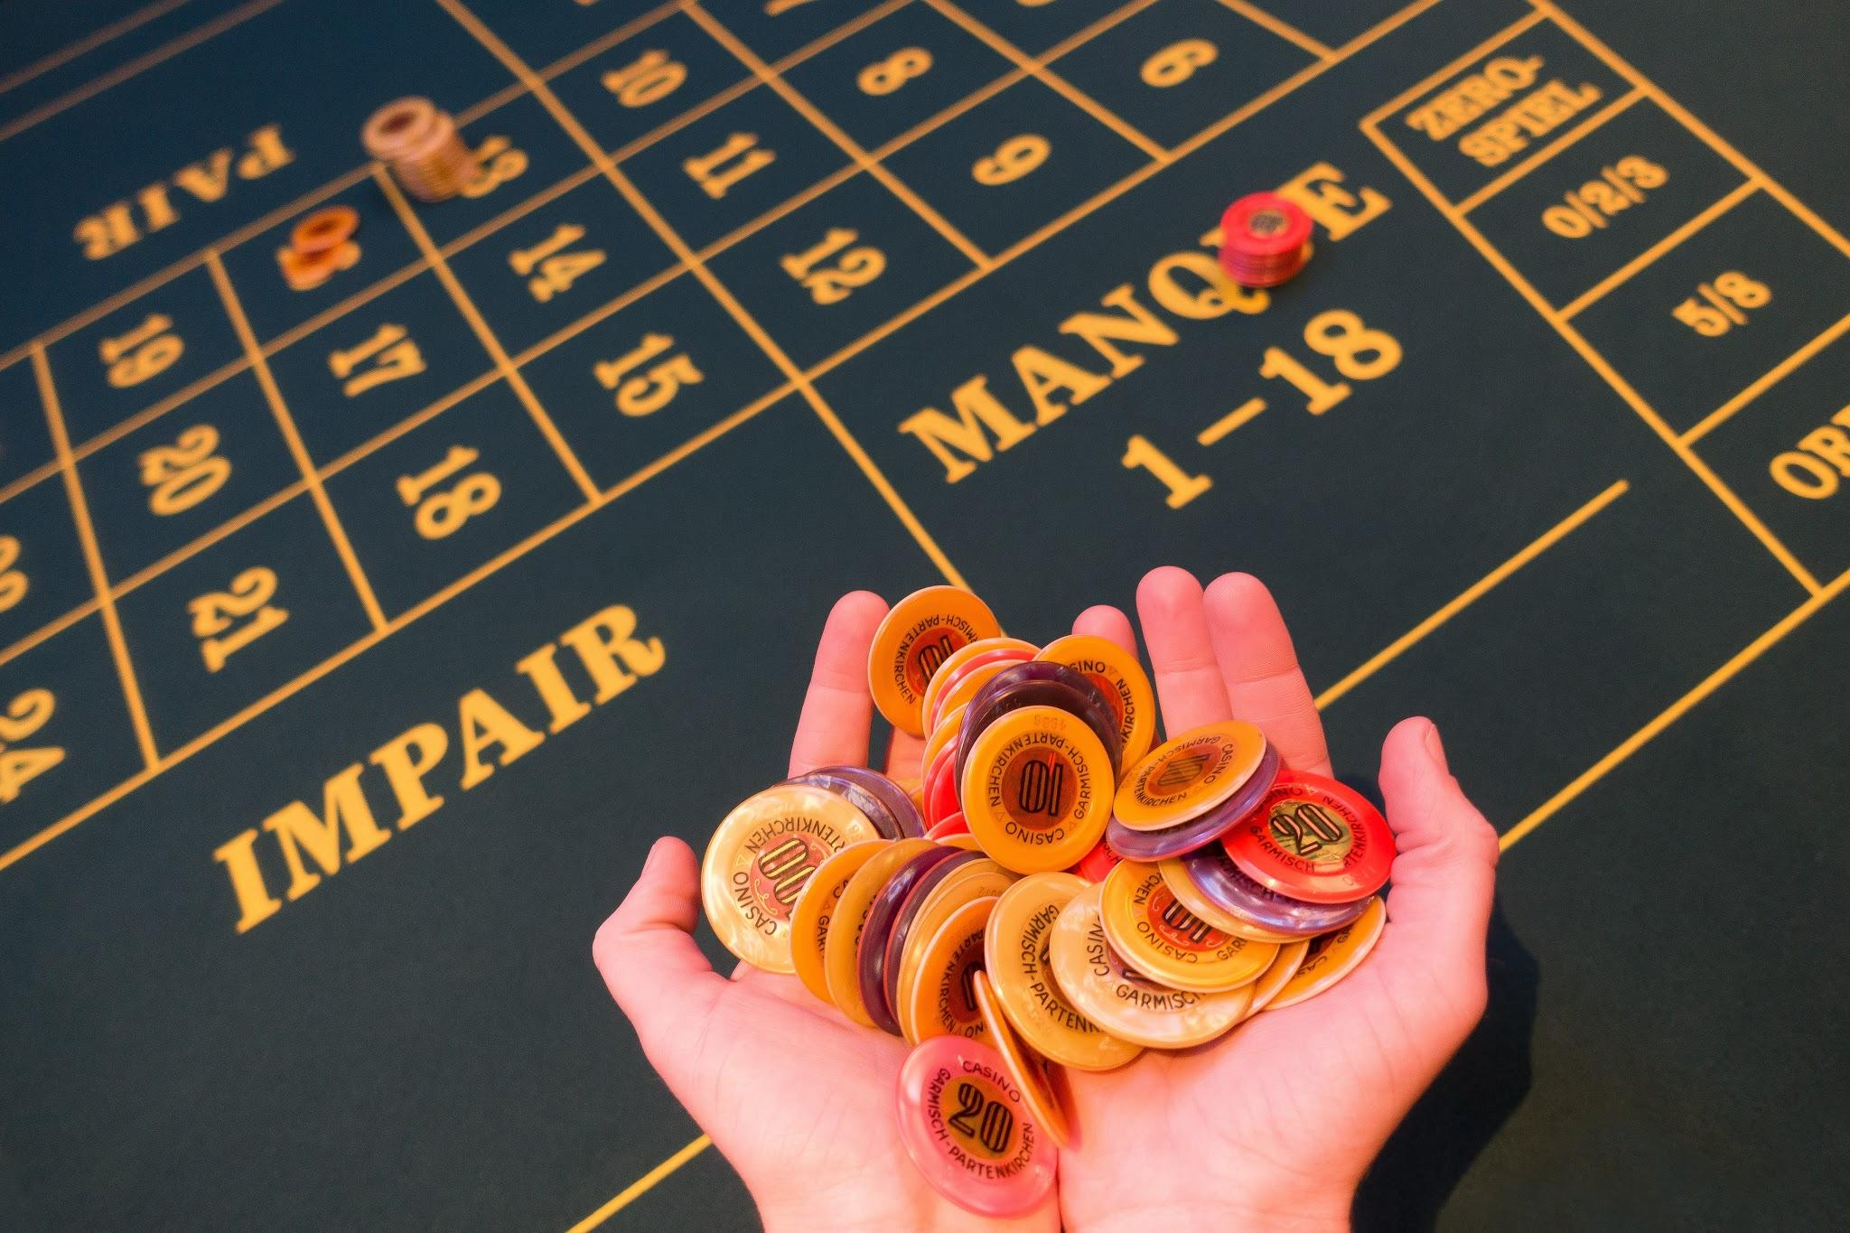
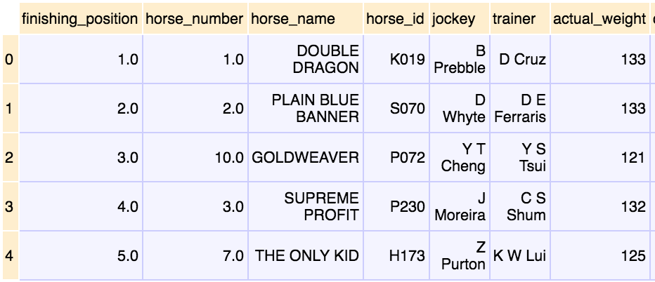
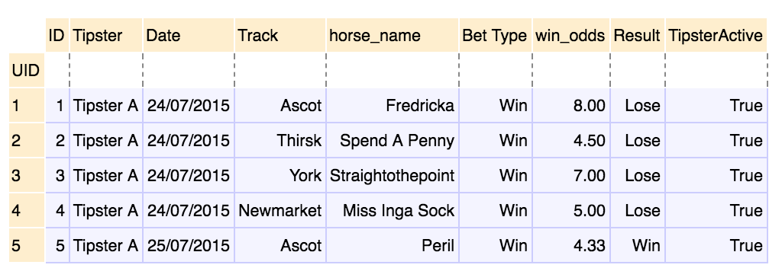
Motivation and Data Sources
Motivation: I love gambling
Data Sources:
Race-result-horse.csv tips.csv

Slide 3
Data Manipulation
Data Cleaning and Merging - combined 2 dataframes and conducted additional individual analysis
Kruskal-Wallis test - determined if difference in odds for winners and losers is significant
Bivariate and Multivariate Linear Regression - built model to predict finishing position given a horse’s winning odds, as well as its weight and number
Pivot Tables - determine which tipsters and horses are most reliable
Exploratory Factor Analysis - built PCA model to separate horses into respective clusters based on their different traits

Slide 4
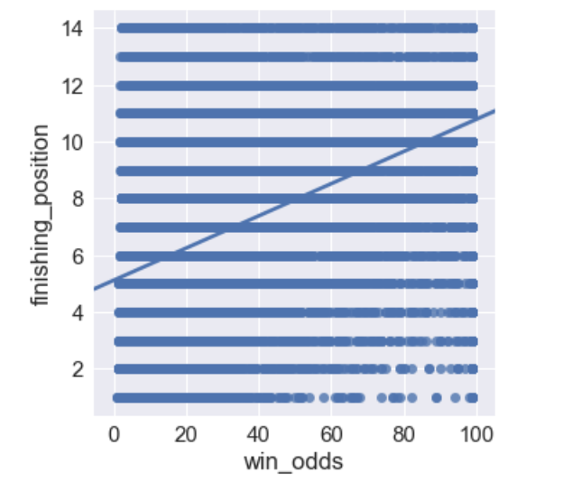
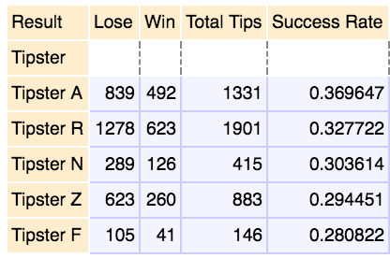
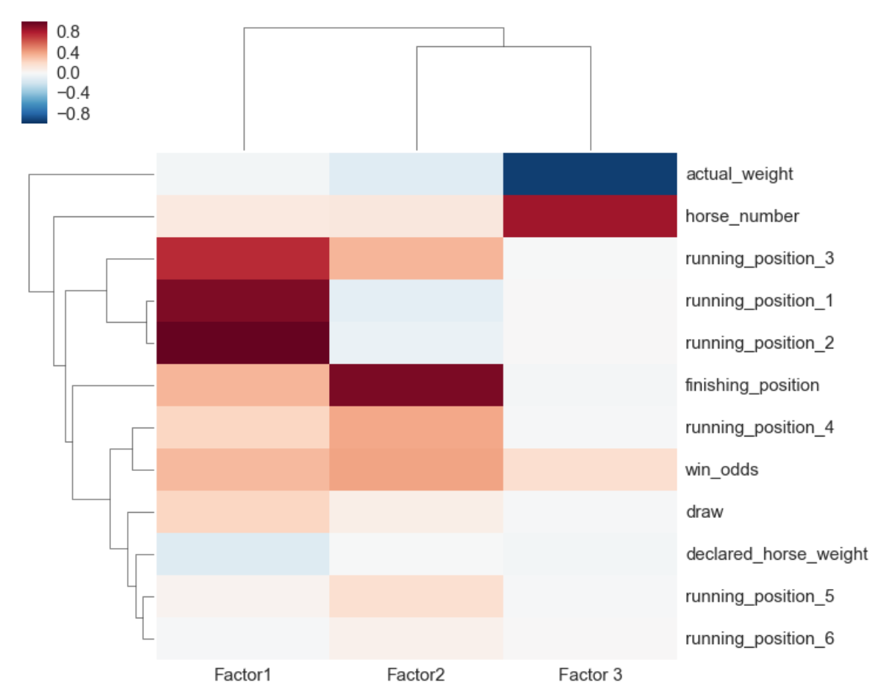
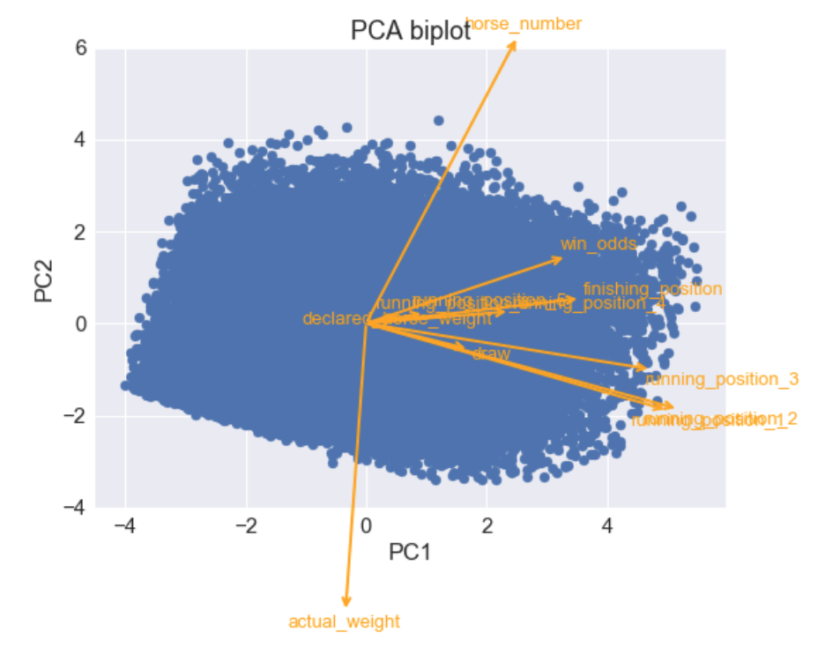
Visualization

