Slide 1
The Unity Game Engine
By Sean Gillis and Shaelyn Hooley

Slide 2
Canadian Video Game Industry
Is a $4 billion dollar industry
Directly employs 21800 employees/indirectly employees 40k +
472 companies where video game development is either part or it’s main source of revenue.
Majority of video game companies are in Quebec due to
a heavy salary subsidy for technical staff ( government pays between 26.25 and 37.5 percent)
multinational companies provide critical experience to tech professionals, who in turn, start their own companies with expert-level skills and a strong understanding of the global video game market.

Slide 3
Canadian Video Game Industry

Slide 4
Game Engines
Framework for game development
Import assets (2D and 3D)
Manipulate those assets
Add lighting
Add audio
Create special effects
Physics
Debug options
* All depends on the Engine

Slide 5
History of Unity
Developed by Over the Edge Entertainment (now Unity Technologies)
Was the engine for their first game, GooBall (Commercial Failure)
Company shifted from game development to engine development
One of the first game engines that fully supported IPhone platform.

Slide 6
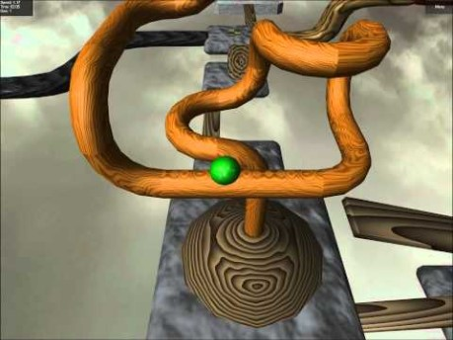
History of Unity

Slide 7
Unity Game Engine: Graphics
Use prebuilt rendering templates
Universal Render Pipeline
High Definition Pipeline
Customize from scratch

Slide 8
Unity Game Engine: Audio
3D spatial sound
Real-time mixing
Hierarchies of mixers
Pre-defined effects

Slide 9
Unity Game Engine: Networking
Component workflow, similar to actual development
Flexible
Supported by Unity

Slide 10
Unity Games Engine: Physics
Pre-made, editable components
Simulates things like collisions or falls
Scripts can make objects dynamic

Slide 11
Unity Game Engine: GUI
Unity UI
Game Object-based UI system
Includes features such as creating Canvas, positioning and animating elements

Slide 12
Unity Game Engine: Scripting
Most critical part of Unity development as from our perspective
Scripting is where we program what each object does

Slide 13
Unity Development: Screens
Interfaces
Scene screen
Game screen
Hierarchy screen
Inspector screen
Project screen

Slide 14
Unity Development: Tools
Toolbar
Hand Tool
Move Tool
Rotate Tool
Scale Tool
Combine Tool
Custom Tool
Pivot/Center Tool
Global/Local Tool

Slide 15
Unity Engine: Practical Component
Initial Steps
Setup
Unity version, Visual Studio Unity Tool
Camera Resolution
Pre-designed resolutions
Creation of custom resolutions

Slide 16
Unity Engine: Practical Component
Tile Palate
Tile map creation
Window options
Level design
Manipulation of assets

Slide 17
Unity Engine: Practical Component
Tile-map
Asset/object layers
Layer hierarchy

Slide 18
Unity Engine: Practical Component
Tile-Map Physics
Colliders
Rigid body, composite collider

Slide 19
Unity Engine: Practical Component
Player
Player assets
Placing player
Hierarchy tool
Player layer
Player tag

Slide 20
Unity Engine: Practical Component
Player Physics
Adding collider
Capsule collider
PlayerSlippy Material
Player Script
Player controller

Slide 21
Unity Engine: Practical Component
Ground Point
Layer set up
Placement

Slide 22
Unity Engine: Practical Component
Animation Tool
Player_Idle
Setup
Player_Jump
Setup
Player_Run
Setup

Slide 23
Unity Engine: Practical Component
Animator Tool
Connection of movement
Transitions of each action

Slide 24
Unity Engine: Practical Component
Camera
CameraController Script
C# functions

