Slide 1

Operators, Conditional Statement, Loop & Nested loop
Module-2

Slide 2
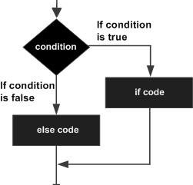

Conditional Statements
Conditional statements control the flow of your program based on certain conditions.

Slide 3
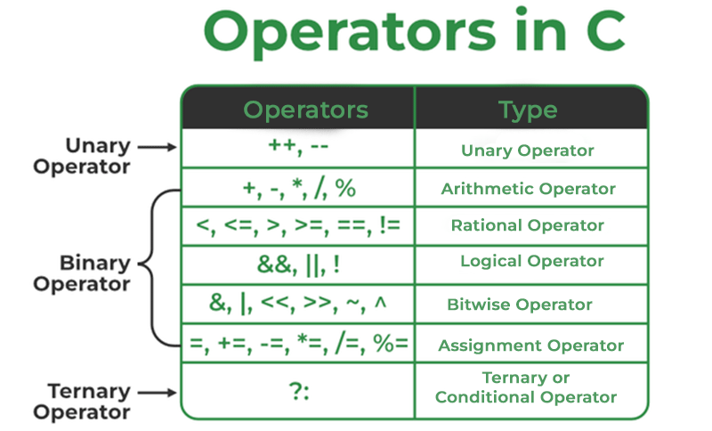

Slide 4
