Slide 1

Variables, Operators, Conditional Statement, Loop & Nested loop
Module-2

Slide 2
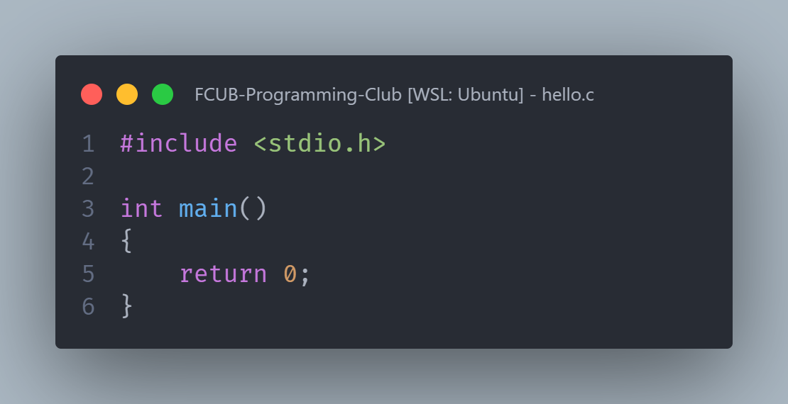
Scalation of a C program

Slide 3
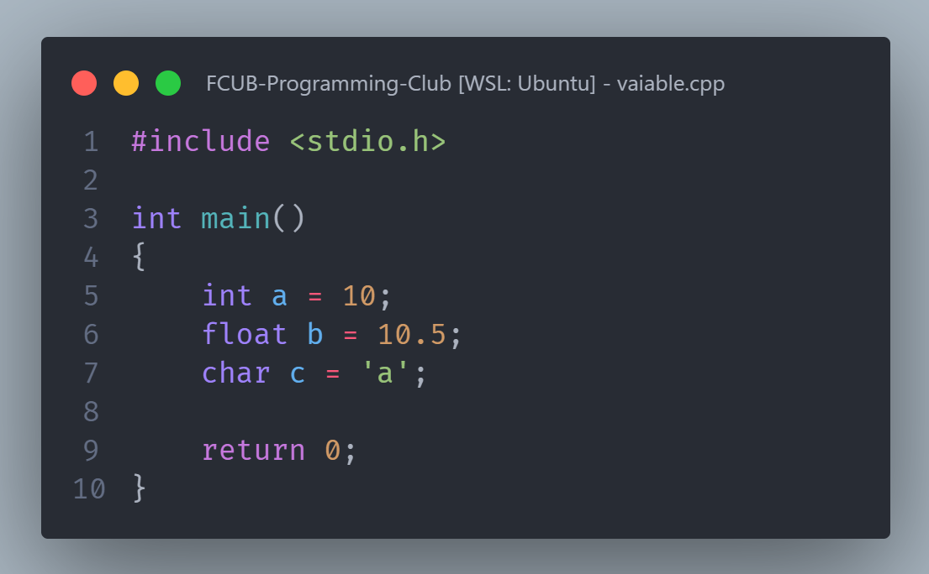
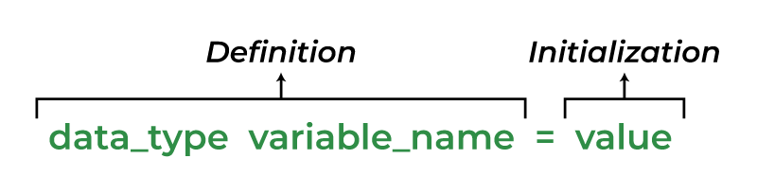
Variables Declaration

Slide 4
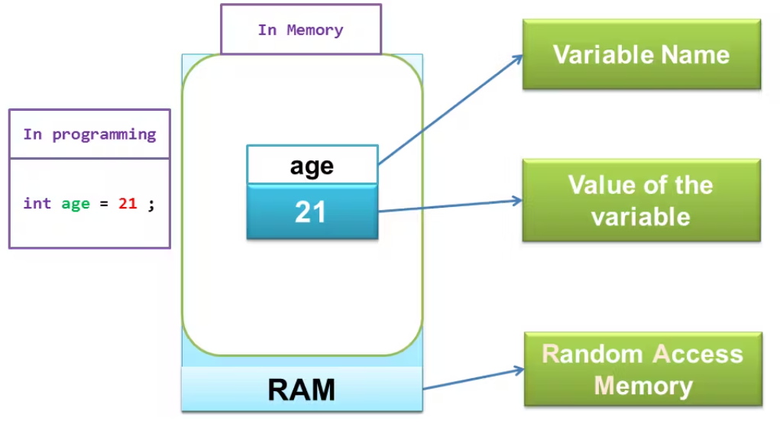
Variable in memory

Slide 5
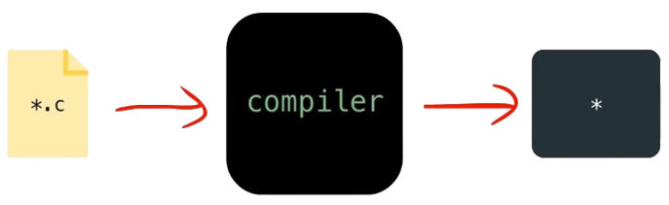
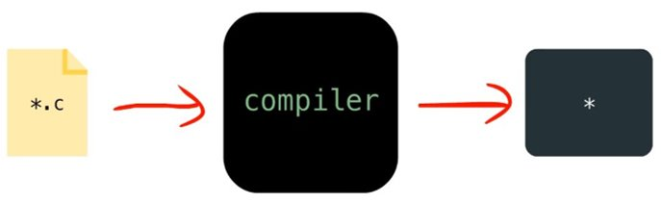

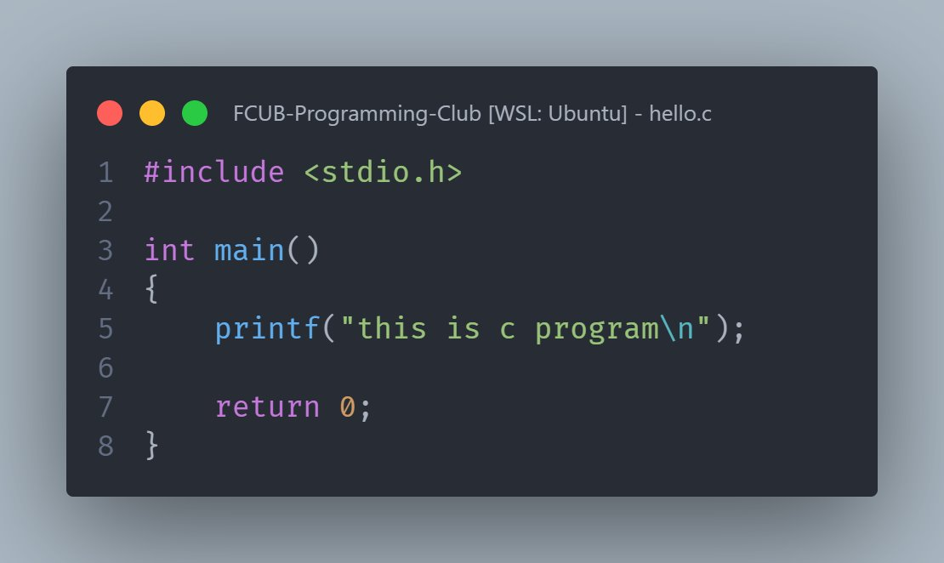
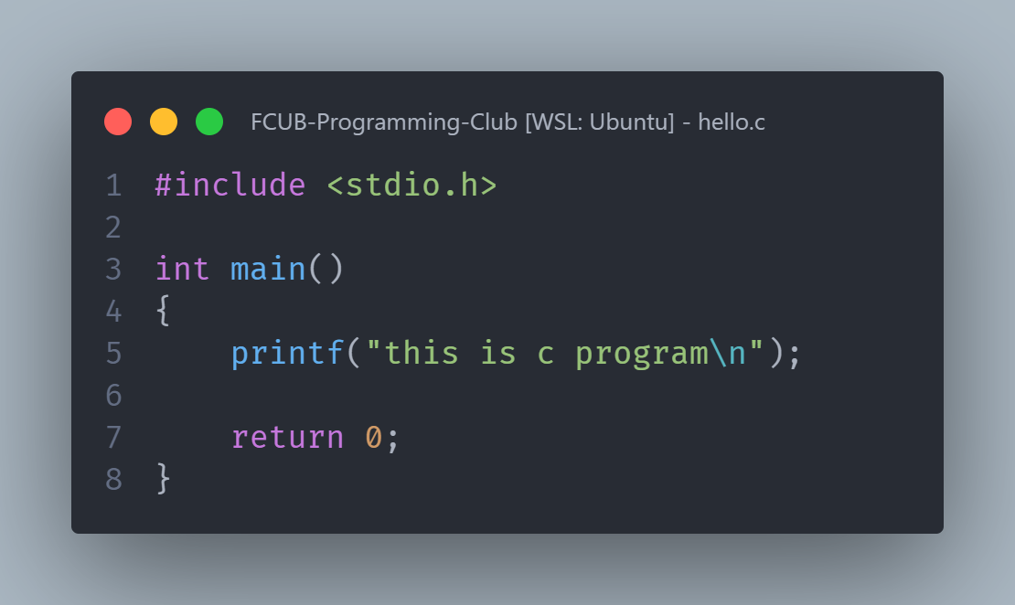


Compilation
gcc input.c -o output.c
input.c
output.c
Source code
Machine code

Slide 6
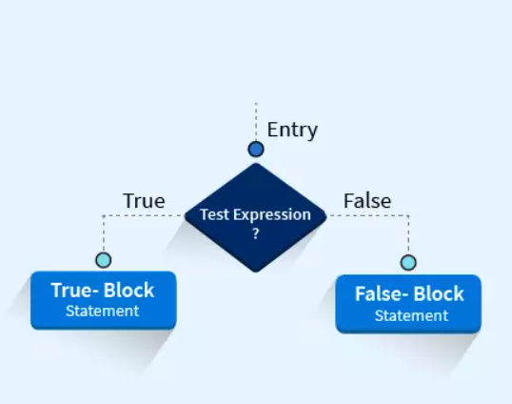

Conditional Statements
Conditional statements control the flow of your program based on certain conditions.

Slide 7
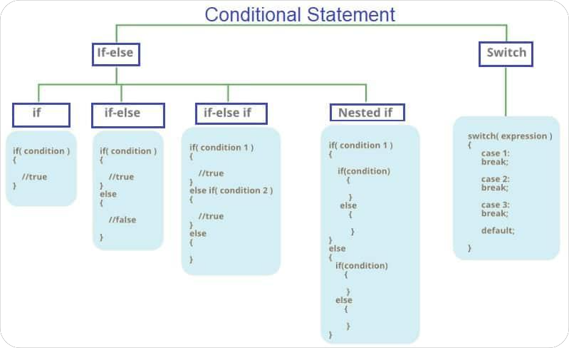

Slide 8
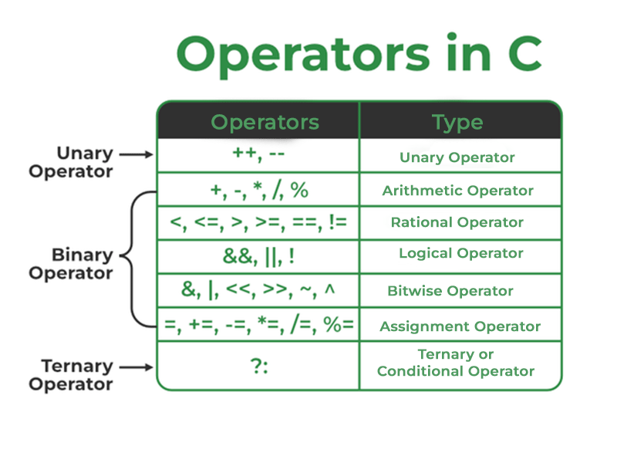

Slide 9

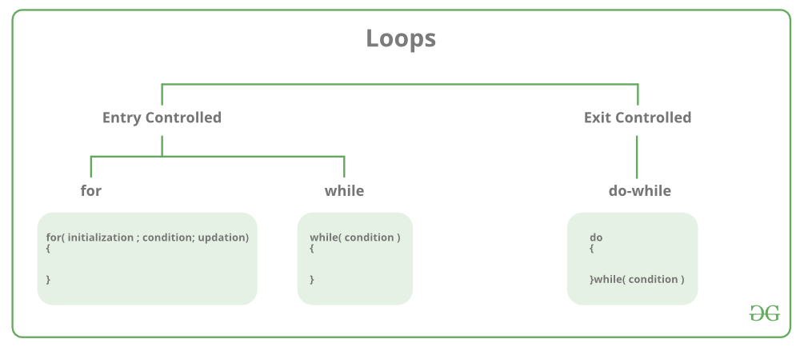
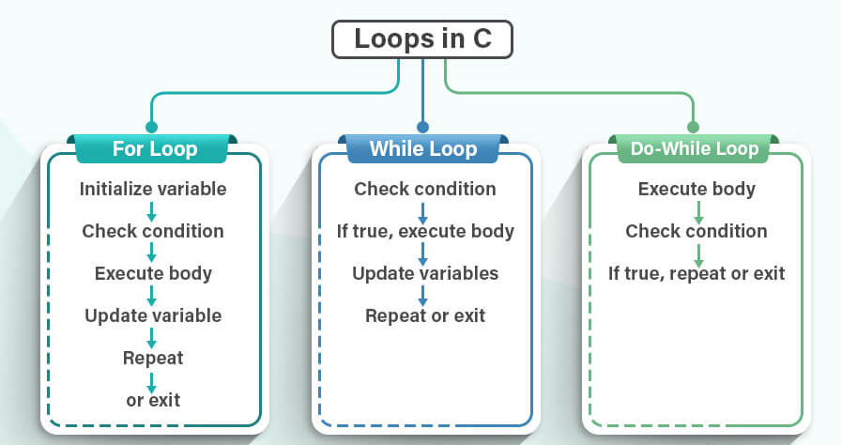

Slide 10
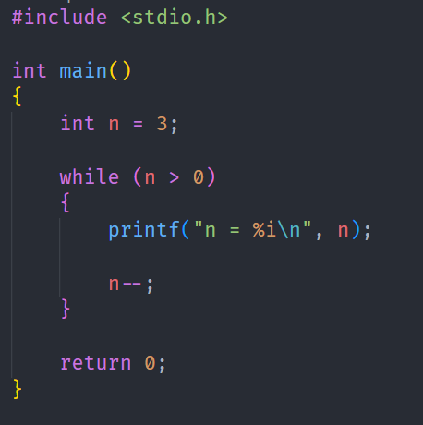
Iteration | n
1
3
0
2
2
2
1
3
True
False
True
3
1
Loop Breaks

Slide 11
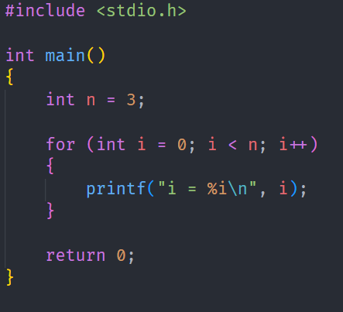
Iteration | i
1
0
2
1
2
0
1
3
3
3
2
True
False
Loop Breaks

Slide 12
Iteration | n
1
3
0
2
2
2
3
1
False
True
3
1
Loop Breaks

Slide 13

Thank You

