Slide 1
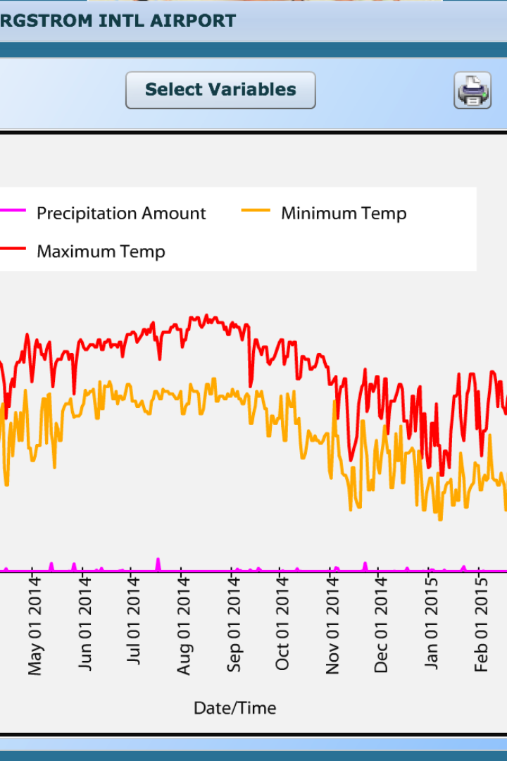
Machine Learning and Weather Data Analysis
Explore the powerful combination of machine learning and weather data analysis to unlock insights, predict weather patterns, and address climate change challenges.
Group Members: Shafeen Yousafzai
Humna khan Muqaddas Fatima

Slide 2

Introduction
1
Purpose of the Presentation
Discover the significance of weather data analysis and how machine learning revolutionizes its application.
2
Importance of Weather Data Analysis
Learn why analyzing weather data is crucial for making informed decisions and understanding environmental impacts.
3
Introduction to Machine Learning
Uncover the fundamentals of machine learning and its role in analyzing vast volumes of weather data.

Slide 3

Machine Learning in Weather Data Analysis
Definition of Machine Learning
Explore the concept of machine learning and how it enables data-driven insights in weather analysis.
How Machine Learning is Applied to Weather Data
Discover the techniques and algorithms employed to extract meaningful patterns from weather datasets.
Benefits of Using Machine Learning in Weather Data Analysis
Understand the advantages of leveraging machine learning for accurate weather predictions and climate analysis.

Slide 4

Examples of Machine Learning in Weather Data Analysis
Predicting Weather Patterns
Explore how machine learning algorithms can forecast weather conditions with higher precision and accuracy.
Forecasting Extreme Weather Events
Learn how machine learning models can identify and predict severe weather events, empowering early warnings.
Climate Change Analysis using Machine Learning
Discover how machine learning techniques aid in analyzing and understanding the impacts of climate change.

Slide 5

Challenges and Limitations
1
Data Quality and Availability
2
Interpretation of Results
3
Ethical Considerations of Using Machine Learning in Weather Data Analysis
Highlight the challenges associated with obtaining accurate and comprehensive weather datasets for machine learning analysis.
Discuss the complexities of interpreting machine learning models' outputs in weather data analysis.
Delve into the ethical dilemmas surrounding the use of machine learning in weather data analysis and the potential need for regulation.

Slide 6
Future Directions and Opportunities
1
Advancements in Machine Learning for Weather Data Analysis
Explore the cutting-edge developments in machine learning techniques and their potential for enhancing weather data analysis capabilities.
2
Integration of Machine Learning in Weather Forecasting Systems
Discuss the prospects of integrating machine learning models into existing weather forecasting systems to improve accuracy and reliability.
3
Potential Applications in Climate Modeling and Adaptation
Discover the potential for machine learning algorithms to aid in climate modeling and assist in developing effective adaptation strategies.

Slide 7

Conclusion
1
Summary of Key Points
2
Importance of Continuing Research in Machine Learning and Weather Data Analysis
Recap the main takeaways on the seamless integration of machine learning and weather data analysis.
Highlight the significance of ongoing research to unlock the full potential of machine learning in understanding and predicting weather phenomena.

