Slide 1

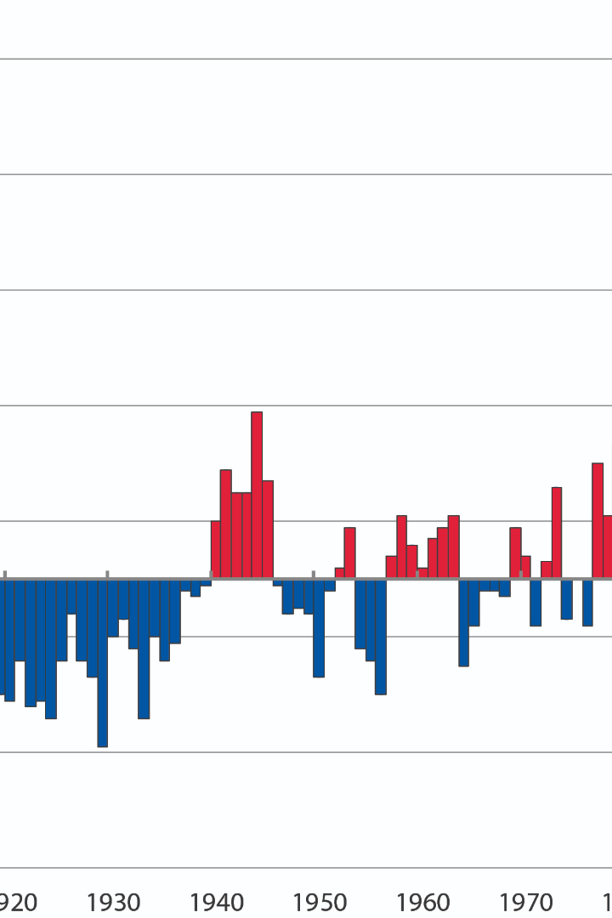
Weather Data Analysis: A Machine Learning Approach
Brief introduction of the analysis and the dataset (NOAA weather data) being used.
By: Shafeen Yousafzai
Humna Khan

Slide 2

Data Preprocessing
Explain the steps taken to handle null values, dropping columns with a high percentage of missing data, filling missing values using forward fill (ffill), and converting data types.

Slide 3

Data Exploration
Discuss how you explored the data, checked for duplicates, visualized certain columns (e.g., "snwd" - snow depth), and observed patterns or trends.

Slide 4

Model Development
Describe the process of creating a predictive model for "Total max temperature for tomorrow." Discuss using Ridge Regression for modeling and features used as predictors.

Slide 5
Backtesting
Explain the backtesting process used for evaluating the model's performance over time. Describe how you split the data into training and testing sets, trained the model, made predictions, and calculated metrics like Mean Absolute Error (MAE).

Slide 6

Functional Backtesting
Describe the functional backtesting approach used to evaluate model performance.

Slide 7

Model Evaluation
Share evaluation metrics such as Mean Absolute Error, Mean Squared Error, Root Mean Squared Error, and R-squared for both backtesting approaches.

Slide 8
Data Visualization
Include visualizations of the predictions against the actual values to illustrate the model's accuracy.

Slide 9

Conclusion
Summarize the findings, strengths, weaknesses of the model, and areas for improvement.

