Slide 1
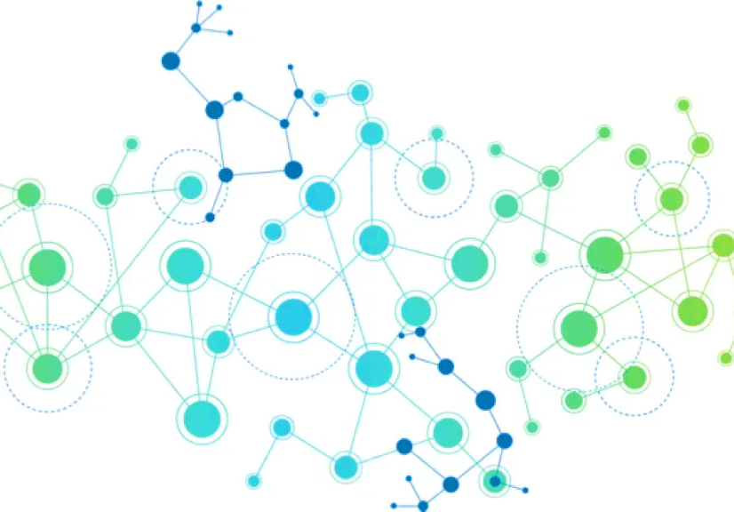

JetStream Graph Analytics on Streaming Data with Event-driven Hardware Accelerator
Shafiur Rahman Mahbod Afarin Nael Abu-Ghazaleh Rajiv Gupta
MICRO 2021

Slide 2
Streaming Graph Processing
Real-world graphs changes rapidly over time
Reevaluation of full graph is computationally expensive
Many vertices are not affected by the change
Full
Computation
Query
edge addition,
deletion
Full
Computation
Query

Slide 3
Incremental Recomputation
Reuse vertex states from previous evaluation
Approximate states for the initial states of new evaluations
Faster convergence
Reduced Computation
Full
Computation
Query
edge addition,
deletion
approximate
states
Incremental
Computation
Query

Slide 4
Event-Driven Execution Concept
Decouple the memory accesses from communication among vertices
Each vertex accesses its own properties only
Eliminates random reads of input set
Simplified memory access pattern
Simplified transaction-safety
Updates are queued as messages
Use the message for scheduling (message becomes events)
No separate active list maintenance
Fine-grained control over scheduling

Slide 5
Event-Driven Processing Example (SSSP)
1
2
3
4
5
6
7
8
9
10
11
12
13
V[:] ← InitialVertexProperty(V)
Queue ← InitialEvents(V)
while Queue is not empty do
(u, Δ) ← pop(Queue)
oldVal ← V[u]
V[u] ← Reduce(V[u], Δ)
if V[u] != oldVal then
foreach outgoing edge E(u,v) do
Δv ← Propagate(V[u], E.wgt)
Queue ← insert(v, Δv)
end
end
end
Initial Vertex Properties
Initial Events
Reduce function
Propagate Function
Local Termination condition
User defines

Slide 6
Event-Driven Processing Example (SSSP)
B
7
1
2
3
4
5
6
7
8
9
10
11
12
13
V[:] ← InitialVertexProperty(V)
Queue ← InitialEvents(V)
while Queue is not empty do
(u, Δ) ← pop(Queue)
oldVal ← V[u]
V[u] ← Reduce(V[u], Δ)
if V[u] != oldVal then
foreach outgoing edge E(u,v) do
Δv ← Propagate(V[u], E.wgt)
Queue ← insert(v, Δv)
end
end
end
V[i] = ∞ (source, 0)
7
2
A
C
2
E
3
8
6
5
D
Initialize Events
A
Queue
0
A
∞
B
∞
C
∞
D
∞
E
∞
Initialize Vertices

Slide 7
Event-Driven Processing Example (SSSP)
B
7
1
2
3
4
5
6
7
8
9
10
11
12
13
V[:] ← InitialVertexProperty(V)
Queue ← InitialEvents(V)
while Queue is not empty do
(u, Δ) ← pop(Queue)
oldVal ← V[u]
V[u] ← Reduce(V[u], Δ)
if V[u] != oldVal then
foreach outgoing edge E(u,v) do
Δv ← Propagate(V[u], E.wgt)
Queue ← insert(v, Δv)
end
end
end
7
2
A
C
2
E
Update
3
8
6
5
D
Min(x,y)
A
Queue
0
A
∞
0
B
∞
C
∞
D
∞
E
∞

Slide 8
Event-Driven Processing Example (SSSP)
B
7
1
2
3
4
5
6
7
8
9
10
11
12
13
V[:] ← InitialVertexProperty(V)
Queue ← InitialEvents(V)
while Queue is not empty do
(u, Δ) ← pop(Queue)
oldVal ← V[u]
V[u] ← Reduce(V[u], Δ)
if V[u] != oldVal then
foreach outgoing edge E(u,v) do
Δv ← Propagate(V[u], E.wgt)
Queue ← insert(v, Δv)
end
end
end
7
2
A
C
2
E
3
8
6
5
D
Propagate
A
B
C
D
Queue
0
7
3
8
Sum(x,y)
A
∞
0
0
B
∞
7
5
5
C
∞
3
3
D
∞
8
8
8
E
∞
13
12
12

Slide 9
Event-Driven Processing Example (SSSP)
B
7
1
2
3
4
5
6
7
8
9
10
11
12
13
V[:] ← InitialVertexProperty(V)
Queue ← InitialEvents(V)
while Queue is not empty do
(u, Δ) ← pop(Queue)
oldVal ← V[u]
V[u] ← Reduce(V[u], Δ)
if V[u] != oldVal then
foreach outgoing edge E(u,v) do
Δv ← Propagate(V[u], E.wgt)
Queue ← insert(v, Δv)
end
end
end
7
2
A
C
2
E
3
8
6
5
D
A
B
C
D
E
B
D
E
Queue
0
7
3
8
14
5
9
13
A
∞
0
0
B
∞
7
5
5
Iterate
C
∞
3
3
D
∞
8
8
8
E
∞
12
12

Slide 10
Event-Driven Processing Example (SSSP)
1
2
3
4
5
6
7
8
9
10
11
12
13
V[:] ← InitialVertexProperty(V)
Queue ← InitialEvents(V)
while Queue is not empty do
(u, Δ) ← pop(Queue)
oldVal ← V[u]
V[u] ← Reduce(V[u], Δ)
if V[u] != oldVal then
foreach outgoing edge E(u,v) do
Δv ← Propagate(V[u], E.wgt)
Queue ← insert(v, Δv)
end
end
end
Min()
E
E
E
14
13
13
Coalesce
A
B
C
D
E
B
D
E
Queue
0
7
3
8
14
5
9
13
A
∞
0
0
B
∞
7
5
5
C
∞
3
3
D
∞
8
8
8
E
∞
12
12

Slide 11
Event-Driven Processing Example (SSSP)
B
7
1
2
3
4
5
6
7
8
9
10
11
12
13
V[:] ← InitialVertexProperty(V)
Queue ← InitialEvents(V)
while Queue is not empty do
(u, Δ) ← pop(Queue)
oldVal ← V[u]
V[u] ← Reduce(V[u], Δ)
if V[u] != oldVal then
foreach outgoing edge E(u,v) do
Δv ← Propagate(V[u], E.wgt)
Queue ← insert(v, Δv)
end
end
end
7
2
A
C
2
E
3
8
6
5
D
A
B
C
D
E
B
D
C
E
Queue
0
7
3
8
13
5
9
15
12
A
∞
0
0
B
∞
7
5
5
Iterate
C
∞
3
3
D
∞
8
8
8
E
∞
13
12
12

Slide 12
Event-Driven Processing Example (SSSP)
B
7
1
2
3
4
5
6
7
8
9
10
11
12
13
V[:] ← InitialVertexProperty(V)
Queue ← InitialEvents(V)
while Queue is not empty do
(u, Δ) ← pop(Queue)
oldVal ← V[u]
V[u] ← Reduce(V[u], Δ)
if V[u] != oldVal then
foreach outgoing edge E(u,v) do
Δv ← Propagate(V[u], E.wgt)
Queue ← insert(v, Δv)
end
end
end
7
2
A
C
2
E
3
Vertex value unchanged Propagation Stops
8
6
5
D
A
B
C
D
E
B
D
C
E
Queue
0
7
3
8
14
5
9
15
12
A
∞
0
0
B
∞
7
5
5
C
∞
3
3
D
∞
8
8
8
E
∞
13
12
12

Slide 13
Event-Driven Processing Example (SSSP)
B
7
1
2
3
4
5
6
7
8
9
10
11
12
13
V[:] ← InitialVertexProperty(V)
Queue ← InitialEvents(V)
while Queue is not empty do
(u, Δ) ← pop(Queue)
oldVal ← V[u]
V[u] ← Reduce(V[u], Δ)
if V[u] != oldVal then
foreach outgoing edge E(u,v) do
Δv ← Propagate(V[u], E.wgt)
Queue ← insert(v, Δv)
end
end
end
7
2
A
C
2
E
3
8
6
5
D
A
B
C
D
E
B
D
C
E
Queue
0
7
3
8
14
5
9
15
12
A
∞
0
0
B
∞
7
5
5
Iterate
C
∞
3
3
3
D
∞
8
8
8
E
∞
13
12
12

Slide 14
Event-Driven Processing Example (SSSP)
B
7
1
2
3
4
5
6
7
8
9
10
11
12
13
V[:] ← InitialVertexProperty(V)
Queue ← InitialEvents(V)
while Queue is not empty do
(u, Δ) ← pop(Queue)
oldVal ← V[u]
V[u] ← Reduce(V[u], Δ)
if V[u] != oldVal then
foreach outgoing edge E(u,v) do
Δv ← Propagate(V[u], E.wgt)
Queue ← insert(v, Δv)
end
end
end
7
2
A
C
2
E
3
8
6
5
D
Queue Empty
A
B
C
D
E
B
D
C
E
Queue
0
7
3
8
14
5
9
15
12
A
∞
0
0
B
∞
7
5
5
Terminate
C
∞
3
3
3
D
∞
8
8
8
E
∞
13
12
12

Slide 15
Event-Based Processing for Streaming Graph
Benefits for Streaming Graphs
Decoupled Model
Isolates computation from communication (graph structure)
Graph mutations do not affect memory access pattern
Asynchronous Computation
Easier to represent streaming operations with reorderable computation model
Changes in graph structure can be encoded in events
Translates into robust high performance hardware implementation

Slide 16
Event Representation of Edge Addition
B
7
7
Event-driven execution is asynchronous
Events can be processed in any order
An added edge is equivalent to an event processed late
2
A
C
2
E
3
8
6
5
D
5
13 → 13
∞ → 7
14
E
B
7 → 5
13 → 12
3 → 3
A | B | C | D | E
Expected Values
0 | 5 | 3 | 8 | 5
New Values
0 | 5 | 3 | 8 | 5
∞ → 0
7
B
E
C
12
14
A
3
C
initial event
∞ → 3
D
8 → 8
8
D
E
15
C
13
∞ → 8
∞ → 13
3 → 3
12 → 5
3 → 3
E
7
C
Edge addition event
5

Slide 17
Processing an Edge Addition
B
7
7
2
Process Edge Additions
A
C
2
E
3
1
2
3
4
foreach added edge E(u,v) do
Δv ← Propagate(V[u], E.wgt)
Queue ← insert(v, Δv)
end
8
6
5
D
5
E
Queue
5
A
0
B
5
C
3
3
D
8
E
12
13

Slide 18
Processing an Edge Addition
B
7
7
2
Process Edge Additions
A
C
2
E
3
1
2
3
4
foreach added edge E(u,v) do
Δv ← Propagate(V[u], E.wgt)
Queue ← insert(v, Δv)
end
8
6
5
D
5
Regular Computation
E
C
Queue
1
2
3
4
5
6
7
8
9
10
11
while Queue is not empty do
(u, Δ) ← pop(Queue)
oldVal ← V[u]
V[u] ← Reduce(V[u], Δ)
if V[u] != oldVal then
foreach outgoing edge E(u,v) do
Δv ← Propagate(V[u], E.wgt)
Queue ← insert(v, Δv)
end
end
end
5
7
A
0
0
B
5
5
C
3
3
3
D
8
8
E
12
5
5

Slide 19
Event Representation of Edge Deletions
Edge deletions are more complex to handle
A deleted edge already carried updates through it
The affected vertices remain in incorrect state
The updates through a deleted edge must be reverted
B
7
7
2
A
C
2
E
3
8
6
5
D
13 → 13
∞ → 7
14
E
B
7 → 5
13 → 12
3 → 3
∞ → 0
7
B
E
C
12
14
A
3
C
initial event
∞ → 3
D
8 → 8
8
D
E
15
C
13
∞ → 8
∞ → 13
3 → 3

Slide 20
Event Representation of Edge Deletions
Reduce (Apply) function is monotonic
Vertex value cannot revert from an event.
Vertex must be reset, so that new events can update it
B
7
7
2
A
C
2
E
3
8
6
5
D
13 → 13
∞ → 7
14
E
B
7 → 5
13 → 12
3 → 3
A | B | C | D | E
Expected Values
0 | 7 | 15 | 8 | 13
Computed Values
0 | 5 | 3 | 8 | 12
∞ → 0
7
B
E
C
12
14
A
3
C
initial event
∞ → 3
D
8 → 8
8
D
E
15
C
13
∞ → 8
∞ → 13
3 → 3
3 → ∞
3 → 3
∞
C
Edge deletion event

Slide 21
Event Representation of Edge Deletions
Resetting the destination vertex is not enough
Other impacted vertices will not revert
All vertices impacted by this edge must be reset
B
7
7
2
A
C
2
E
3
8
6
5
D
13 → 13
∞ → 7
14
E
B
7 → 5
13 → 12
3 → 3
A | B | C | D | E
Expected Values
0 | 7 | 15 | 8 | 13
Computed Values
0 | 5 | ∞ | 8 | 12
∞ → 0
7
B
E
C
12
14
A
3
C
initial event
∞ → 3
D
8 → 8
8
D
E
15
C
13
∞ → 8
∞ → 13
3 → 3
3 → ∞
∞
B
5 → 5
∞
C
Edge deletion event
∞
D
8 → 8

Slide 22
Recovery Approach – Vertex Tagging
Separate Recovery Phase to reset all impacted vertices
Propagate a tag to all neighbors from an impacted vertex
Tagged vertices will reset themselves and propagate tag
Tag propagation stops when a vertex is already tagged
New events can restore reset vertices to correct state
B
7
7
2
A
C
2
E
3
8
6
5
D
5 → ∞
12 → ∞
∞ → ∞
A | B | C | D | E
Previous Values
0 | 5 | 3 | 8 | 12
After Recovery
0 | ∞ | ∞ | ∞ | ∞
delete event
B
∞
E
∞
C
∞
∞
C
3 → ∞
8 → ∞
∞ → ∞
∞
D
∞
E

Slide 23
Reapproximation After Edge Deletion
Reset vertices need new events to converge
Create new events from all incoming neighbors
Tagged vertex requests updates from neighbors
Neighbor vertices propagate their states
Reapproximation events restores the correct vertex states
B
7
7
2
A
C
2
E
3
8
6
5
D
∞ → 7
14
13 → 13
A
7
B
E
C
∞
B
∞ → ∞
A | B | C | D | E
After Recovery
0 | ∞ | ∞ | ∞ | ∞
∞
A | B | C | D | E
Expected Values
0 | 7 | 15 | 8 | 13
Approximation
0 | 7 | 15 | 8 | 13
E
C
∞ → ∞
B
7 → 7
17
A
8
D
E
C
13
15
21
Reapproximation
Events
∞ → 8
∞ → 13
∞ → 15
D
8 → 8
C
∞
D
∞ → ∞
∞
Evaluate query on this approximation for correct result
B
E
∞ → ∞
D
∞
E
∞ → ∞

Slide 24
Processing a Deleted Edge
B
7
7
Process Edge Deletions
2
A
C
2
E
1
2
3
foreach deleted edge E(u,v) do
Queue ← insert(v, ∞)
end
3
8
6
5
D
C
Queue
∞
A
0
B
5
C
3
3
D
8
E
12
5

Slide 25
Recovery from a Deleted Edge
B
7
7
Process Edge Deletions
2
A
C
2
E
1
2
3
foreach deleted edge E(u,v) do
Queue ← insert(v, ∞)
end
3
8
6
5
D
Recovery
1
2
3
4
5
6
7
8
9
10
while Queue is not empty do
(u, Δ) ← pop(Queue)
oldVal ← V[u]
V[u] ← Δ
if oldVal != Δ then
foreach outgoing edge E(u,v) do
Queue ← insert(v, Δ)
end
end
end
C
B
D
E
E
Queue
∞
∞
∞
∞
∞
A
0
0
B
5
∞
∞
C
3
∞
∞
∞
D
8
∞
∞
E
12
∞
∞
∞

Slide 26
Recovery from a Deleted Edge
B
7
7
Process Edge Deletions
2
A
C
2
E
1
2
3
foreach deleted edge E(u,v) do
Queue ← insert(v, ∞)
end
3
8
6
5
D
Recovery
1
2
3
4
5
6
7
8
9
10
while Queue is not empty do
(u, Δ) ← pop(Queue)
oldVal ← V[u]
V[u] ← Δ
if oldVal != Δ then
foreach outgoing edge E(u,v) do
Queue ← insert(v, Δ)
end
end
end
C
B
D
E
E
C
Queue
∞
∞
∞
∞
∞
∞
A
0
0
B
5
∞
∞
C
3
∞
∞
∞
D
8
∞
∞
E
12
∞
∞
∞

Slide 27
Recomputation after Recovery
Reapproximate Vertex States
B
7
7
1
2
3
4
5
foreach impacted vertex I do
foreach incoming edge E(u,v) of I do
Δv ← Propagate(V[u], E.wgt)
Queue ← insert(v, Δv)
end
2
A
C
2
E
8
6
5
D
B
B
C
D
D
E
E
Queue
7
∞
∞
8
∞
∞
∞
A
0
B
∞
C
∞
D
∞
E
∞

Slide 28
Recomputation after Recovery
Reapproximate Vertex States
B
7
7
1
2
3
4
5
foreach impacted vertex I do
foreach incoming edge E(u,v) of I do
Δv ← Propagate(V[u], E.wgt)
Queue ← insert(v, Δv)
end
2
A
C
2
E
8
6
5
D
Coalesce
B
B
C
D
D
E
E
Queue
7
∞
∞
8
∞
∞
∞
A
0
B
∞
C
∞
D
∞
E
∞

Slide 29
Recomputation after Recovery
Reapproximate Vertex States
B
7
7
1
2
3
4
5
foreach impacted vertex I do
foreach incoming edge E(u,v) of I do
Δv ← Propagate(V[u], E.wgt)
Queue ← insert(v, Δv)
end
2
A
C
2
E
8
6
5
D
Regular Computation
1
2
3
4
5
6
7
8
9
10
11
while Queue is not empty do
(u, Δ) ← pop(Queue)
oldVal ← V[u]
V[u] ← Reduce(V[u], Δ)
if V[u] != oldVal then
foreach outgoing edge E(u,v) do
Δv ← Propagate(V[u], E.wgt)
Queue ← insert(v, Δv)
end
end
end
B
C
D
E
E
E
Queue
7
∞
8
∞
14
13
A
0
B
∞
7
C
∞
∞
D
∞
8
E
∞

Slide 30
Recomputation after Recovery
Reapproximate Vertex States
B
7
7
1
2
3
4
5
foreach impacted vertex I do
foreach incoming edge E(u,v) of I do
Δv ← Propagate(V[u], E.wgt)
Queue ← insert(v, Δv)
end
2
A
C
2
E
8
6
5
D
Regular Computation
1
2
3
4
5
6
7
8
9
10
11
while Queue is not empty do
(u, Δ) ← pop(Queue)
oldVal ← V[u]
V[u] ← Reduce(V[u], Δ)
if V[u] != oldVal then
foreach outgoing edge E(u,v) do
Δv ← Propagate(V[u], E.wgt)
Queue ← insert(v, Δv)
end
end
end
B
C
D
E
C
B
D
Queue
7
∞
8
13
15
7
8
A
0
0
B
∞
7
7
∞
C
∞
∞
15
15
D
∞
8
8
8
E
∞
13
13

Slide 31
Selective vs Accumulative Algorithms
Selective algorithms
Reduce function keeps only one value (Min, Max, AND, OR)
Monotonic Nature
Only one edge contributes to the final value of a vertex
BFS, SSSP, SSSP, Connected Components, etc.
Accumulative Algorithms
Reduce function accumulates values (Sum, Product)
All active edge contributes to the value of a vertex
PageRank, Adsorption, etc.
Features of Accumulative algorithms
Non-monotonic: Edge deletion is equivalent to edge addition
Deletion events can revert effects of the deleted edge
Do not need separate recovery phase

Slide 32
Hardware Acceleration of Incremental Recomputation
GraphPulse is an asynchronous graph processing accelerator that leverages the decoupling of vertex updates and vertex communications to maximize memory access efficiency and increase parallelism.
GraphPulse provides hardware primitives to mitigate challenges of Event-Driven Execution
Features
Implements sorted queue which has high complexity in software
Enables coalescing within a queue without extra overhead
Implements low-cost event scheduling policy
JetStream extends GraphPulse for Streaming Graphs

Slide 33
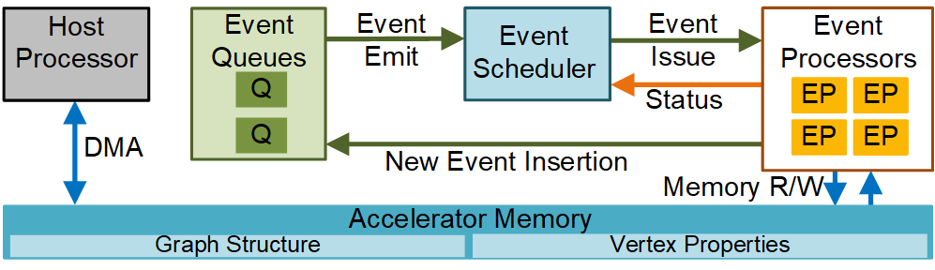
JetStream Base Architecture
Event Queue
In-place coalescing of events
Events sorted by destination
Fast insertion and issue of events
Event Scheduler
System-level control
Memory access friendly scheduling
Fetch, buffer, and issue events
Maximize parallelism
Event Processors
Accurate prefetching of target vertices
Optimize DRAM reads with prefetcher
Event generation in parallel
Abstract view of the JetStream Base Architecture (GraphPulse)

Slide 34
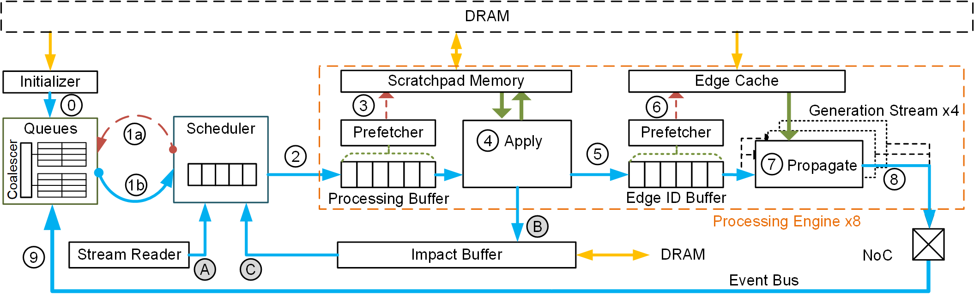
GraphPulse Original Datapath
(host initializes vertex data and event)
Read initial event to queue
1
a. Request events from queue
b. Queue emit events
(loop)
2
Issue events to available processor
Prefetches vertex properties
0
1
3
0
3
6
1
4
2
5
7
1
8
9
4
Apply vertex update
(Writeback to scratchpad)
Send to generation units
6
Prefetches edge list
Generates events (Propagate)
8
Events routed through event bus
Queue picks up events from bus
7
9
5
Typical Compute phase – Continues until queue is empty

Slide 35
Architectural Extensions for JetStream
Scheduler
Extended to handle multiple phase and creation of streaming events
Reset Logic
Apply unit extended for vertex reset from edge deletions
Coalescer
Extended to coalesce delete events
Reset Logic
Stream Reader
Reads list of modified edges
Sends to scheduler for creating events
Impact Buffer
Records list of impacted edges
Stores to and fetches from DRAM
NoC
Expanded to handle larger event size

Slide 36
JetStream Execution Flow
Stream Events Creation
3
4
5
2
7
Reset Logic
8
9
A
A
Read streamed edges from list
2
Pass edges through scheduler
3
4
5
Read source vertex value
7
8
9
Create and insert event

Slide 37
JetStream Execution Flow
Recovery From Deleted Edges
Reset Logic
B
1
9
Typical Compute Cycle using Reset Logic
B
Record impacted edges

Slide 38
JetStream Execution Flow
Reapproximation of Impacted Vertices
3
6
4
5
2
7
Reset Logic
8
9
C
C
Read list of impacted vertices
2
Pass vertices through scheduler
3
4
5
Read input edge pointers
6
7
8
9
Create request events
1
9
Finally, run Compute Cycle for result

Slide 39
Evaluated Systems
Hardware Simulation
Cycle-accurate hardware simulation of GraphPulse and JetStream
Based on Structural Simulation Toolkit
8x GraphPulse cores @1GHz
4x DDR3 17GB/s Channels
64MB on-chip memory
Software Systems
KickStarter for selective update algorithms and GraphBolt for accumulative update algorithms
36x Intel Core i9 processors @3GHz
24MB L2 Cache
4x DDR4 19GB/s Channels

Slide 40
Evaluated Workloads
Graph Algorithms
Six heavily-used graph processing applications
Incremental PageRank
Adsorption
Breadth-First Search
Single-source Shortest Path
Single-source Widest Path
Connected Components
Input Graphs
Five real-world graph workloads
Wikipedia Page Links (Wk)
Facebook Social Network (FB)
LiveJournal Social Network (LJ)
.uk Domain Web Crawl - 2002 (UK)
Twitter Follower Graph (TW)

Slide 41
JetStream Performance
JetStream achieves ~10x speedup over KickStarter’s incremental reevaluation
and ~15x speedup over complete reevaluation in GraphPulse
for algorithms with Selective Updates.

Slide 42
JetStream Performance
JetStream achieves ~53x speedup over GraphBolt’s incremental reevaluation
and ~10x speedup over complete reevaluation in GraphPulse
for algorithms with Accumulative Updates.

Slide 43
JetStream Incremental Computation Efficiency
JetStream requires less than 7% of vertex computation compared to GraphPulse for incremental computation of a mutated graph

Slide 44
JetStream Recovery Efficiency
74K
JetStream’s delete propagation technique finds a smaller set of impacted vertices for most cases compared to KickStarter

Slide 45
JetStream Performance with Different Batch Sizes
Sensitivity to Batch Size
JetStream performance increases significantly for smaller batch sizes. Speedup is more significant than KickStarter and GraphBolt.

Slide 46
Find More in Paper
Difference in execution methods for accumulative algorithms
Optimizations for delete propagations
Value Aware Propagation Technique
Dependency Aware Propagation Technique
More evaluations and sensitivity analysis
Power and area analysis

Slide 47
Summary
Incremental processing for streaming graphs
Capable of processing edge deletions
Reuses data and reduces evaluation cost
Adopts event-driven techniques for efficient incremental evaluation
Based on GraphPulse event-driven architecture
Extension retains original functionalities
Significant improved performance for incremental computation
13x speedup over complete recomputation in hardware accelerator
18x speedup over incremental recomputation in software frameworks

Slide 48

Thank You
Please contact the authors for question
mrahm008@ucr.edu
This presentation and recording belong to the authors. No distribution is allowed without the authors' permission.

