Slide 1

A Very Brief Introduction to Microfacet BRDFs
CS 419: Production Computer Graphics
UNIVERSITY OF ILLINOIS AT URBANA-CHAMPAIGN
Eric Shaffer

Slide 2
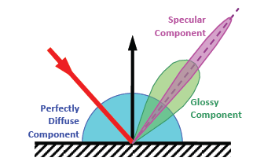
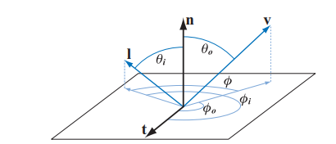
Bidirectional Reflectance Distribution Function

Slide 3
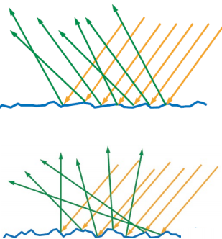
Modeling Microgeometry
Microgeometry → bumps bigger than light wavelength, invisible to eye
Rougher the surface, the blurrier the reflections

Slide 4
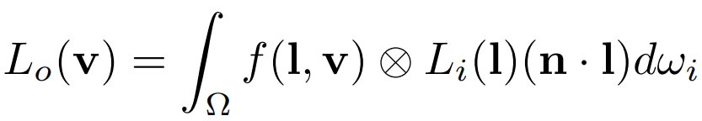
The Reflectance Equation

Slide 5
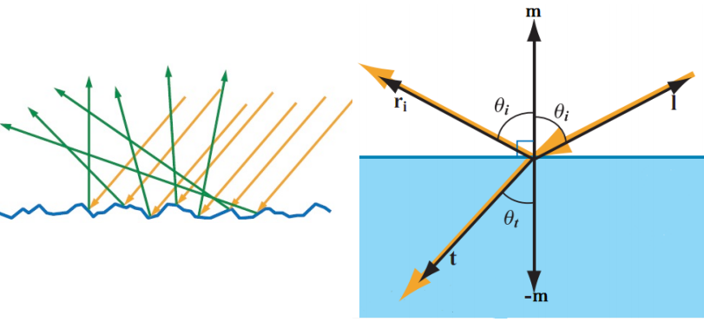
Microfacet Theory
Microfacet Theory allows us to derive BRDFs for general surfaces
Assumes each microfacet is a perfect mirror
Reflects light in just one outgoing direction
Outgoing direction depends on light direction l
Outgoing direction also depends on microfacet normal m

Slide 6
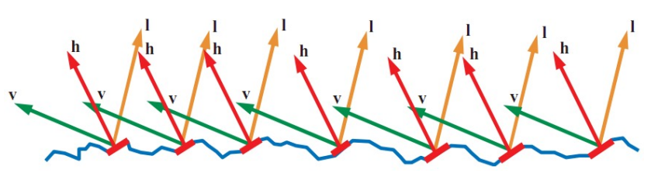
The Half Vector
Only microfacets with m halfway between l and v reflect any visible light
This direction is the halfway vector h

Slide 7
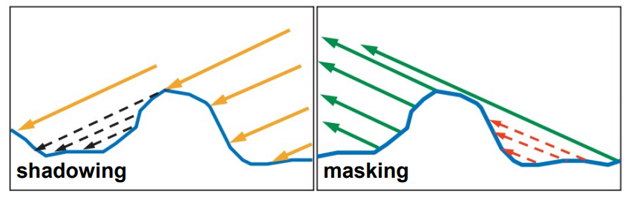
Shadowing and Masking
Not all microfacets with m=h contribute
Some will have incoming light blocked (shadowing)
Some will have view direction blocked (masking)

Slide 8
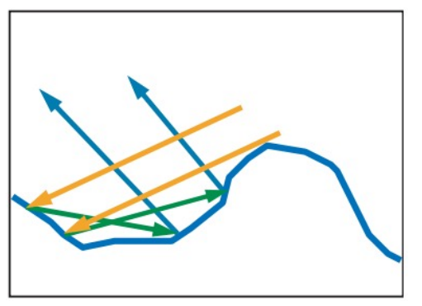
Multiple Surface Bounces
In reality, blocked light will continue to bounce
Some will eventually contribute to the BRDF
Microfacet BRDFs ignore this and assume that light is lost

Slide 9
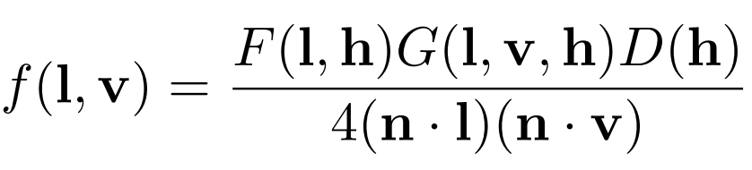
General Microfacet BRDF

Slide 10
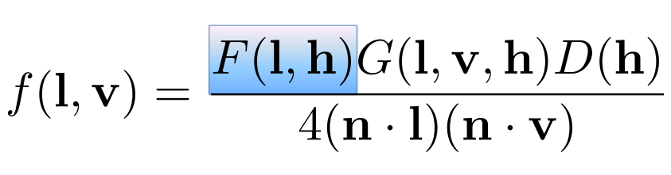
Fresnel Reflectance
Fraction of incoming light that is reflected
Depends on light direction and normal m
Tells us how much light hitting the microfacets with m=h gets reflected

Slide 11
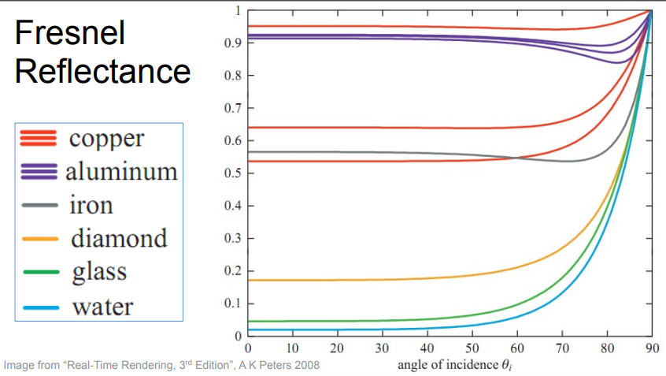
Fresnel Reflectance
Depends on refraction index of material (so...what it’s made of)
And depends on the angle of incidence

Slide 12
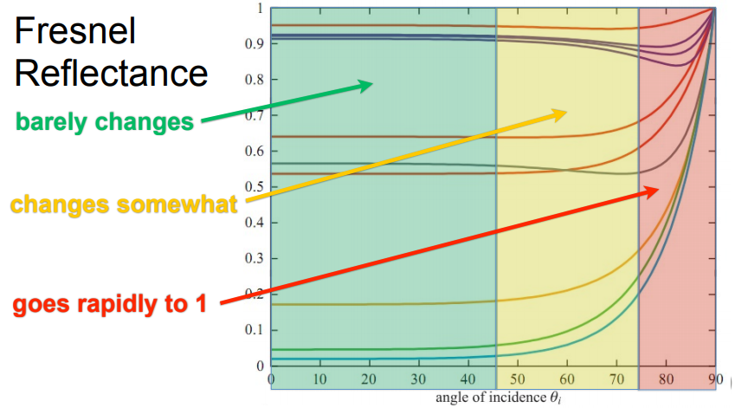
Fresnel Reflectance

Slide 13
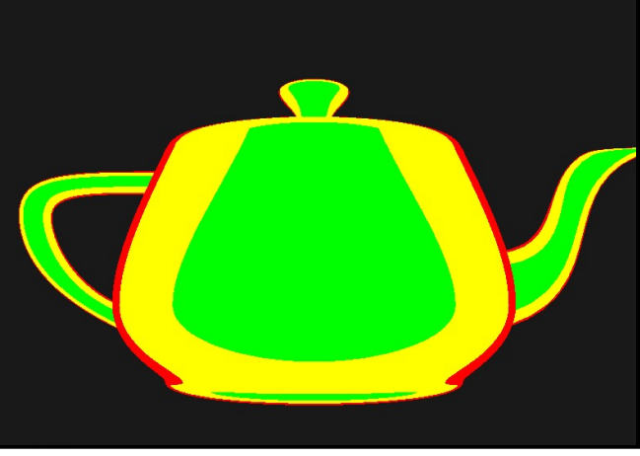
Reflectance Zones on a Teapot

Slide 14
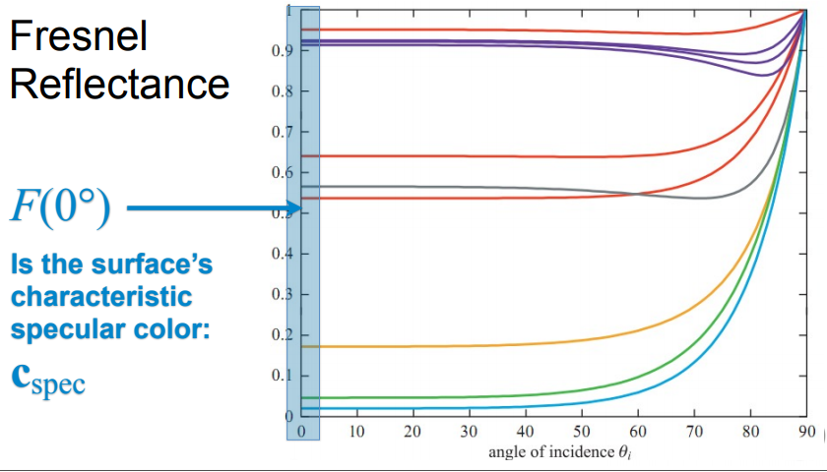
Characteristic Specular Color
Surface characteristic specular color is defines at 0 degrees
This means, when the light hits the surface aligned with m

Slide 15
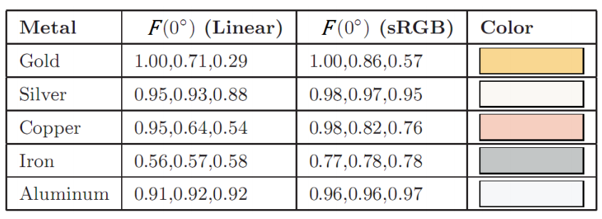
Metals
Metals have bright specular colors

Slide 16
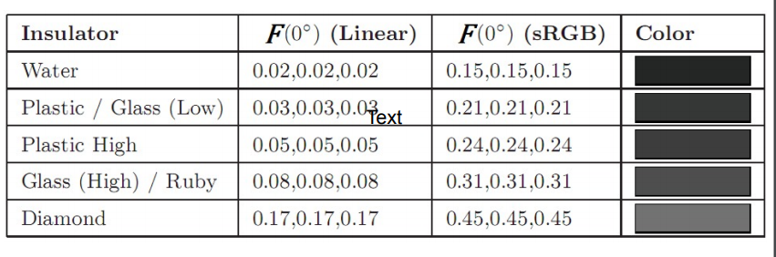
Insulators
Non-metals specular colors are achromatic and dark
Also have subsurface or diffuse color in addition to Fresnel (specular) color)

Slide 17
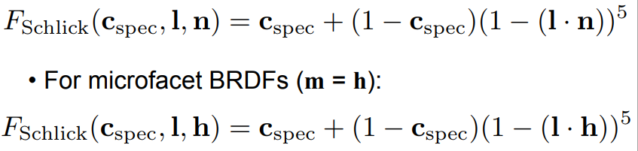
Schlick Approximation
Schlick approximation to Fresnel is commonly used
Cheap
Pretty accurate
Parameterized only by specular color

Slide 18
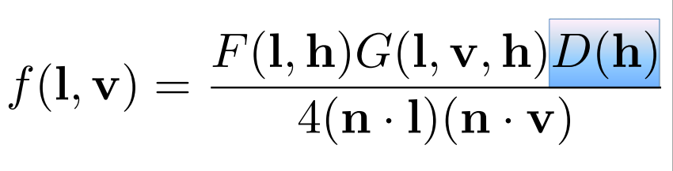
Normal Distribution Function
Gives the concentration of microfacet normal in a given direction
We need to know value for direction h
Determines size and shape of highlight

Slide 19
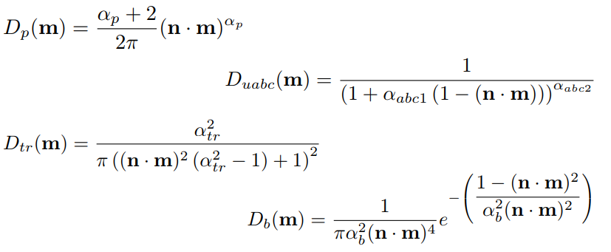
Some NDFs People Use

Slide 20
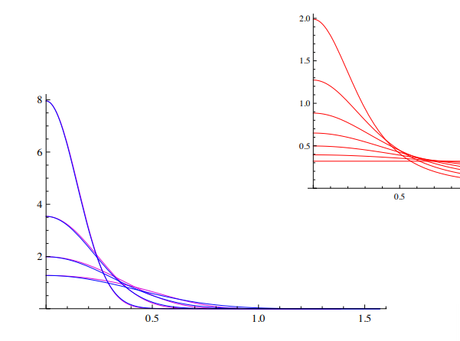
Some NDFs are Gaussian
Blobby highlights

Slide 21
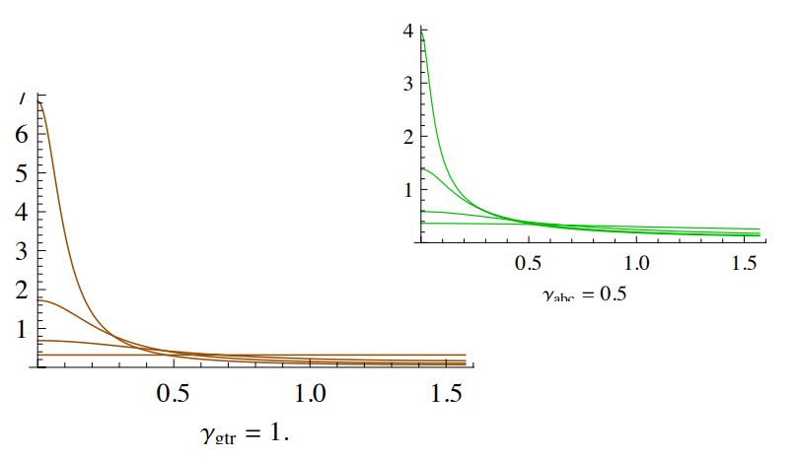
Some NDFs are Spiky with Tails
Results in halos

Slide 22
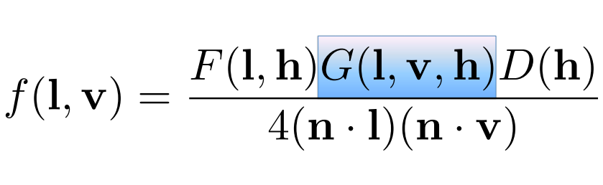
The Geometry Factor
Gives the chance that a microfacet with normal h is lit and visible

Slide 23
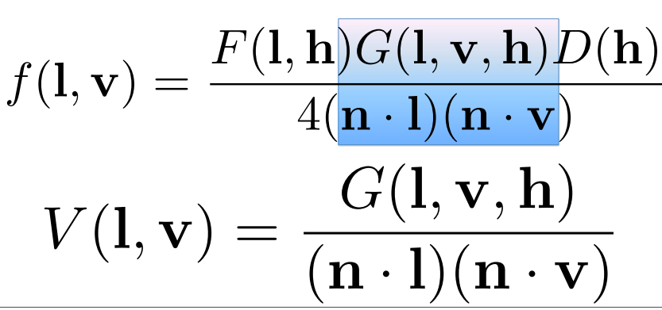
The Visibility Term
Can combine G with the foreshortening term

Slide 24
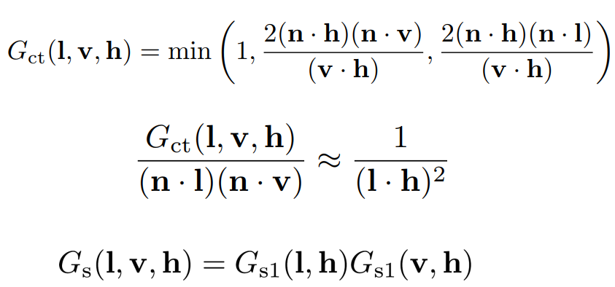
Other Options for G

Slide 25
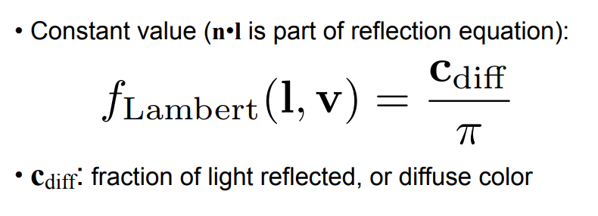
Need to Handle Diffuse and Subsurface
Lambert Model is simplest

