Slide 1
CS 419: Production Rendering
Eric Shaffer

Slide 2
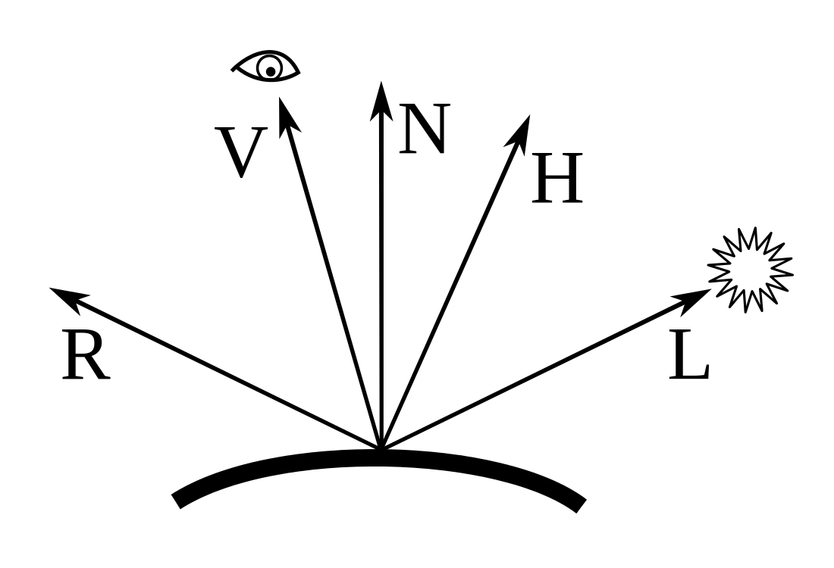

Phong Reflectance Model
Simple model of light reflection from a surface
ambient light
diffuse light
specular light
Ambient is a hack
Simply light throughout space
Diffuse scatters in all directions
Specular focuses in the mirror reflection direction

Slide 3
Phong Reflectance Model
V is the vector from surface point to eye
Only used for specular term
N is the surface normal
How can you compute it for sphere?
L is the vector from surface point to light
αis the shininess factor
What does a larger value do to reflections?
What makes a surface look smoother?
Use unit-length vectors
Dot products are cosine of angle

Slide 4
Phong Reflectance Model
Simple model of light reflection from a surface
k_{a}, k_{d}, k_{s} reflectance factors for the surface ambient, diffuse, specular all in RGB with values in [0,1]
i_{a}, i_{d}, i_{s} illumination from the lights diffuse and specular all in RGB with values in [0,1] the m subscript indicates which light

Slide 5
Walking through some code
You can grab a simple Python implementation https://github.com/shaffer1/UIllinois_Rendering
Code covers
Main rendering loop
Sphere class
ViewPort class
Ray class
Diffuse Phong shading
Code doesn’t include
Viewing
Plane plane or triangle
Sampling
Rendering multiple objects

