Slide 1
CS 419: Production Rendering
Shadows
Eric Shaffer

Slide 2
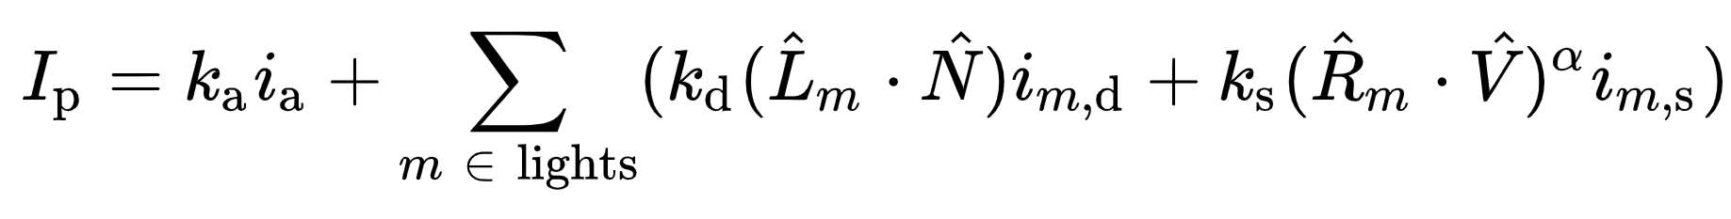
Revisiting the Phong Reflectance Model
◉ What happens when the light is behind the object?

Slide 3
Revisiting the Phong Reflectance Model
◉ Clamping negative cosine values to zero is a typical solution
The darkness on the far side of the sphere is from the shading…NOT shadows…

Slide 4
Simple Shading
◉ We model three types of light reflected/emitted by surfaces
◉ Ambient
◉ Light that has bounced around a scene…environmental light
◉ Specular
◉ Light reflected in a mirror-like fashion at surface
◉ Diffuse
◉ Light that has undergone transmission, absorption, scattering

Slide 5
Simple Shading
Shading
◉ Using an equation to compute outgoing radiance L_{o}
◉ Along a view ray v
◉ Based on material properties and light sources
We will focus on diffuse and specular shading
◉ c_{diff} = diffuse material color
◉ c_{spec} = specular material color

Slide 6
Diffuse Radiance
◉ Depends on
◉ light irradiance
◉ light direction vector l
◉ surface normal n
◉ diffuse material color c_{diff}
^{c}diff
L =
⊗ E_{L} max(n ⋅ l, 0)
diff
π

Slide 7
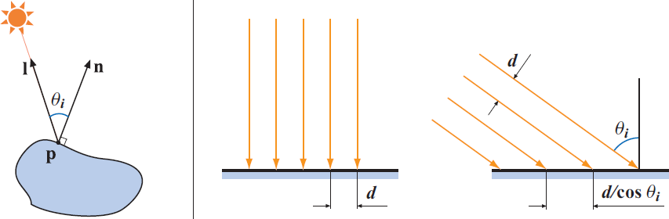
Irradiance
◉ Sum of energies of photons passing through a surface in 1 second
◉ per unit time and unit area
◉ Can represent it as an RGB vector
◉ Surface irradiance
E = E_{L} cos(θ_{i} ) = E_{L} max(n ⋅ l, 0)

Slide 8
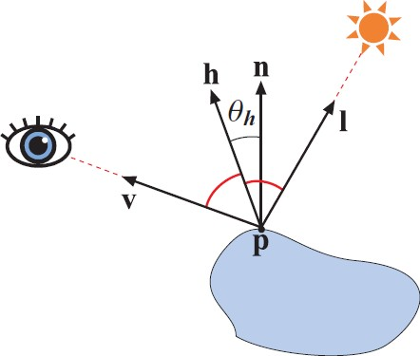
Specular Radiance (another version)
This one is from Real-Time Rendering
m is the shininess coefficient from the familiar Phong model
M_{spec} = c_{spec} ⊗ E_{L} max(n ⋅ l, 0)
l + v
h =
l + v
m + 8 8π
m
L_{spec} (v) =
cos θ_{h}M
spec

Slide 9
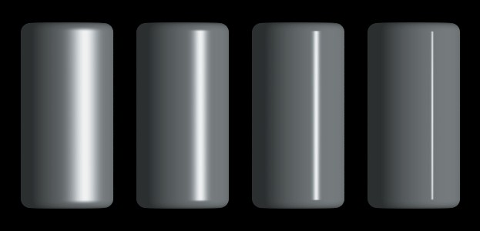
Varying Smoothness

Slide 10
Total Radiance and End Notes
◉ Total radiance = ambient+specular+diffuse
◉ What we’ve done here is like Blinn-Phong equation (1977)
◉ You’ll see variations of these…all produce similar results
◉ This simple model is usually used in real-time applications
◉ We’ll look at more advanced modeling based on BRDFs later

Slide 11



Shadows
◉ Easy to implement, can be computationally expensive
◉ Lights
◉ Point light has a position, emits light isotropically
◉ Directional lights have direction but no position
◉ For idealized lights (point and directional) shadows are hard-edged

Slide 12





Real Lights…Soft Shadows
Real lights have a finite area
Umbra is the shadow where no light is visible Penumbra is partial light
penumbra
umbra
2
(a)
(b)
(c)
1 3
(d)

Slide 13
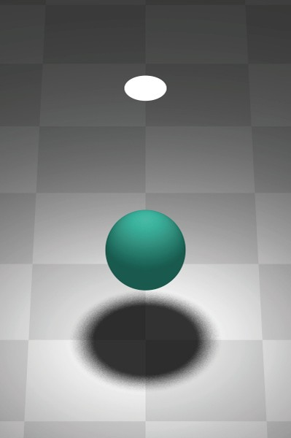
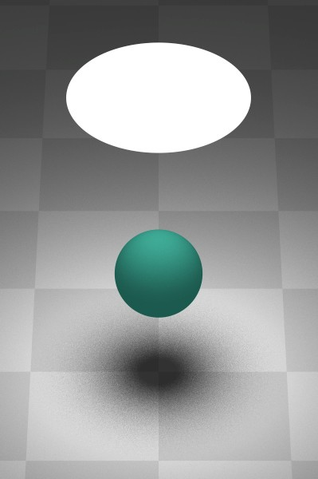
Real Lights…Soft Shadows

Slide 14
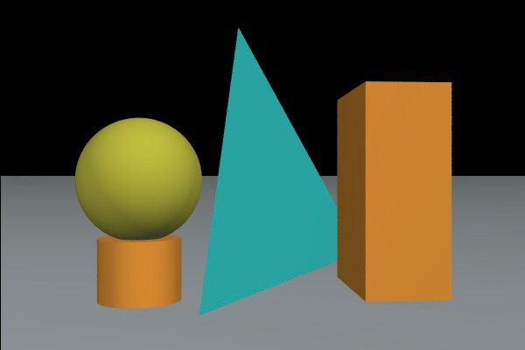
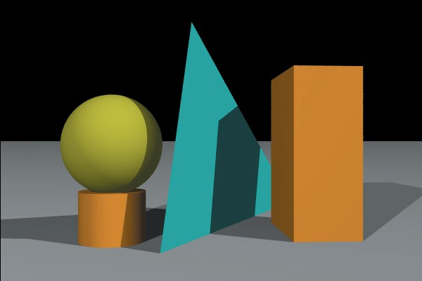
Shadows
How far are the objects above the plane?
What is their distance from the cameras and relative sizes? How many lights are there?

Slide 15
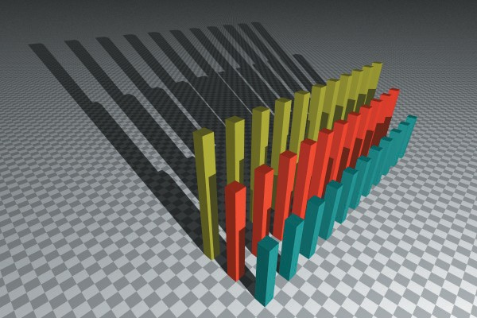
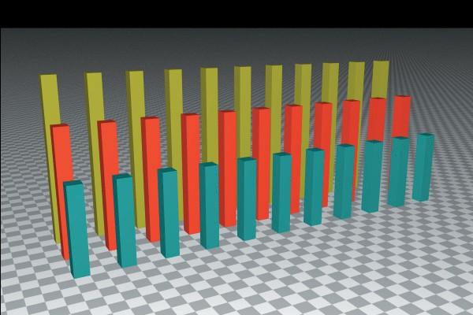
Shadows
What are the relative positions of the light and eyepoint?

Slide 16


Implementation
◉ Determine visibility of light be ray-casting
◉ Shadow ray origin is a object-primary ray hit point
◉ Direction is the light direction
◉ For point lights, use light position – hit point
b
shadow rays
a
primary rays

Slide 17
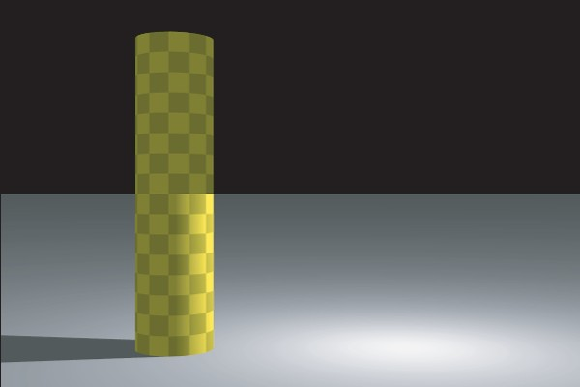
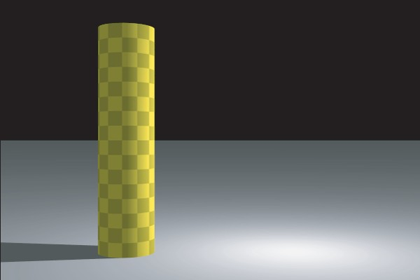


What Went Wrong?

Slide 18


What Went Wrong?
this shadow ray hits the plane
this shadow ray doesn't hit any objects
plane

Slide 19
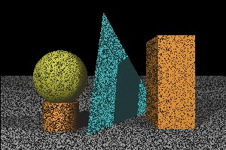
What Went Wrong?

Slide 20
Rays from Objects
◉ Need to add an εvalue to ray origin
◉ Move it slightly in direction of ray…
◉ Otherwise, numerical issues can result in hitting the object surface
◉ Define a constant for each geometric object type

Slide 21

Shadows Can Be Expensive
arbitrary number of shadow rays
single primary ray

