Slide 1

A Very Brief Introduction to Real-Time Ray Tracing
CS 419: Production Computer Graphics
UNIVERSITY OF ILLINOIS AT URBANA-CHAMPAIGN
Eric Shaffer

Slide 2
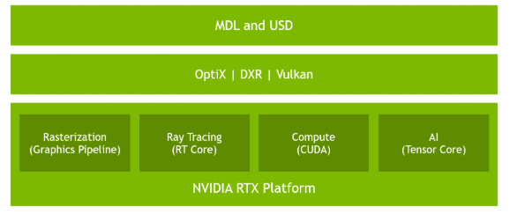
NVIDIA RTX platform
RTX is a set of APIs and SDKs to access the capabilities of Turing GPUs

Slide 3
DirectX Ray Tracing (DXR)
Extension of DirectX 12
Ray tracing GPU work is dispatched via command lists and queues that the application schedules.
Ray tracing shaders are dispatched as grids of work items, similar to compute shaders.
The application synchronizes GPU work and resources, as it does with rasterization and compute.
Ray tracing and other dispatch types share all resources such as textures, buffers, and constants.
Shader compilation is explicit and therefore under full application control.

Slide 4
New DXR Concepts for DirectX
Ray Tracing Pipeline State Objects compiled shader code executed during a ray tracing dispatch
Acceleration Structures data structures used to accelerate ray tracing
Shader Tables define the relationship between ray tracing shaders, their resources (textures, constants, etc), and scene geometry

Slide 5
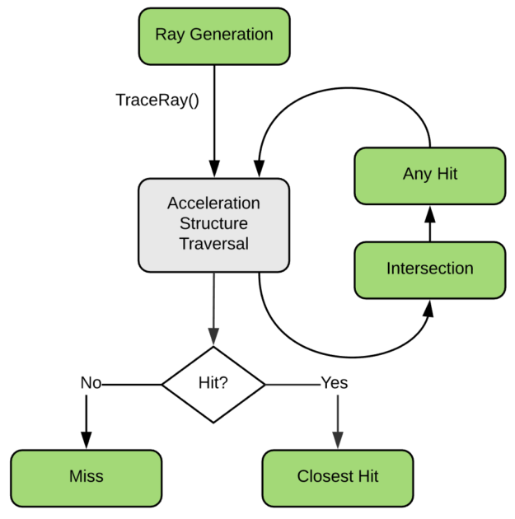
Ray-Tracing Pipeline
Ray Generation Shader HLSL code that can call TraceRay()
Intersection and any hit shaders invoked by TraceRay() for potential intersections
Optimized Triangle-Ray Intersection in the API already
Once TraceRay() has completed the search for ray-scene intersections, either a closest hit or a miss shader is invoked

Slide 6
Ray-Tracing Pipeline
These shaders defines a single-ray programming model.
Each GPU thread handles one ray at a time and cannot communicate with other threads or see other rays currently being processed.
The main way for the different shader types to communicate with each other is the ray payload.
The payload is simply a user-defined struct that’s passed as an inout parameter to TraceRay(). Any hit, closest hit, and miss shaders can read and write the payload, and therefore pass back the result of their computations to the caller of TraceRay.

Slide 7
// An example payload struct. We can define and use as many different ones as we like. struct Payload { float4 color; float hitDistance; };
// The acceleration structure we'll trace against. This represents the geometry of our scene.
RaytracingAccelerationStructure scene : register(t5);
[shader("raygeneration")]
void RayGenMain()
{
// Get the location within the dispatched 2D grid of work items (often maps to pixels, so this could represent a pixel coordinate).
uint2 launchIndex = DispatchRaysIndex();
// Define a ray, consisting of origin, direction, and the t-interval we're interested in.
RayDesc ray;
ray.Origin = SceneConstants.cameraPosition.
ray.Direction = computeRayDirection( launchIndex ); // assume this function exists
ray.TMin = 0;
ray.TMax = 100000;
Payload payload;
// Trace the ray using the payload type we've defined. Shaders that are triggered by this must operate on the same payload type.
TraceRay( scene, 0 /*flags*/, 0xFF /*mask*/, 0 /*hit group offset*/, 1 /*hit group index multiplier*/, 0 /*miss shader index*/, ray, payload );
outputTexture[launchIndex.xy] = payload.color;
}
An Example Ray Generation Shader in HLSL

Slide 8
An Example Closest Hit Shader in HLSL
// Attributes contain hit information and are filled in by the intersection shader.
// For the built-in triangle intersection shader, the attributes always consist of
// the barycentric coordinates of the hit point.
struct Attributes { float2 barys; };
[shader("closesthit")]
void ClosestHitMain( inout Payload payload, in Attributes attr )
{
// Read the intersection attributes and write a result into the payload.
payload.color = float4( attr.barys.x, attr.barys.y, 1 - attr.barys.x - attr.barys.y, 1 );
// Demonstrate one of the new HLSL intrinsics: query distance along current ray
payload.hitDistance = RayTCurrent();
}

Slide 9
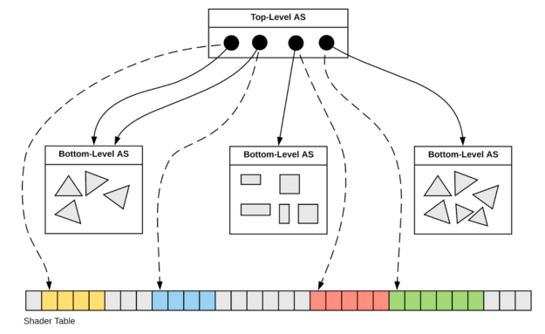
Acceleration Structures
Application builds these data structures explicitly using the new command list method BuildRaytracingAccelerationStructure()
NVIDIA RTX contains optimized construction algorithms that produce high quality results
Very fast…can build and update these structures in real time.

Slide 10
Acceleration Structures
All geometry in a scene is represented by two levels of acceleration structures.
Bottom-level acceleration structures are built from geometric primitives (e.g. triangles)
Top-level acceleration structures are built from references to bottom-level structures.
We call these references instance descriptors.
Each instance descriptor includes
a transformation matrix to position it in the scene,
and an offset into the shader table to locate material information

Slide 11
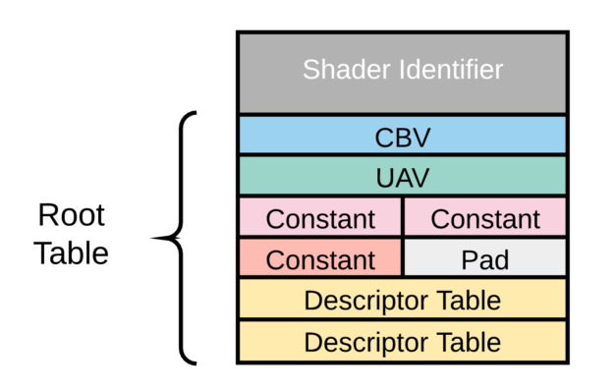
Shader Tables
The shader table ties together shaders and acceleration structures
Defines which shader is associated with which object in the scene.
Holds information about the resources accessed by each shader, such as textures, buffers, and constants

Slide 12
Shader Tables
A shader table is an array of equal-sized records.
Each record associates a with a set of resources. Usually there exists one record per geometry object Shader tables often have thousands of entries

Slide 13
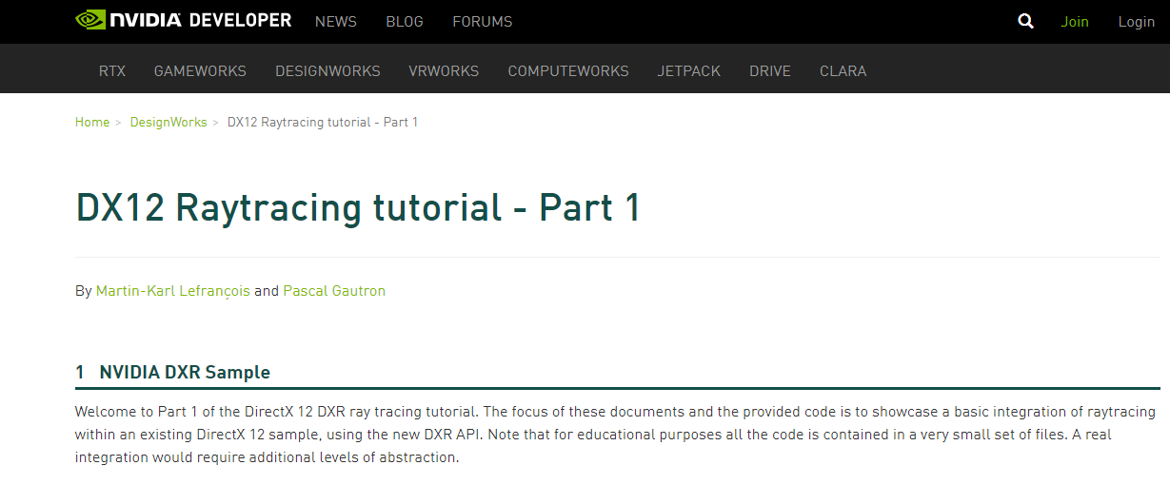
Going Further…..
https://developer.nvidia.com/rtx/raytracing/dxr/DX12-Raytracing-tutorial-Part-1

Slide 14
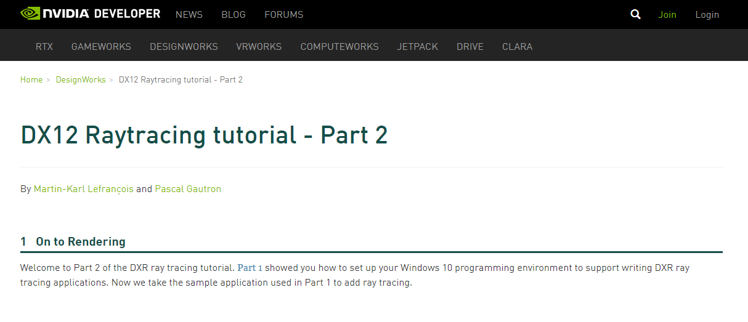
Going Further…..
https://developer.nvidia.com/rtx/raytracing/dxr/DX12-Raytracing-tutorial-Part-2

