Slide 1
CS 419: Production Rendering Sampling a Circle Ambient Occlusion Diffuse Shading
Eric Shaffer

Slide 2
Sampling from a Disk
Needed for
simulating depth of field effect (camera lens is circular)
Disk lights
We know how to sample a unit square. Can we use that?
Rejection Sampling:
Notes:
One problem N-Rooks distribution condition can fail

Slide 3
Concentric Mapping
Preserves all samples
Samples close on square also close on disk
Breaks the square into quadrants, maps each quadrant

Slide 4
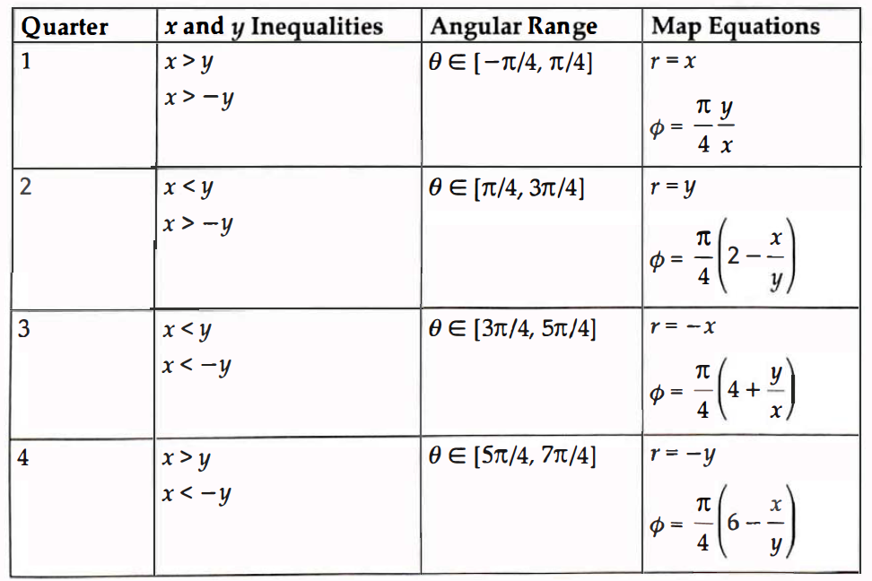
Concentric Mapping
Map x,y to polar values
r mapped from coordinate along axis through the quadrant
Polar angle derived from quotient in [-1,1]

Slide 5
Results

Slide 6
Sampling on a Unit Hemisphere
Later, when a ray hits an object we will
Center a hemisphere on a hit point
We will shoot shadow rays, reflected rays, transmission rays
These rays can be used to simulate
ambient occlusion
glossy reflection/transmission

Slide 7
Ambient Occlusion
Ambient illumination
Constant level of illumination throughout a scene
Surface that only has ambient illumination appears as a constant color
Occlusion
Let hemisphere H enclose a surface point p
Amount of illumination at p depends on amount of H unblocked
include a visibility term in the model

Slide 8
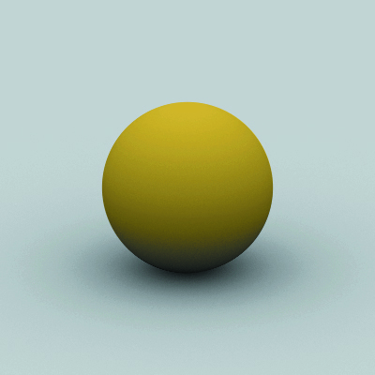

Ambient Occlusion

Slide 9
Cosine Distributions
Sampling distribution varies with Θ

Slide 10
Mapping
Map (r₁, r₂) on unit square to (φ,θ)
φ is azimuth angle
θis polar angle
Notes:
How will a uniform square dist. be distributed in the 2 hemi directions?

Slide 11
But we need to shoot rays…
Can define a local orthonormal basis on the surface
Convert sample points to (u,v,w) coordinates

Slide 12
Cosine Power Distribution of Hammersley Samples

Slide 13
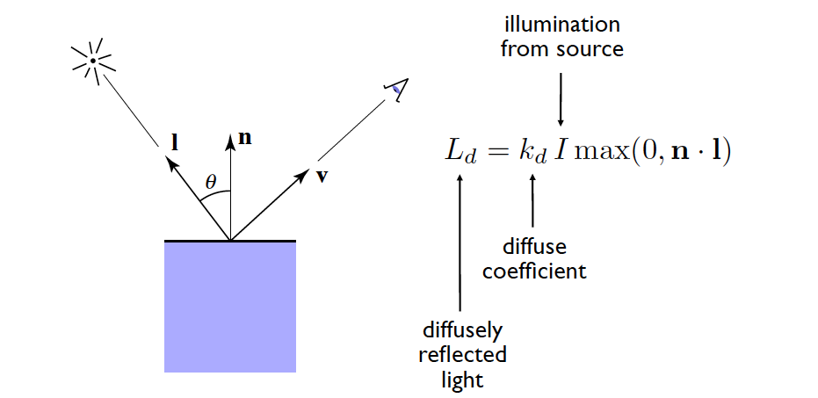
Diffuse (Lambertian) Shading
For MP1, you are asked to do some very simple shading
Just implement the diffuse term of the Phong illumination model
Notes:
Try 0.9

Slide 14
Diffuse (Lambertian) Shading
Need to compute the normal vector for the surface at the hit point
Compute a light direction
Take the dot product of these 2 unit length vectors
The illumination from the source is an rgb value
The diffuse coefficient is in [0,1]
What is missing from this model that you should probably add?
Notes:
Try 0.9

