Slide 1
CS 419: Production Rendering Introduction to Monte Carlo Methods
Eric Shaffer

Slide 2
The Power of Randomization
Randomization is an important tool in algorithm design.
Las Vegas algorithm: uses randomness but always yields same result for same input
Monte Carlo algorithm: give different results depending on “random” inputs used…give right answer on average

Slide 3
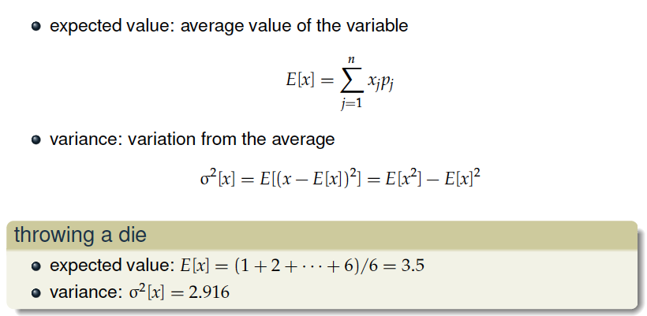
Expected Value and Variance

Slide 4
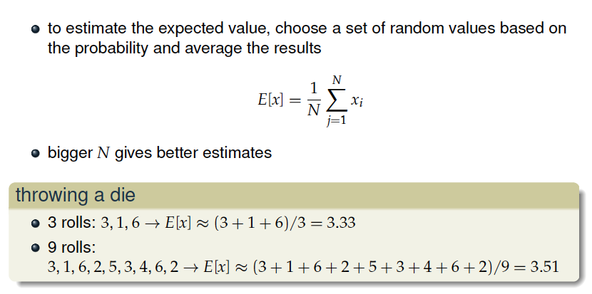
Estimated E[x]

Slide 5
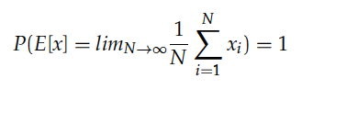
Law of Large Numbers
As the number of samples goes to infinity, the error goes to zero and the answer converges to the correct number

Slide 6
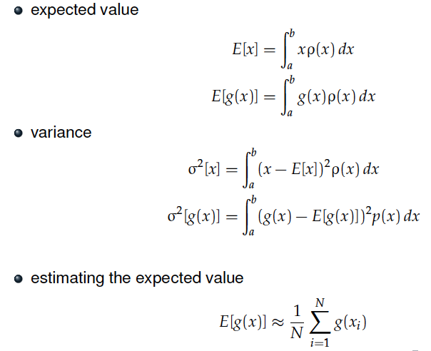
Continuous Versions

Slide 7
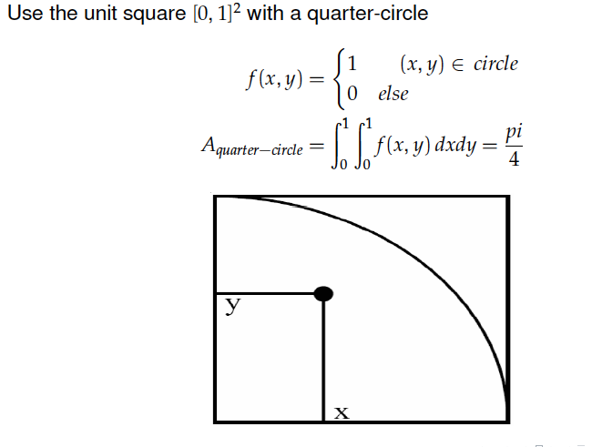
2D Example…computing π

Slide 8
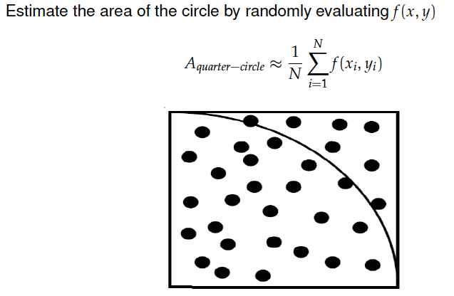
2D Example…computing π

Slide 9
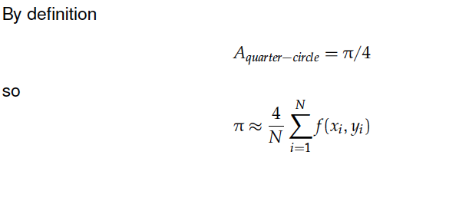
2D Example…computing π

Slide 10
1D Example
Monte Carlo estimator for integral I

Slide 11
Central Limit Theorem
If you are sampling an average, the distribution of the average approaches the normal distribution, even if the the distribution being sampled from is not normal
As N approaches infinity, the estimate lies in a narrower band around the expected value of the integral with higher probability
Within three standard deviations 99.7% of the time
Standard deviations vary as 1/√N

Slide 12
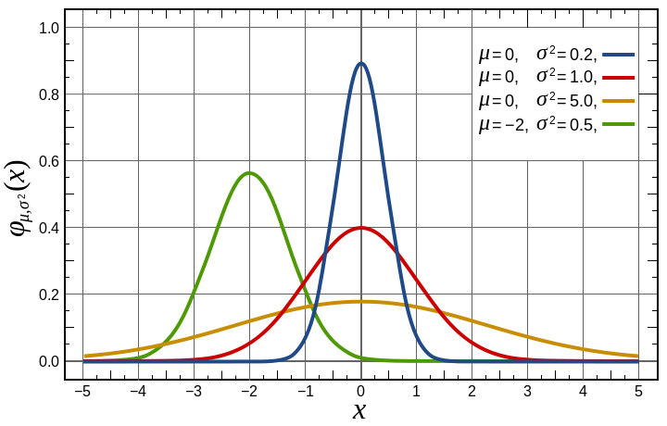
Larger N Reduces Variance

Slide 13
Variance Reduction
Variance V=σ²
Based on what we’ve seen, if we wanted to cut error in an N sample estimate in half how many samples would we need to take?
Monte Carlo methods converge slowly
But often are the only realistic option
Variance reduction techniques can help

Slide 14
Importance Sampling
Do not sample uniformly
Sample with a density that has a similar shape to the shape of f(x)

Slide 15
Summary: Monte Carlo Integration
Computing the expected value of a function is an integral
We can estimate expected value using random sampling
By the Law of Large Numbers
So…we can estimate an integral by sampling
Each integral estimate is an average
These averages form a normal distribution
By the Central Limit Theorem
The estimate will fall within 1 standard dev. with high probability
Can reduce the standard deviation by using more samples in the avg.
Error reduction behaves like the function

Slide 16
Stochastic Simulation with MC
Two requirements for Monte Carlo
Know which probability distribution you need to sample
Generate sufficiently random numbers
Random Numbers
Most Random Number Generators (RNGs) are pseudo-random
Any idea why?
You can get faster convergence with a quasi-random sequence
Doesn’t clump, samples more or less uniform across domain
Hammersley and Halton are examples
Why not just use a uniform grid of samples?

