Slide 1
CS 419: Production Rendering Geometric Data Structures: Regular Grids
Eric Shaffer

Slide 2
Objectives
Be able to use geometric data structures to accelerate ray-tracing
Know how to compute/intersect a bounding box
Be able to implement a regular grid to accelerate ray tracing

Slide 3
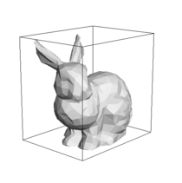
Bounding Boxes
Complex geometric models require expensive tests for ray intersections
Boxes are fast to test for ray intersection
Can implement a “quick rejection” test on the bounding box of a complex object
Usually, lots of rays will miss an object

Slide 4
Axis-Aligned Bounding Box
Box is defined by
min point p₀=(x₀,y₀,z₀)
max point p₁=(x₁,y₁,z₁)
Box is
How can we efficiently compute the box?
Imagine you are given a triangle mesh… what is the bounding box for all those triangles?

Slide 5
Box-Ray Intersection Test
Box is defined by slabs along each axis
We will look at 2D case and generalize to 3D
Ray misses the box when the slab intersection intervals do not overlap
How would you test this?

Slide 6
Box-Ray Intersection Test
Check if largest entering t value is less than smallest exiting t value

Slide 7
Box-Ray Intersection Test
But ray can also miss if smallest exiting t value is negative

Slide 8
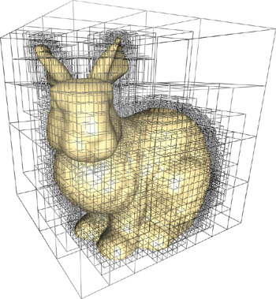
Geometric Data Structures
We can do more than just use bounding boxes
What about a data structure that partitions space?
And we only test objects in the sections of space the ray traverses
Lots of choices
Bounding Volume Hierarchy (BVH)
Octree
BSP-Tree
KD-tree
Regular grid

Slide 9
Regular Grids
A regular grid is an axis-aligned box
Subdivided into smaller axis-aligned boxes called cells
Each cell has the same shape and size
This is why it’s called a regular or uniform grid

Slide 10
Regular Grids
Each cell stores a list of object that
Are contained in the cell
Are partially contained in the cell
Might be in the cell….
Why might? What insertion procedure would result in that condition?

Slide 11
Tracing Rays through Regular Grids
You can march a ray through the grid
Only test for intersections against objects in the cells you march through
You can also terminate the march on the closest hit
Is closest = first?

Slide 12
Constructing a Regular Grid
Procedure is simple:
Compute bounding box of all objects
Divide up the bounding box into cells
Insert the objects into the grid
Implementation detail:
Underlying data structure should be a hash table
Hash functions should map cell (i,j,k) to array index
Only allocate space for a cell if it is occupied

Slide 13
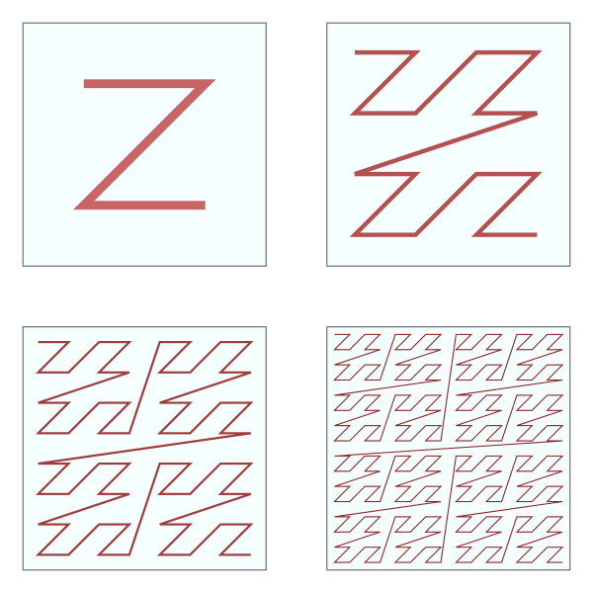
A Hash Function for 3D Points
Convert a point p=(x,y,z) into (i,j,k) indices
In other words, map p to grid cell address
Covert (i,j,k) to binary
Interleave the bits of the 3 binary numbers
This generates a Morton Code
Also known as a Z-order curve
Example: (5,9,1)
(0101,1001,0001)
010001000111 = index 1095 in a linear array
Where does the Z-order curve place neighbor grid cells in the array? Why is this important?

Slide 14
How Many Cells?
Want to avoid having large number of objects in a single cell
Isotropic cells are probably best for uniformly distributed objects
We’ll try to make cells as cube-like as we can
n_{x}, n_{y}, n_{z} are the number of cells along each axis
w_{x}, w_{y}, w_{z} is the length of the grid along each axis
Let n be the number of objects we have to store
m allows you to pick how many cells per object
m=2 yields 8ish cells per object, good number
why use +1?

Slide 15
Inserting Objects into the Grid
Compute the bounding box for the object
Intersect the box with the grid
Insert object into all cells overlapped by box

Slide 16
Inserting Objects into the Grid
Compute the bounding box for the object
Intersect the box with the grid
Insert object into all cells overlapped by box

Slide 17
Computing a Cell Index for a Point
Example: Computing x-axis index for a point p
Note that indices must be clamped in range [0,n_{x}-1]

Slide 18
Traversal
Find start point of a ray through the grid
If ray origin is inside grid
If so, find the starting cell
If origin is outside grid
Intersect ray with grid bounding box
If ray hits the grid bounding box
Find starting grid cell
Else, return 0 intersections

Slide 19
Traversal: Marching Along the Ray
Intersection of rays with cell faces can be unequally spaced
They are equally spaced in the x, y, and z directions
We can compute parametric increments across the cell
Figure out, based on smallest t, which face the ray next hits

Slide 20
Traversal: Marching Along the Ray

Slide 21
Theoretical Performance
Grid will have cells in each cardinal direction
Rays tested on objects
In practice tests per ray

Slide 22
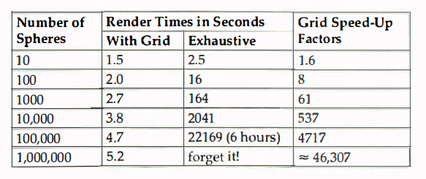
Empirical Performance
From book…10 years ago
400x400 image using 1 ray per pixel, no shadows
Uniform grid m=2
450 MHz Mac G3(!?) with 512 MB RAM

Slide 23
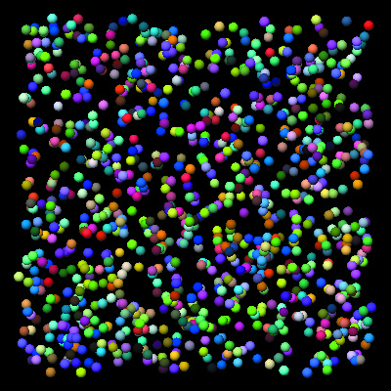
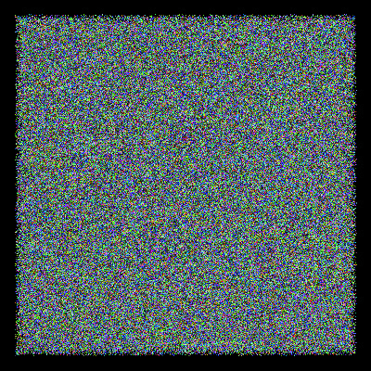
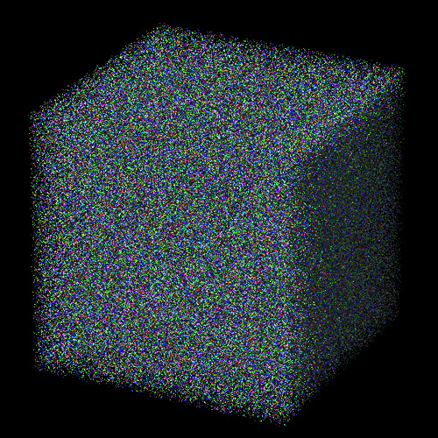
Empirical Performance

Slide 24
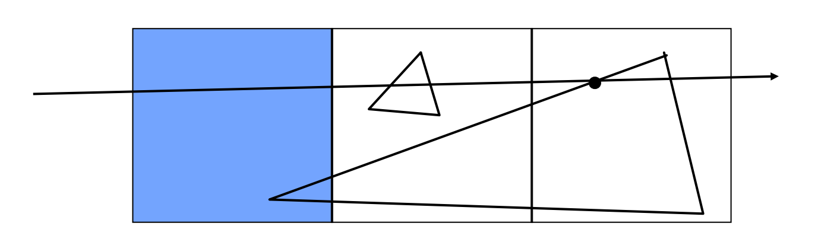
Mailboxing
A hit on an object may not be in the cell
Need to check the the intersection point falls in cell
If not, keep marching
Will we end up testing same object multiple times?
Use mailboxing in which
Each ray gets an integer id
Store most recent checked ray id and test result with object…like caching

Slide 25
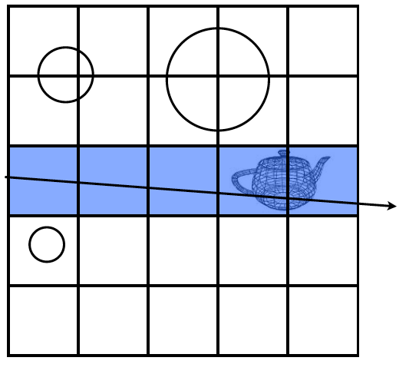
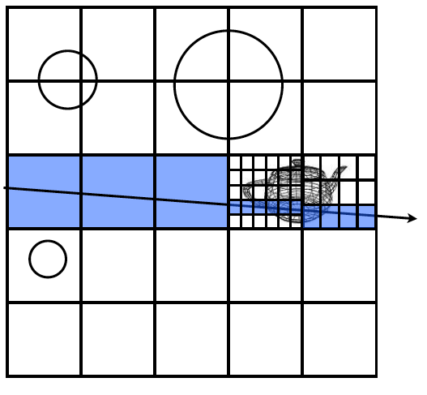
Uniform Grids and Scene Complexity
Work best for uniformly distributed objects
Objects all have similar complexity
Poor performance for non-uniform complexity in scene
“Teapot in a stadium” problem – Eric Haines
Can nest grids or use a tree-based structure

