Slide 1
Myo-Gesture-Control
Enabling Myo to general audience like developers, lazy web surfers, presenters etc for automation
By :
- Shafi Ulla
- Sufian Kaki

Slide 2
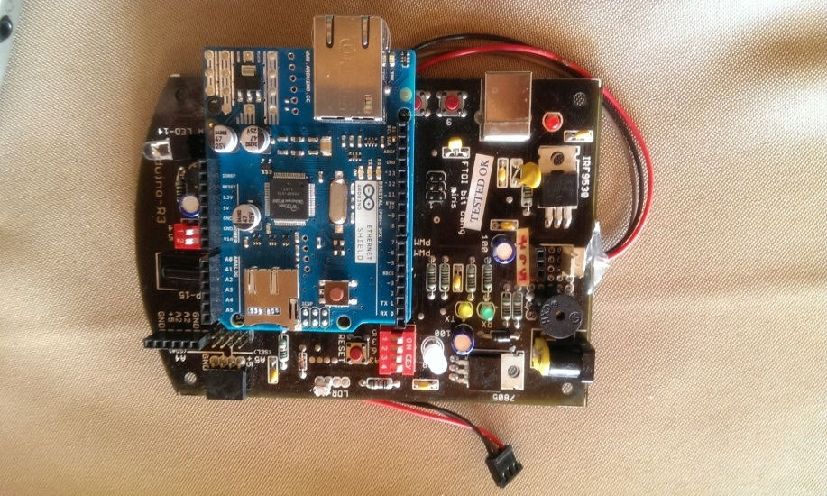
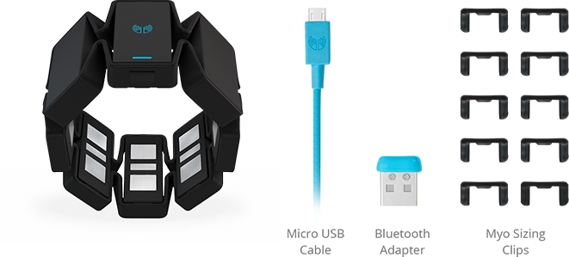
Goal and Objective
Ease working with Myo to developers, lazy web surfers, presenters etc
Enable Myo to implement their own custom listeners
Find use case for house automation using Arduino / Raspberry Pi

Slide 3
Technology & language used
Myo Driver / Myo Connect which works on Bluetooth 4.0
Current app Compatible with Windows & Mac
Can be make compatible for Andriod / Unity (Gaming)
Wrapper is writing in Python
Windows environment is set using powershell

Slide 4
Demo Cases
Powerpoint Slides control
Build Apps control
Custom Listen or Gestures :
On Finger Spread – Open monkeybar (Any sites)
On Double tap - Send GET/POST/DELET request
Wave in - Switch ON Digital Pin in Arduino device
Wave out - Switch OFF Digital Pin in Arduino device
Fist - Play Movie

Slide 5
Future objectives
.Use in House Automation
Use to control any application in Host operation System ( Windows / MacOs)
Python Wrapper can extended to capture action sequence
Provide Gestures/Profile-as-a-service

Slide 6
References
Python SDK binding for Myo
https://github.com/NiklasRosenstein/myo-python
Code Repo
https://github.com/shafi-codez/myo-gestures-control
Developer Portal
https://developer.thalmic.com/

