Slide 1

Supply-Chain optimization
By
Vedant Kulkarni
Alihusain Shafi
Athulya Surendran

Slide 2
Objective
Our Client: This is a cost-optimization problem for 'Ikea’ (hypothetical scenario)
The Dataset we have: We have data for number of product units for each order id, plant/unit cost for each order id, warehouse operating cost for each plant, freight rate for each order under each plant, minimum and maximum quantity possible for each plant.
Our Objective: Minimize total operational cost for shipping the products from warehouses to the distributors (customers), while optimizing the warehouse, and shipping capacities and requirements

Slide 3
Why is it important?
The problem is important because nearly all manufacturing companies go through the same scenarios. They aim to minimize costs while producing and supplying at optimum levels. Thus, the solution we derived could be modified for any companies
Our problem also investigates various constraints that can arise in any large business that hosts multiple warehouses to satisfy many orders. Such supply-chain solutions are extremely helpful to manufacturing and shipping companies across the world
Manufacturing costs, operational costs, and shipping costs make up for the most expenditures for businesses. As such, optimizing these would help business operate efficiently
Companies like Amazon, Apple, Tesla, etc. could use similar models to optimize their businesses.

Slide 4
ASSUMPTIONS
The terms Plant and Warehouse are used interchangeably in the given dataset.
The plant operates as both the manufacturing factory and as warehouse.
One orderID can have only one product associated with it, but one product can have multiple orders I.e., one product can be associated with multiple orderID.
Multiple warehouses can host same products.
All the packages being sent are under 50 lbs.
Freight rates are consistent and fall within a given cost interval.

Slide 5
Optimization Model (1/2)
Objective function: Minimize the total operational cost which involves three expenses
Manufacturing Costs (manufacturing cost for number of orders for each plant)
Warehouse operations costs (cost of operation for a given warehouse)
Shipping costs (shipping cost for number of orders for each plant)
DVs:
Assign a warehouse to an order such that the total cost is at its minimum. The data we have takes input about orders and returns information about all of the previously mentioned costs by the respective warehouses
Variables to determine if a plant is operating or not

Slide 6
Optimization Model (2/2)
Constraints:
Constraint 1: Supply per order should be greater than demand of that order
Constraint 2: Units of orders should be more than the minimum warehouse unit capacity
Constraint 3: Units of orders should be less than maximum warehouse unit capacity
Input parameters:
Order Number
Plant Number (Warehouse number)
ProductID
Number of Order Units
Warehouse Operating Costs

Slide 7
Analysis
We collected data from a Kaggle Supply-Chain Optimization problem.
Link: https://www.kaggle.com/datasets/laurinbrechter/supply-chain-data?datasetId=1953097
The data was in a spreadsheet format, with multiple sub-sheets within. Each sub-sheet contained plethora of data about Warehouses, Orders, Customers, etc.
The data was cleaned, and we were able to concise it to only contain information that is relevant to the objective we decided to work on.
A sample model with smaller amount of data was constructed in Excel.
A larger model containing 1000 orders was analyzed in Python.

Slide 8
Analysis (Excel)
Excel model was solved with the help of SIMPLEX solver
Steps:
First, we cleaned the data we had from the Kaggle repository and kept the elements needed for the model
Binary and non-binary decision variables were defined (highlighted in blue)
Constraints were then defined and highlighted in yellow (for definitions) and pink (for numeric values)
Outputs were calculated in 3 separate tables (highlighted in green) for 3 separate expenses and then summed up into one cell (highlighted in orange).
Different color formats were used for ease of client use

Slide 9
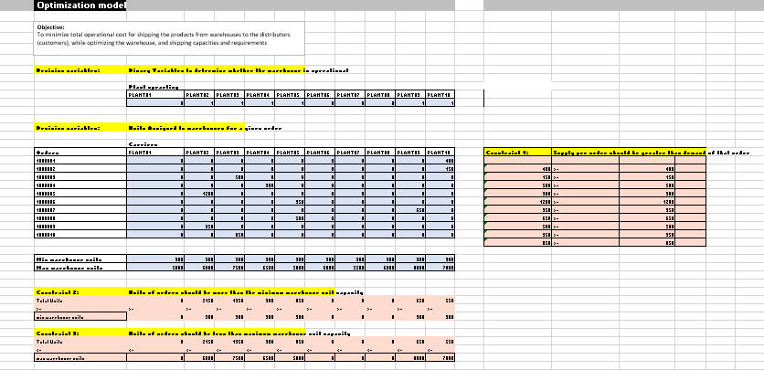
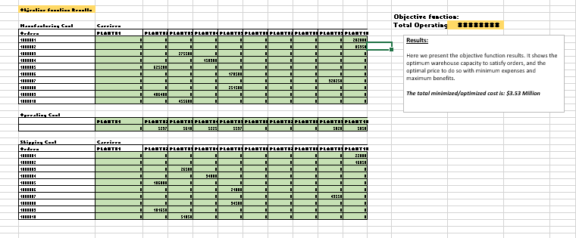
Analysis (Excel)

Slide 10
Analysis (Python)
Python model involved using and leveraging optimization algorithm
Steps:
After importing required libraries (Pyomo), we read dataset in each sheets and converted them into lists
Then we build a ConcreteModel() with necessary DVs, objective function and constraints and solved it
We printed the total minimized costs, dv that determined what plants were operating and how many orders were under each plant and percentage of capacity used for each warehouse
Attached the outputs in the next slide for reference

Slide 11
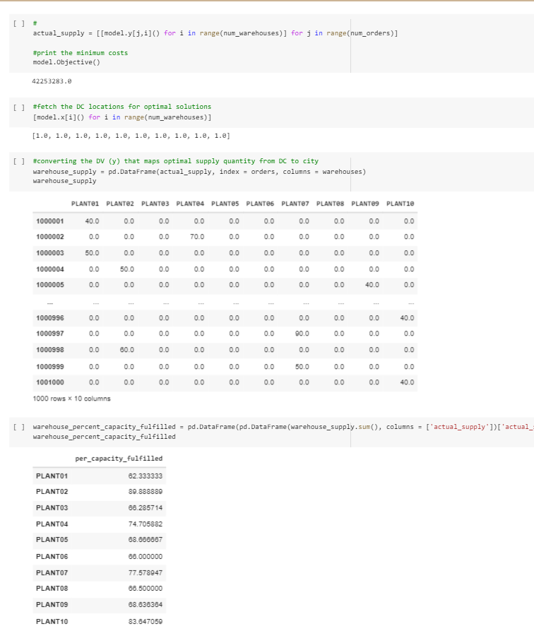
Analysis (Python)

Slide 12
Challenges
Challenges:
The complexity of the original raw data was challenging. We had to clean it heavily and keep only the relevant parts.
SIMPLEX solver returned scientific numbers for some of the binary values which was a challenge to solve
We had to build multiple models before we could create one that took all the data needed into consideration.

Slide 13
Projected Benefits and Usage
Ikea produces numerous products that it keeps in its warehouse before shipping them off to its distributors and stores. As such, they go through numerous supply chain challenges wherein they need to optimize manufacturing, warehouse, and shipping cost to operate their business at maximum profit.
The project helps identity the optimum number of products that can be produced and shipped to the distributors from various plants to the customers they serve while finding the most effective amount of production and shipment, the model also calculates the total cost of the operation.
Since the entire model is based on optimization, the total cost is the best-case scenario where Ikea would pay relatively low amount for operations, and in-return, get an efficient supply-chain operation
Ikea, and other such clients, can apply this model to various other business scenario to optimize them as well.

Slide 14
Limitations, caveats, and next steps
The entire project essentially acts as a prototype that can be further developed into a better application for the business.
With more business data and information, we can build an application that can be used by the customers on their end entirely.
As the data was complicated, we had to simplify it rigorously in order to build the model
The next steps for the project would involve taking more supply-chain data in, inputting more decision variables, adding further business constraints, using ML techniques in the model for predictions, and in the end building a desktop models for businesses to use.

Slide 15
THANK YOU!

Slide 16
References
Kaggle supply chain dataset information:
https://www.kaggle.com/datasets/laurinbrechter/supply-chain-data?datasetId=1953097

Slide 17
Statement of contribution
Members in the project:
Vedant Deepak Kulkarni, Alihusain Hakimuddin Shafi, Athulya Surendran Krishnaleela
Submitted by: Vedant Kulkarni
All members in the group worked together to build the model and presentation.
Selection of project options happened over Zoom with all members present.
Data collection and cleaning happened with the help of all members, with Ali & Vedant meeting in-person, and Athulya joining virtually
Model Building took place in stages with Ali & Vedant meeting in-person to work on it and sharing their progress with Athulya who worked remotely and continued upon the progress made. The progress would then be sent back and forth between the members accordingly.
Ali used his Google Collab to begin building the model and Vedant and Ali worked on it in-person together. As Collab does not permit real-time editing abilities like Google Doc, Ali would download the .ipynb file and share it with Athulya who could then carry on with the progress from abroad. Athulya would share her updates with Ali & Vedant, and they would then continue building the model.
The creation and preliminary work on the presentation was started by Vedant on Microsoft Teams. Ali and Athulya added the data they possessed.
Final editing of the presentation, codes, and spreadsheet was done by all three members individually and as a group via virtual meeting.

