Slide 1
01
OF 08
● IBM BOB AI INNOVATION HACKATHON 2026 · PROBLEM D2 · TRACK: AI
CASE FILE / AEGIS
ALERT ENRICHMENT,
GROUPING & INTELLIGENCE
SCORING
Threat-intelligence correlation and consequence-based alert prioritisation — with an evidence trail IBM Bob can be interrogated about, line by line.
EVIDENCE-BACKED · NOT BLACK BOX
TEAM BLUE VECTOR
Het Khatusuriya (lead, cybersecurity) · Manan Modi (AI/ML) · Mohammad Safik (frontend) · Samarth Bhalala (backend & data)

Slide 2
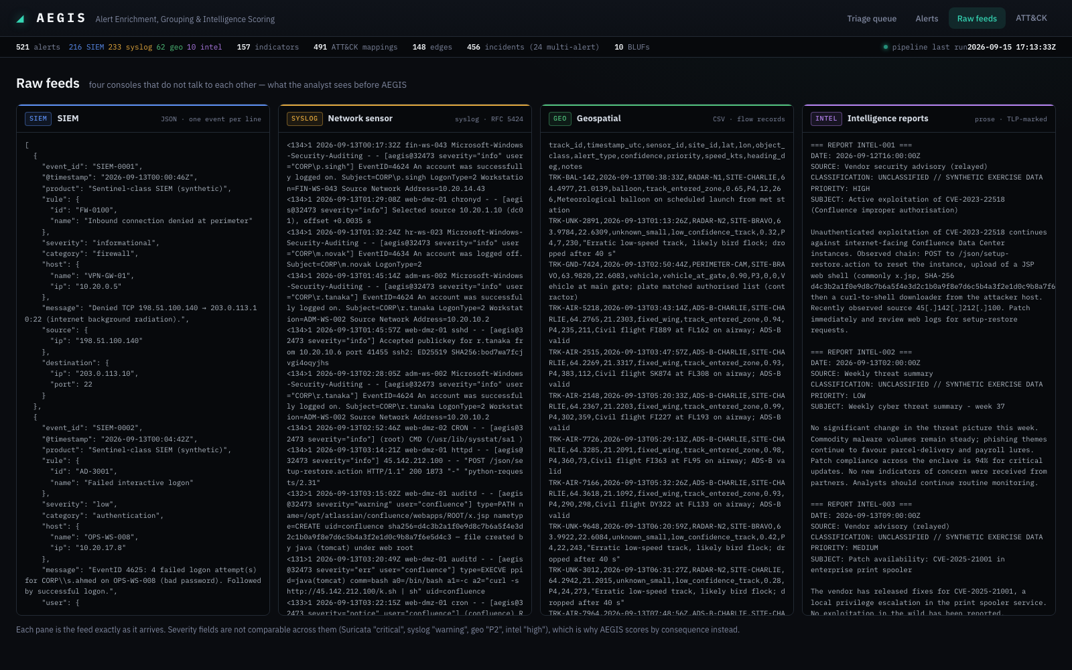
02
OF 08
● PROBLEM DEPTH
FOUR CONSOLES, FOUR SEVERITY SCALES, ONE ANALYST
VOLUME EXCEEDS CAPACITY
Thousands of alerts a day across SIEM, network sensors, geospatial feeds and written intelligence. Nobody reads them all — triage collapses into whatever sorts to the top.
SEVERITY DOESN'T TRANSLATE
The SIEM says critical, the sensor says err, the geo feed says P2, the report says HIGH. None knows the asset, or what else is happening around it.
THE COST IS ASYMMETRIC
A false positive costs an analyst-hour. A missed intrusion costs the mission. A real intrusion arrives as three unremarkable alerts, in three different consoles.
What the analyst starts the shift with FIG. 01
AEGIS / Blue Vector
Problem depth & vision

Slide 3
03
OF 08
● SOLUTION & INNOVATION
TRIAGE AS A GRAPH PROBLEM, WITH AN EVIDENCE TRAIL
01
FOUR RAW FORMATS
SIEM JSON, syslog, geo CSV, intel prose
02
CANONICAL ALERT
IOCs extracted & refanged
03
ATT&CK V19.2
TF-IDF + curated rules
04
WEIGHTED GRAPH
4 signals, evidence on every edge
05
CONSEQUENCE SCORE
4 factors, 9 suppression rules
06
BLUF + BOB
Commander brief, MCP-queryable
→
→
→
→
→
FOUR CORRELATION SIGNALS PER ALERT PAIR
Shared indicator ≤ 0.40 — rarity-weighted (IDF); a shared SHA-256 outweighs a shared DNS server
Temporal proximity ≤ 0.20 — exponential decay, no hard cut-off window
Asset adjacency ≤ 0.15 — same host, user, subnet, or a named cross-reference
Tactic progression ≤ 0.25 — directional: Initial Access → Execution scores, the reverse does not
WHY IT IS NOT “GROUP BY SOURCE IP”
Incidents are connected components above a threshold — the count emerges from evidence, not a chosen k
A medium-confidence hit on a domain controller outranks a certain one on a print server
Vendor severity is preserved, shown to the analyst — and never scored
AEGIS / Blue Vector
Solution & innovation

Slide 4
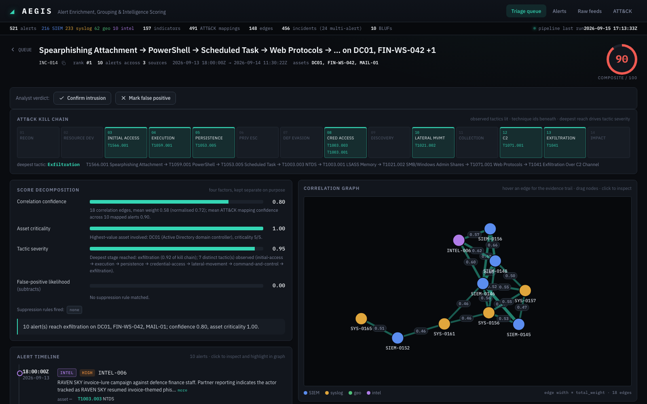
04
OF 08
● TECHNICAL IMPLEMENTATION
ONE STATE, TWO SURFACES — THE CONSOLE AND BOB NEVER DISAGREE
PIPELINE · PYTHON 3.10 · ~3S FOR 521 ALERTS
Ingest adapters → SQLite (stdlib, zero servers) → ATT&CK mapper (TF-IDF over the pinned STIX corpus, 697 techniques) → correlation engine (NetworkX) → prioritiser → BLUF generator.
SERVICE LAYER → FASTAPI + MCP SERVER
The console and IBM Bob read the same SQLite state through the same service functions. Neither computes anything independently, so they cannot disagree.
CONSOLE · PLAIN HTML/JS · NO BUILD STEP
Force-directed correlation graph on canvas, kill-chain strip, score decomposition, analyst disposition, BLUF panel with one-click export.
INC-014: phishing → PowerShell → C2 → exfiltration FIG. 02
AEGIS / Blue Vector
Architecture

Slide 5
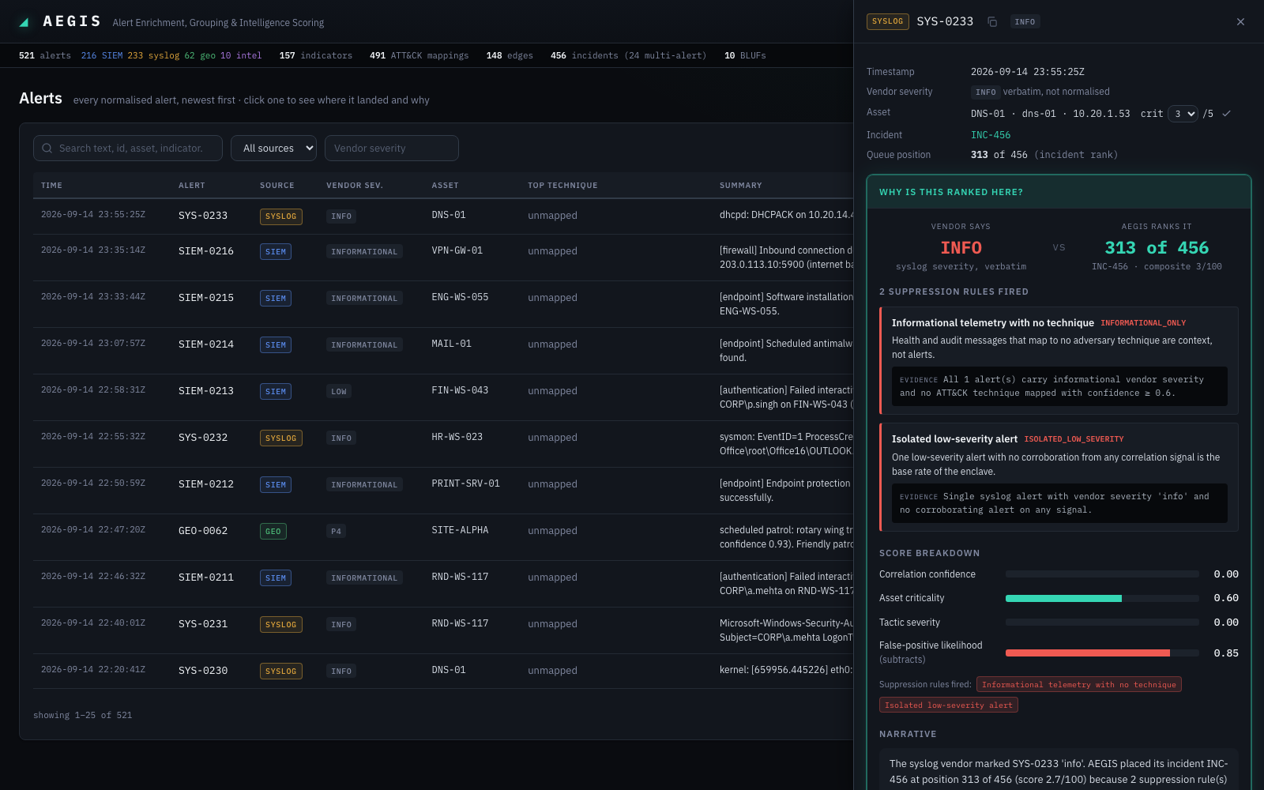
05
OF 08
● WORKING DEMO
“THE SIEM MARKED THIS CRITICAL. WHY IS IT RANKED 136TH?”
136 / 456
CRIT
vendor severity, verbatim
AEGIS queue position
WHAT AEGIS ANSWERS
Rule KNOWN_SCANNER_RANGE fired: 12 of 12 alerts are scanning techniques from 10.50.1.10, inside the authorised scanner range, Monday 06:00 UTC — matching the standing schedule.
Correlation confidence 0.73, asset criticality 1.00, false-positive likelihood 0.92.
WHAT WOULD CHANGE ITS MIND
A different source address, a different account, activity outside the window, or any technique beyond scanning. Same answer via IBM Bob's why_deprioritised MCP tool.
Vendor severity vs. AEGIS, with the rules that explain the gap FIG. 03
AEGIS / Blue Vector
Working demo & functionality

Slide 6
06
OF 08
● IBM TECHNOLOGY INTEGRATION
IBM BOB IS THE ANALYST'S INTERFACE — NOT A FOOTNOTE
SIX READ-ONLY MCP TOOLS · PYTHON MCP SDK, STDIO
BUILT WITH BOB
Used throughout the build: planning module contracts, implementing ingest adapters and correlation signals, driving the terminal for pipeline runs, and the full frontend redesign & feature pass.
TOOL | THE ANALYST ASKS
get_priority_queue | “What should I look at first this shift?”
explain_correlation | “Why are SIEM-0146 and SYS-0161 the same incident?”
get_bluf | “Give me the BLUF for INC-017.”
why_deprioritised | “Why is critical alert SIEM-0121 ranked so low?”
search_by_technique | “Show me everything mapped to T1059.”
get_incident | “Walk me through INC-014.”
WATSONX.AI GRANITE (OPTIONAL)
Rewrites the BLUF narrative from structured evidence under a strict JSON schema. Hallucinated alert IDs are rejected; the template path is what the demo runs on.
REMOVE BOB, AND…
the analyst loses their conversational interface into the evidence trail — not a summary paragraph bolted on afterward.
AEGIS / Blue Vector
IBM Bob integration

Slide 7
07
OF 08
● RESULTS & IMPACT
MEASURED AGAINST GROUND TRUTH, NOT ASSERTED
521 synthetic alerts · 8 planted scenarios (6 intrusions, 2 look-alike benign) · 466 noise · python -m src.eval.evaluate
SCENARIO | TRUTH | COVERAGE | PURITY | RANK | SUPPRESSION
Invoice phishing → PowerShell → C2 → DC01 NTDS → exfiltration | intrusion | 1.00 | 1.00 | 1 | —
UAS + RF emitter → rogue AP → OT VLAN → PLC write (SITE-ALPHA) | intrusion | 0.86 | 1.00 | 2 | —
VPN password spray → account takeover → AD/share enumeration | intrusion | 1.00 | 1.00 | 3 | —
CVE-2023-22518 → web shell → cron → reverse shell | intrusion | 1.00 | 1.00 | 4 | —
Shadow-copy deletion → masquerading → mass encryption | intrusion | 1.00 | 1.00 | 5 | —
Insider staging → personal cloud upload (ambiguous) | intrusion | 1.00 | 1.00 | 6 | —
Sysadmin rollout inside change window | benign | 0.75 | 1.00 | 117 | MAINTENANCE_WINDOW
Authorised scan, 8 vendor-CRITICAL alerts | benign | 1.00 | 1.00 | 136 | KNOWN_SCANNER_RANGE
6 / 6
intrusions in the top 6 of 456
2 / 2
benign look-alikes below every intrusion
0
noise alerts in any planted incident
55 / 55
planted alerts mapped to ATT&CK
Honest misses: a HUMINT report with no technical indicator, and one geo track linked only by time and place — the cost of refusing to chain on timing alone.
AEGIS / Blue Vector
Results & impact

Slide 8
08
OF 08
● TEAM & ROADMAP
TEAM BLUE VECTOR — AND WHERE THIS GOES NEXT
MEMBER | BUILT
Het Khatusuriya (lead) | Corpus & ground truth, IOC extraction, tactic ordering matrix, suppression rules, asset inventory
Manan Modi | ATT&CK mapping, correlation graph & signal weights, BLUF generation, evaluation harness
Mohammad Safik | Analyst console: queue, correlation graph, kill-chain view, disposition & BLUF export
Samarth Bhalala | Canonical schema, four ingest adapters, SQLite store, FastAPI, MCP server for Bob
BEYOND THE HACKATHON
Streaming ingestion with incremental graph updates
Suppression knowledge sourced from the CMDB, not code
Analyst disposition (TP/FP) already ships — next: feed it into per-enclave signal recalibration
Bob as the first-line triage assistant on the watch floor
github.com/shafik-shaikh/bob-ai-hackathon-blue-vector
python scripts/demo.py → http://localhost:8000
AEGIS / Blue Vector
Team

