Slide 1
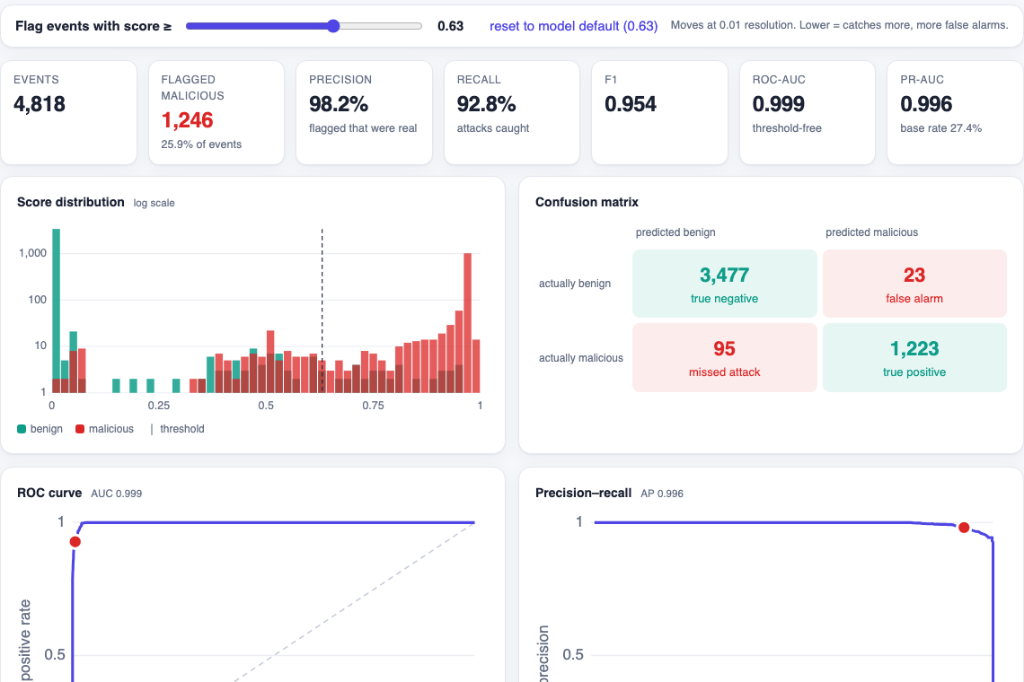
NETWORK THREAT DETECTION WITH MACHINE LEARNING
SIEM ML
Predictor
Upload network events. A pre-trained model scores every one as malicious or benign, and shows why.
UNSW-NB15
XGBoost
FastAPI
Live app: full statistics view
Notes:
Introduce the project: SIEM ML Predictor is a simple web app. You upload a file of network events, a pre-trained machine-learning model scores each event, and the page shows the statistics. The screenshot is the real running app.

Slide 2
WHY THIS MATTERS
The problem: analysts drown in events
SIEM tools export millions of network events every day
Most events are benign, but every one needs a look
Manual rules miss new patterns and raise false alarms
Slow triage gives attackers more time inside
What the model does to a real capture
1,140,045
network flows in the test capture
224,530
flagged for review · 19.7%
218,787
real attacks · 97.4%
SIEM ML Predictor
2
Notes:
SOC teams face too many events. The bars show what the model does on a held-out capture of 1.14 million flows: it flags about 224 thousand for review, and 97.4 percent of those flagged are real attacks.

Slide 3



THE APPROACH
The solution: upload, score, understand
1. Upload
2. Score
3. Understand
Drop a CSV, Parquet, JSON or NDJSON file
Up to 300 MB or 2M rows
Missing columns are reported, not fatal
Pre-trained XGBoost model
Every event gets a 0 to 1 attack score
Flagged above the tuned threshold (0.63)
Precision, recall, F1, ROC-AUC
Confusion matrix and per-attack detection
Plain-word reasons behind each flag
No accounts. No database. No case management. Just a file in and statistics out.
SIEM ML Predictor
3
Notes:
Three steps: upload a flow export, the model scores each event, and the page explains the result. The app is intentionally simple: no accounts, database or case management.

Slide 4


ARCHITECTURE
How it works: from file to flagged events
Upload
Ingest
Features
XGBoost
Output
Browser UI
CSV, Parquet, JSON, NDJSON
Parse and align columns
Reports missing fields
37 flow features
Protocol, service, state encoded
43 trees, depth 6
Score 0 to 1 per flow
Flag at threshold
Stats, reasons, CSV
Tech stack
FastAPI (Python)
XGBoost
pandas
Plain HTML / CSS / JS
MCP server for IBM Bob
SIEM ML Predictor
4
Notes:
Pipeline: the browser uploads a file, the backend parses it and aligns the columns, builds the 37 flow features, runs 43 boosted trees, then returns scores, a flag per event, statistics and a downloadable CSV. The frontend has no build step.

Slide 5
DATA AND MODEL
Data and model behind the scores
912K
training flows
1.14M
held-out test flows
Dataset: UNSW-NB15 raw network flows from UNSW Canberra
Trained on an early capture, threshold tuned on a later slice
Tested on a separate later capture the model never saw
IPs, client ports and timestamps left out: they identify the lab, not the behaviour
Threshold 0.63 maximises F1 on validation
37
flow features
43
trees, depth 6
SIEM ML Predictor
5
Notes:
The model is trained on the raw UNSW-NB15 capture: 912 thousand flows. It is tuned on a validation slice and evaluated on a different, later capture of 1.14 million flows. Identifiers such as IPs and timestamps are deliberately excluded so the model learns behaviour, not the testbed.

Slide 6
PERFORMANCE
Results on a capture the model never saw
97.4%
Precision
96.2%
Recall
0.968
F1 score
0.999
ROC-AUC
0.63%
False alarms
Confusion matrix (1,140,045 flows)
What it means
Predicted benign
Predicted malicious
Of 100 flagged events, about 97 are real attacks
Of 100 real attacks, about 96 are caught
Only 0.63% of benign traffic raises a false alarm
ROC-AUC 0.999: attacks are ranked far above normal traffic
Actually benign
906,858
true negative
5,743
false alarm
Actually malicious
8,657
missed attack
218,787
true positive
SIEM ML Predictor
6
Notes:
Held-out results at the tuned threshold: precision 97.4 percent, recall 96.2 percent, F1 0.968, ROC-AUC 0.999, false alarms 0.63 percent of benign flows. Say clearly that the test set comes from an easy lab testbed, so real-world numbers will be lower.

Slide 7


DETECTION QUALITY
Detection by attack type
Strong
Seven of nine types above 96% recall. Generic, the largest class, reaches 99.9% (151K flows).
Weak spot: Fuzzers
Only 52.8% recall: 7,814 of 14,806 caught. Fuzzing traffic is the hardest to separate from normal.
SIEM ML Predictor
7
Notes:
Per-category recall on the held-out capture. Most attack types are above 96 percent. Fuzzers are the honest weak spot at about 53 percent recall.

Slide 8
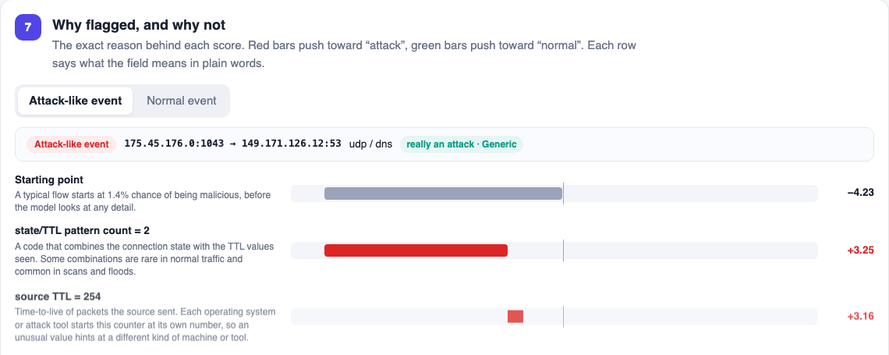
PRODUCT TOUR
Product tour: see how every score is made
Why flagged: per-event reasons
9-step animated walkthrough of every scoring stage
Live threshold slider recomputes all metrics
Reasons in plain words for each flagged event
One-click CSV of all predictions
Full statistics: threshold slider, KPIs, score distribution, confusion matrix
SIEM ML Predictor
8
Notes:
Demo slide. The walkthrough plays nine steps: data received, columns matched, features built, rules learned, trees vote, decision, why flagged, priority, result. Every number shown is measured from the real run. Full statistics has a threshold slider and downloadable predictions.

Slide 9
TRIAGE AND INTEGRATION
Priority tiers and IBM Bob integration
Priority tiers for triage
IBM Bob via MCP
Score 0.90 to 1.00 · 214,189 flows
99.2% real · holds 93.4% of attacks
Same code as the web app, exposed as four read-only tools:
Critical
get_model_info: which model, how far to trust it
list_samples: sample flow files to try
analyze_file: which flows look malicious, what to check first
explain_event: why the model flagged row N
Score 0.63 to 0.90 · 10,341 flows
61.1% real · holds 2.8% of attacks
High
Score 0.30 to 0.63 · 21,876 flows
34.8% real · holds 3.3% of attacks
Watch
Ask Bob: “Which flows in sample_labelled.csv look malicious, and what should I check first?”
Score below 0.30 · 893,639 flows
0.1% real · holds 0.5% of attacks
Low
SIEM ML Predictor
9
Notes:
Priority tiers turn a score into a work queue: the Critical tier holds 93 percent of attacks at 99 percent precision, so analysts start there. The MCP server lets IBM Bob call the same analysis conversationally through four read-only tools.

Slide 10

HONEST VIEW
Limits, next steps and takeaway
Honest limits
Next steps
UNSW-NB15 is a 2015 lab testbed: expect lower scores on a real network
Source TTL alone reaches ROC-AUC 0.983, so the data is easy
Fuzzers only 52.8% recall
Reads flow records only, not syslog or CEF text
Scores rank events for review, not a verdict
Train and validate on real enterprise flow logs
Add a text model for syslog and CEF events
Fuzzer-specific features to lift recall
Analyst feedback loop for periodic retraining
Fast, explainable, honest triage help. Thank you. Questions?
SIEM ML Predictor
10
Notes:
Close with honesty: the benchmark is an easy lab dataset, fuzzers are weak, and the model only reads flow records. Next steps are real enterprise data, a log-text model, better fuzzer features, and a feedback loop. Then take questions.

