Slide 1
SEBA ( সেবা) A NGO MANAGEMENT System Presented by: Quest
Ashfaq Ali Shafin ID: 14.01.04.111
Irtiza Abir ID: 14.01.04.122
AbID Hasan Prottoy ID: 14.01.04.125

Slide 2
Introduction
What is NGO ?
Types of NGO
NGO Management of this Project

Slide 3
Project Summary
Web Based Management Software
Donation System
Modification of Content

Slide 4
Project Requirements
Programming Language: C#, ASP.net, HTML, JavaScript
Style: CSS
IDE: Bracket, MS Visual Studio
Database: MsSQL
Operating System: Windows 10

Slide 5
DFD
DATA FLOW DIAGRAM

Slide 6
Activity Lists (Micro-Credit)
Customer Request to be assigned in Micro-Credit Project
Feedback of the Request
Loan Assignment
Loan Receiving

Slide 7
Activity List (Education)
Customer Request to be assigned in Education Project
Feedback of the Request
Admission in Program

Slide 8
Activity List (Administration)
Content Modification (add/delete/modify)
Donation Procedure
Keeping Track of Donation
Task assignment for Employee
Keeping Track of Employees’ Work

Slide 9
Decomposition of DFD
Context Level | Level -0 | Level-1
NGO Management System | 1.0 Micro – Credit | 1.1 Record Micro-Credit Program
 |  | 1.2 Receive Loan
 |  | 1.3 Pay Loan
 | 2.0 Education | 2.1 Record Education Program
 |  | 2.2 Admission
 |  | 2.3 Service
 | 3.0 Administration | 3.1 Content Process
 |  | 3.2 Donation
 |  | 3.3 Employee Work Process

Slide 10
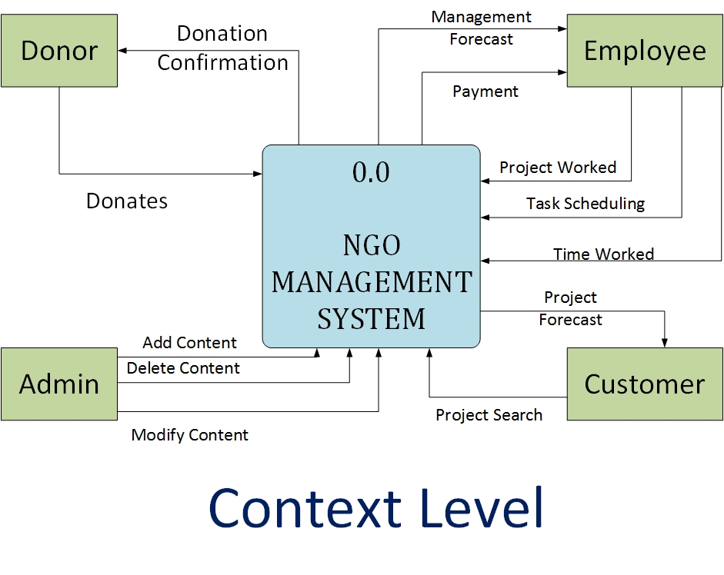
Context Level

Slide 11
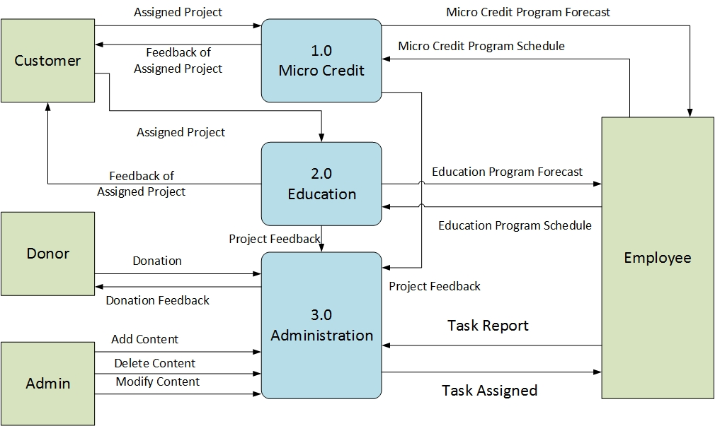
Level- 0

Slide 12
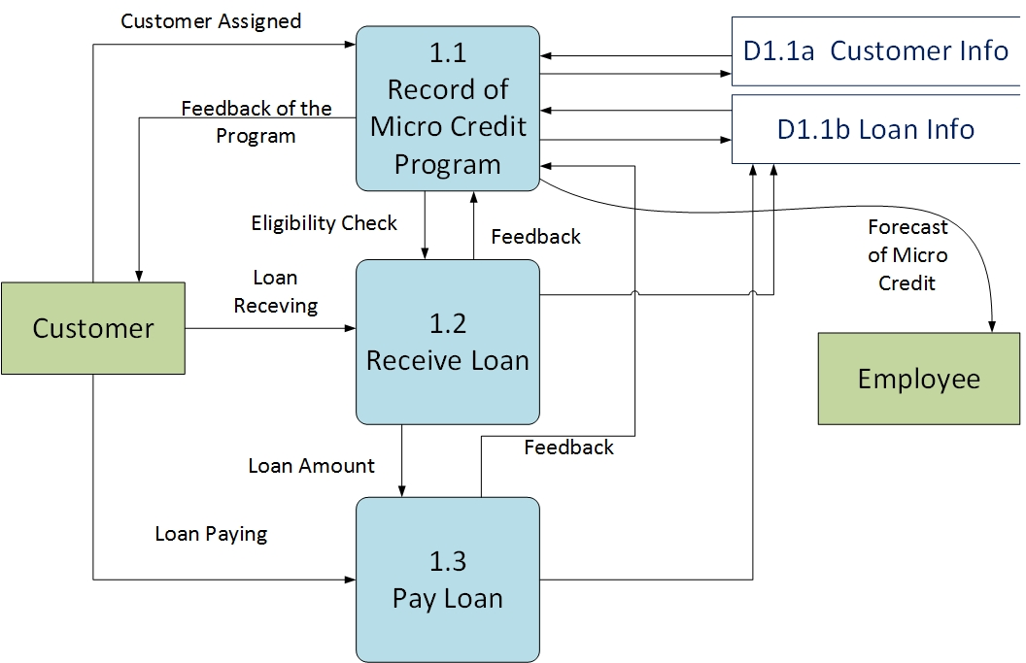
DFD Level 1

Slide 13
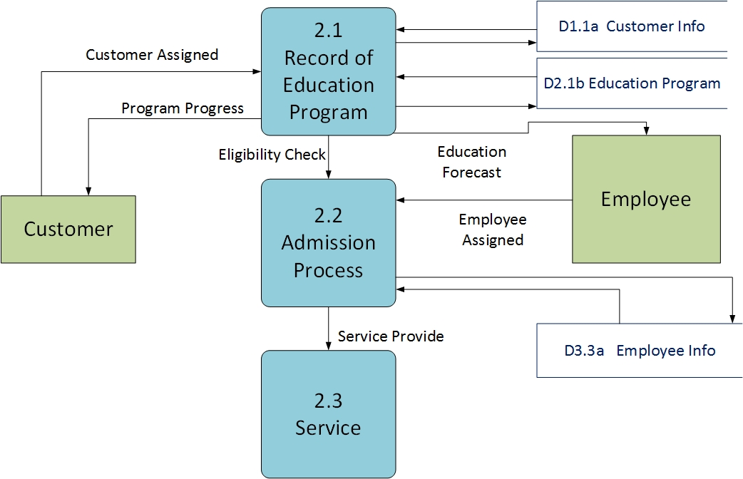
DFD Level 1

Slide 14
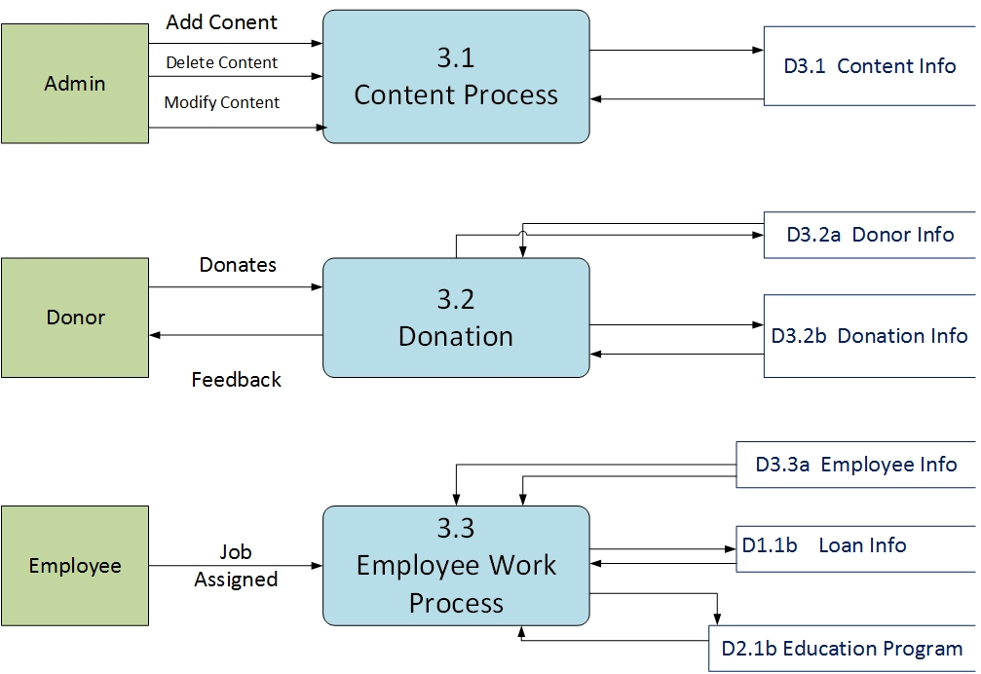
DFD Level 1

Slide 15
ERD
Entity Relationship Diagram

Slide 16
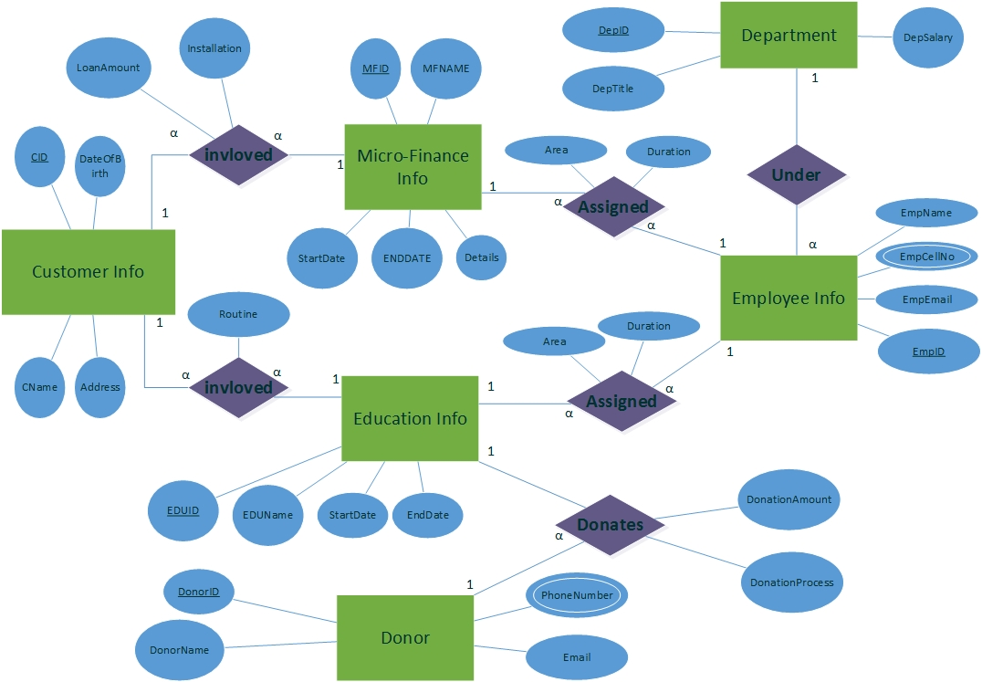
ERD

Slide 17
Future Plan
Completion of the Software
Responsive Website
Addition of Missing Features
Android App for Field Workers
Email Notification for Donation
Newsletter

Slide 18


