Slide 1
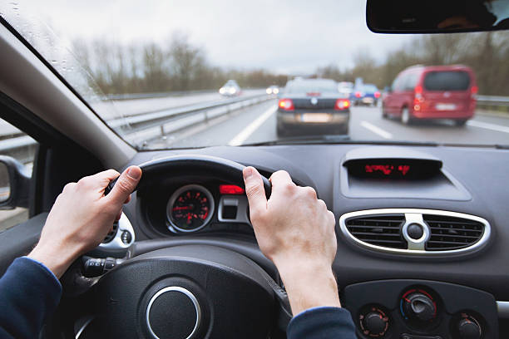
Steering Wheel Safety System
Group: 04
Course: CSE231
Section – 07
Course Instructor: Dr. Khaleda Ali

Slide 2

The Problem

Slide 3

About 6284 people died in accident due to getting distracted while driving.
[source: Dhaka Tribune]

Slide 4
Potential solution

Slide 5


A System that detects removal of hand from the steering wheel

Slide 6
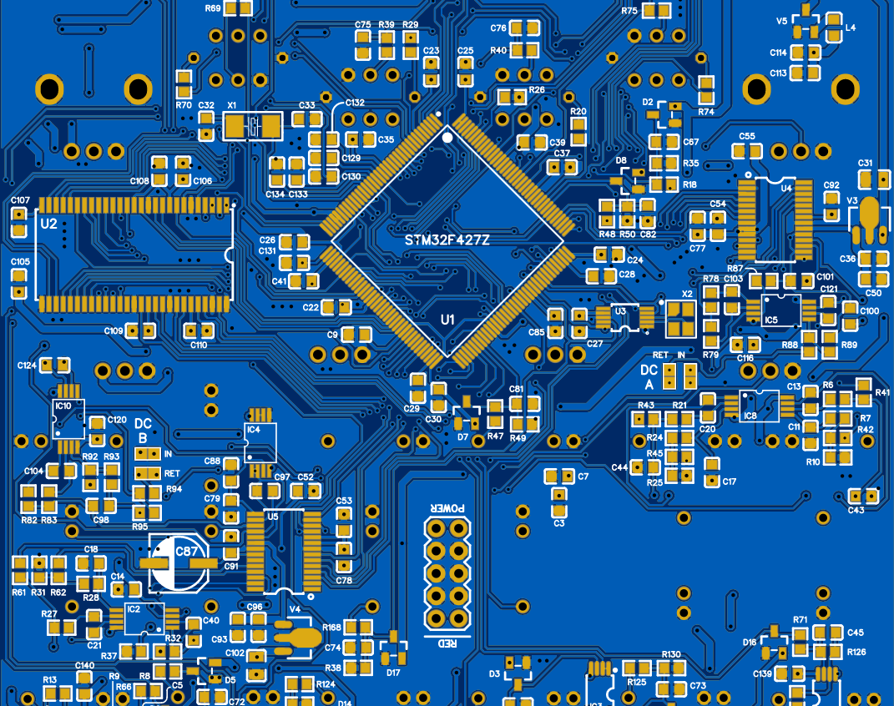
Blueprint of the solution

Slide 7
Our system functions by detecting the presence of the driver's hands on the steering wheel:
Full Contact (10 fingers): No alarm is triggered, indicating safe driving.
Partial Contact (6-10 fingers): No warning buzzer sounds,indicating safe driving.
No Contact (0-4 fingers): An alarm activates, alerting the driver to take immediate action.

Slide 8
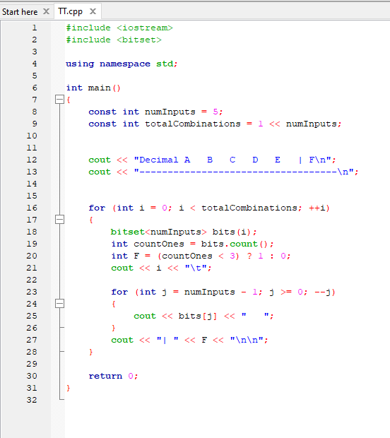

Truth Table using C++ code

Slide 9
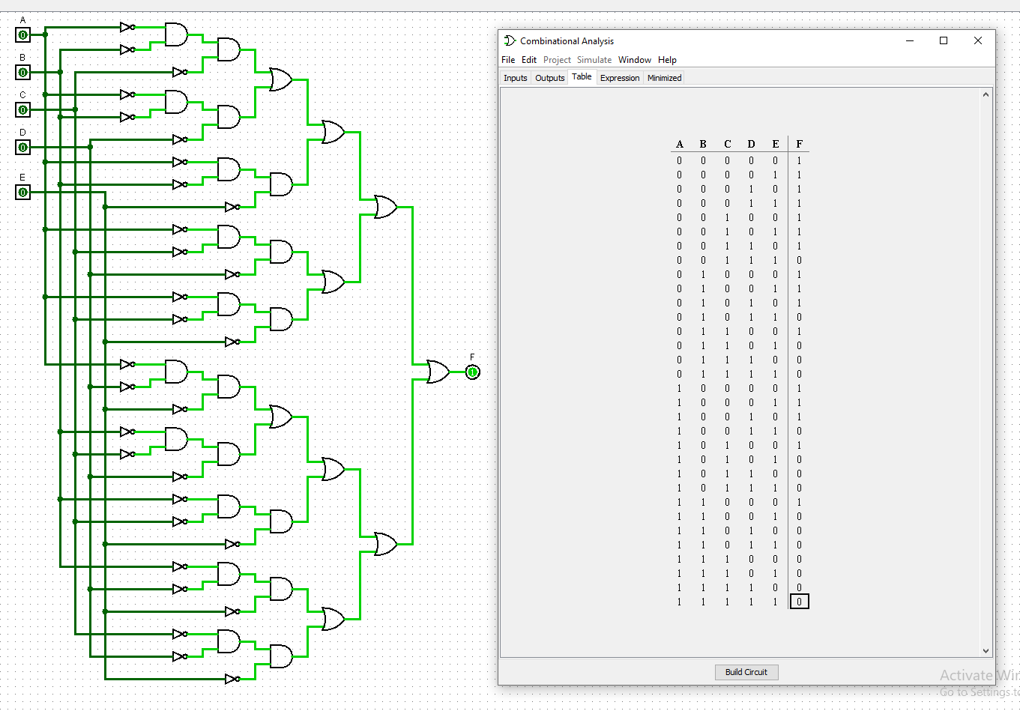
First Attempt

Slide 10
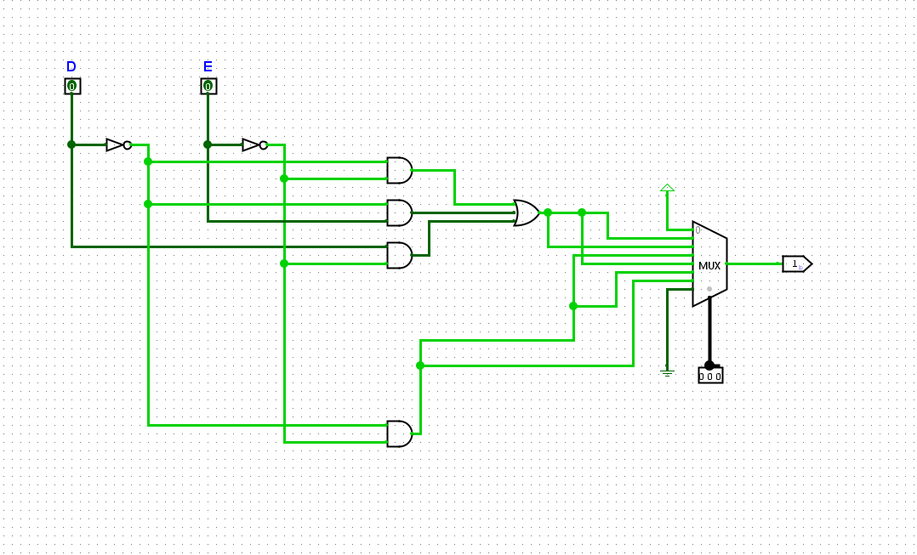
Final Circuit Simulation

Slide 11
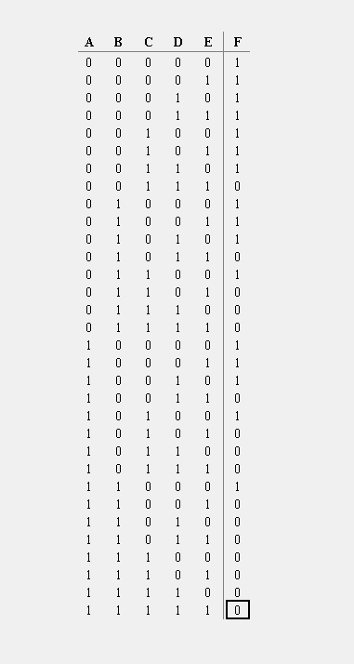
Truth Table

Slide 12
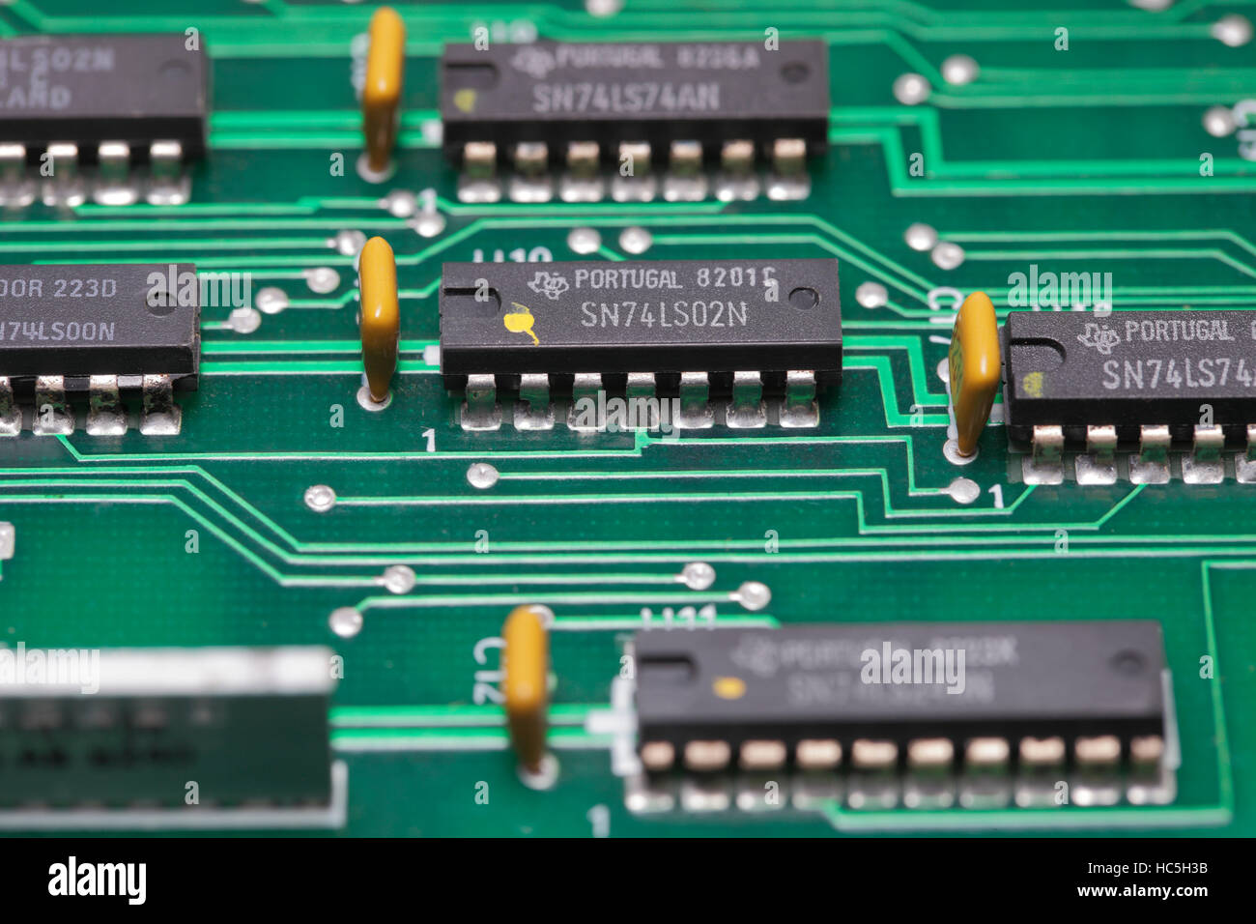
Components

Slide 13
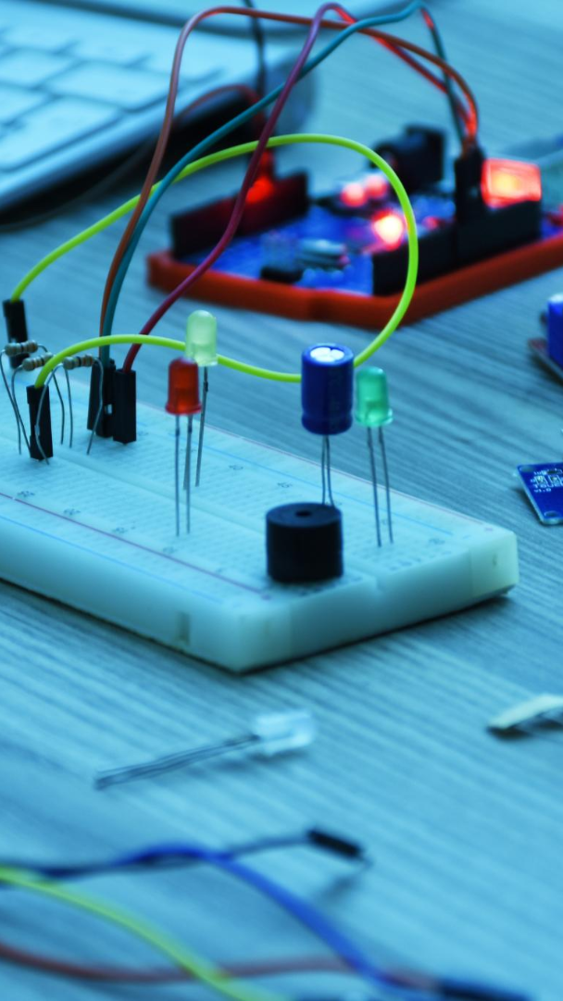
Wires
→Used for making electrical connections.
Breadboard
→for building and testing circuits.
3- input OR Gate
→Outputs high if any one of the inputs is high.
2 input AND Gate
→Outputs high only if both inputs are high.
8X1 MUX (Multiplexer)
→selects one of several input signals and forwards the selected
input to a single output line.
NOT Gate
→Outputs the inverse of the input.
Buzzer
→Used for sound alarms .
Resistor
→ limits or regulates the flow of electrical current in a circuit.
Power Module
→Supplies power to the breadboard and components
Push Button Switch
→Used for manual input to the circuit.

Slide 14
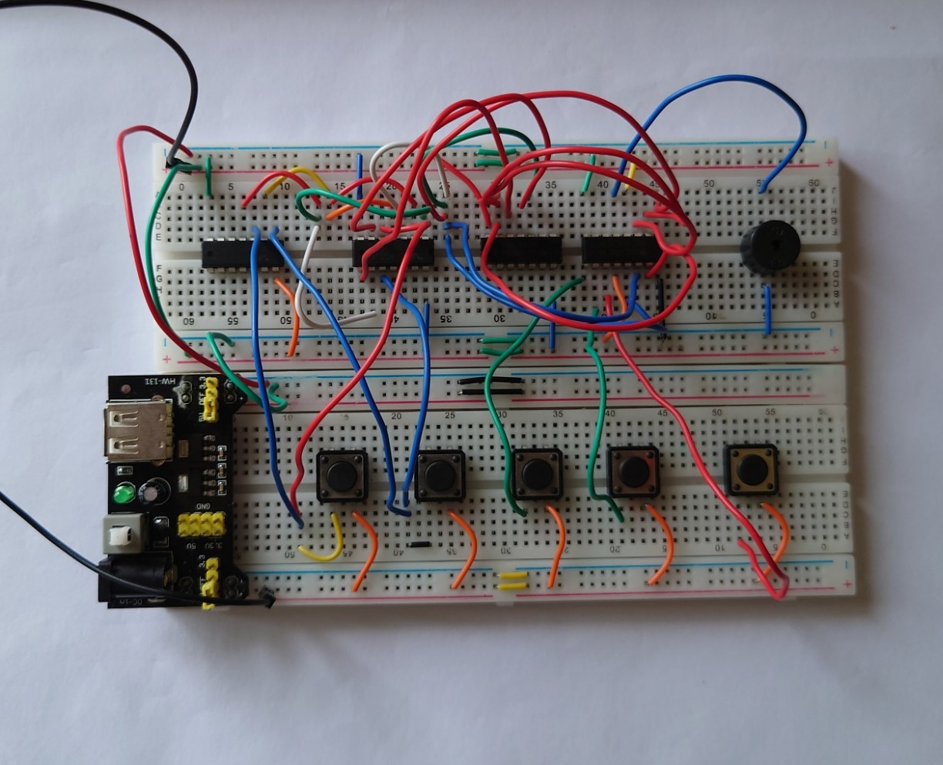
CIRCUIT IMPLEMENTATION

Slide 15
Thank
You

Slide 16




Members
Shafin Rahman 2233146642 Md. Kaif Uddin 2231910643
Mohammad Safayet Hossain Alif 2232562642 Nishat Tasnim Zaman Nibrita 213226764

