Slide 1
Cross-Modal Affective Coherence
Detecting Discrepancies Between Externally Expressed and Internally Experienced Emotion Using EEG, Audio, and Video
Shafin
[Institution name — to be filled in]
Pre-thesis 2 · June 2026

Slide 2
Problem & Motivation
Emotion recognition systems must address two distinct problems:
• What emotion is the subject displaying? (classification)
• Does the displayed emotion match what they are internally feeling? (coherence)
The second question is largely unaddressed in the literature.
Audio and video capture voluntary, controllable external expression.
EEG captures involuntary internal physiological state.
Cross-modal disagreement is itself a clinically meaningful signal.
Real-world relevance: emotion suppression is documented in depression, anxiety, alexithymia, PTSD, and autism spectrum conditions. A method that quantifies cross-modal divergence in a healthy population establishes the foundation for clinical Phase 2 work.
Cross-Modal Affective Coherence · Shafin · Pre-thesis 2
2 / 13

Slide 3
Research Questions
1. Per-modality baselines: Can audio, video and EEG individually exceed the EAV paper's published per-modality baselines?
2. Fusion gain: Does multimodal fusion improve over the best single modality, and by how much?
3. Architectural contribution: Does learned cross-modal attention fusion outperform a naïve softmax-averaging late-fusion baseline?
4. Coherence as signal: When the modalities disagree, do consistent and interpretable cross-population patterns emerge?
5. Robustness: Does the system continue to produce meaningful predictions when one modality (specifically EEG) is unavailable at inference time?
Cross-Modal Affective Coherence · Shafin · Pre-thesis 2
3 / 13

Slide 4
Dataset — EAV (Lee et al., Sci. Data 2024)
EAV: EEG-Audio-Video dataset for emotion recognition in conversational contexts.
Property | Value
Participants | 42 (lab-controlled, cued)
Emotion classes | 5 (Neutral, Sad, Angry, Happy, Calm)
Interactions / subject | 200 (Listen + Speak)
EEG channels / rate | 30 ch / 500 Hz
Audio rate / segment | 16 kHz / 5 s
Video resolution / fps | 224×224 (cropped) / 30 fps
Per-subject train/test | 280 / 120 trials
Total test trials | 5,040 (42 × 120)
Why EAV?
• Only public corpus combining EEG + AV at 42-subject scale.
• Synchronised acquisition: labels apply uniformly across modalities.
• Conversational cue-based protocol elicits all 5 emotions controllably.
• EAV authors published per-modality baselines (SCNN, DeepFace, EEGNet); no fusion baseline reported.
Cross-Modal Affective Coherence · Shafin · Pre-thesis 2
4 / 13

Slide 5
Methodology — Three-Stage Pipeline
Stage 1
Per-Modality Encoders
(AST · ViT · EEGNet)
Stage 2
Trimodal Cross-Attention
Fusion Module
Stage 3
Coherence Analysis
(Suppression Matrix)
Two stages classify; the third characterises modality disagreement.
Two architectural commitments (load-bearing for the demo):
• forward() returns named per-modality embeddings → future temporal head requires no rewrite.
• forward(audio, video, eeg=zeros) is a valid call → enables EEG-missing inference at the demo time.
Cross-Modal Affective Coherence · Shafin · Pre-thesis 2
5 / 13

Slide 6
Proposed Architecture
TrimodalAttentionFusion (2.28M parameters):
Audio (AST)
768-d feature
Linear projection
→ 256-d
+ modality embed
Transformer encoder
(2 layers, 8 heads,
GELU, pre-LN, d_ff=1024)
Transformer encoder
(2 layers · 8 heads
GELU · pre-LN)
Mean-pool
→ 256-d fused
embedding
MLP head
→ 5 emotion
logits
Vision (ViT)
768-d feature
EEG (EEGNet)
960-d feature
Why self-attention over 3 modality tokens, not 6-way pairwise CMA?
• Our pretrained encoders produce a single pooled vector per modality (not a sequence of tokens).
• At single-token-per-modality resolution, pairwise cross-attention degenerates to learned projection.
• Self-attention over the 3-token modality sequence achieves equivalent cross-modal mixing with cleaner code and fewer parameters.
Cross-Modal Affective Coherence · Shafin · Pre-thesis 2
6 / 13

Slide 7
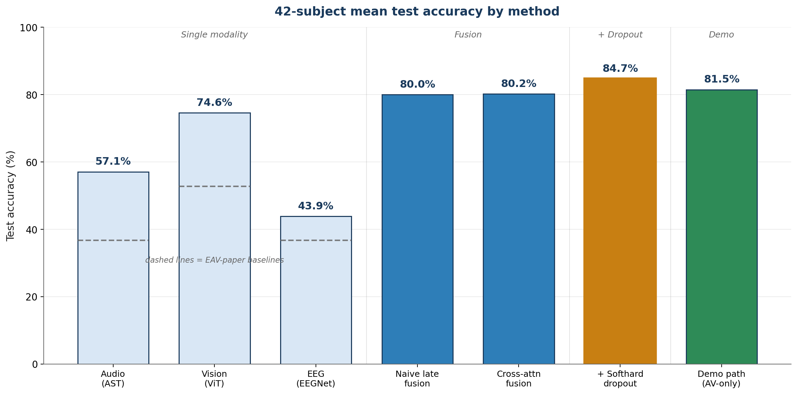
Training Results (42 Subjects)
Headline 42-subject mean test accuracies:
Three key findings:
• Per-modality classifiers exceed EAV's published baselines by +7 to +22 pp.
• Multimodal fusion adds 5.4 pp over the best single modality.
• Modality-dropout training adds another 4.5 pp on full-modality accuracy — a regularisation benefit on top of robustness.
Δ vs EAV-paper baselines:
+47 pp on best single modality
Cross-Modal Affective Coherence · Shafin · Pre-thesis 2
7 / 13

Slide 8
Comparison with Prior EAV Work
EAV was released in September 2024. To date there are three published trimodal fusion baselines on the dataset:
Paper | Year | Audio | Vision | EEG | Fusion | Code
Lee et al. — EAV dataset paper | 2024 | 36.7% | 52.8% | 36.7% | — (no fusion) | Yes
AMERL (Yin et al.) | 2024 | 58.2% | 67.2% | 53.5% | 70.86% | Yes
Hyper-MML (Kang et al.) — prev. SOTA | 2025 | n/r | n/r | n/r | 76.65% | No
EEG-MoCE | 2026 | 60.5% | 53.8% | 62.7% | 75.88% | No
Ours — cross-attention fusion | 2026 | 57.1% | 74.6% | 43.9% | 80.20% | Yes
Ours — + softhard modality dropout | 2026 | 57.1% | 74.6% | 43.9% | 84.70% | Yes
Cross-attention fusion alone exceeds prior SOTA (Hyper-MML) by +3.5 pp. With softhard modality dropout: +8.1 pp over SOTA.
Three contributions unique to this work: modality dropout · zero-EEG demo path · cross-modal coherence matrix.
Cross-Modal Affective Coherence · Shafin · Pre-thesis 2
8 / 13

Slide 9
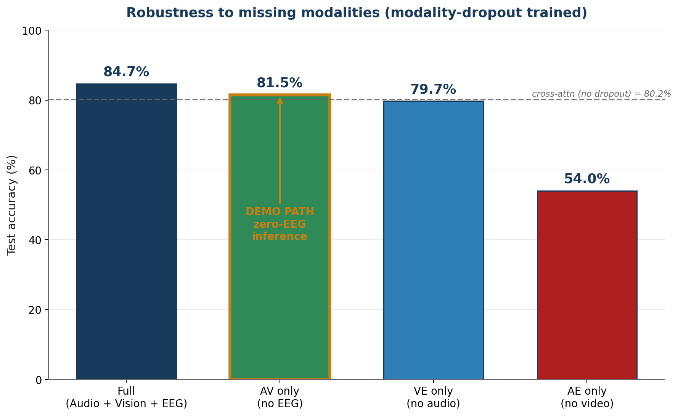
Modality Dropout & Robustness
Softhard modality dropout: at each training step one of the three modality tokens is randomly zeroed.
What the numbers tell us:
• Vision is the dominant modality — removing it costs 30 pp.
• EEG-missing inference (the deployment scenario) is near-tied with full-modality.
• Demo path (81.5%) is above the pre-dropout cross-attention baseline (80.2%).
The system deployed without EEG (81.5%) is more accurate than the original full-modality system before dropout (80.2%).
Cross-Modal Affective Coherence · Shafin · Pre-thesis 2
9 / 13

Slide 10
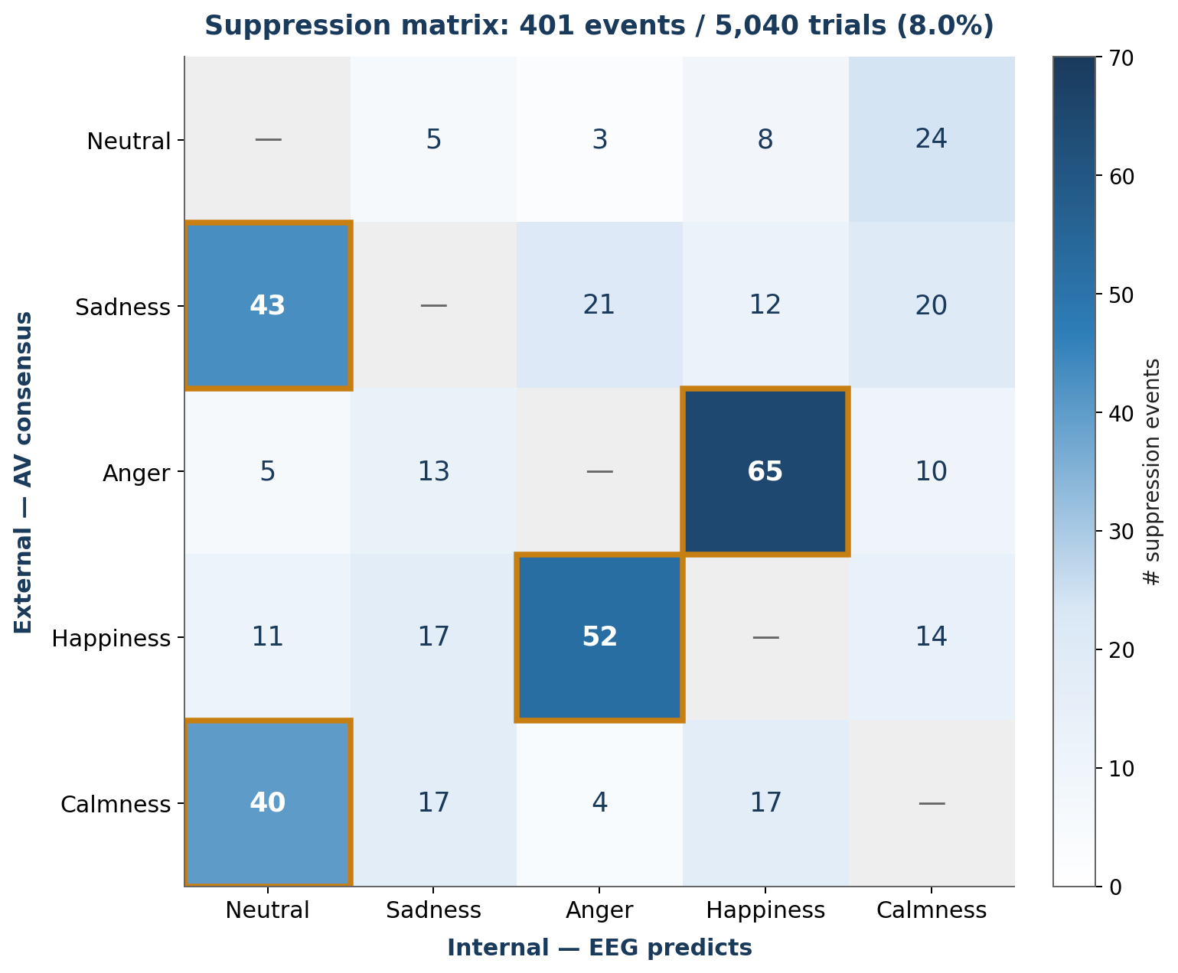
Cross-Modal Coherence Analysis — Suppression Matrix
Suppression event: AV agree on top-1, EEG predicts a different class with confidence ≥ 0.5.
5,040 trials → 401 suppression events (8.0 % base rate)
Dominant patterns (highlighted):
• Bidirectional Anger ↔ Happiness: 65 + 52 = 117 events → high-arousal valence confusion.
• Sadness → Neutral: 43 events; Calmness → Neutral: 40 events → low-arousal physiological baseline.
• Patterns distributed across many subjects (not driven by outliers).
• EEG-Neutral inflation = −1.0 pp → no model-bias confound at scale; matrix is interpretable at face value.
Cross-Modal Affective Coherence · Shafin · Pre-thesis 2
10 / 13

Slide 11
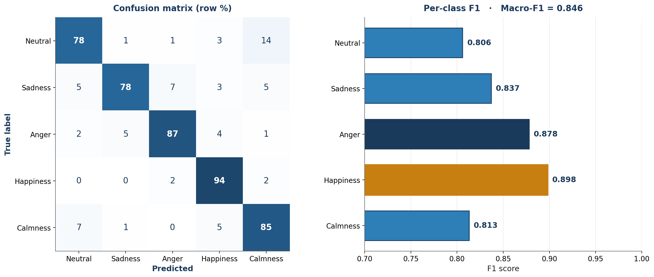
Per-Class Performance & Confusion Patterns
Per-emotion classification on the dropout-trained model (42 subjects, 5,040 trials):
Cross-validation between classification and coherence: Neutral ↔ Calmness confusion (14 %) matches the Calmness → Neutral suppression pattern (40 events). Low-arousal emotions are confusable in both supervised classification and cross-modal coherence terms.
Cross-Modal Affective Coherence · Shafin · Pre-thesis 2
11 / 13

Slide 12
Live Demonstration
Personal video clip processed by the demo path (AV-only, EEG = 0).
▶ PLAY DEMO VIDEO ◀
(thesis_demo_overlay.mp4)
What to look for:
• Per-segment emotion label updates every ~1 second using 5-second sliding windows.
• Audio + video only; no EEG hardware required at inference.
• Reported demo-path accuracy on the 42-subject test set: 81.5 %.
Cross-Modal Affective Coherence · Shafin · Pre-thesis 2
12 / 13

Slide 13
Future Work & Conclusion
Phase 2 future work (out of scope):
Summary of contributions:
• Clinical validation: deploy coherence detection on labelled depression / alexithymia populations.
• In-the-wild deployment: temporal head over per-modality embeddings; DFEW or MAFW dataset.
• MERCL contrastive pre-training across the three modalities.
• Full LOSO subject-independent evaluation.
• First reproduction of trimodal A+V+E fusion on EAV.
• Cross-attention fusion module with named per-modality embeddings supporting future extensions.
• Modality-dropout training enabling EEG-missing inference at 81.5 % accuracy.
• Novel cross-modal coherence framework via suppression matrix.
• Cross-method validation: classification confusion mirrors coherence patterns.
Thank you for your attention.
Questions?
Cross-Modal Affective Coherence · Shafin · Pre-thesis 2
13 / 13

