Slide 1

WEB SCRAPING OF COVID 19 CASES(GUI BASED)
Final Evaluation
Presenter
Shafin Showkat(2020a1r084)
Guide
Mr. Arjun Puri
Assistant Professor
DEPARTMENT OF COMPUTER SCIENCE AND ENGINEERING
MIET(Autonomous), JAMMU

Slide 2
What is Web Scraping?
Web scraping is the technique to extract and read the data from the internet. The collected data can be saved and reused for data analytics.
There are many python libraries that are available for web scraping like
1) Beautifulsoup and scrappy are the two most useful python modules for scrapping information
2) The request module is to read the data from internet webpages
3) Json library is used to dump, to read and write the JSON formatting objects,
6/27/2022
Attendance Management System using Face recognition

Slide 3
Topics covered during internship
1) Uses of python
2) identifiers,keywords,constants,operators
3) Data, object type and variables
4) String,lists,tuples,dictionary,sets
5) Function in python
6) If-else statements
7) Exception handling
8) File handling
9) concept of oops
10) Uses of classes in python
11) Introduction to numpy,matplotlib and pandas
6/27/2022
Attendance Management System using Face recognition

Slide 4
Topics used to create project
. Requests and Beautifulsoup of python used for web scraping
. Graphical user interface is created using Tkinter module.
26/09/22
WEB SCRAPING OF COVID 19 CASES(GUI BASED)

Slide 5
Contents
Problem Statement
Solution
Tech Stack
Features
Workflow
Demonstration
26/09/22
WEB SCRAPING OF COVID 19 CASES(GUI BASED)

Slide 6
Problem Statement
COVID data for different areas/states is not available collectively for research and visualization so different organizations/individuals have to go across sites to collect this data. With the scrapper the different data can be collected and a single dataset can be created.
26/09/22
WEB SCRAPING OF COVID 19 CASES(GUI BASED)

Slide 7

Solution
This system would be able to monitor the number of Covid19 cases in India.
The system will tell us information about the active cases ,total cases, deaths in India.
It can automatically change the data if there is any change in the Covid cases in India.

Slide 8
Tech Stack
Python
Html
Css
Tkinter
Beautifulsoup
26/09/22
WEB SCRAPING OF COVID 19 CASES(GUI BASED)

Slide 9
Features
Real time monitoring
Gui based desktop
Shows active cases, total cases ,deaths and discharged patients.
Automatic data processing
26/09/22
WEB SCRAPING OF COVID 19 CASES(GUI BASED)

Slide 10
WORKFLOW
26/09/22
WEB SCRAPING OF COVID 19 CASES(GUI BASED)

Slide 11
Steps
Identify the target website
Collect URLs of the pages where you want to extract data from
Make a request to these URLs to get the HTML of the page
Use locators to find the data in the HTML
Save the data in a JSON or CSV file or some other structured format
26/09/22
WEB SCRAPING OF COVID 19 CASES(GUI BASED)

Slide 12
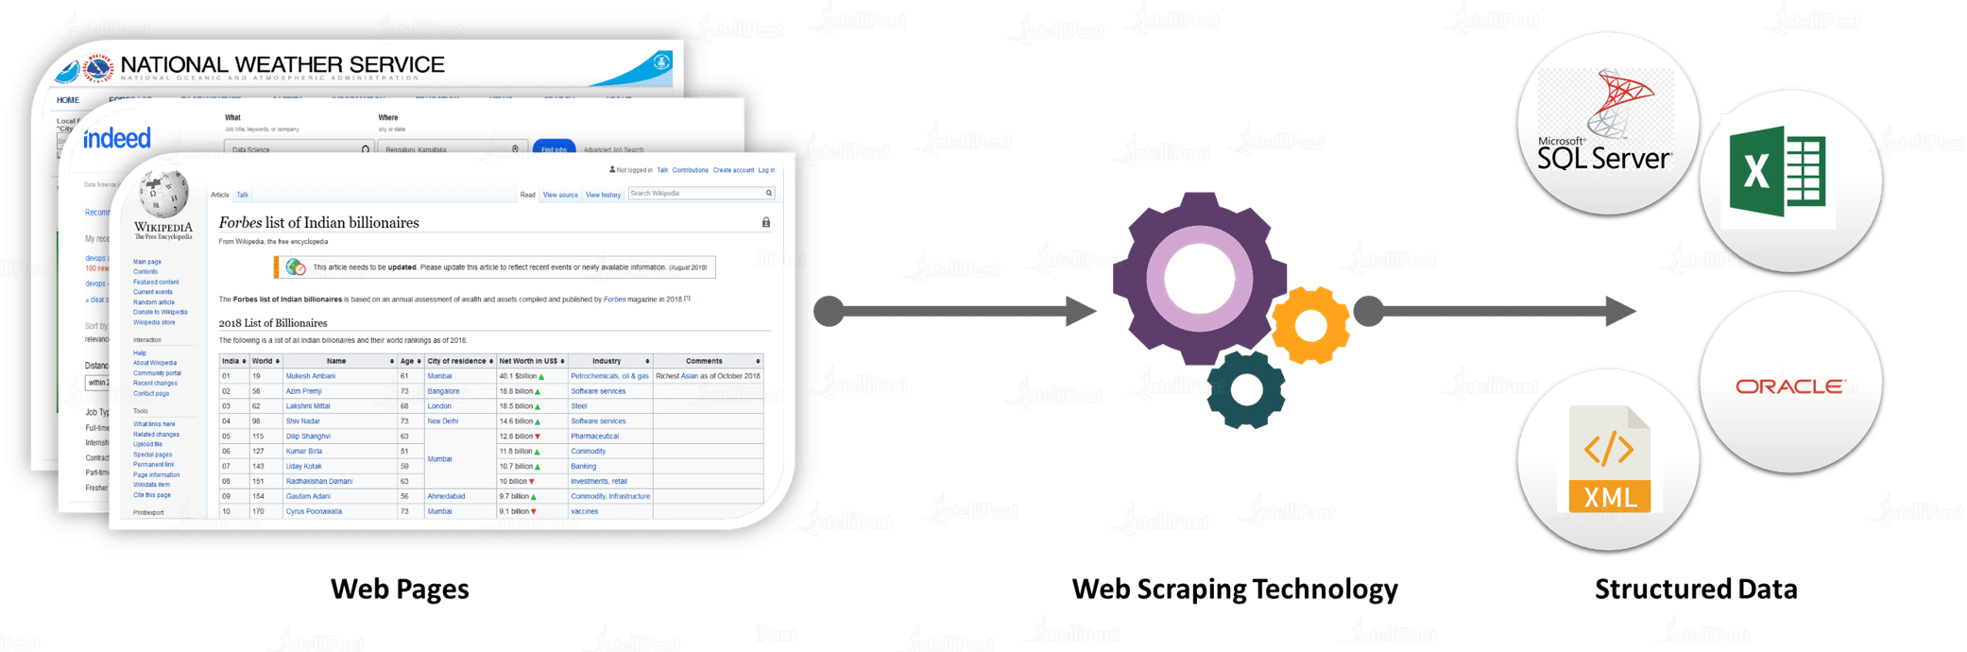

Slide 13
DEMONSTRATION
26/09/22
WEB SCRAPING OF COVID 19 CASES(GUI BASED)
13

Slide 14
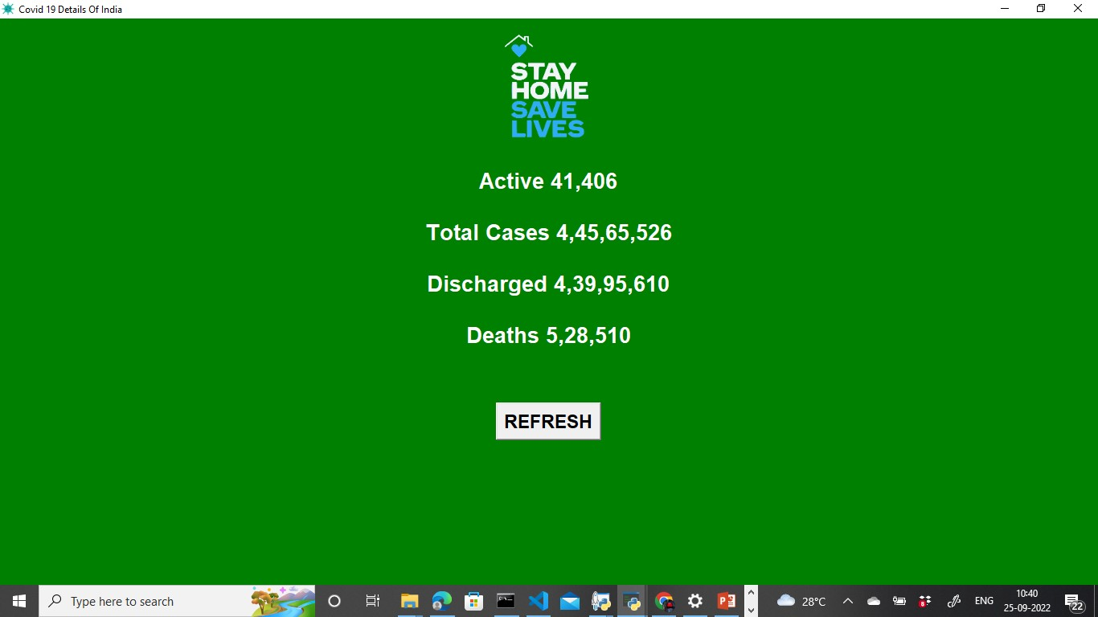
6/27/2022
WEB SCRAPING OF COVID 19 CASES(GUI BASED)
14

Slide 15

WEB SCRAPING OF COVID 19 CASES(GUI BASED)
15

