Slide 1
Alma better
Capstone Project -1
Exploratory Data Analysis
Hotel Booking Analysis
By,
Shafiq Abubacker

Slide 2
Problem Statement
In this project, we will conduct an analysis on hotel booking data, encompassing information related to reservations for both a city hotel and a resort hotel.
The dataset comprises details such as the booking date, duration of stay, the count of adults, children, and/or babies, as well as the availability of parking spaces.
The hotel booking dataset presents an excellent opportunity to explore various questions related to booking patterns, optimal stay durations, and factors influencing special requests.

Slide 3
Business Context
The Hotel Booking Analysis project is undertaken within the context of the competitive and dynamic hotel industry.
As hotels continually navigate the challenges of fluctuating demand, varying customer preferences, and the potential
for booking cancellations, this project seeks to provide valuable insights through a comprehensive examination of the
provided dataset.
Customer-Centric Decision Making:
  Understanding booking patterns and customer behavior is crucial for hotels striving to offer tailored services and enhance the overall guest experience.
  Unraveling factors influencing booking decisions allows hotels to align their strategies with customer preferences.
Optimizing Operational Efficiency:
  By analyzing trends in booking lead times, the project aims to assist hotels in optimizing their operations, potentially reducing costs and improving resource utilization.
  Insights into seasonality and stay length correlations contribute to effective capacity planning.
Risk Mitigation through Cancellation Analysis:
  Cancellations can significantly impact revenue and resource allocation. Examining the impact of booking lead time on cancellations provides insights into potential risk mitigation strategies.
  Understanding the dynamics of cancellations helps hotels implement policies to minimize revenue loss.
Strategic Forecasting and Planning:
  The ultimate goal of the project is to equip hotels with predictive insights. By uncovering trends and patterns, the analysis aids in forecasting future bookings, enabling proactive planning and resource allocation.
  Multivariate analysis delves into the complex interactions between various factors, providing a holistic view for strategic decision-making.
Competitive Edge:
  In the highly competitive hotel industry, staying ahead requires a deep understanding of customer preferences and market dynamics. This project aims to provide a competitive edge by offering actionable insights derived from robust exploratory data analysis.

Slide 4
Data Understanding
The dataset for the Hotel Booking Analysis project consists of 119,390 rows and 32 columns. Post data collection, a comprehensive understanding of these
32 columns is imperative for a nuanced analysis and interpretation of the information encapsulated within the dataset.
Data Description:
hotel :Resort Hotel or City Hotel
is_canceled : Value indicating if the booking was canceled (1) or not (0)
lead_time : Number of days that elapsed between the entering date of the booking and the arrival date
arrival_date_year : Year of arrival date
arrival_date_month : Month of arrival date
arrival_date_week_number : Week number of year for arrival date
arrival_date_day_of_month : Day of arrival date
stays_in_weekend_nights : Number of weekend nights
stays_in_week_nights : Number of week nights.
adults : Number of adults children : Number of children
babies : Number of babies meal : Type of meal booked.
country : Country of origin.
market_segment : Market segment designation. (TA/TO)
distribution_channel : Booking distribution channel.(T/A/TO)
is_repeated_guest : is a repeated guest (1) or not (0)
previous_cancellations : Number of previous bookings that were cancelled by the customer prior to the current booking
previous_bookings_not_canceled : Number of previous bookings not cancelled by the customer prior to the current
booking
reserved_room_type : Code of room type reserved.
assigned_room_type : Code for the type of room assigned to the booking.
booking_changes : Number of changes made to the booking from the moment the booking was entered on the
PMS until the moment of check-in or cancellation
deposit_type : No Deposit, Non Refund , Refundable.
agent : ID of the travel agency that made the booking
company : ID of the company/entity that made the booking .
days_in_waiting_list : Number of days the booking was in the waiting list before it was confirmed to the customer
customer_type : type of customer. Contract,Group,transient,Transient party.
adr : Average Daily Rate as defined by dividing the sum of all lodging transactions by the total number of staying nights
required_car_parking_spaces : Number of car parking spaces required by the customer
total_of_special_requests : Number of special requests made by the customer (e.g. twin bed or high floor)
reservation_status : Reservation last status.

Slide 5
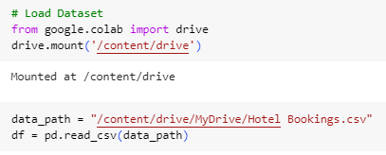
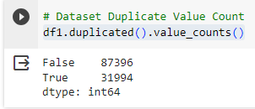
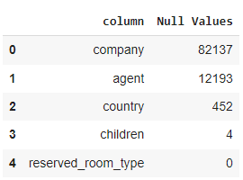
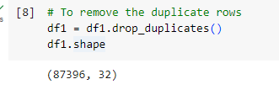
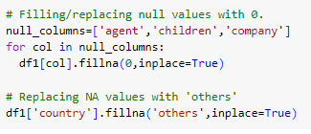
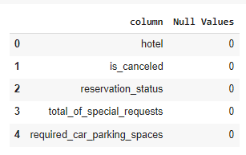
Data loading and cleanup
Load the Dataset using Google Drive
There are 31994 Duplicate values
Company, Agent,country,children has Null Values
Remove 31994 Duplicate values
Replaced Null values with “0” for agent,children,company and country with “Others”

Slide 6
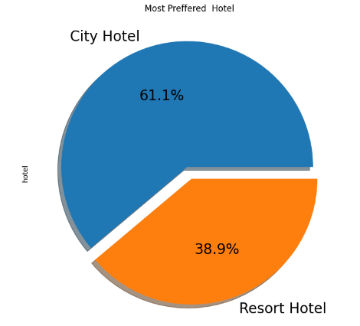
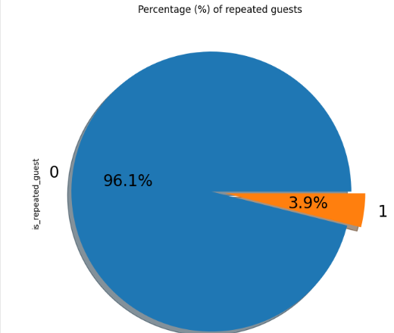
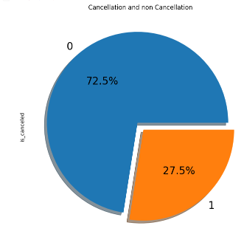
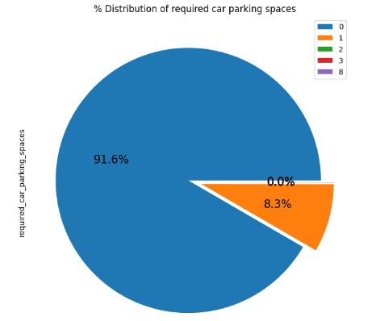
Exploratory Data Analysis
City Hotel is the most preferred Hotel for the guests
Reasons:
Location Convenience
Brand Reputation
Tourist Attractions
Almost 96.1 percent of People are new Guests
This may be because of Customer Acquistation, Customer Retention, Feedback
On the Whole, 27.5% bookings have been cancelled.
This may be because of customer experience,Cancellation Policies or Because o Market Competition
Almost 91.6% does not required Car Parking spaces.

Slide 7
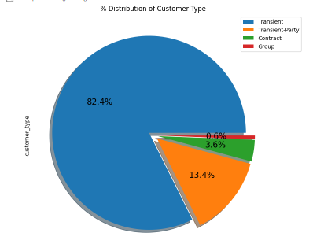
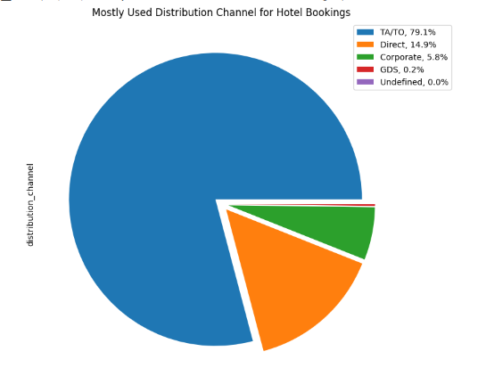
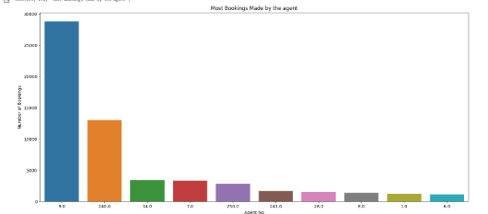
Exploratory Data Analysis
Around 79.1% are booked through travel agents and 14.9% booked directly.5.8% are from corporate booking and 0.2% booked through global
Around 82.4% are of transient type, 13.4% Transient –Party, 3.6% are of contract type and just 0.6% are from a group
Agent number 9 made the most number of around 28759 Bookings followed by Agent number 240 which is just half of agent 9. Agent 7 and 14 shares almost equal number of bookings

Slide 8
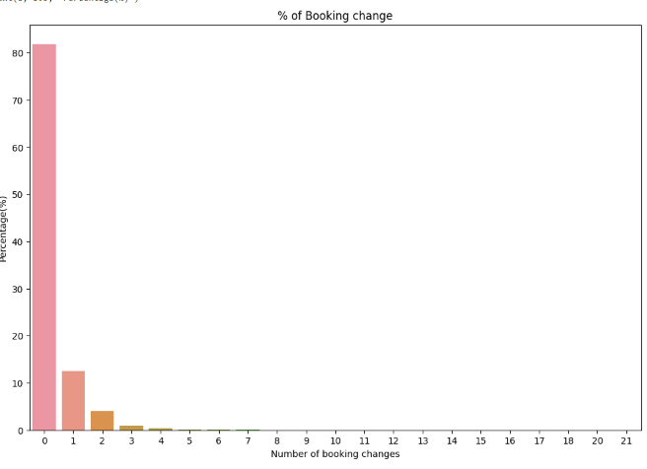
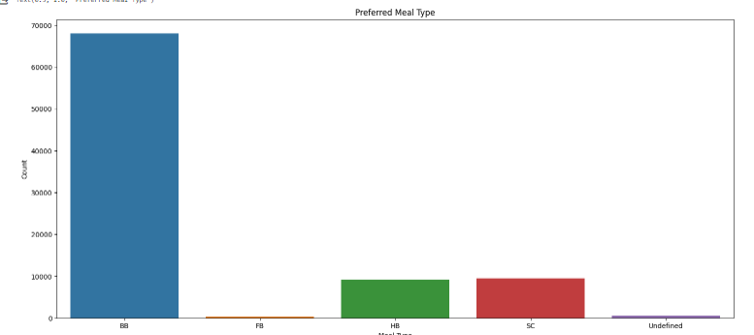
Exploratory Data Analysis
82% of people doesn’t make any changes and 10% made a single change.
Most of the Guest preferred Bed and Breakfast while Full board was least preferred. Half Board and Self change are preferred equally.

Slide 9
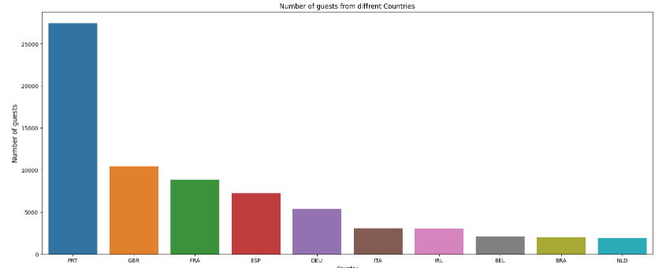
Exploratory Data Analysis
Dominant Guest Origin:
  A significant majority of guests, exceeding 25,000 individuals, originated from Portugal, indicating a pronounced preference for the hotel from this specific country.
International Guest Preferences:
  Following Portugal, the primary sources of guests were identified as GBR (Great Britain), France, and Spain. These countries collectively contribute to a substantial portion of the hotel's international clientele.
Portugal's Strong Influence:
  Portugal emerges as a key influencer in the hotel's guest demographic, with a substantial number exceeding 25,000. This underscores the hotel's appeal and resonance with Portuguese visitors.
European Visitor Concentration:
  The clustering of guests from GBR, France, and Spain underscores the hotel's allure for European visitors. This regional concentration suggests the hotel's successful positioning within the European travel market.
Diversification in Guest Demographics:
  The combination of Portugal, GBR, France, and Spain as primary sources of guests suggests a diversified guest demographic, contributing to the hotel's global appeal.
Strategic Insights for Marketing:
  The data provides strategic insights for marketing efforts, indicating potential target regions and highlighting successful periods that can be leveraged for future promotional campaigns.

Slide 10
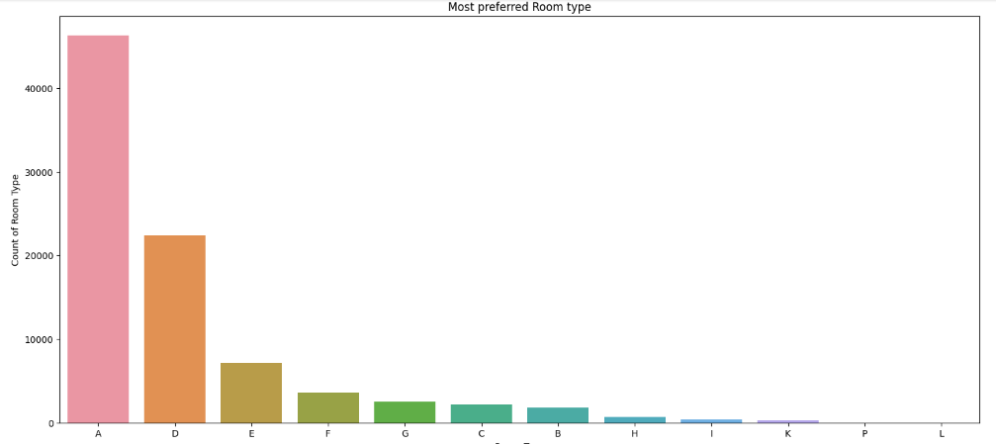
Exploratory Data Analysis
The preeminent choice among guests is undeniably room type "A," surpassing an impressive booking count of over 40,000.
In contrast, room type "D" demonstrates a preference level merely half of that observed for room type "A.“
Meanwhile, room type "E" registers bookings below the 10,000 mark, indicating a lower but still substantial popularity among guests. This hierarchy in booking preferences offers valuable insights into guest choices and preferences, enabling strategic decision-making in areas such as inventory management, pricing strategies, and targeted marketing efforts.
By recognizing the distinct appeal of each room type, the hospitality establishment can tailor its offerings to align more closely with guest expectations and enhance overall satisfaction.

Slide 11
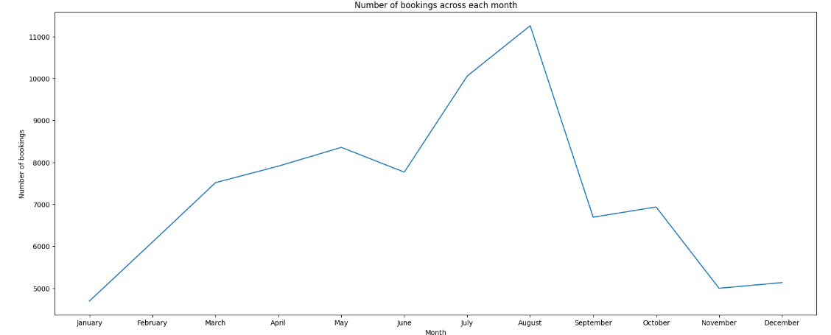
Exploratory Data Analysis
Resort Hotel Dominance in Peak Months:
  Resort hotels exhibited the highest Average Daily Rates (ADR) during the summer months of June, July, and August, surpassing those of City hotels. This suggests a heightened demand for resort-style accommodations during the vacation season.
City Hotels Lead in Other Months:
  In contrast, during the remaining months, City hotels outperformed Resort hotels in terms of ADR. This indicates a shift in customer preferences or demand dynamics, with City hotels offering better ADR during non-peak periods.
Optimal Months for Customer Savings:
  January, February, March, April, November, and December emerge as favorable months for customers to secure advantageous ADR. During these months, both Resort and City hotels present opportunities for guests to enjoy more favorable rates.
Strategic Booking Considerations:
  The observed seasonal variations highlight the importance of strategic booking for customers. Depending on the desired experience and budget considerations, guests can capitalize on optimal ADR in specific months.
Balancing Cost and Experience:
  Customers seeking cost-effective options may find the mentioned months conducive to securing favorable ADR. Balancing budget constraints with seasonal preferences allows for a more tailored and cost-efficient booking strategy.
Enhanced Customer Decision-Making:
  This analysis empowers customers with insights into the seasonal nuances of ADR, enabling informed decision-making when planning their stays. Understanding the fluctuations in pricing contributes to a more satisfying and economically prudent guest experience.
Business Strategy Implications:
  For hotel management, recognizing the seasonal patterns in ADR facilitates strategic planning. It allows for targeted marketing efforts, pricing adjustments, and resource allocation to align with the anticipated demand fluctuations throughout the year.

Slide 12
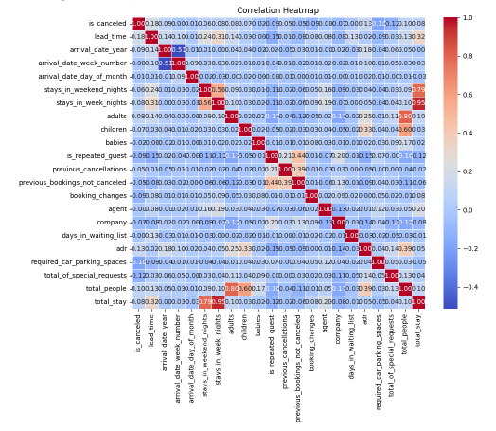
Exploratory Data Analysis
Negative Correlation between Cancellation and Same Room Allotment:
  An intriguing observation is the negative correlation between the variables "is_canceled" and "same_room_alloted_or_not." The data suggests that the failure to get the same room as reserved is not a significant factor contributing to booking cancellations.
Positive Correlation between Lead Time and Total Stay:
  A positive correlation is identified between "lead-time" and "total stay," indicating that as the duration of a customer's stay increases, the lead time for booking tends to be longer. This pattern suggests that customers with extended stays tend to plan and book well in advance.
High Correlation between ADR and Total People:
  A noteworthy finding is the high correlation between "ADR" (Average Daily Rate) and the variable "total people." This implies that as the number of people in a booking increases, the ADR tends to be higher. The correlation underscores the potential relationship between group size and higher revenue generation for the hotel.
Strong Correlation between Repeated Guests and Not Canceled Bookings:
  A robust correlation is observed between "is_repeated_guest" and "previous_bookings_not_canceled." This suggests that guests who have a history of previous bookings are less likely to cancel their reservations. The loyalty or familiarity factor may contribute to this strong correlation.
Interpretation and Implications:
Guest Room Allotment and Cancellations: The negative correlation challenges the assumption that room allotment discrepancies contribute significantly to cancellations. The hotel may explore other factors influencing cancellations to enhance guest satisfaction.
Lead Time and Extended Stays: Understanding the positive correlation between lead time and total stay helps the hotel anticipate and manage reservations more effectively, especially for customers with longer stays.
Revenue Optimization through ADR and Group Bookings: The correlation between ADR and total people highlights an opportunity for revenue optimization. The hotel might consider tailored pricing strategies for group bookings to capitalize on higher ADR associated with larger parties.
Customer Loyalty and Booking Reliability: The strong correlation between repeated guests and not canceled bookings emphasizes the importance of customer loyalty in reducing cancellation rates. The hotel can leverage this information to implement targeted loyalty programs and personalized services for returning guests.

Slide 13
Conclusion
Hotel Booking Distribution:
  Approximately 60% of bookings are for City hotels, emphasizing their higher demand compared to Resort hotels, which account for 40% of bookings. The overall Average Daily Rate (ADR) of City hotels is slightly higher.
Stay Duration Preferences:
  Guests typically stay for less than 5 days in hotels, with the trend shifting towards longer stays in Resort hotels. This insight can influence pricing strategies and package offerings.
Cancellation Rates and Guest Loyalty:
  Both hotels experience high booking cancellation rates. City hotels have a notably low percentage of guests returning for another booking (less than 3%), while Resort hotels show a higher return rate of 5%.
Geographical Source of Guests:
  European countries contribute the majority of guests, with Portugal being the primary source. Understanding these demographics aids in targeted marketing and guest experience customization.
Booking Channels and Recommendations:
  Guests predominantly use the TA/TO (Travel Agency/Tour Operator) channel for bookings. However, around 30% of bookings via TA/TO are canceled, indicating potential issues that may need attention. Hotels should focus on optimizing popularity on GDS (Global Distribution System) channels.
Cancellation Factors and Room Allotment Impact:
  Factors such as not getting the same room as reserved, longer lead time, and waiting time do not significantly affect booking cancellations. However, different room allotments do lower the ADR. This suggests an opportunity for hotels to improve room allocation practices.
Peak Months and Weekend Trends:
  July-August emerge as the busiest and most profitable months for both hotels. Within a month, ADR gradually increases towards the end, with a slight surge on weekends. This information is valuable for revenue management.
Targeted Services for Couples:
  Couples are the most common guests, indicating an opportunity for hotels to tailor services to meet couples' needs and preferences, potentially enhancing guest satisfaction and loyalty.
Special Requests and Guest Composition:
  More people in a booking result in a higher number of special requests. Complementary market segments and bookings with adults tend to have a higher average number of special requests.
Longer Stays and Better Deals:
  Longer stays, especially exceeding 15 days, can result in better deals with lower ADR. This insight is valuable for both guests seeking extended stays and hotels aiming to optimize revenue for prolonged bookings.

