Slide 1
Capstone Project The Battle of Neighbourhoods (Week2)
Exploring Good Places at Scarborough in Toronto¶
By Shafiq Alias

Slide 2
Introduction
This initiative aims to help individuals discover better facilities in their neighbourhood. It can help individuals make wise and successful choices about choosing great neighbourhoods from numbers in Scarborough, Toranto, from other neighbourhoods.
Lots of people are migrating to various states of Canada and needed lots of research for good housing prices and reputation schools for their children. This project is for those people who are looking for better neighbourhoods. For ease of accessing to Cafe, School, Super market, medical shops, grocery shops, mall, theatre, hospital, like minded people, etc.
This undertaking is aimed to create an evaluation of functions for a people migrating to Scarborough to look a first-class neighbourhood as a comparative evaluation among neighbourhoods. The capabilities encompass median housing price and better faculty in keeping with ratings, crime fees of that specific region, road connectivity, weather conditions, top management for emergency, water resources each fresh and waste water and excrement conveyed in sewers and recreational facilities.
This will help people to get awareness of the area and neighbourhood before moving to a new city, state, country or place for their work or to start a new fresh life.

Slide 3
Problem Statement
The major purpose of this project, is to suggest a better neighbourhood in a new city for the person who are shifting there. Social presence in society in terms of like minded people. Connectivity to the airport, bus stand, city centre, markets and other daily needs things nearby.
1. Sorted list of house in terms of housing prices in a ascending or descending order
2. Sorted list of schools in terms of location, fees, rating and reviews

Slide 4
The City Location
Scarborough is a popular destination for new immigrants in Canada to reside. Therefore, it is perhaps the most assorted and multicultural zones in the Greater Toronto Area, being home to different strict gatherings and spots of love. In spite of the fact that movement has become a hotly debated issue in the course of recent years with more governments looking for additional limitations on settlers and outcasts, the overall pattern of migration into Canada has been one of on the ascent.

Slide 5
Data
Source of Data:
Data Link: https://en.wikipedia.org/wiki/List_of_postal_codes_of_Canada:_M
Will use Scarborough dataset which we scrapped from wikipedia on Week 3. Dataset consisting of latitude and longitude, zip codes.
Foursquare API Data:
We will require information about various scenes in various neighborhoods of that particular precinct.
To acquire that data we will utilize "Foursquare" locational data. Foursquare is an area information supplier with data pretty much all way of settings and occasions
inside a territory of interest. Such data incorporates setting names, areas, menus and even photographs. All things considered, the foursquare area stage will be
utilized as the sole information source since all the expressed required data can be gotten through the API. The API Client ID and Client Secret can be obtained from
the Foursquare website https://foursquare.com/ with a registered developer account.
After finding the list of neighborhoods, we then connect to the Foursquare API to gather information about venues inside each and every neighborhood.
For each neighborhood, we have chosen the radius to be 100 meter.
The data retrieved from Foursquare contained information of venues within a specified distance of the longitude and latitude of the postcodes. The information obtained per venue as follows:
Neighborhood
Neighborhood Latitude
Neighborhood Longitude
Venue
Name of the venue e.g. the name of a store or restaurant
Venue Latitude
Venue Longitude 8. Venue Category

Slide 6
3. Methodology
Clustering Approach:
To compare the similarities of two cities, we decided to explore neighbourhoods, segment them, and group them into clusters to find similar neighbourhoods in a big city like New York and Toronto. To be able to do that, we need to cluster data which is a form of unsupervised machine learning: k-means clustering algorithm.

Slide 7
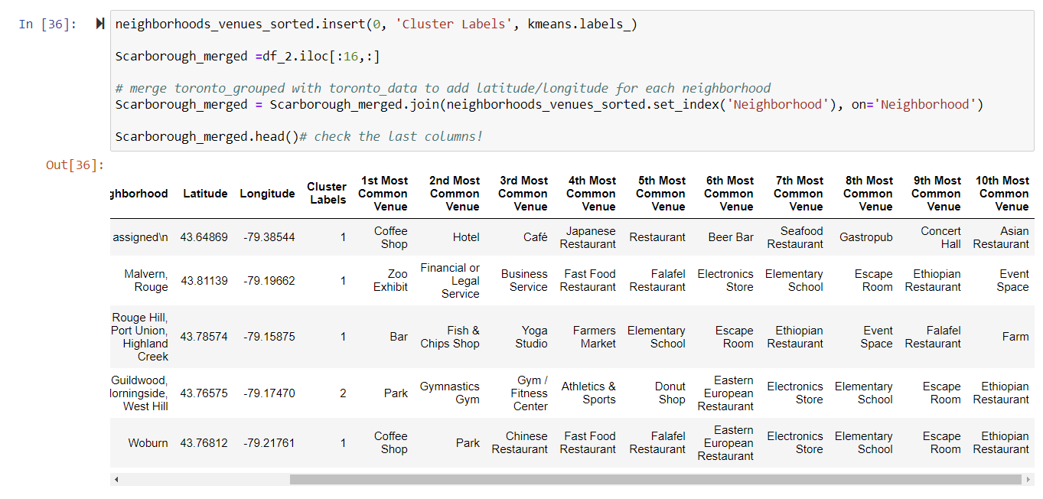
Using K-Means Clustering Approach

Slide 8
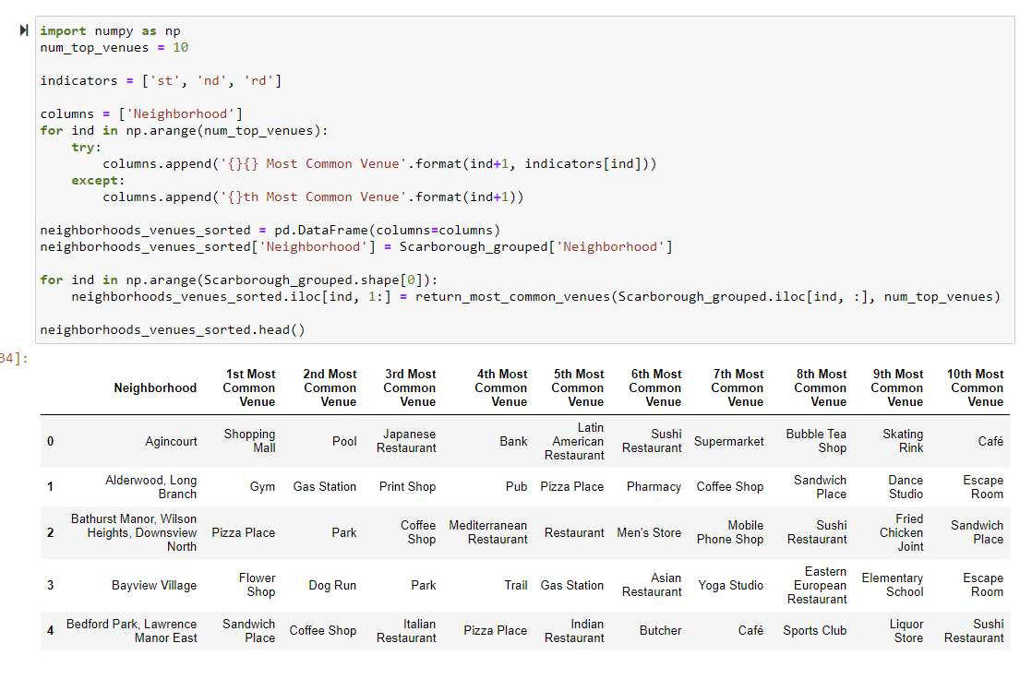
Most Common venues near Neighbourhood

Slide 9
Tools & Library
> Pandas: For creating and manipulating dataframes.
>
> Folium: Python visualization library would be used to visualize the neighborhoods cluster distribution of using interactive leaflet map.
>
> Scikit Learn: For importing k-means clustering.
>
> JSON: Library to handle JSON files.
>
> XML: To separate data from presentation and XML stores data in plain text format.
>
> Geocoder: To retrieve Location Data.
>
> Beautiful Soup and Requests: To scrap and library to handle http requests.
>
> Matplotlib: Python Plotting Module.

Slide 10
RESULTS

Slide 11
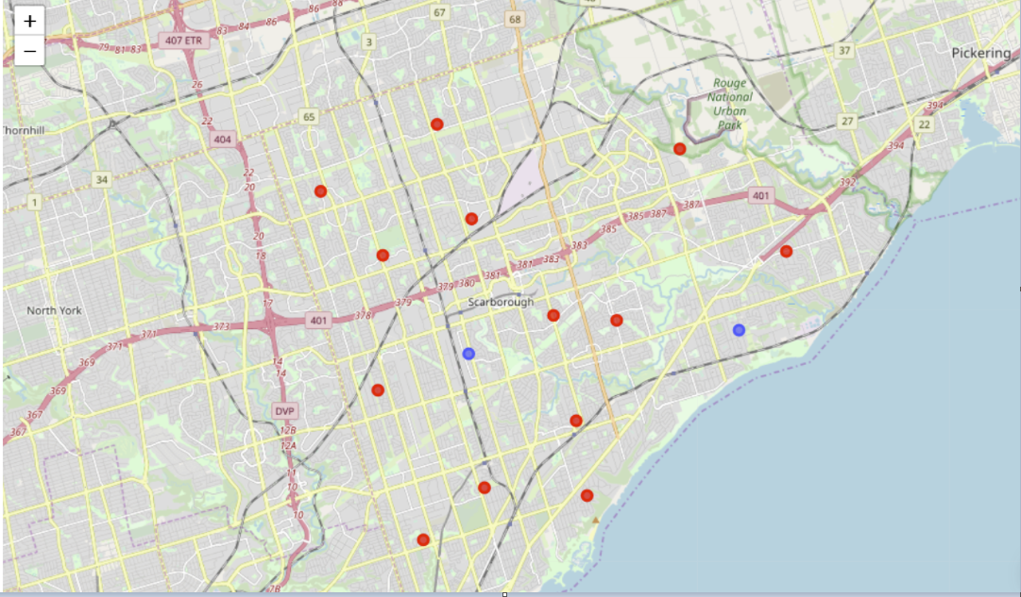
Map of Clusters in Scarborough

Slide 12
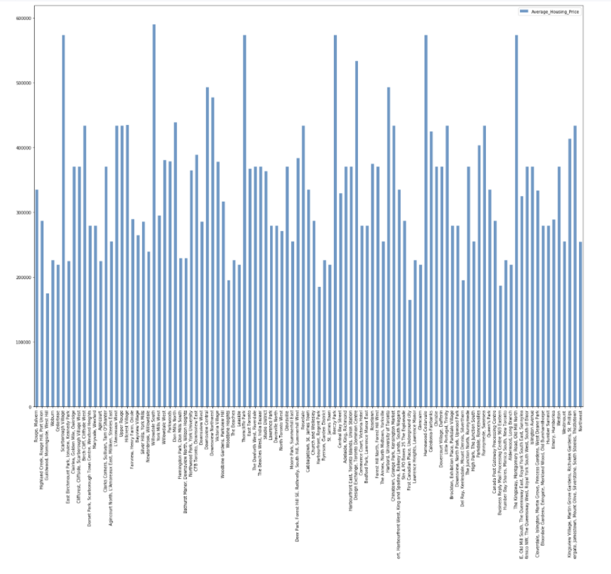
Average Housing Price

Slide 13
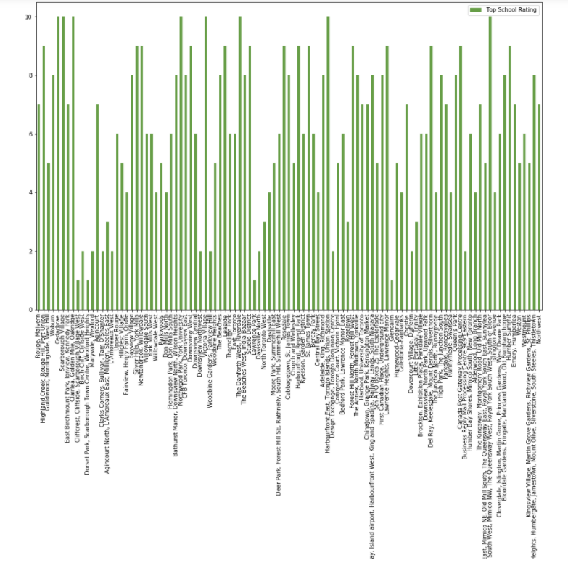
Top School Rating

Slide 14
Discussion
Problem Which Tried to Solve:
The major purpose of this project, is to suggest a better neighborhood in a new city for the person who are shiffting there. Social presence in society in terms of like minded people. Connectivity to the airport, bus stand, city center, markets and other daily needs things nearby.
1. Sorted list of house in terms of housing prices in a ascending or descending order
2. Sorted list of schools in terms of location, fees, rating and reviews

Slide 15
Conclusion
In this project, using k-means cluster algorithm I separated the neighborhood into 10(Ten) different clusters and for 103 different latitude and logitude from dataset, which have very-similar neighbourhoods around them. Using the charts above results presented to a particular neighborhood based on average house prices and school rating have been made.
This project has shown me a practical application to resolve a real situation that has impacting personal and financial impact using Data Science tools.
The mapping with Folium is a very powerful technique to consolidate information and make the analysis and decision better with confidence.

