Slide 1
Capstone Project The Battle of Neighbourhoods (Week2)
Exploring Good Places at Scarborough Town in Toronto¶
By Shafiq Alias

Slide 2
Introduction
This initiative aims to help individuals discover better facilities in their neighbourhood. It can help individuals make wise and successful choices about choosing great neighbourhoods from numbers in Scarborough, Toranto, from other neighbourhoods.
Lots of people are migrating to various states of Canada and needed lots of research for good housing prices and reputation schools for their children. This project is for those people who are looking for better neighbourhoods. For ease of accessing to Cafe, School, Super market, medical shops, grocery shops, mall, theatre, hospital, like minded people, etc.
This undertaking is aimed to create an evaluation of functions for a people migrating to Scarborough to look a first-class neighbourhood as a comparative evaluation among neighbourhoods. The capabilities encompass median housing price and better faculty in keeping with ratings, crime fees of that specific region, road connectivity, weather conditions, top management for emergency, water resources each fresh and waste water and excrement conveyed in sewers and recreational facilities.
This will help people to get awareness of the area and neighbourhood before moving to a new city, state, country or place for their work or to start a new fresh life.

Slide 3
Problem Statement
The major purpose of this project, is to suggest a better neighborhood in a new city for the person who are shiffting there. Social presence in society in terms of like minded people. Connectivity to the airport, bus stand, city center, markets and other daily needs things nearby.
1. Sorted list of house in terms of housing prices in a ascending or descending order
2. Sorted list of schools in terms of location, fees, rating and reviews

Slide 4
The City Location
Scarborough is a popular destination for new immigrants in Canada to reside. Therefore, it is perhaps the most assorted and multicultural zones in the Greater Toronto Area, being home to different strict gatherings and spots of love. In spite of the fact that movement has become a hotly debated issue in the course of recent years with more governments looking for additional limitations on settlers and outcasts, the overall pattern of migration into Canada has been one of on the ascent.

Slide 7
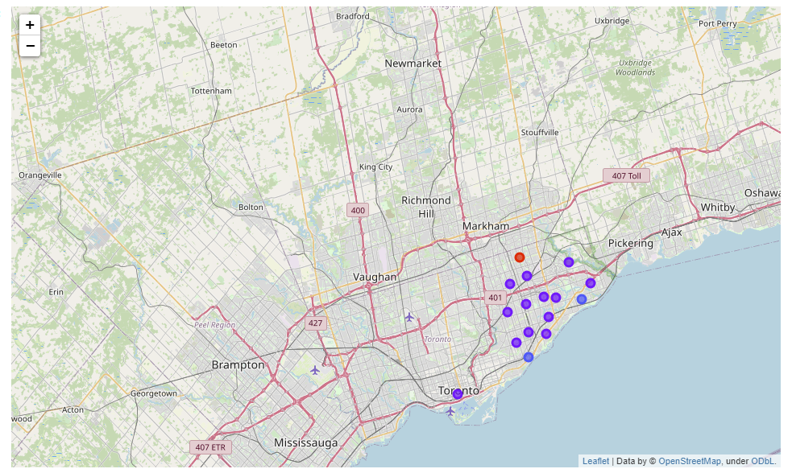

Slide 9
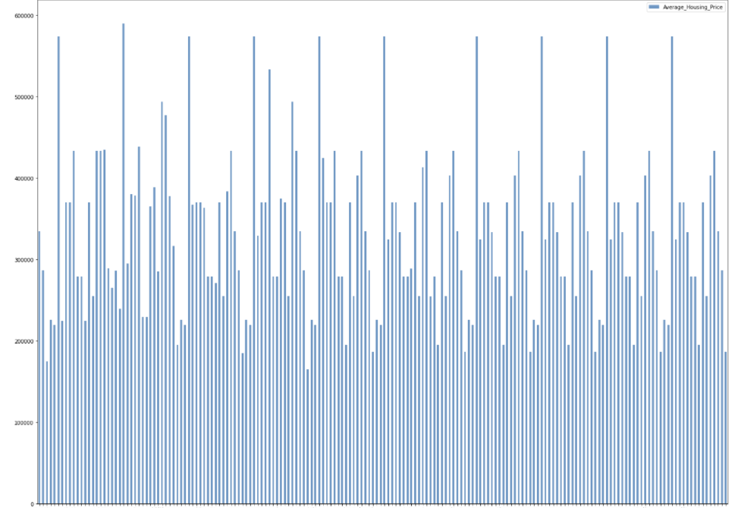
Average Housing Price

Slide 10
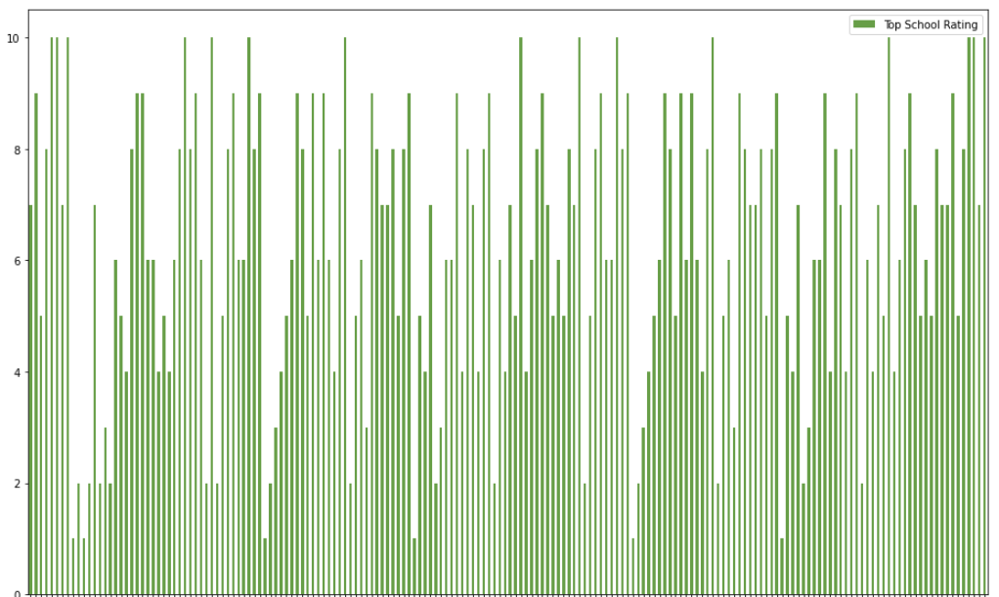
Top School Rating

Slide 11
Conclusion

