Slide 1
E-CARE
e-desk
(help desk system)

Slide 2
Introduction
E-care is customer care management system.
E-care is called as E-desk or Help Desk System. It is so called as Help Desk System because it tries to solve all the HD (helpdesk) problems, which are coming from the users of E-care.
E-care will take care of every request coming from their users and try to solve and produce the solution of the particular request.
E-care also will store the responses for the future use.

Slide 3
Product Features
The salient features provided in our product are:
Minimal administration
Support both corporate and individual users
Unique interface will be provided to each client to rephrase a particular problem
Client problem will be directed to the concern support team member
User roles and permission levels
Efficient internal messaging service
Virtual service reports for management purpose

Slide 4
System Analysis
Existing System.
Problem Definition.
Proposed System.
Requirement Analysis.
Requirement Specification.
Feasibility Study

Slide 5
System Design
Project Modules.
E-R Diagrams.
Data Flow Diagrams.
Hardware And Software Specifications.

Slide 6
1.Project Modules
User Module.
Super User Module.
Administration Module.

Slide 7
ENTITY-RELATIONSHIP Diagrams
Symbols
Purpose
Represent Entity Set
Represent Attribute
Represent Relationship Set

Slide 8
Password
idu
password
idu
name
Company
name
idc
user id
Registers
As
Customers
Coorporate
Client
USER
Ticket no
idu
Password
Catagory
name
Registers
ids
Module
Name
Super User
idc

Slide 9
Flow Of Posting Queries
Catagory
Name
idu
Ticket no
Module
Name
Name
Password
Query des
User
Post
Query
Super
User
User Name
idu
idc
Password
Support
Team
Name
ids
Description
Of
Query
Query
Details
Query
date
Ticket no

Slide 10
Flow of forwarding the query to the levels
id u
Ticket no
id s
Catagorization
and
Modularization
and
Messaging
the solution
Super
User
Module
Name
id c
Level
name
Level id
Catagoty
name
HD Levels
Users
Solutions

Slide 11
Data Flow Diagrams
Notations used in DFD’s.
Data flow process
Process
Data store
Source and sink

Slide 12
Data flow diagrams
Response
of
query
User
id,password and query
User
E-Care

Slide 13
First level
2.0
User Database
Login
process
Update
User
details
Password
1.0
Solved
Query
Super
User
User
Client
Process
3.0
User
Administration
Process
Invalid id
User id
4.0
Corporate
User
Process

Slide 14
Second level
2.0
User details
Client
process
Company
details
Query no
2.1
2.3
2.2
Add/Delete
/Modify
Users
Add/
Delete
Query
Company
Profile
Update
Update
User
Status
3.0
Update
Profile
Administration
process
Adninistration
Details
Administration Database

Slide 15
Second level
Level1 data
3.0
level details
3.1
3.4
Administration
process
Create/
delete/
modify
levels
Super user
3.5
3.2
Modify
company profile
3.3
Query
status
add/delete
client details
client detaols
Administration database

Slide 16
Third level
database administration
3.2
3.2.4
3.2.5
new catagory
module
query
status
creat
1st level
creat
2nd level
unsolved query
catagory name
3.2.1
3.3
1st level
admin
3.2.3
resolved
3rd level
admin
messaging
system
module
name
3.2.2
2nd level
admin
user

Slide 17
Hardware And Software Requirements
Hardware specifications
processor: Intel p3 based system
processor.
speed : 250MHz to 833MHz.
RAM : 64MB to 256MB.
Hard disk : 2GB to 40GB.
Key board : 104 keys.

Slide 18
Software specifications
Language : .Net (ASP.Net)
Database : SQL
Operating system: Windows
NT/2000/XP

Slide 19
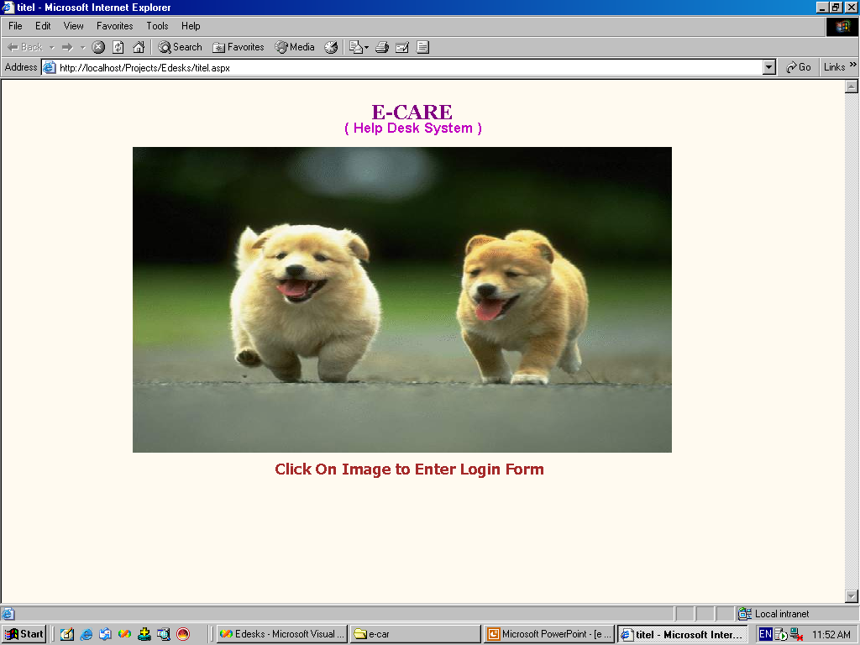
Screens

Slide 20
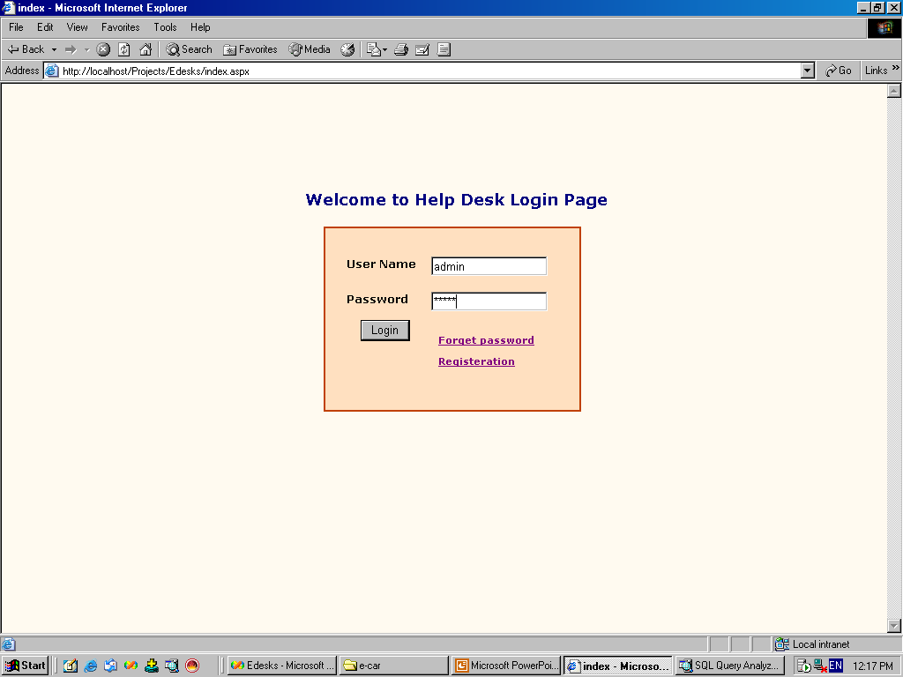
Login Screen

Slide 21
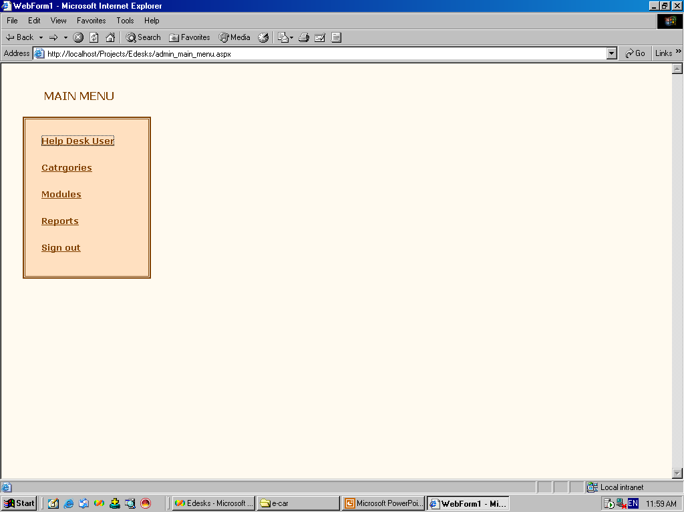
Corporate User

Slide 22
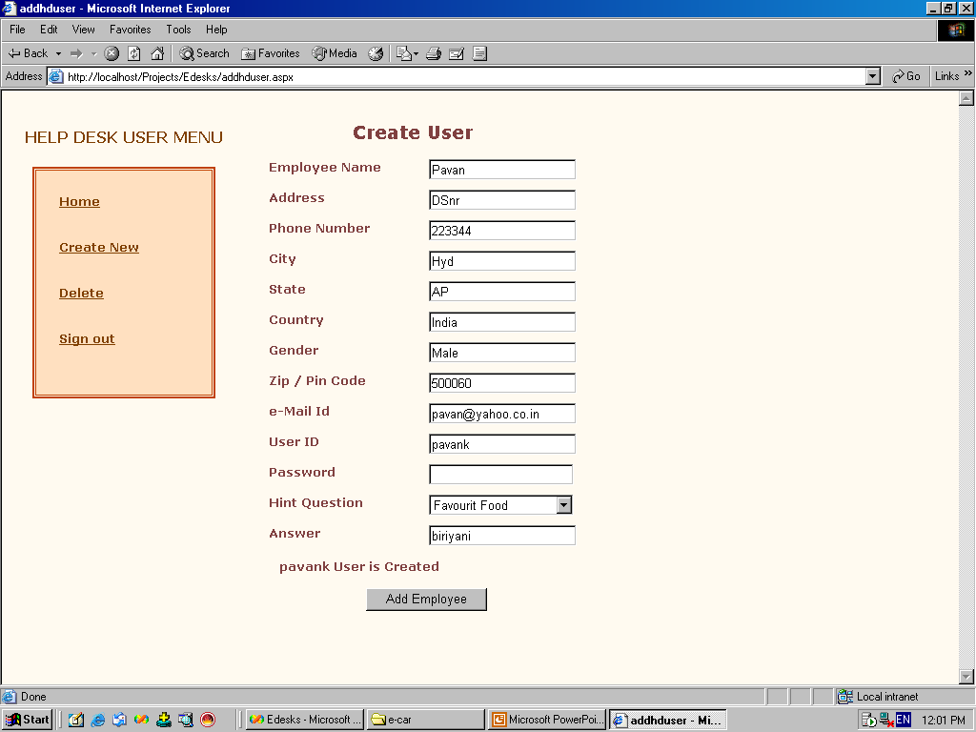
Adding Help Desk User

Slide 23
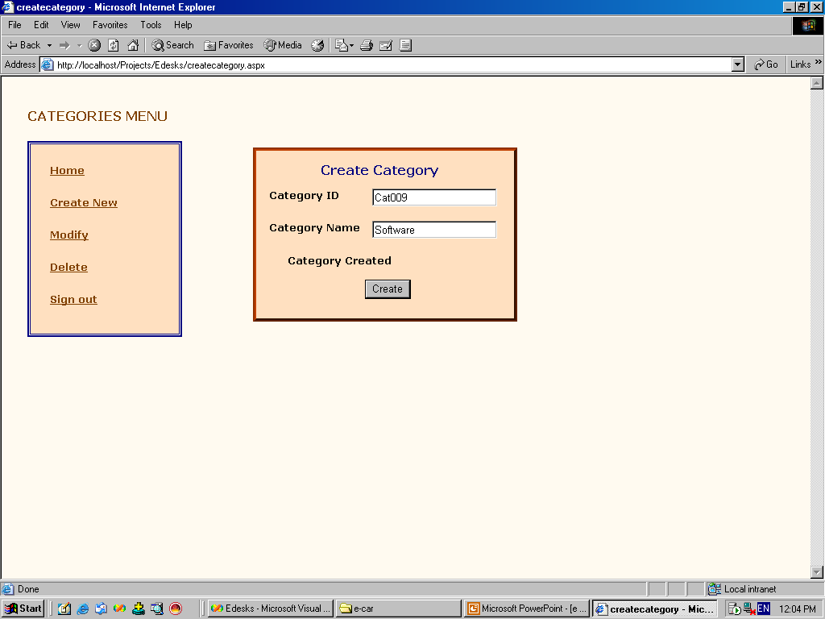
Adding Category

Slide 24
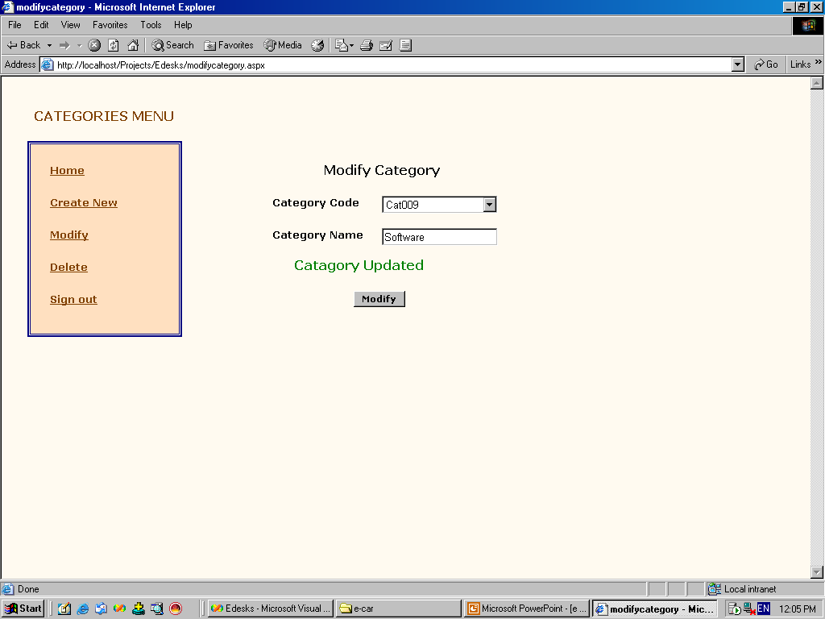
Modify Category

Slide 25
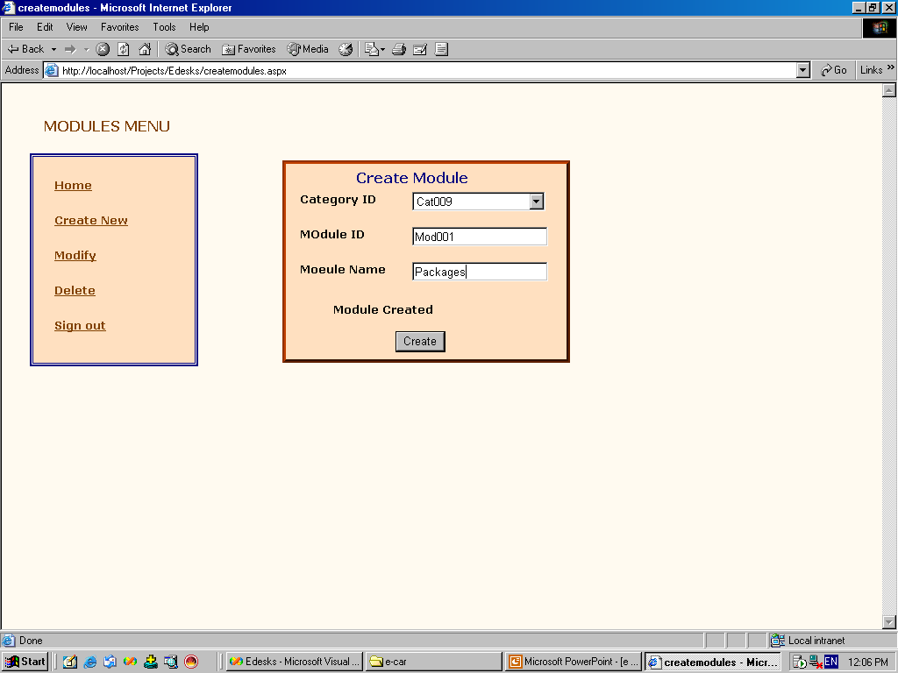
Adding Module

Slide 26
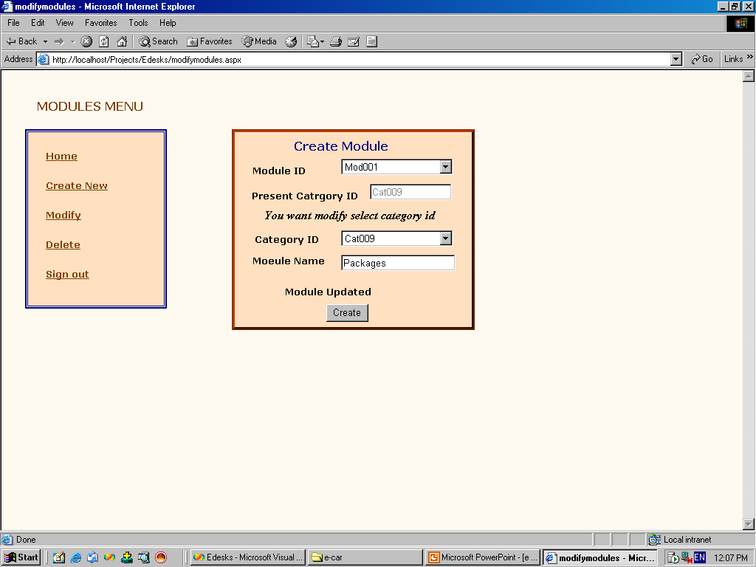
Module Updating

Slide 27
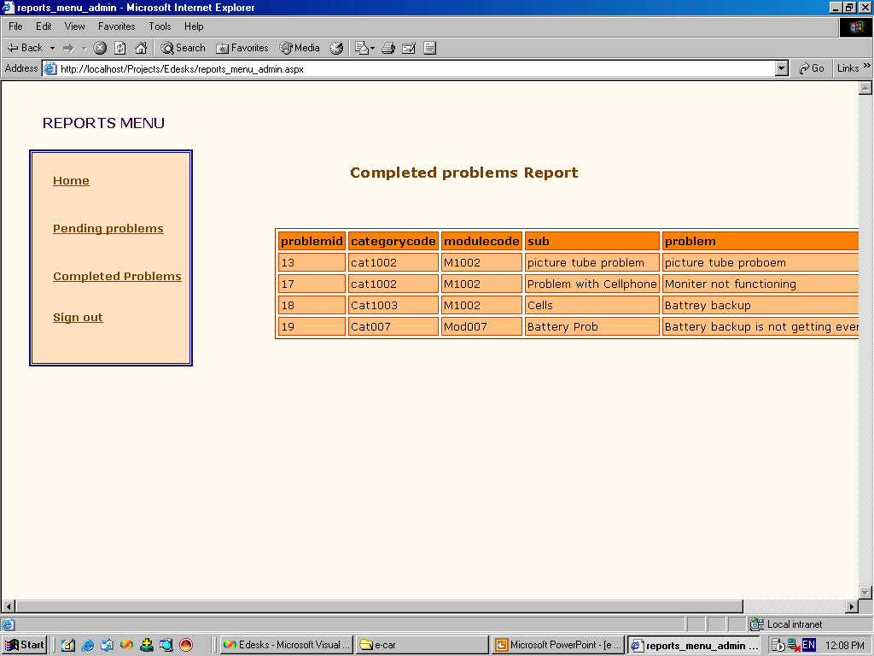
Completed Problems

Slide 28

Help Desk User

Slide 29
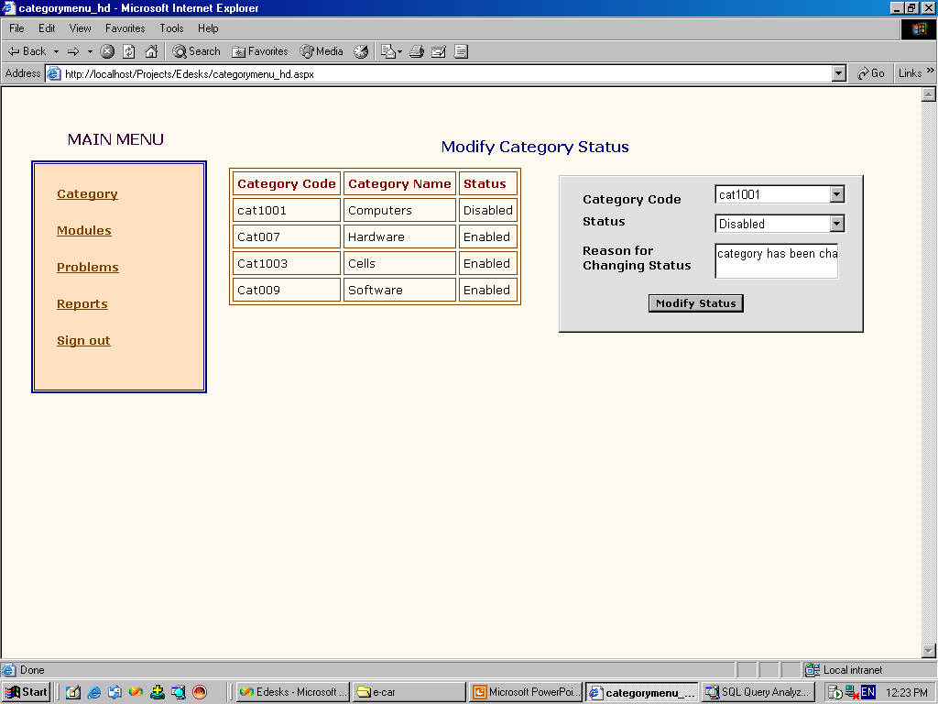
Changing Status of Category

Slide 30
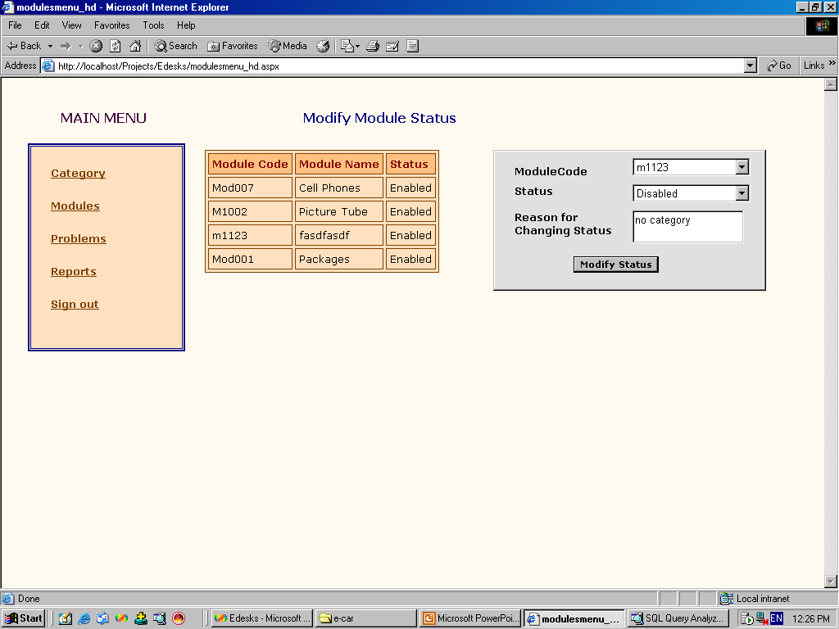
Changing Status of Module

Slide 31
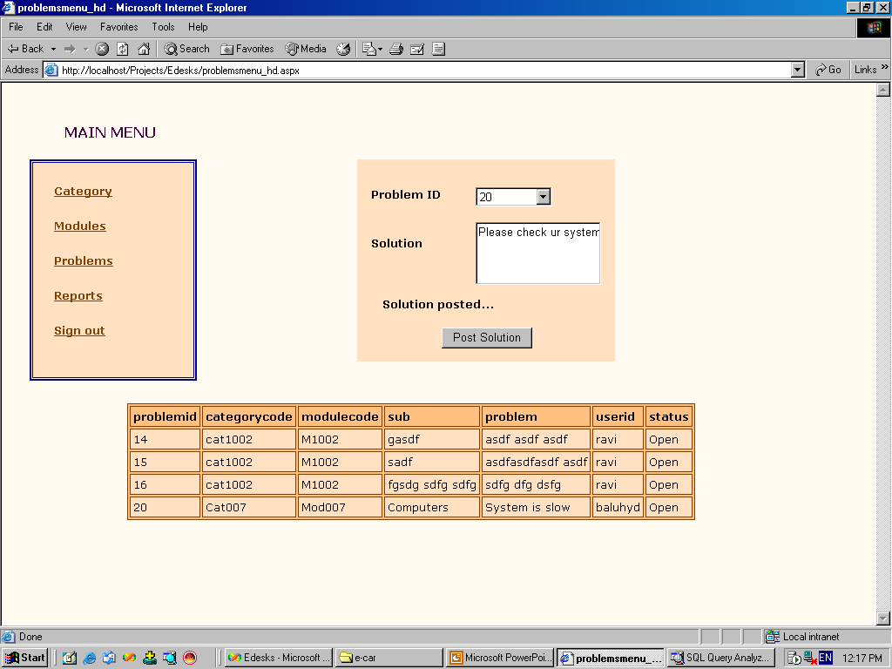
Solution for the Problem

Slide 32
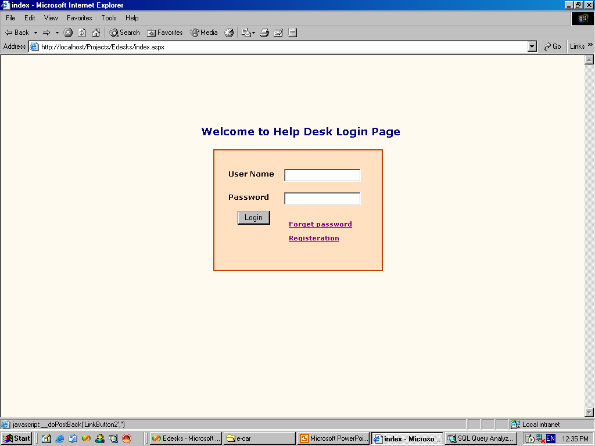
New User Registration

Slide 33
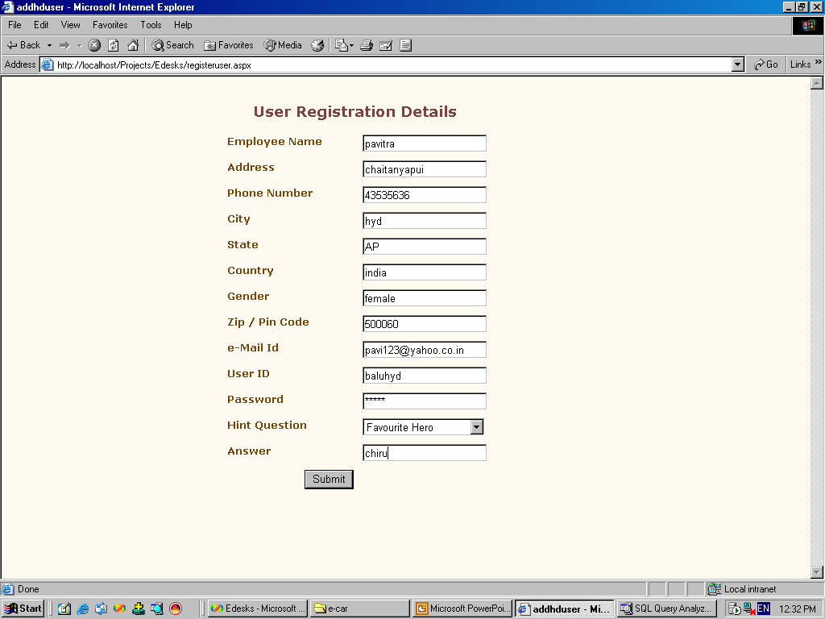
New User registration

Slide 34

User Module

Slide 35
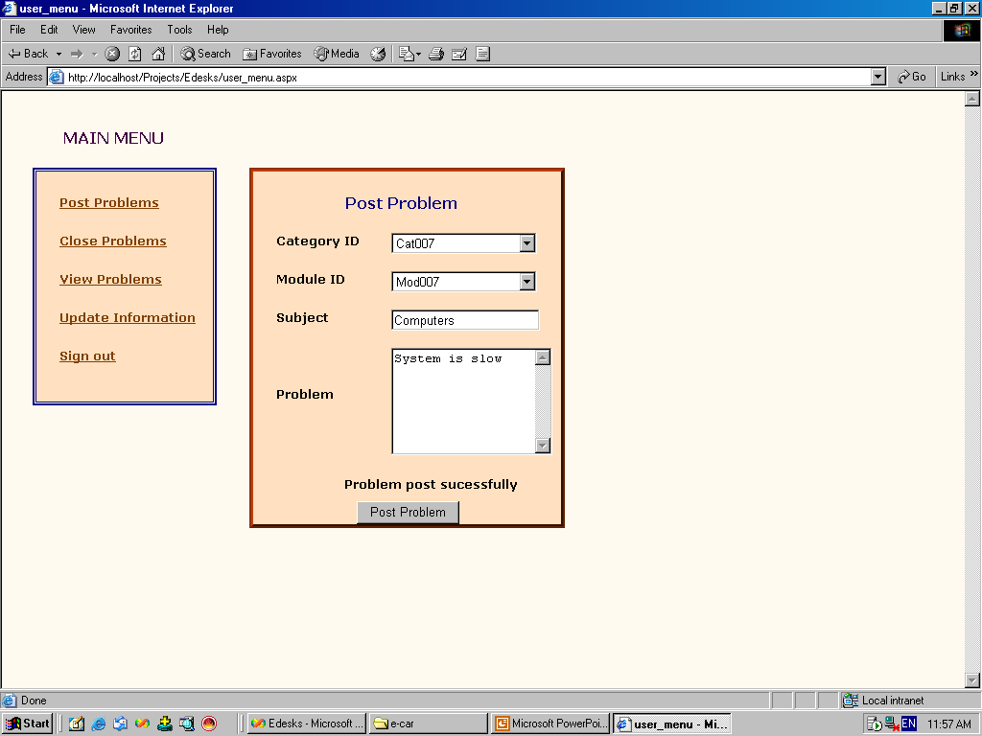
Post Problem

Slide 36
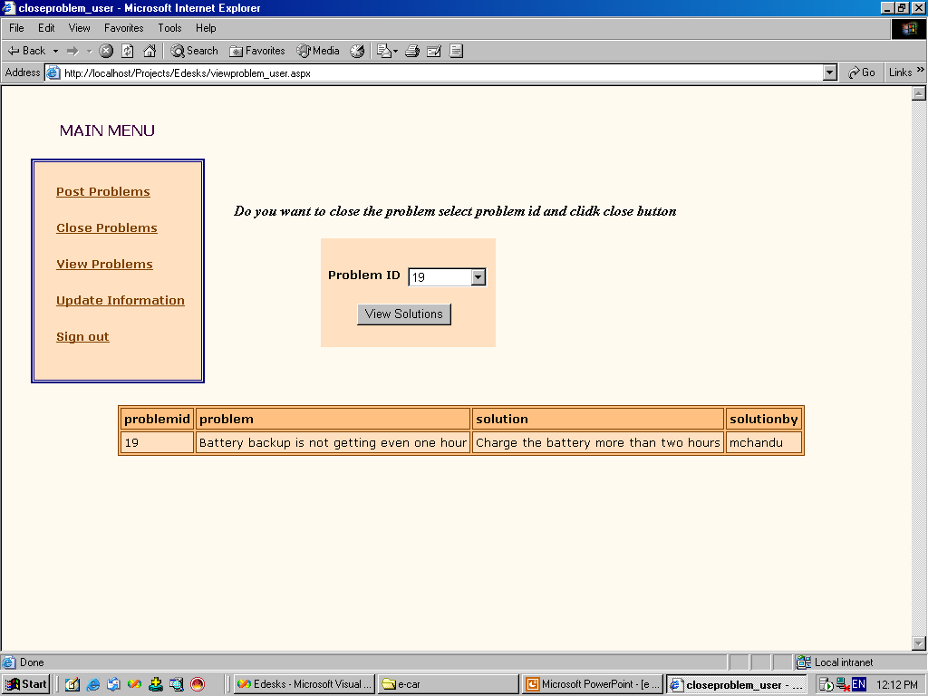
View Solution for Post Problem

Slide 37
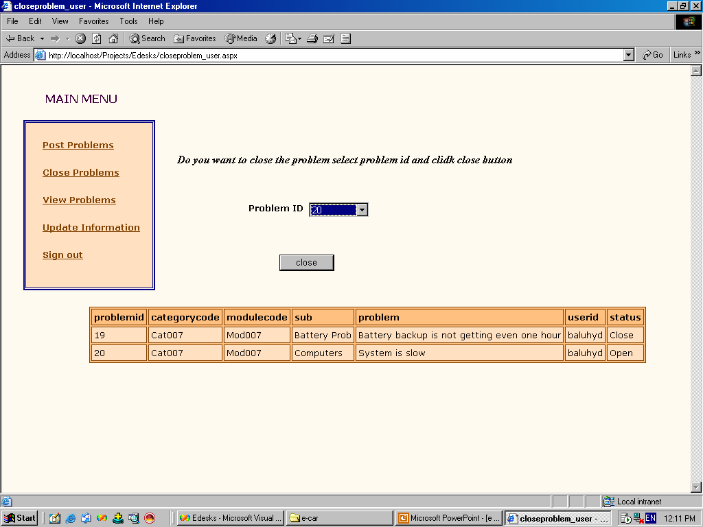
Close Problem

Slide 38
Technical Notes
Introduction To .NET.
Introduction To ASP.NET.
Introduction To Sql Server

Slide 39
Conclusion
The result of the E-care is that it supports many corporate clients and the individual users or the end-users with unique interface, through which the HD problems are solved within given time and it shows efficiency in the internal messaging system and results in accurate task scheduling system and this E-care can be run with the minimal administration.

