Slide 1
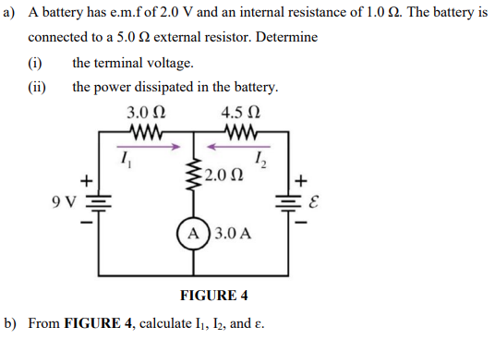
[$1.67V, 0.111W$; $1A, 2A,15V$]
Notes:
[$1.67V, 0.111W$; $1A, 2A,15V$]

Slide 2
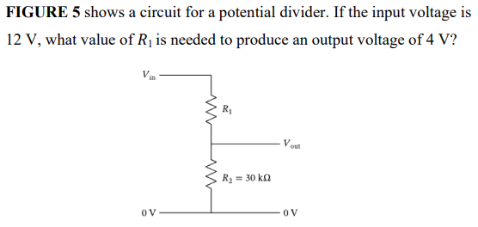
[$60kΩ$]
Notes:
[$1.67V, 0.111W$; $1A, 2A,15V$]

Slide 3
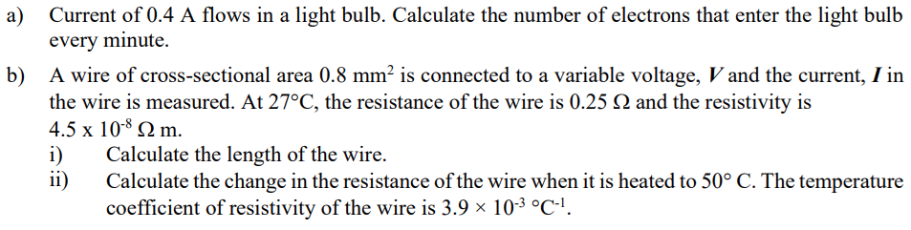
[$1.5×10^{20}$ electrons; $4.44m$, $0.022Ω$]
Notes:
[$1.67V, 0.111W$; $1A, 2A,15V$]

Slide 4
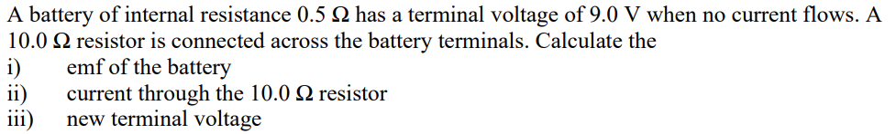
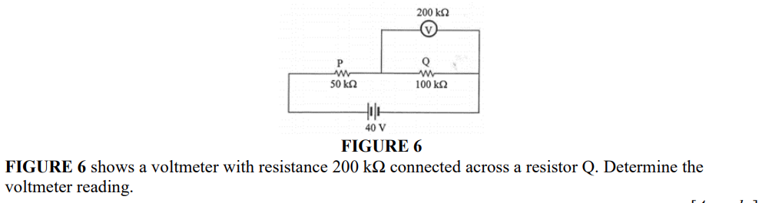
(a)
(b)
[$9V$, 0.86A, 8.6V; 22.86V]
Notes:
[$1.67V, 0.111W$; $1A, 2A,15V$]

Slide 5
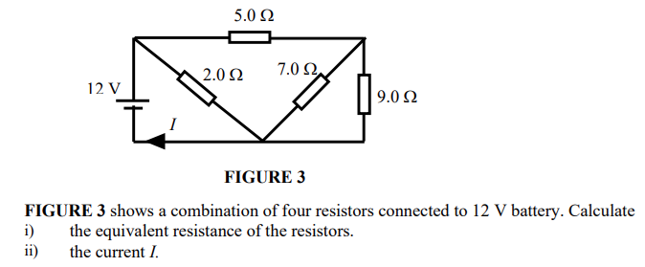
[$1.63Ω$, 7.36A]
Notes:
[$1.67V, 0.111W$; $1A, 2A,15V$]

Slide 6
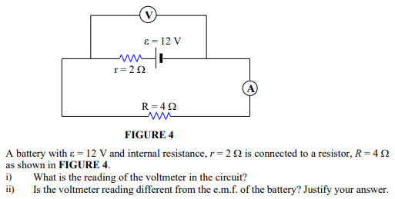
[$8V$, yes]
Notes:
[$1.67V, 0.111W$; $1A, 2A,15V$]

Slide 7
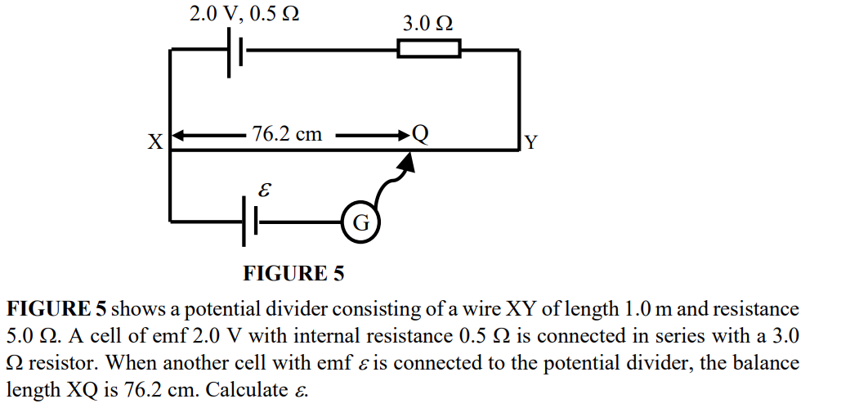
[$0.895V$]
Notes:
[$1.67V, 0.111W$; $1A, 2A,15V$]

Slide 8
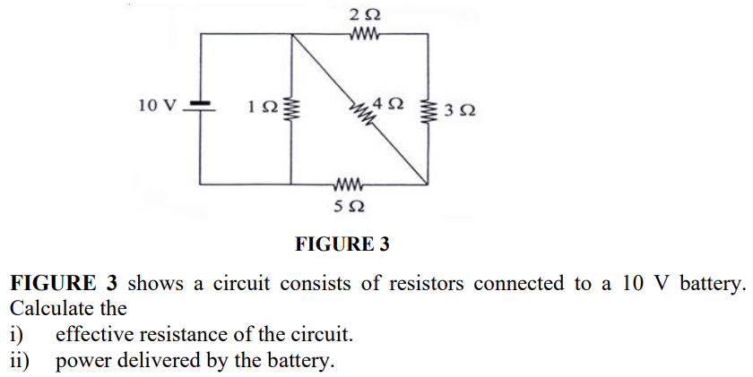
[$0.878Ω$, 113.9W]
Notes:
[$1.67V, 0.111W$; $1A, 2A,15V$]

Slide 9
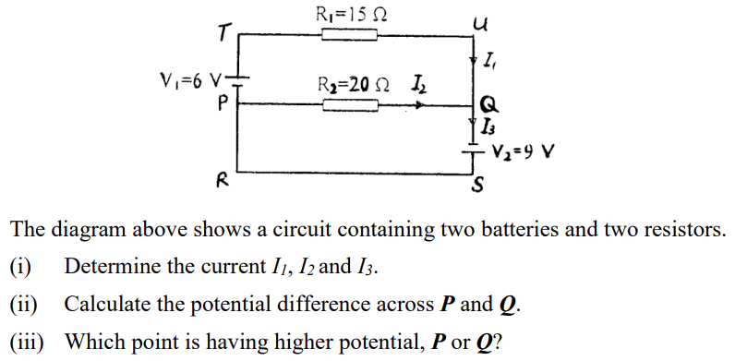
[$\left\{1,0.45,1.45\right\}A$, 9V, P]
Notes:
[$1.67V, 0.111W$; $1A, 2A,15V$]

Slide 10
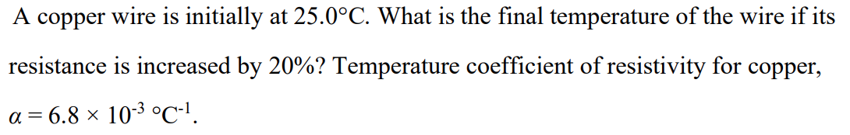
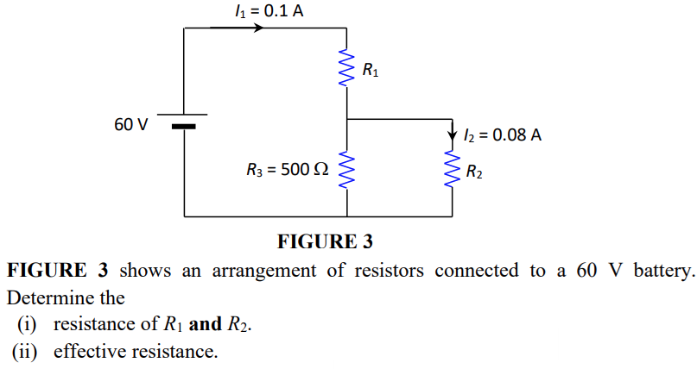
(a)
(b)
[$54.4^{o}C;$ {500,125}$Ω$, 600$Ω$]
Notes:
[$1.67V, 0.111W$; $1A, 2A,15V$]

