Slide 1
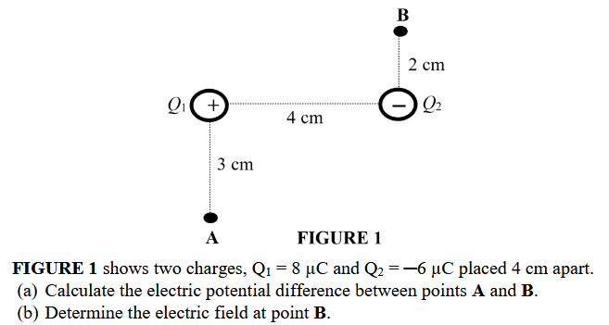
[(a) −2.42 × ${10}^{6}$ V (b) 123.25 × ${10}^{6}$ N C−1, −75.1°]
Notes:
[(a) −2.42 × ${10}^{6}$ V (b) 123.25 × ${10}^{6}$ N C−1, −75.1°]

Slide 2
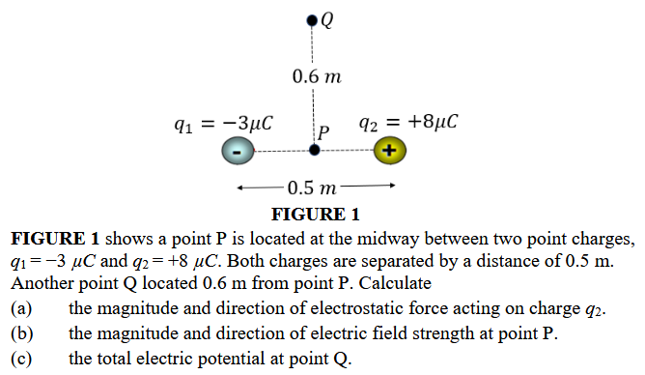
[0.864𝑁 towards $q_{1}$, −1.58 × ${10}^{6}$𝑁$C^{−1}$, 69.2 𝑘𝑉]
Notes:
]0.864𝑁 towards $q_{1}$, −1.58 × ${10}^{6}$𝑁𝐶−1, 69.2 𝑘𝑉]

Slide 3
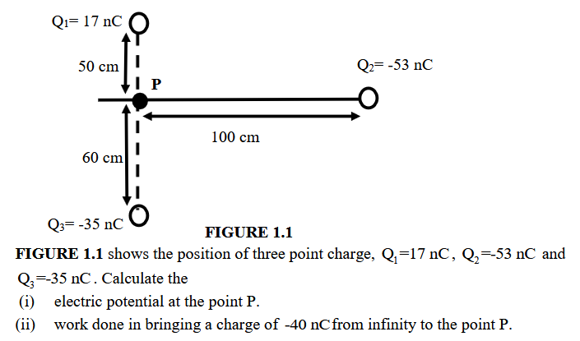
[$−696V$, 27.8$μJ$]
Notes:
[$−696V$, 27.8$μJ$]

Slide 4
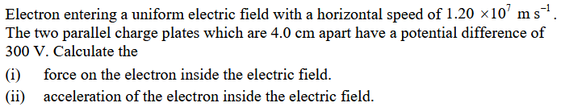
[$1.2×{10}^{−15}N$; $1.32×10^{15}ms^{−2}$]
Notes:
[$1.2×{10}^{−15}N$; $1.32×10^15ms^{−2}$]

Slide 5
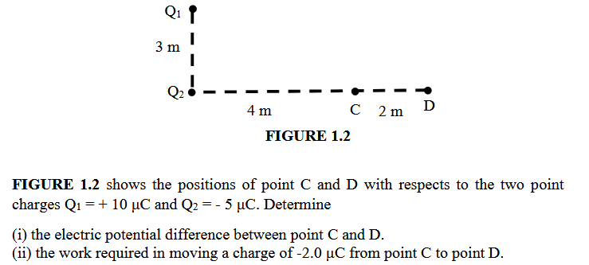
[$−837.18V$; $1.67mJ$]
Notes:
[$−837.18V$; $1.67mJ$]

Slide 6
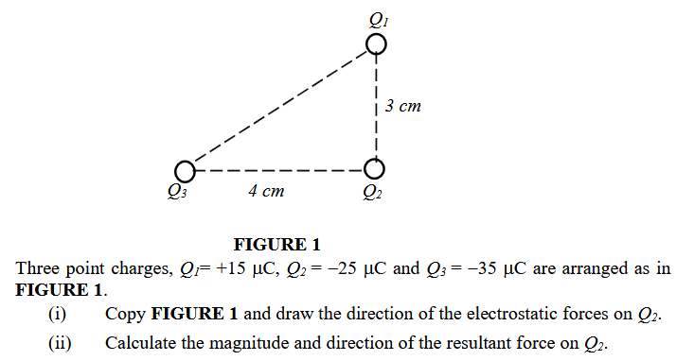
[$F=6.19×{10}^{3} N , θ=37.31° above x−axis$]
Notes:
[$F = 6.19 × {10}^{3} N , θ = 37.31° above x − axis$]

Slide 7
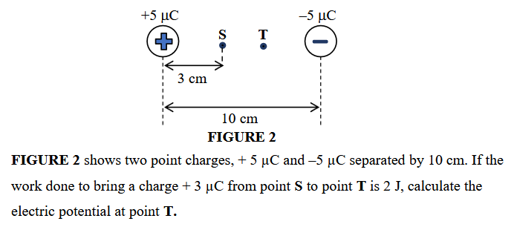
[$1.52 × {10}^{6}V$]
Notes:
[$1.52 × {10}^{6}V$]

Slide 8
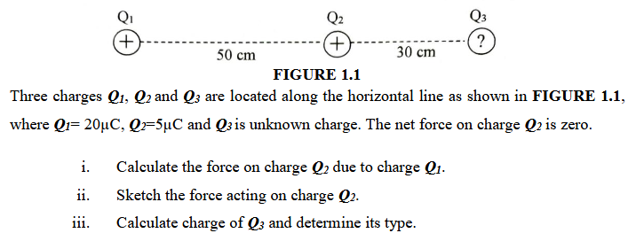
[$3.6N$; $7.2 μC$]
Notes:
[$3.6N$; $7.2 μC$]

Slide 9
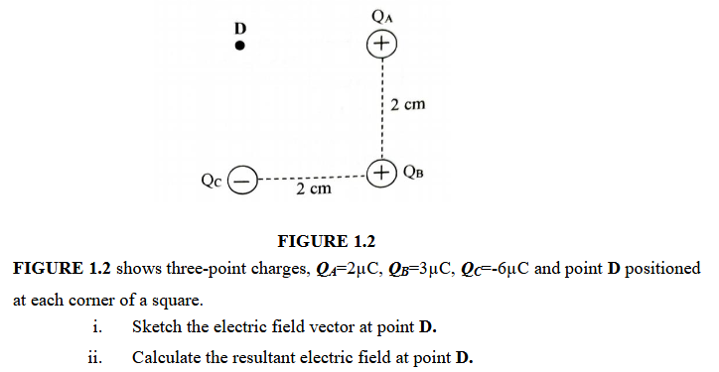
[$13.06×{10}^{7} NC^{−1}$]
Notes:
[$13.06×{10}^{7} NC^{−1}$]

Slide 10
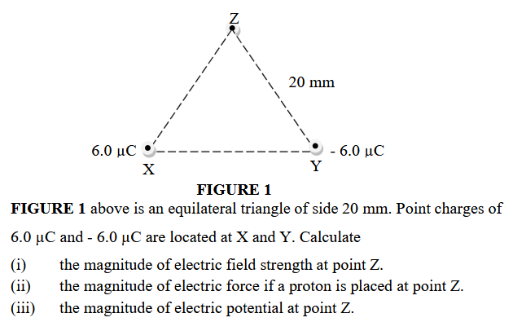
[$1.35×{10}^{8}NC^{−1}$; $2.16×{10}^{−11}N$; 0V]
Notes:
[$1.35×{10}^{8}NC^{−1}$; $2.16×{10}^{−11}N$; 0V]

