Slide 1
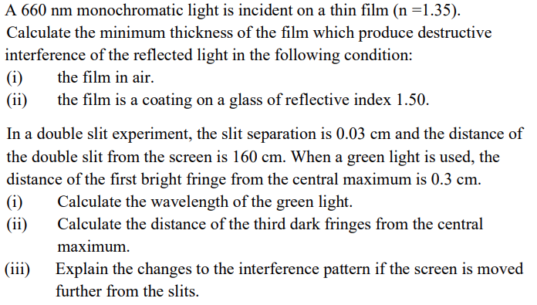
(a)
(b)
[222nm, 111nm; 562.5nm, 0.263nm, increase]
Notes:
(a)

Slide 2
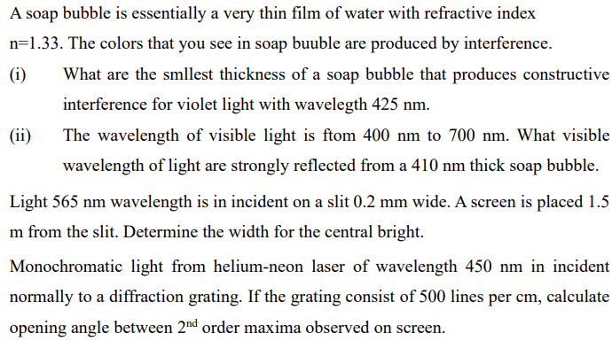
(a)
(b)
(c)
[79.9nm, 436nm; 8.48mm; $5.2^{o}$]
Notes:
(a)

Slide 3
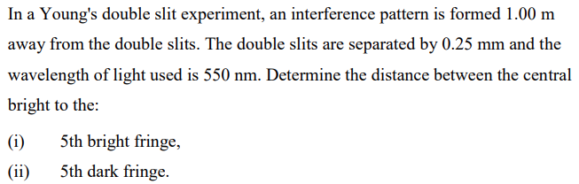
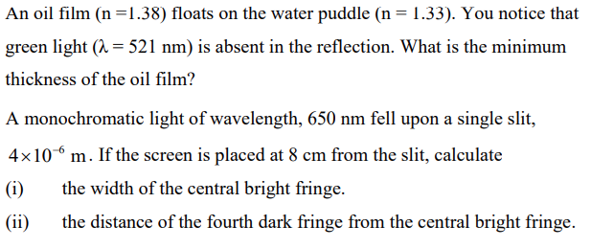
(a)
[11mm,9.9mm]
(b)
[94.5nm]
(c)
[2.6cm, 5.2cm]
Notes:
(a)

Slide 4
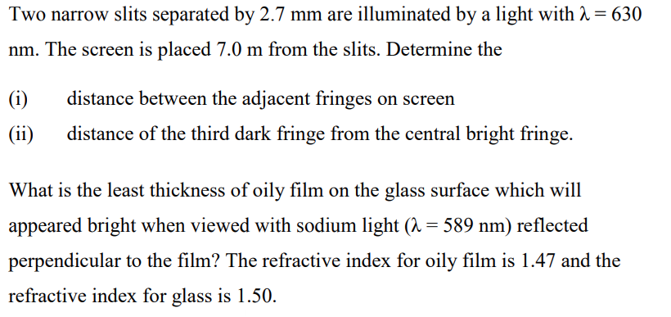

(a)
(b)
[8.17$μm$; 40.8 $μm$; 0.2 $μm$]

Slide 5
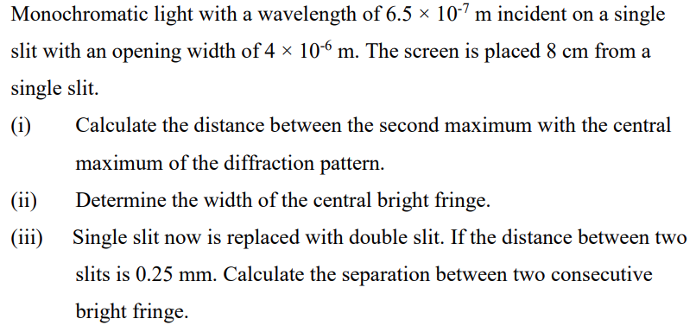
[32.5mm, 26mm, 0.208mm]

Slide 6
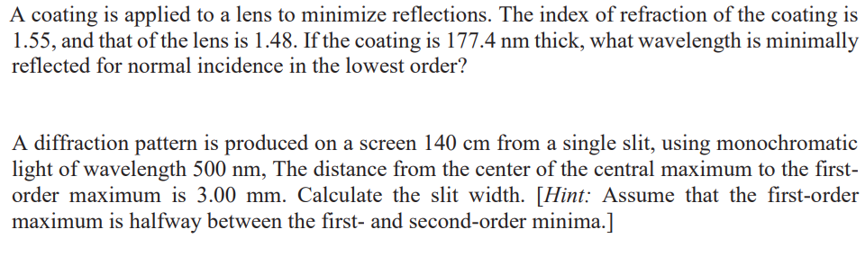
(a)
(b)
[549.94nm, 0.35mm]

Slide 7
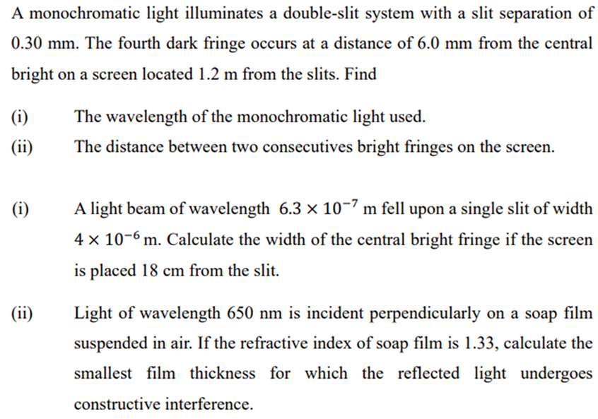
(a)
[429nm, 1.72mm]
(b)
[56.7mm, 122nm]

Slide 8
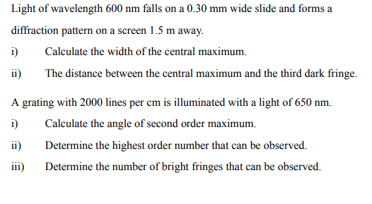

(a)
[6mm, 9mm]
(b)
[$15.1^{o}$, 7, 15]

Slide 9
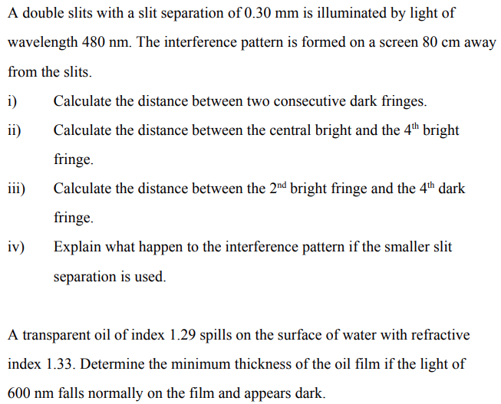

(a)
[1.28mm, 5.12mm, 1.92mm, wider]
(b)
[$116nm$]

Slide 10
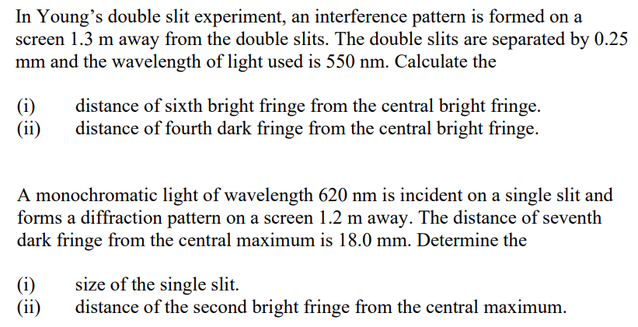

(a)
[17mm, 10mm]
(b)
[$0.289mm$, 6.44mm]

