Slide 1
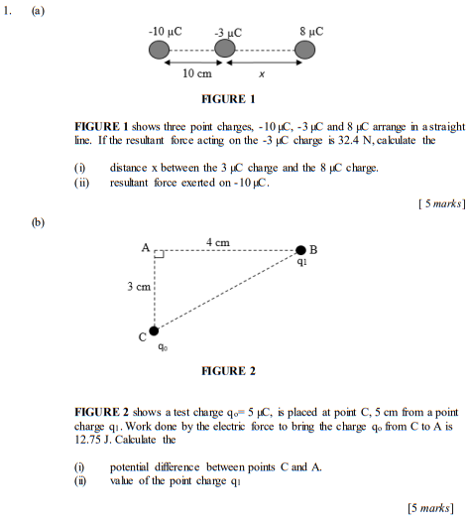
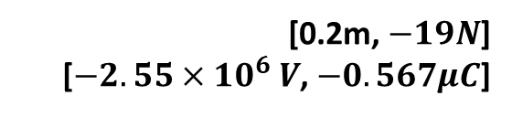
[0.2m, $−19N$]
[$−2.55×{10}^{6} V$, $−0.567μC$]
Notes:
[0.2m, $−19N$]
[$−2.55×{10}^{6} V$, $−0.567μC$]

Slide 2
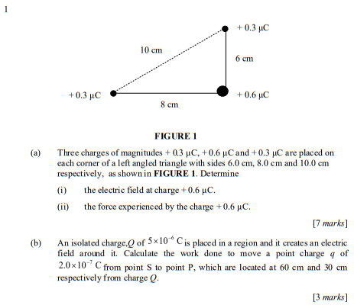

Slide 3
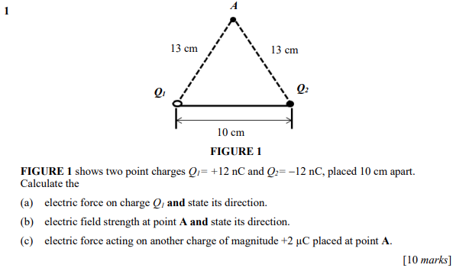

Slide 4
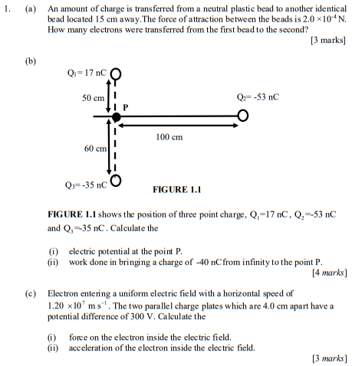

Slide 5
