Slide 1
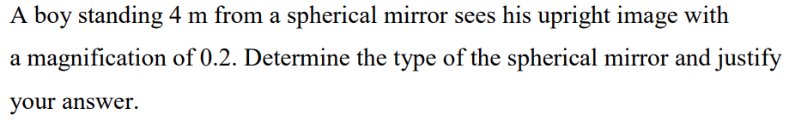
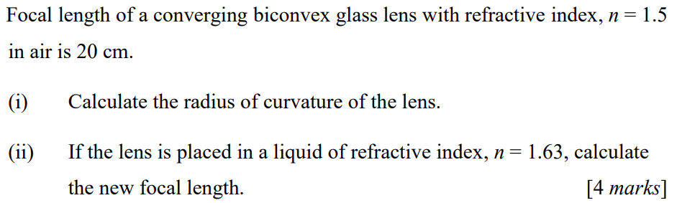
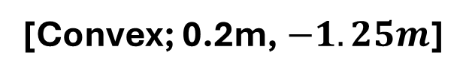
(a)
(b)
[Convex; 0.2m, $−1.25m$]
Notes:
[]

Slide 2
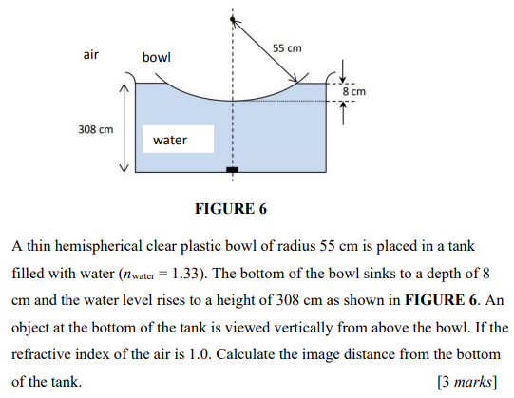
[2.04m]

Slide 3
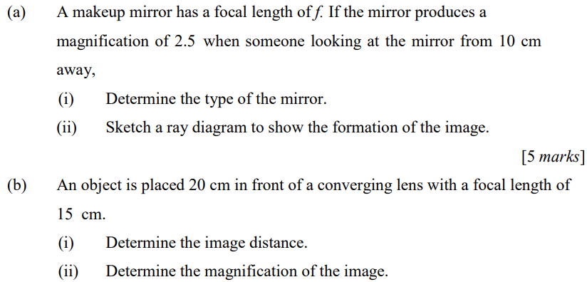

[Concave; 60cm, $−3$]

Slide 4
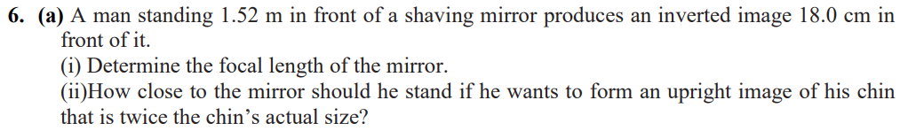
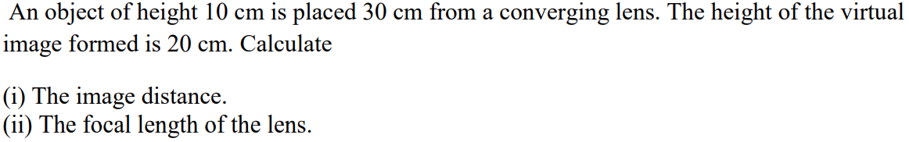
(a)
(b)
(c)
[0.161m, 8.05cm; $−14cm$ ; $−60cm$, 60cm]

Slide 5
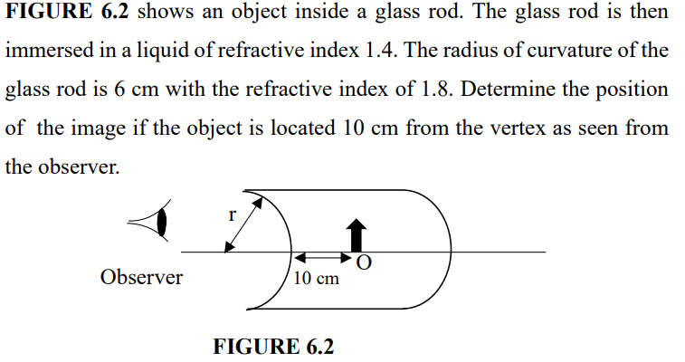
[$−5.67cm$]

Slide 6
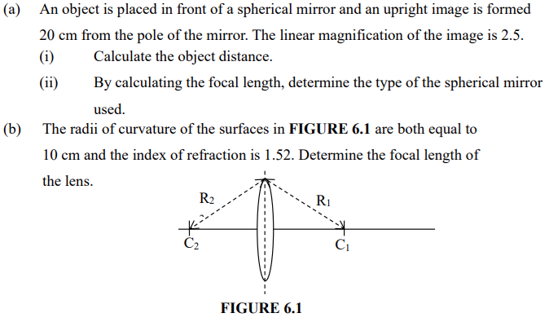
[8cm, concave; 9.6cm]

Slide 7
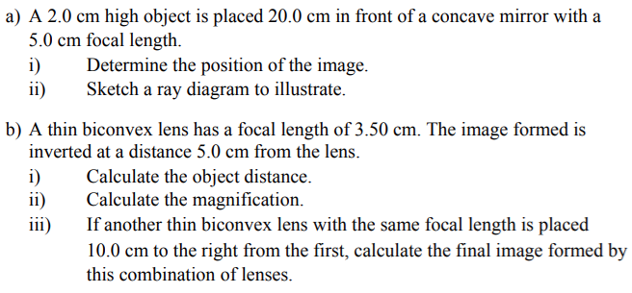
[6.67cm; 11.67cm, $−0.43$, 11.67cm]

Slide 8
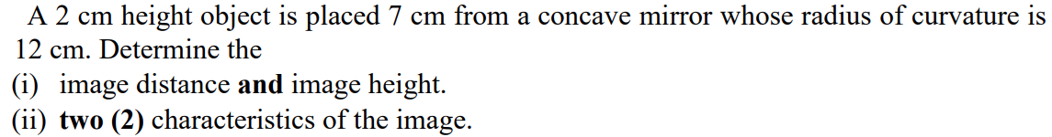
(a)
(b)
[$−4.74m$; 42cm, $−12cm$, {real, inverted, magnified}]

Slide 9
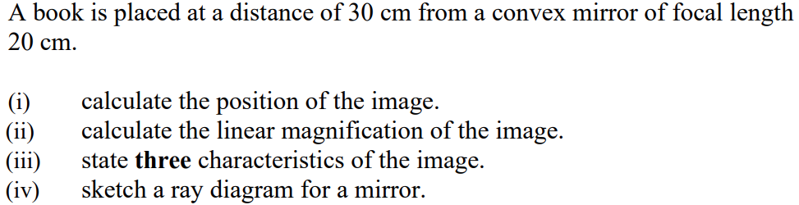
[$−12cm$, 0.4, {virtual, upright, diminished}]

Slide 10
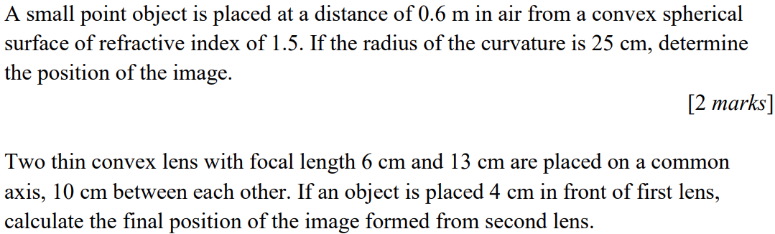
(a)
(b)
[4.5m (behind); 31.8cm (behind lens 2)]

