Slide 1
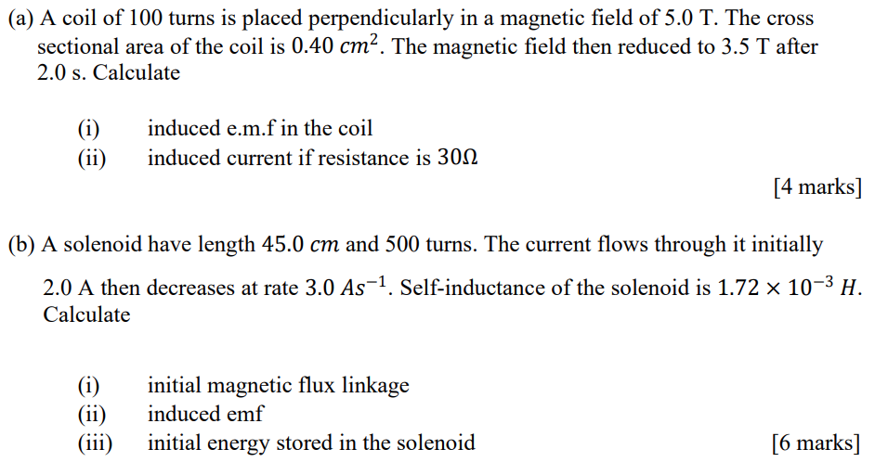
[3mV, 0.1mA; 3.44mWb, 5.16mV, 3.44mJ]

Slide 2
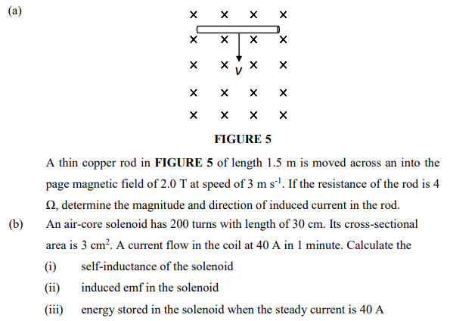
[2.24A to the right; $50.3μH$, $−33.5μV$, 0.04J]

Slide 3
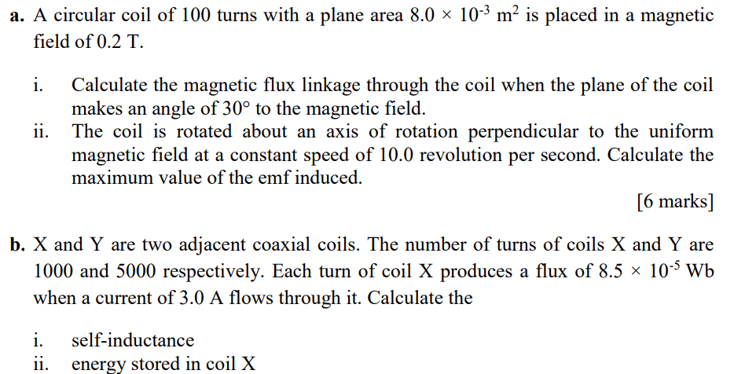
[0.08Wb, 10.05V; 0.0283H, 0.127J]

Slide 4
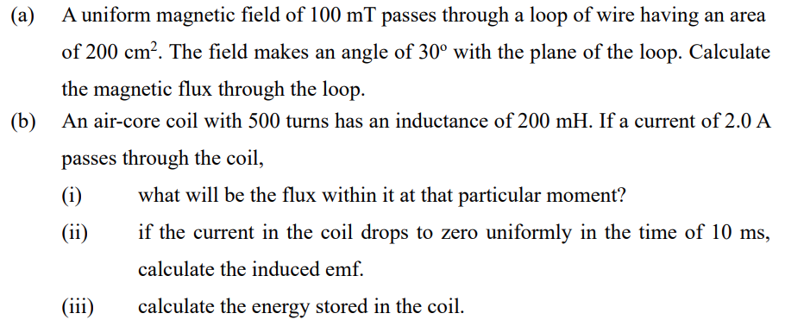
[1mWb; 0.8mWb, 40V, 0.4J]

Slide 5
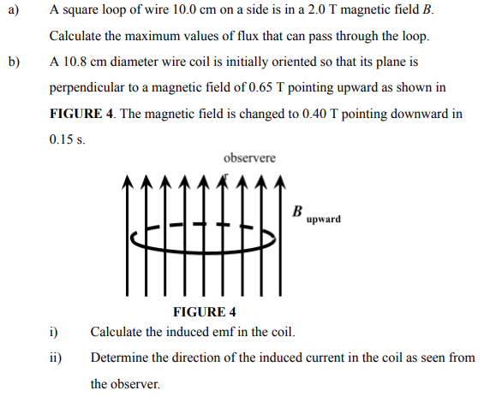
[0.02Wb; 0.064V, acw]

Slide 6
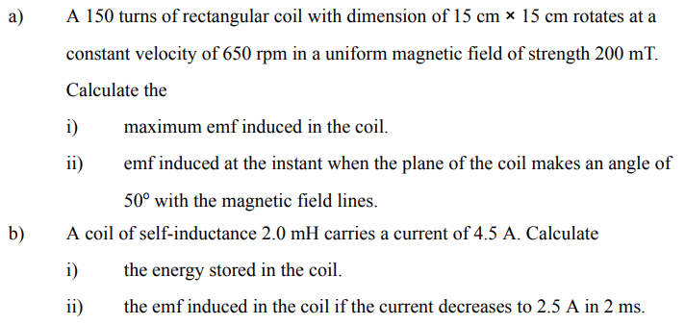
[45.95V, 29.54V;20.25mJ, 2V]

Slide 7
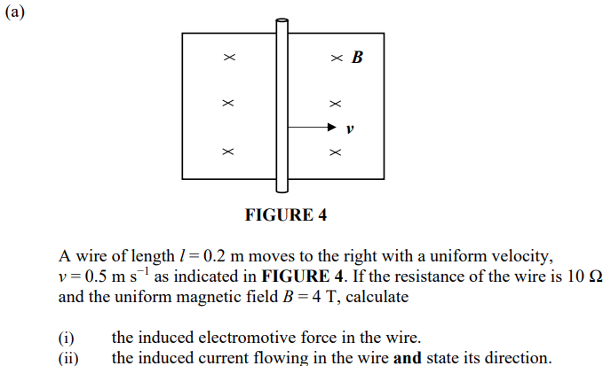
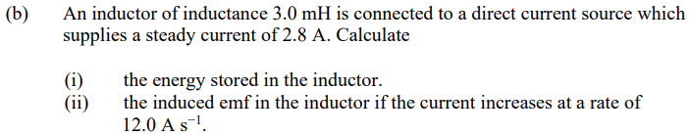
[0.4V, 0.04A (upwards); 12mJ, 36mV]

Slide 8
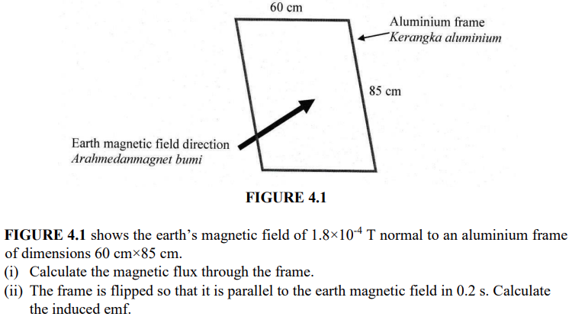
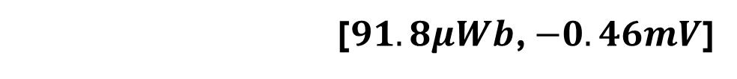
[$91.8μWb$, $−0.46mV$]

Slide 9
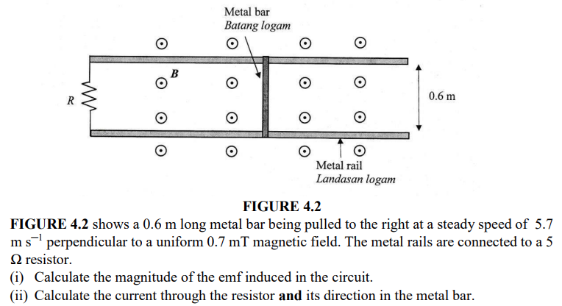
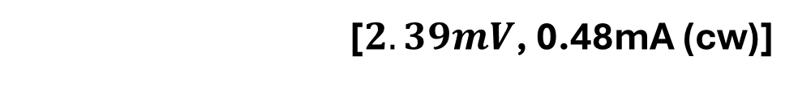
[$2.39mV$, 0.48mA (cw)]

Slide 10
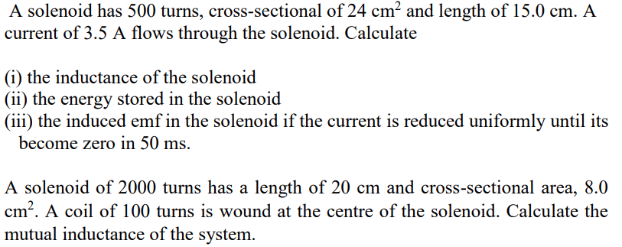
(a)
(b)
[5.03mH, 30.8mJ, 0.35V; 1mH]

