Slide 1
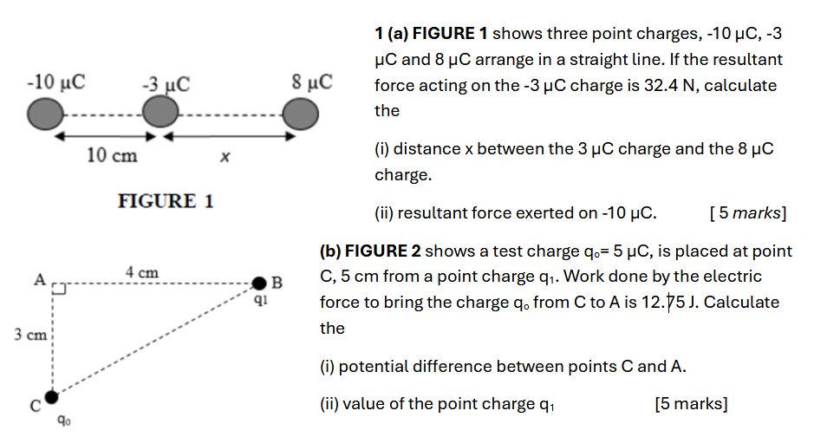
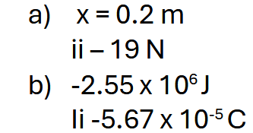

Slide 2
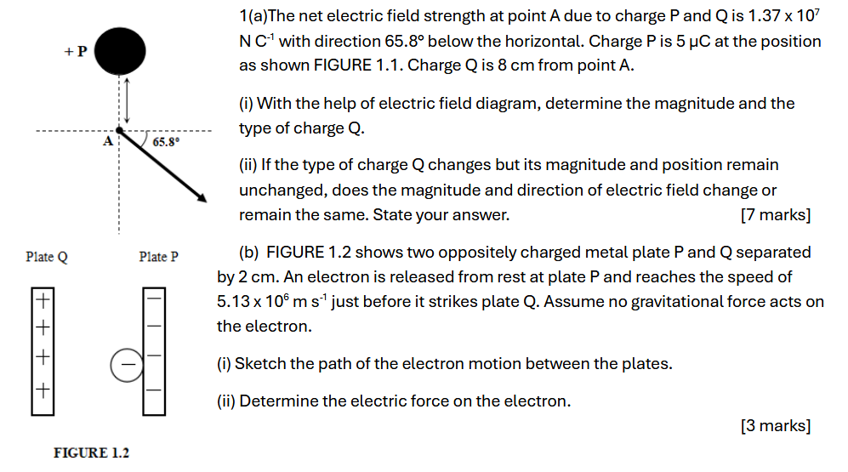
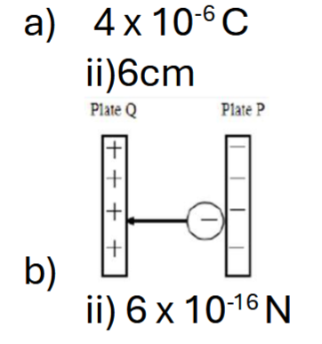

Slide 3
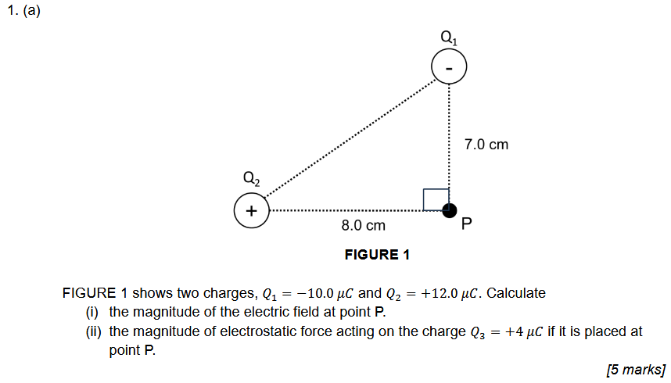
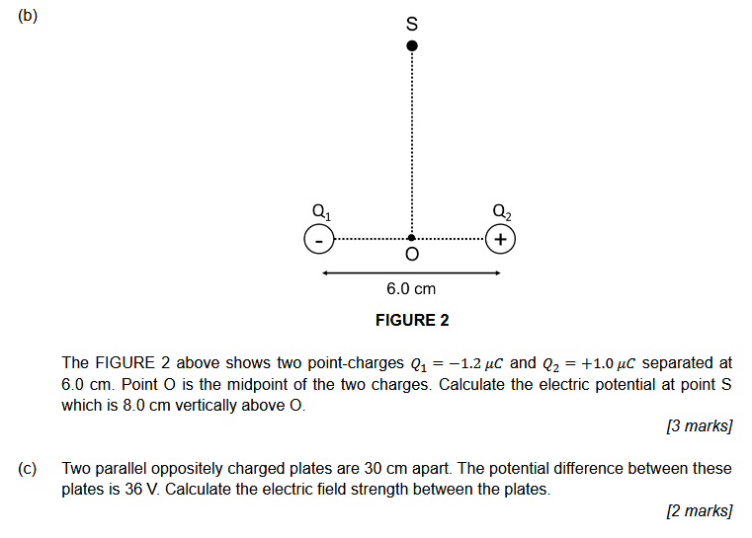
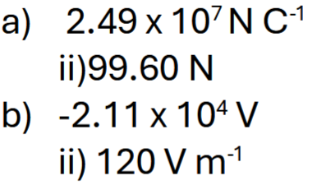
1a)
1b)
Notes:
1a)

Slide 4
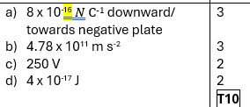
1 A proton is released from rest in a uniform magnetic field between two parallel plates that are separated by 5 cm as shown in FIGURE 1. The electric field strength between the plates is 5000 NC⁻¹. Calculate the
(a) magnitude and direction of electric force acted on the proton. [3 marks]
(b) acceleration of the proton due to electric field. [3 marks]
(c) potential difference between the parallel plates. [3 marks]
(d) a change in potential energy of the proton when it reaches negative plate. [3 marks]

Slide 5
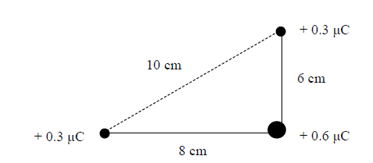

1 (a) Three charges of magnitudes + 0.3 μC, + 0.6 μC and + 0.3 μC are placed on each corner of a left angled triangle with sides 6.0 cm, 8.0 cm and 10.0 cm respectively, as shown in FIGURE 1. Determine
(i) the electric field at charge + 0.6 μC.
(ii) the force experienced by the charge + 0.6 μC. [7 marks]
(b) An isolated charge, Q of 5 x 10⁻⁶C is placed in a region and it creates an electric field around it. Calculate the work done to move a test charge q of 2 x 10⁻⁷C from point S to point P, which are located at 60 cm and 30 cm respectively from charge Q. [3 marks]

Slide 6
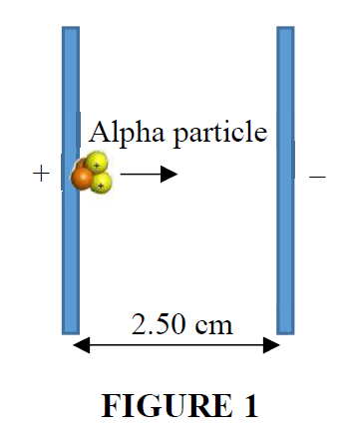
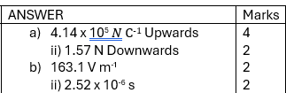
(a) Two point charges, q₁ and q₂ are located on the y-axis. Charge q₁ = +2.3 µC is placed at y = -0.56 m and charge q₂ = -5.3 µC is located at y = +0.37 m.
(i) Calculate the magnitude and direction of the net electric field at the origin due to these two point charges.
(ii) Determine the magnitude and direction of the electric force exerted on a third charge, q₃ = -3.8 µC placed at the origin.
[6 marks]
(b) FIGURE 1 shows a stationary alpha particle is accelerated at 7.86 x 10⁹ m s⁻² from the positive plate towards the negative plate. The alpha particle has a mass of 6.64 x 10⁻²⁷ kg and a charge of +2e travels between two parallel plates separated by 2.50 cm.
(i) Calculate the magnitude of the electric field strength between the plates.
(ii) Determine the time taken for the particle to reach the negative plate.
[4 marks]

Slide 7
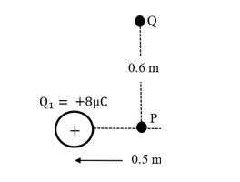

1. FIGURE 1 shows a point P is located at the midway between two points charges, Q₁ = +8 μC and Q₂ = -3 μC. Both charges are separated by a distance of 0.5 m. Another point Q located 0.6m from point P. Calculate the:
a) magnitude and direction of electrostatic force acting on charge Q₂. [3 marks]
b) magnitude and direction of electric field strength at point P.
[4 marks]
c) total electric potential at point Q.
[3 marks]

Slide 8
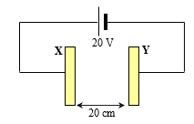
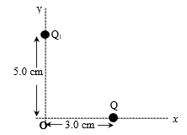

a) FIGURE 1a shows two parallel plates X and Y with a separation distance of 20 cm. Potential difference between the plate is 20 V.
i) Calculate electric field strength between the plates.
ii) If an electron held at midpoint between the plates is released, calculate the acceleration for it to reach plate X.
[5 marks]
FIGURE 1a
b) Two points charges, Q₁ = -12 μC and Q₂ = +8 μC are arranged as shown in FIGURE 1b. Calculate the magnitude and direction of the resultant electric field at the origin.
[5 marks]
FIGURE 1b

Slide 9
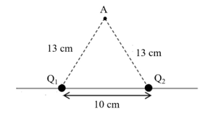

1. FIGURE 1 shows two point charges Q₁ = +12 μC and Q₂ = –10 μC, placed 10 cm apart.
Calculate the Coulomb force on charge Q₁.
Calculate the work done to bring a positive test charge 2.0 × 10⁻⁷ C from infinity to point A.
Calculate the potential energy of the system when the positive test charge 2.0 × 10⁻⁷ C is located at A.
[10 marks]

