Slide 1
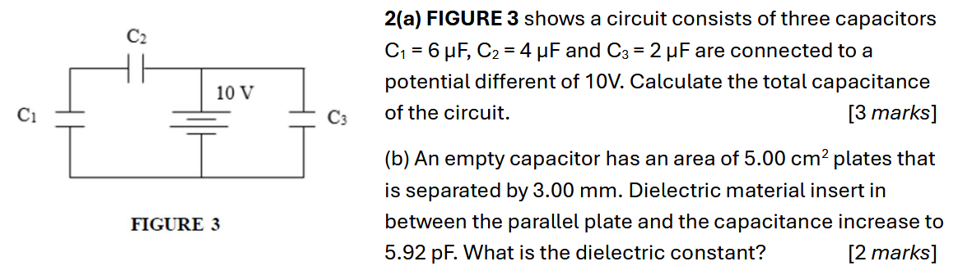
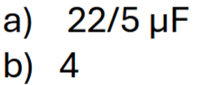

Slide 2
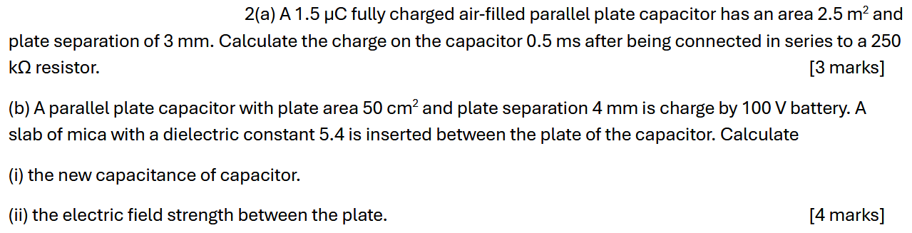
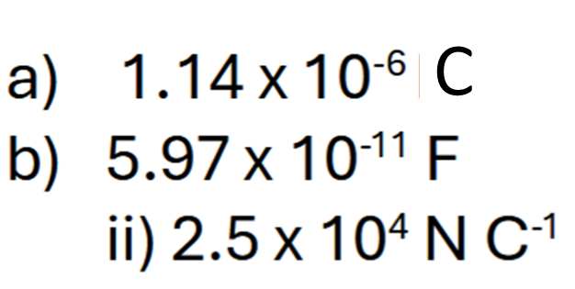
Notes:
C

Slide 3
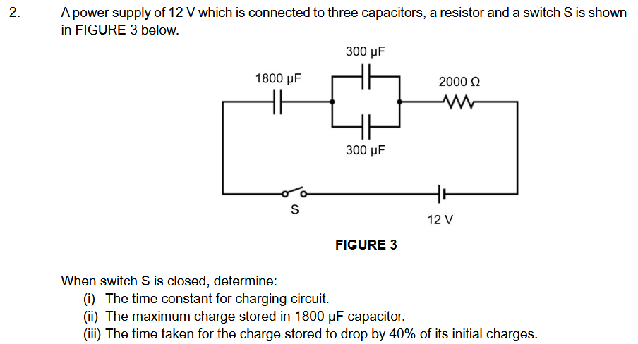
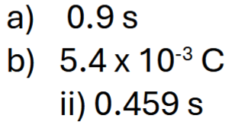

Slide 4
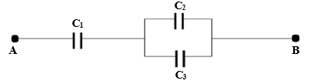

2. FIGURE 2 shows three capacitors C₁, C₂, and C₃, each 12 μF, connected between points A and B.
a) Calculate the effective capacitance.
b) If the potential difference across AB is 9 V, calculate:
i) charge on C₂
ii) total energy stored
[7 marks]

Slide 5

2. a) A 20 μF capacitor has a charge of 240 μC is connected to a 50 kΩ resistor. Calculate the:
i) time constant.
ii) initial current.
iii) charge stored in the capacitor after 5 s.
b) A parallel plate capacitor has plates of area 6 m² separated by a piece of paper. The dielectric constant and thickness of the paper are 3.7 and 1 mm respectively. Calculate the capacitance of the capacitor.
[7 marks]

Slide 6
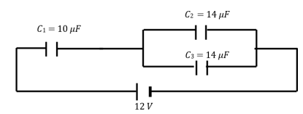
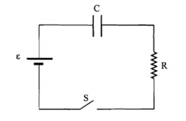

2 a). FIGURE 2a shows an arrangement of three capacitors, C₁, C₂ and C₃. Calculate:
total charge of these capacitors.
ii) potential difference across capacitor C₂.
[5 marks]
FIGURE 2a
2 b) FIGURE 2b shows a charging capacitor circuit where a capacitor charges through a resistor when the switch is closed. If the capacitance and resistance is 0.2 μF and 15 kΩ respectively, calculate the time taken for the charge to reach 60% of its maximum value.
[2 marks]
FIGURE 2b

Slide 7
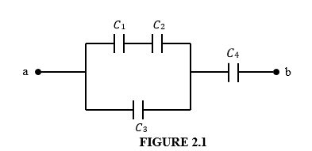
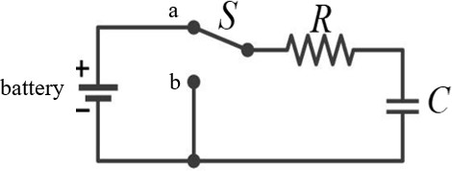
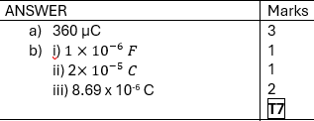
2 (a) FIGURE 2.1 shows a configuration of four identical capacitors 𝐶₁, 𝐶₂, 𝐶₃ and 𝐶₄, connected to 12 V potential difference, Vab . Each capacitor has a capacitance of 50 𝜇F. Calculate the charge on capacitor 𝐶₄.
[4 marks]
(b) FIGURE 2.2 shows an RC circuit where the battery is fully charged the capacitor. At t = 0 s, switch S is thrown from position a to b. The battery voltage is 20.0 V and the resistance of resistor, R is 60 Ω. The time constant is 60 μs.
Determine
the capacitance C.
the value of the charge on the capacitor at t = 0 s.
the value of the charge at t = 50 μs
[3 marks]

Slide 8
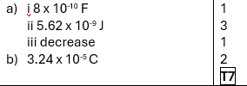
2 (a) A parallel plate air-filled capacitor whose capacitance, C is 250 x 10⁻¹² F is charged by a battery to a potential difference of 12 V between the two plates. Then the fully charged capacitor is disconnected and a porcelain slab with dielectric constant 3.2 is inserted between the plates. Calculate
the capacitance of the capacitor after the slab is inserted.
the energy stored in the capacitor after the slab is inserted.
Calculate the new potential difference if after the dielectric is inserted between the plates [5 marks]
(b) A 12 V battery is connected to a 4 μF capacitor and a 20 Ω resistor. Calculate the charge in the capacitor at time t = 90 μs. [2 marks]

Slide 9
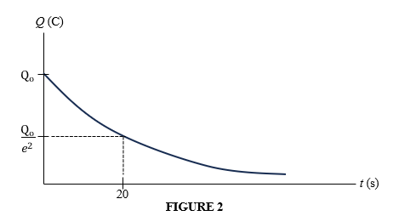

2(a) FIGURE 2 shows a variation of charge with time in a circuit during discharging process of a capacitor through a resistor of 10 MΩ. Calculate the
time constant. [3 marks]
capacitance of the capacitor. [2 marks]
(b) An air-filled parallel plate capacitor has a capacitance of 5.5 μF. Calculate the capacitance when a dielectric material with dielectric constant 3 is inserted between the plates. [2 marks]

